Slide 1

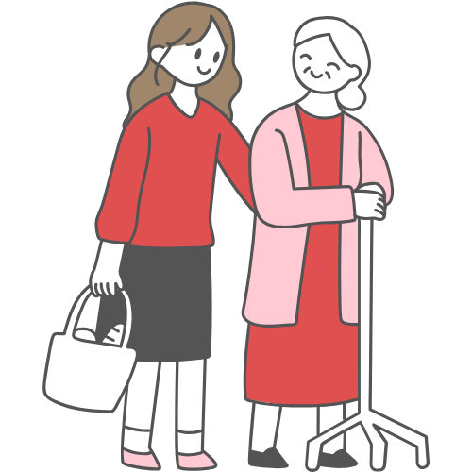
Young Carers
LO - To be able to recognise some of the challenges faced by young carers and become aware of available support.

Slide 2

HERE

Slide 3
Rights Respecting Schools
Today’s lesson links to the following article on the UNCRC -
Article 31 (leisure, play and culture)
Every child has the right to relax, play and take part in a wide range of cultural and artistic activities
The UNCRC is a legal document which sets out the rights children from birth to 18 are entitled to.
Notes:
Teacher - You may wish to return to this slide at the end of the lesson and discuss how the article links.

Slide 4
Starter
A young carer is a young person who looks after someone in their family or a friend who is ill, disabled, or has a mental health problem or an addiction.
Discuss / Consider - In what ways might they provide care or help?

Slide 5
Starter Feedback
They may care or help by:
Shopping, cooking, cleaning
Managing medicines or money
Providing personal care
Helping get people out the house
Keeping an eye on someone
Providing emotional support

Slide 6

Watch this clip. Discuss / Consider - What challenges does it suggest young carers might face?

Slide 7
Possible Challenges for Young Carers
Having to perform tasks they are not confident in can be a challenge.
Caring duties such as lifting, cooking, and cleaning can be tiring.
Keeping up with schoolwork and homework due to their responsibilities at home can be difficult.
The demands of caring can prevent young carers from considering further education or ambitious career goals, limiting their future prospects.
Families relying on a young carer often experience financial difficulties, as the person they care for may be unable to work, affecting household income.
Young carers may miss out on friendships, social activities, and extracurricular opportunities, leading to loneliness and a lack of peer support.
The emotional strain of caring for a loved one can lead to stress, anxiety, and depression.
Some young carers feel a sense of guilt or responsibility, making it hard for them to reach out for support. They may worry about the person they are caring for.

Slide 8

Watch this clip. Discuss / consider - How might you identify someone who is a young carer? How could you support them as a friend?

Slide 9
Possible signs of a young carer
Tiredness and Lack of Focus. Frequently appears exhausted or struggles to concentrate in class.
Poor Attendance and Punctuality. Regularly arrives late or has frequent absences without clear explanations.
Difficulty Completing Homework. Often hands in incomplete or missing homework. Seems anxious about deadlines but struggles to explain why.
Emotional and Mental Health Struggles. Appears withdrawn, anxious, or easily overwhelmed. Displays mood swings, frustration, or signs of stress.
Social Isolation. Avoids social activities, clubs, or school trips.
Physical Signs of Responsibility. Talks about caring for someone at home (e.g., cooking, helping with medication, doing household chores). Mentions looking after siblings or an ill/disabled family member.
Low Aspirations or Reluctance to Talk About the Future. Avoids discussions about future education or career plans. Expresses a need to stay at home rather than pursuing further studies or work.

Slide 10
How you could support a young carer as a friend
1. Be a Good Listener. Let them talk about their feelings without judging or interrupting.. Show empathy and understanding when they share their struggles.
2. Offer Practical Help. Help them catch up on missed schoolwork or explain things they might have missed. Offer to share notes or help with homework if they’re struggling to keep up.
3. Include Them in Social Activities. Invite them to hang out, even if they often say no, just knowing they are welcome matters. Find activities that fit their schedule, like lunch breaks instead of evenings.
4. Be Understanding About Their Situation. Recognise that they might have responsibilities that prevent them from joining in everything. Don’t take it personally if they have to cancel plans or seem distracted.
5. Check In Regularly. A simple "How are you?" or "Do you need anything?" can show that you care. Send messages or call if you notice they’ve been absent a lot.
6. Encourage Them to Seek Support. Remind them that teachers or young carer support groups are there to help. Offer to go with them if they feel nervous about asking for help.

Slide 11

Ask an Expert
If you need further support in relation to today’s lesson either for yourself or someone else please speak with a trusted adult. In school you may wish to see Teacher’s Name who supports our young carers.
You could also find more information and support at -
Carers Trust here
Carers First here
Carers UK here
Action for Family Carers here

Slide 12
Plenary
Partner Responses
Tell your partner one challenge a young carer might experience. Your partner should tell you a way a friend could support them with this challenge.
Swap roles.

Slide 13

Careers Link
Today’s lesson may link to the following careers. If you would like to find out more about these jobs please speak to your careers advisor or use the link below.
Family Support Worker
Social Worker
Education Welfare Officer
LINK
Notes:
Link - https://nationalcareers.service.gov.uk/

