Slide 1
teacher slide
This lesson explores human fertility and includes some discussion around infertility and miscarriage. Be mindful of any teachers or students who may have personal experience with these issues and may be affected by these discussions.
When talking about fertility, explain that although students might not be thinking about fertility and parenthood yet, it is important for them to have the knowledge to make an informed decision about when, if and how to start a family in the future. This includes contraceptive options, which are revisited in this lesson.

Slide 2
Teacher slide
 | Description | Timing
Introduction | Do it now task – ask students to write as many types of contraception as they can remember, or discuss with the person next to them. Introduce lesson and learning objectives. | 5 mins
Fertility & reproduction recap | Share definition of fertility and recap previous learning about human reproduction. Introduce infertility and ask class to share what they think might cause infertility in men and women. Answers are on the following slides. Play video “Pregnancy 101” and invite feedback. | 10-15 mins
Miscarriage | Introduce this topic sensitively. Ensure the class understands that miscarriages are not usually caused by anything a pregnant woman has done or didn’t do. Emphasise that miscarriages are more common than people might think. If time allows, ask the class why they think people might struggle to be open about experiencing this. | 5-10 mins
Contraception/ scenarios | Explain that not wanting to start a family is a normal and valid choice. Share scenarios on the following slides and ask students to work in small groups, pairs, or as a whole class to decide which type of contraceptive the people in the scenario should use. | 10 mins
The menopause | Introduce menopause and explain this as a natural occurrence. Play video and invite discussion after – how can we better support women who are experiencing this? | 10 mins
Reflection | Ask students to share reflections using the ASK acronym. | 5 mins

Slide 3

do it now
List as many different types of contraception as you can remember from your previous learning.
Notes:
Share the ‘Do It Now’ task. Ask students to write down any of the contraceptive options they can remember learning about in previous lessons/years.

Slide 4

HUMAN FERTILITY & REPRODUCTION
YEAR 11
Notes:
Introduce the lesson and learning objectives.

Slide 5
learning objectives
  Identify the different types of contraception available and how to access these
  Understand the connection between health and fertility, including causes of infertility
  Understand that some pregnancies end in miscarriage and that this affects many families
  Describe what menopause is and how this can affect a woman’s physical and emotional health

Slide 6

CLASS AGREEMENTS
  Kindness and respect
  Right to pass
  Nonjudgmental
  No such thing as silly
questions
any others?
Notes:
Explain that you would like the class to create a list of 'agreements' for how everyone will behave and treat one another in the class. Ensure a common understanding. For example:
1. We will treat one another with kindness and respect (listening to each other, speaking one at a time, etc)
2. We all have the right to 'pass' on answering a question or participating in an activity that makes us feel uncomfortable.
3. We can disagree but will not pass judgments, make fun of, or or put anybody down. 'Challenge the opinion, not the person.'
4. Asking questions is encouraged and will be valued by our teacher. We do not ask questions to purposefully embarrass or belittle another.
*Feel free to change the agreements to suit your class, and ask whether there are any others they'd add to the list in order to create a safe, comfortable learning environment.

Slide 7
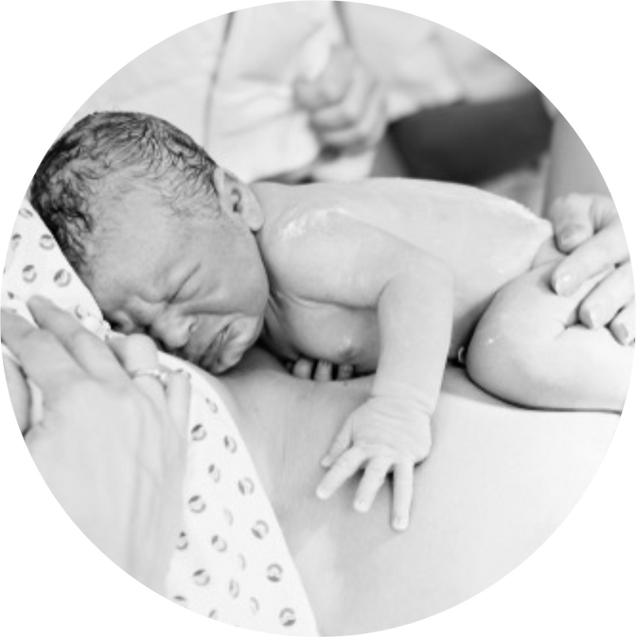
WHAT IS FERTILITY?
Fertility is the natural capability to produce offspring.
Reproduction (or procreation or breeding) is the biological process by which new individual organisms – "offspring" – are produced from their "parents.”
In this lesson we will talk and learn about:
•Pregnancy
•Miscarriage
•Fertility
•Infertility
•Menopause
Notes:
Explain this lesson is about human fertility and reproduction. Acknowledge that pregnancy and trying to conceive a baby can be stressful times for families. Also state that there is no assumption that the young people want to have children – they may not. Also note, the experience of miscarriage is very difficult for people, but all the aspects of the activity today are about aspects of human fertility and reproduction.

Slide 8
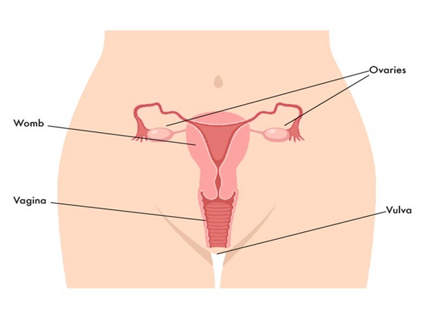
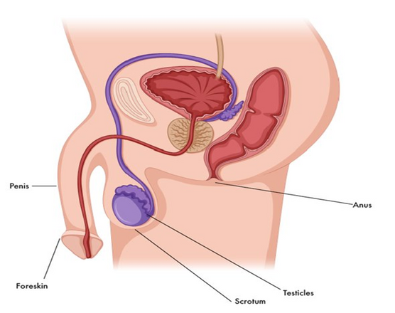
RECAP...
Let’s remember what we learned a long time ago…
A woman’s eggs are kept inside her body, in her ovaries. Every month (her hormonal cycle) a woman releases an egg.
A man’s sperm is made in his testicles which are inside the bag of skin (scrotum) that hangs behind his penis.
Fertilisation can happen when the egg and the sperm meet. This can happen in different ways.
Notes:
Slides 8-10 review prior learning about sex/reproduction/conception/pregnancy.

Slide 9
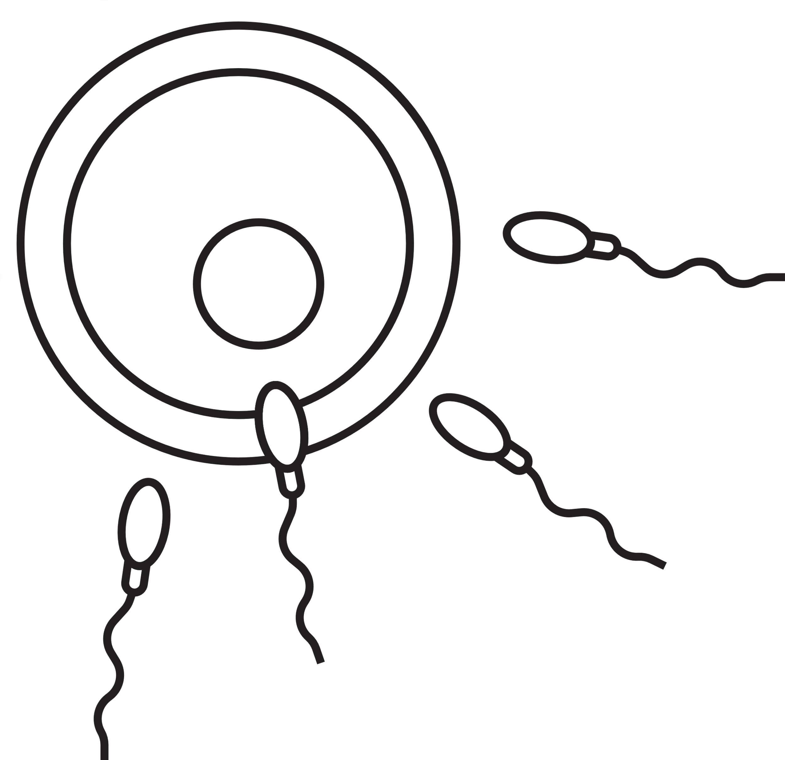
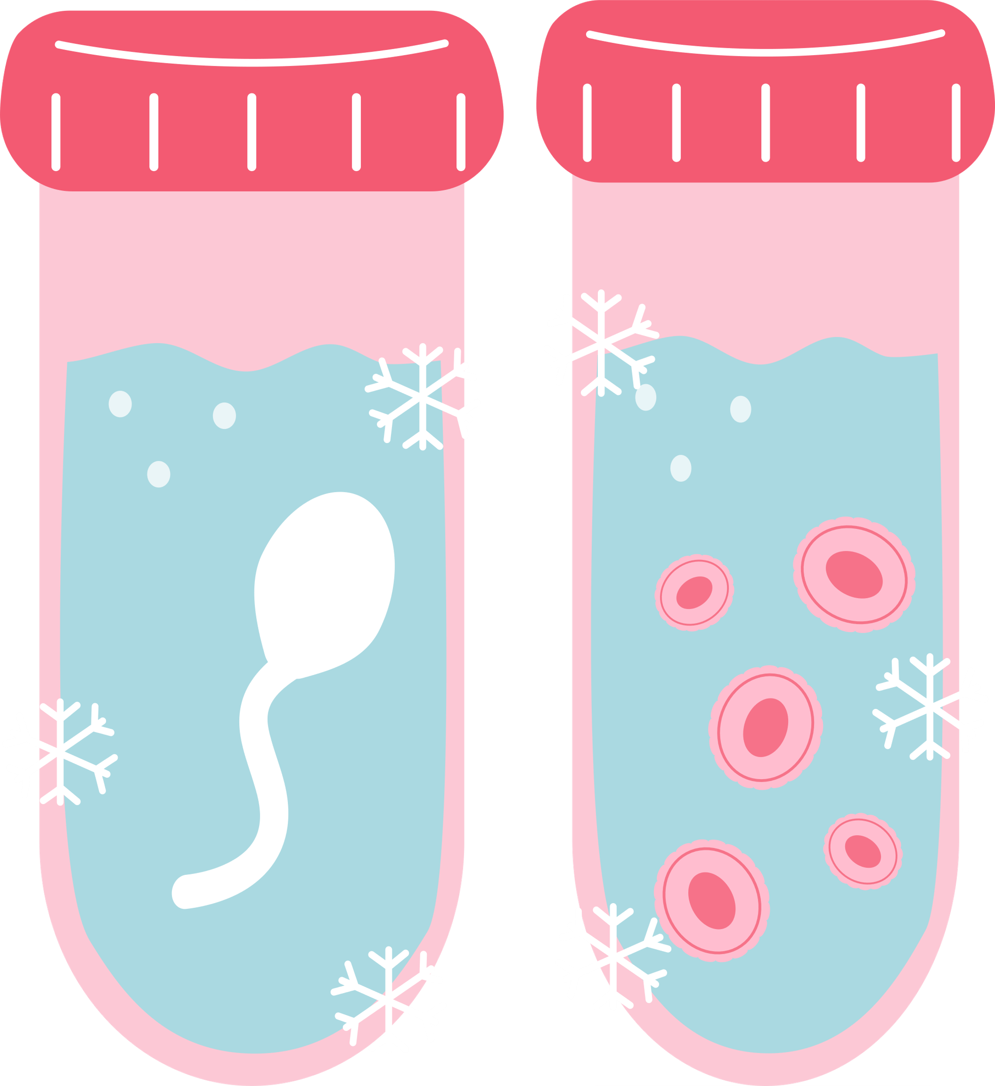
During sex, the man’s penis can go inside the woman’s vagina. When the man ejaculates, the sperm comes out and goes to meet the egg inside the woman’s body.
Some parents need help to start the pregnancy. Some babies start when the egg and sperm come together in a laboratory. The doctor then puts the fertilised egg back into the woman’s womb. This is called IVF (In vitro fertilisation).

Slide 10
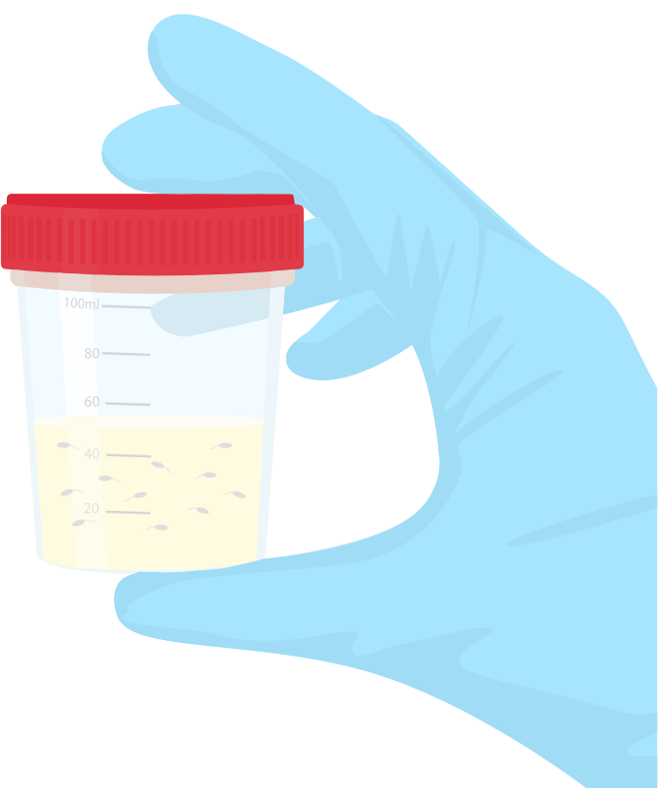
Other babies are created when a man gives his sperm to the woman, this is called being a donor. She puts the sperm inside her vagina. If the sperm swim to meet her egg, she can become pregnant.
These are all perfectly normal and valid ways to start a family!

Slide 11
Have you ever thought about your fertility?
Women have a hormonal cycle which determines when they can get pregnant. The cycle is approximately twenty-eight days long, with a fertile period of five days per cycle, but this does vary between women.
Men are fertile continuously, and their sperm quality is affected by their health, frequency of ejaculation, and environmental factors.
Everybody has a different level of fertility.
Notes:
The slide poses a question to be put to the class/group. The topic may or may not be one which young people have thought about, explore why so? Introduce the topic of infertility and explain what this means. Ask the class if they can think of things that might contribute to infertility in men and women. Of course, be sensitive to the fact that some young people will come from families where fertility is a concern.

Slide 12
Some women get pregnant quickly, but for others it can take longer. If a woman cannot get pregnant this may be because she or a male partner may be infertile.
There are a number of things can cause infertility, many can be treated successfully.
What kinds of things do you think can cause infertility in men and women?

Slide 13
Causes in men
  Low sperm count due to conditions like diabetes or hormonal variations
  Sexual problems like premature ejaculation, erectile dysfunction
  Overexposure to certain chemicals
  Smoking
  Certain medications

Slide 14
Causes in women
  Ovulation disorders/variations in hormones
  Problems with the uterus such as endometriosis - thickening of the Uterine walls
  Being overweight
  Infections that are sexually transmitted
  Being exposed to certain types of chemicals

Slide 15
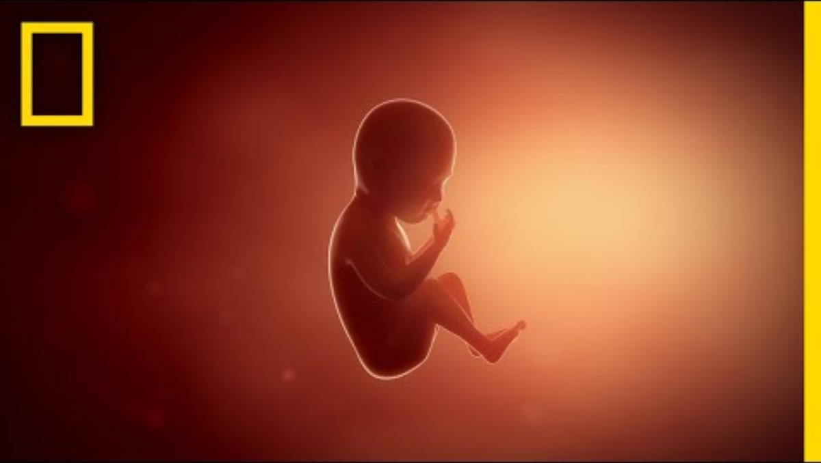

Slide 16
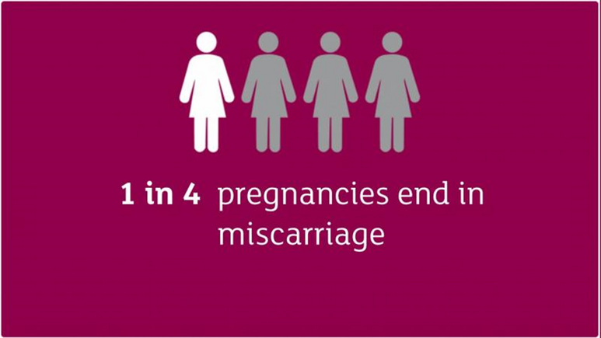
Miscarriage
A miscarriage is the loss of a baby before 24 weeks. Early miscarriages happen in the first 12 weeks of pregnancy. A woman may have a miscarriage before they even know they are pregnant. If this happens it can feel like a late period with heavy bleeding.
  In women of 20, around 15% pregnancies will end in miscarriage
  In women of 30, around 18% pregnancies will end in miscarriage
  In women of 40, around 38% pregnancies will end in miscarriage
  In women of 45, around 70% pregnancies will end in miscarriage.
Notes:
Slides 17 & 18 explain what this is and how common it is, highlighting that the occurrence of miscarriage increases with the age of the woman. Ensure the class understands that miscarriage usually is not caused by anything a woman has or hasn’t done, and is more common than people think. Explain that although it is common, miscarriage is not always widely talked about. Ask the class why they think this might be?

Slide 17
Miscarriage
  Most of the time there is no clear reason why it happens, but it is very unlikely to be caused by anything a woman did or didn’t do.
  Doctors think most miscarriages are caused when the building blocks controlling the development of a baby (the chromosomes) aren’t right. Babies with too many or not enough chromosomes won't develop properly. This can lead to a miscarriage.
  The experience of miscarriage is unique to each person and for some it may be a time of sadness and feelings of loss and grief.

Slide 18
Some people may also decide they do not wish to start a family, which is also a valid and perfectly normal choice!
If a person is sexually active, but does not wish to start a family, some form of contraception should be used.
Let’s have a look at a few scenarios and try to decide which type of contraception would be best for the people involved...
Notes:
Explain that sometimes a person will choose not to start a family, and that this is a personal decision for everyone to make themselves. Tell the class that if a person is sexually active but does not wish to start a family, they should be using contraception.

Slide 19
SCENARIO
Jasmin and David have just started going out and are planning to have sex. Neither has had sex before. Jasmin is very bad at remembering to take any medication.
WHICH KIND OF CONTRACEPTIVE SHOULD THEY USE? WHY?
Notes:
Share the scenarios on the following slides and ask the class which type of contraceptive option would be best for the people involved. Refer to Teacher Handout to help guide discussion/answers.

Slide 20
SCENARIO
Sonia used to be in a long-term relationship with a man who was unfaithful to her but is now going out with Daisy.
WHICH KIND OF CONTRACEPTIVE SHOULD THEY USE? WHY?

Slide 21
SCENARIO
Nico is single and regularly goes out clubbing where he gets drunk and often has sex with people he just met that night.
WHICH KIND OF CONTRACEPTIVE SHOULD THEY USE? WHY?

Slide 22
SCENARIO
Rosie and Keith are in their late 30s and faithful to each other. Rosie cannot take the pill, or have a coil fitted for medical reasons. Neither of them like using condoms and they definitely don’t want any more children.
WHICH KIND OF CONTRACEPTIVE SHOULD THEY USE? WHY?

Slide 23
We’re now going to think about menopause, which is the time in a woman’s life when she stops having her menstrual cycle, and she is no longer able to get pregnant.
Notes:
Explain that as the class/group have been thinking about fertility and reproduction there comes a natural time in a woman’s life where hormones decline - this can affect how she feels physically and mentally. Use the slides to discuss – checking current awareness/knowledge and what is new.

Slide 24
The word menopause means final period.
  The menopause is a natural part of ageing that usually occurs between 45 and 55 years of age, as a woman’s oestrogen levels decline.
  However, around 1 in 100 women experience the menopause before 40 years of age. This is known as premature menopause or premature ovarian insufficiency; it can happen naturally or as a side effect of some medical treatments
  Some women experience few symptoms of menopause, but for others it can be a really difficult time, affecting how they feel physically and mentally. Women will need help and support during this time from family, friends and the workplace.

Slide 25
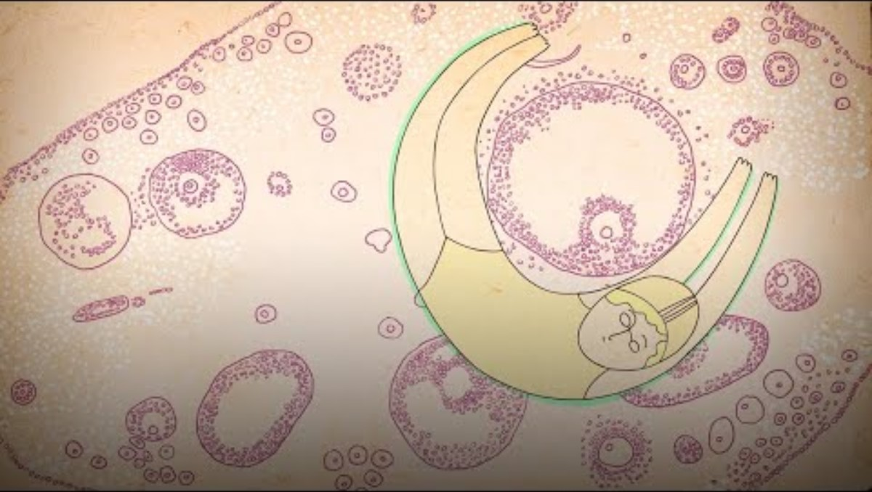
Notes:
https://youtu.be/cheqkrcHkrI
Watch this short film together and afterwards check understanding and ask young people to consider: as menopause is such a natural part of a woman’s life how can we best support women when they go through it? At home? At work?

Slide 26
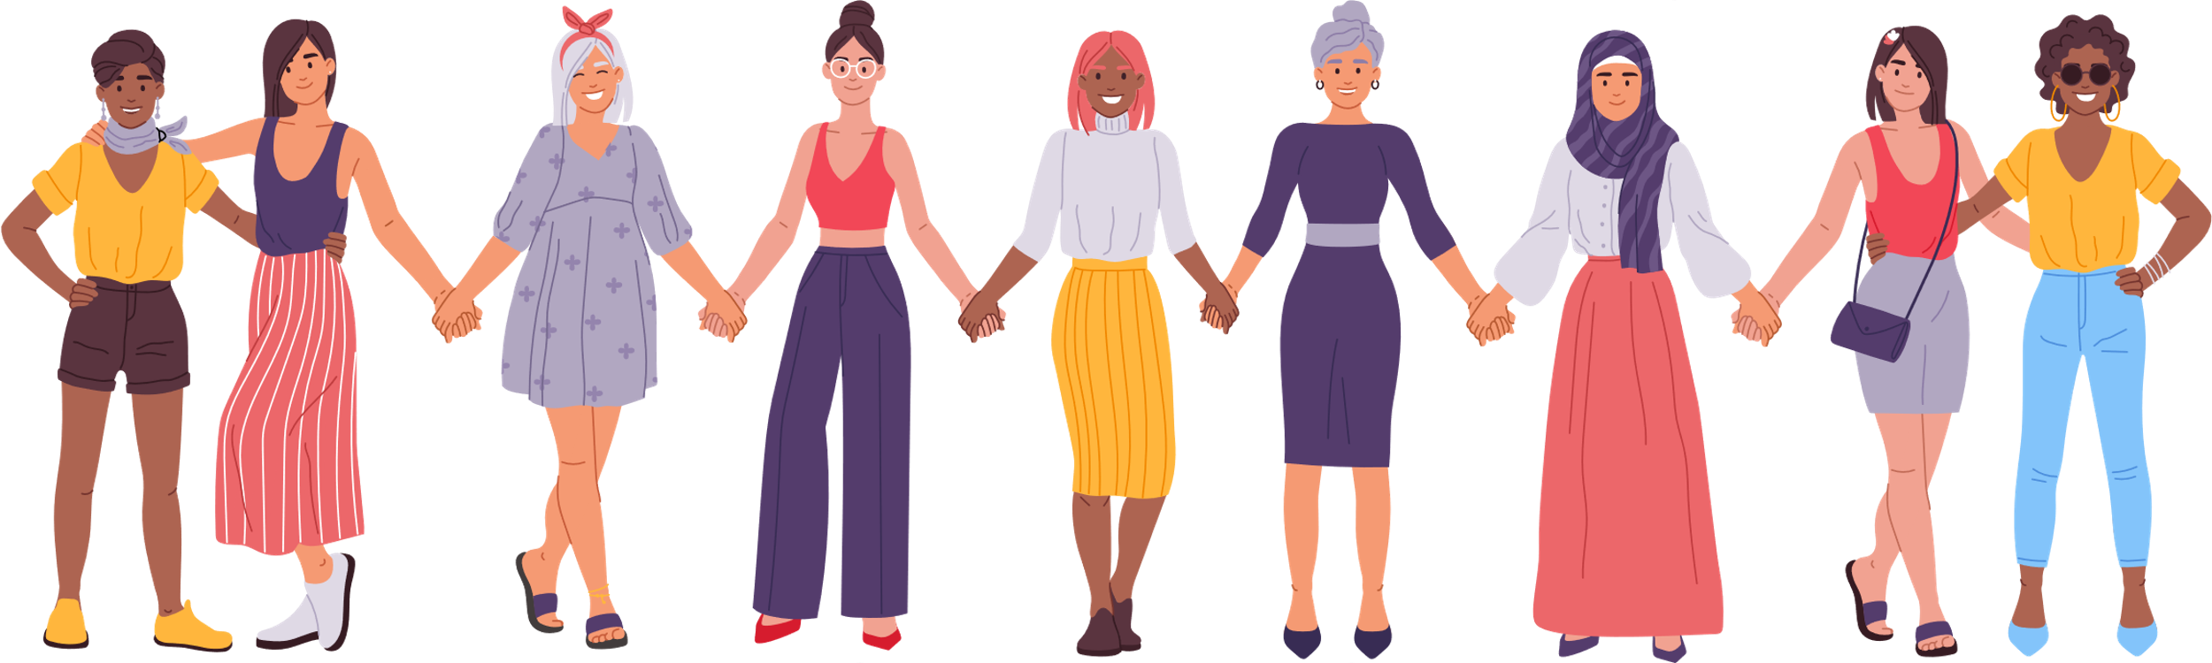
As menopause is such a natural part of a woman’s life, how can we best support women when they go through it?
At home? At work?

Slide 27

REFLECTION
Let’s ASK ourselves - what are we taking from today’s lesson?
Attributes?
Skills?
Knowledge?
Notes:
If time permits, this slide can be further developed into a collective, group reflection.
Please ask students to discuss what Attributes (e.g. honesty, integrity, courage, humility, generosity, self-worth, kindness, trustworthiness etc) they have used during this lesson.
What Skills (e.g. oracy, empathy, compassion, presentation, assertiveness, active listening, interpersonal skills, positive peer pressure, capacity to resist unwelcome pressure, distinguish between fact & opinion , etc.
What Knowledge have they used, or developed during this lesson?

