Slide 1
teacher slide
This lesson touches on the different types of changes a young person may experience within their families - including death, separation/divorce, births, etc, with a particular focus on bereavement. Be aware that students in your class are likely to have experienced or are currently experiencing some of these changes, and ensure the topic is handled with sensitivity.
It is important to normalise the emotions caused by these changes, and for young people to know where to access support if needed.

Slide 2
Activity | Description | Timing
Introduction | Students to complete do it now task. Introduce lesson and learning objectives. | 5 mins
Family/changes | Briefly ask the class to describe a family - make the point that all families are different, coming in all shapes/sizes/types. Just like families are different, so are the changes they may go through. Ask students to refer back to the do it now task - which changes did they identify? | 5 mins
Change scenarios | Split class into small groups, providing each with a scenario (on handout). Students should reflect on the character in the scenario and use questions on slide 11 to prompt discussion. After a few minutes, have whole class feedback. | 10 mins
Grief | Explain you are going to examine Ava’s experience more closely and look at grief. Share definition of grief. Using a sheet of paper, ask students to draw someone who is grieving - what do they look/act like? How would we know they’re grieving? What might be going on inside? Ask students to share their drawings if they are comfortable, but do not force it. Show picture on slide 19 and ask for class reactions. | 15 mins
Coping strategies | Can be done as whole class or small groups/pairs. Ask students to review list of coping strategies (separate handout) and consider the pros/cons of each. Make the point that there is no one right or wrong way to deal with changes/grief. Share signposting slide. | 10 mins
Reflection | Ask students to reflect on the session using ASK. | 5 mins

Slide 3

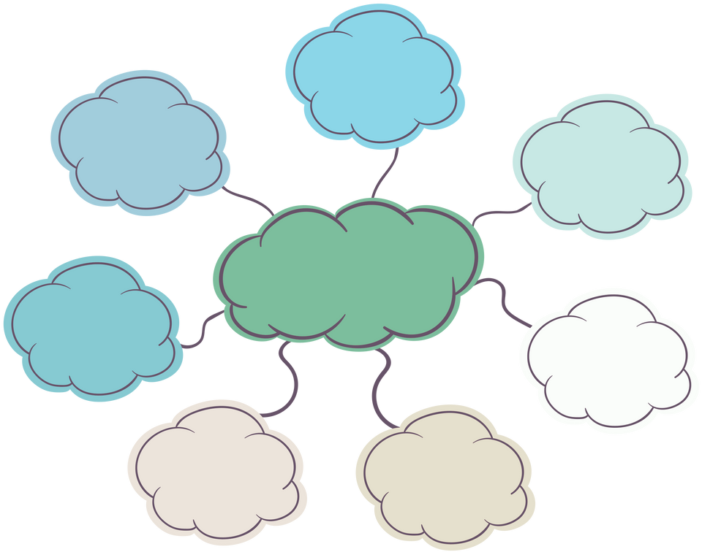
do it now
Families can change in lots of ways—some joyful, some challenging.
Create a mind map to answer the following questions:
What kinds of changes do you think families could experience over time?
What impact do you think these changes might have on someone your age?
Notes:
Ask students to spend a few minutes creating a mind map of the changes a family can experience (e.g. death, illness, marriage, divorce/separation, birth of a new child, moving house, financial or job loss, etc).
Encourage students to consider how these kinds of changes might impact a young person - how would they think or feel? How might their behaviour change?

Slide 4

FAMILY CHANGES & GRIEF
YEAR 11

Slide 5
learning objectives
identify the different types of changes a family may experience and discuss the emotional/practical impacts of these changes on young people
describe some healthy ways to manage changes, including bereavement
identify sources of support within schools and the wider community
Notes:
Ask the students to spend a few moments thinking about the terms explicit material/pornography. How do they define it? Students can write a few ideas down on a sheet of paper, or discuss with the person next to them.

Slide 6

CLASS AGREEMENTS
Kindness and respect
Right to pass
Nonjudgmental
No such thing as silly
questions
any others?
Notes:
Explain that you would like the class to create a list of 'agreements' for how everyone will behave and treat one another in the class. Ensure a common understanding. For example:
1. We will treat one another with kindness and respect (listening to each other, speaking one at a time, etc)
2. We all have the right to 'pass' on answering a question or participating in an activity that makes us feel uncomfortable.
3. We can disagree but will not pass judgments, make fun of, or or put anybody down. 'Challenge the opinion, not the person.'
4. Asking questions is encouraged and will be valued by our teacher. We do not ask questions to purposefully embarrass or belittle another.
*Feel free to change the agreements to suit your class, and ask whether there are any others they'd add to the list in order to create a safe, comfortable learning environment.

Slide 7
WHAT IS A FAMILY?
Notes:
Ask students to reflect on this question privately for a moment, before sharing with a partner or the wider class.

Slide 8
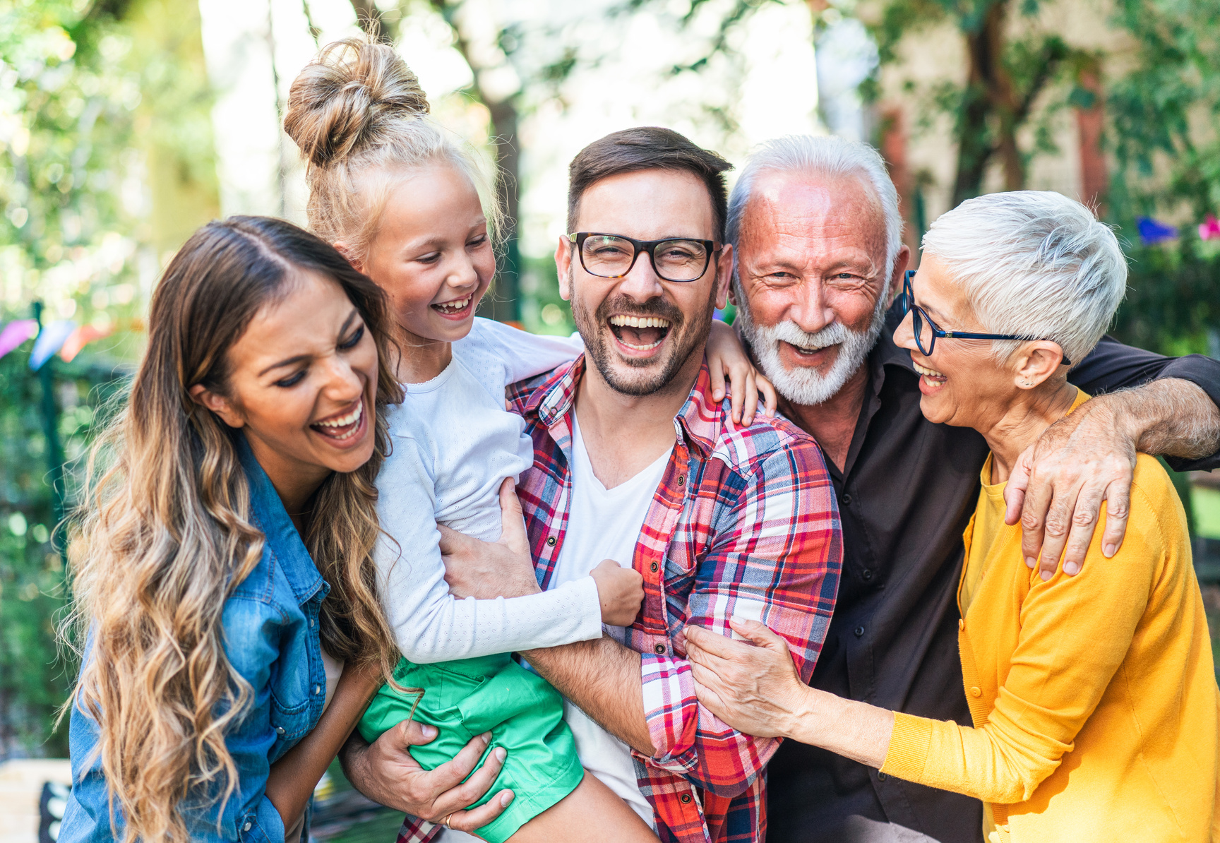
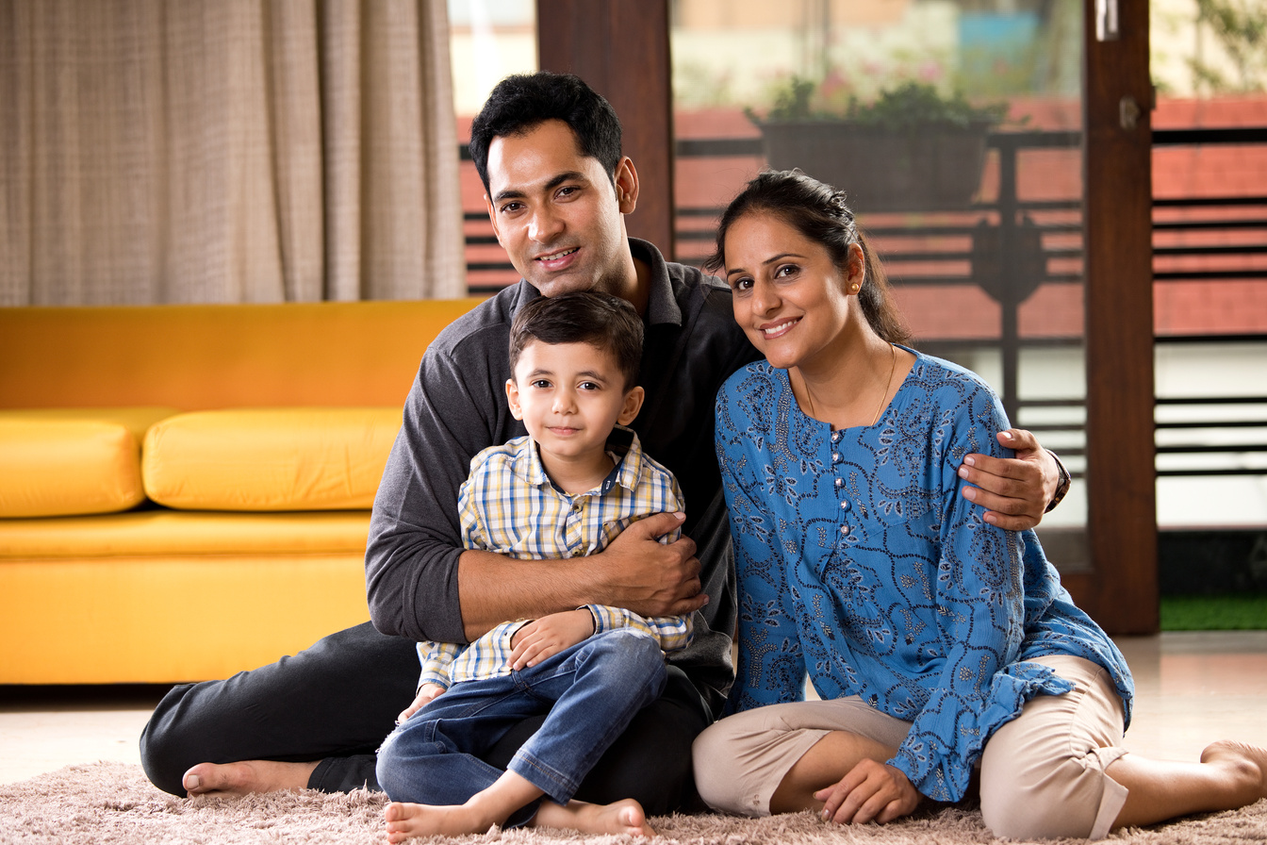
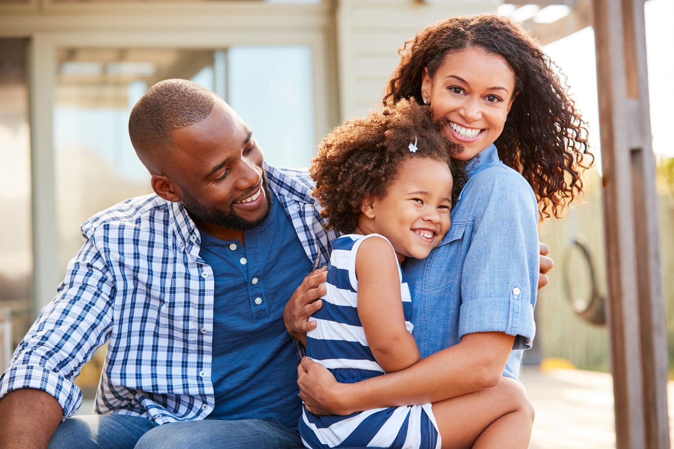
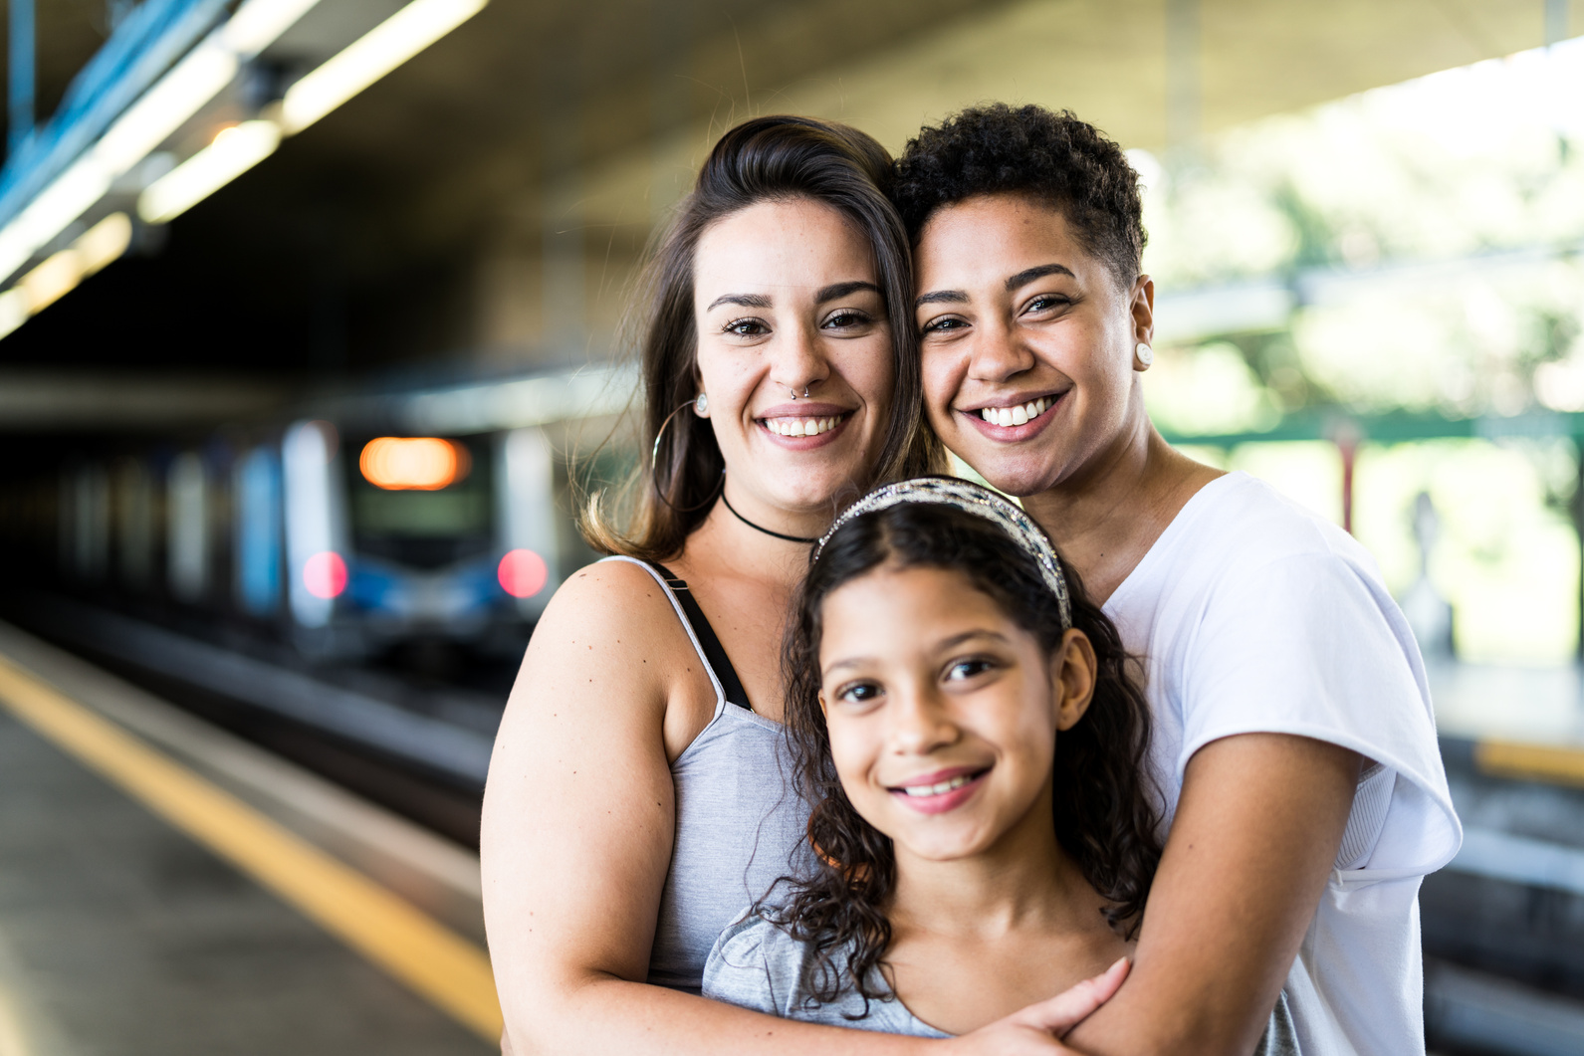
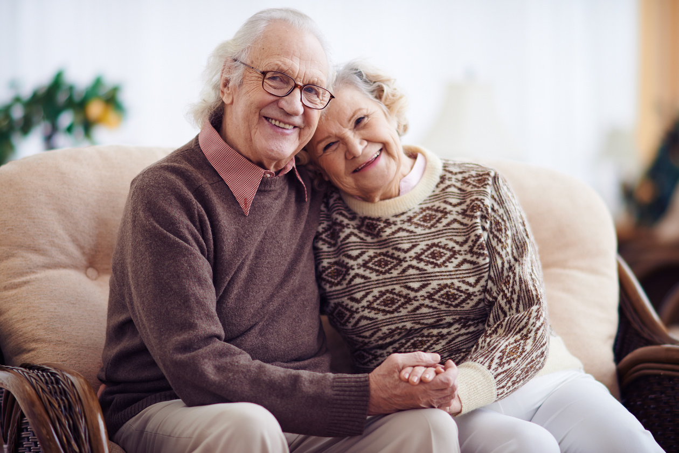
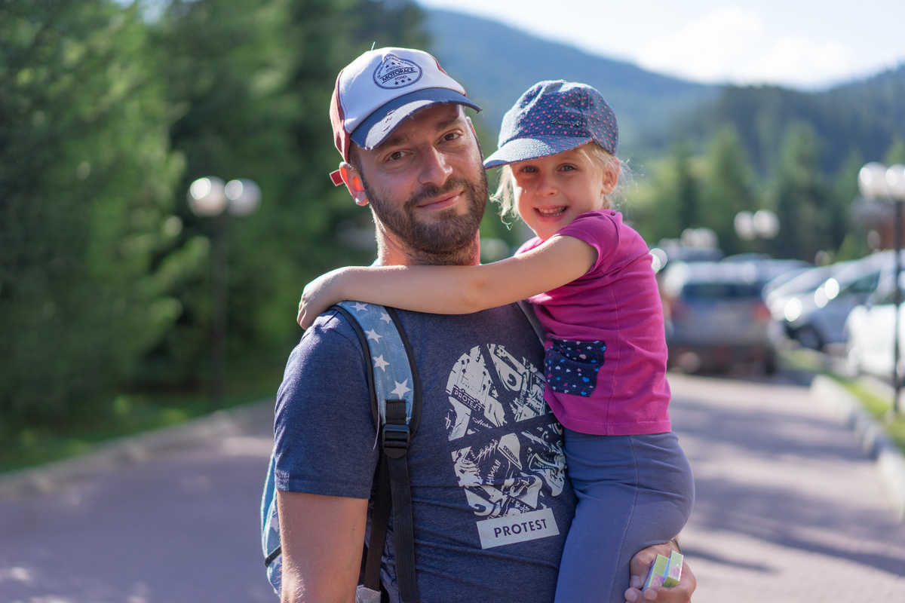
THERE IS NO ONE SINGLE MEANING OF THE WORD ‘FAMILY’ TODAY
Notes:
The point to make is that families are all very different - there is no one single definition of a family that resonates with everyone.

Slide 9
Family means different things to different people. Families come in all types, like:
single parent families
same sex parent families
families with no children
families with lots of children
children being raised/cared for by extended family (aunts, uncles, grandparents, cousins)
foster families
biological families
adopted families
mixed race families
stepfamilies
CAN YOU THINK OF ANY OTHERS WE MAY HAVE MISSED?
Notes:
Again, to make the point that families come in all sizes and makeups. This is not an exhaustive list by any means, so invite students to share their ideas of family, and whether they believe any were left off the list.

Slide 10

Just as our families are all different, so are the kinds of experiences and changes that our families may go through over time.
LOOKING AT YOUR MIND MAP, WHAT SORTS OF CHANGES DID YOU IDENTIFY?
Notes:
Ask students to share their answers from the do it now task, focusing on the changes identified (tell them you will explore feelings/impact later).
Again, the point is: just like our families are different, so are some of the changes/experiences we may go through.

Slide 11
CHANGE SCENARIOS
While there are many changes a family can go through, we’re going to focus on a select few for today. In small groups, you will be given a scenario about a family. Read the scenario and reflect on the following:
Describe the change: what happened to the character’s family?
How might this change affect their daily life (school, hobbies, responsibilities)?
What emotions could they be feeling?
If this character were your friend or classmate, what could you do to help?
Notes:
Split the class into small groups, and give each group a character scenario to read and reflect on, using the questions on the slide as a guide.
Ask groups to feed back to the wider class following their discussion.

Slide 12
SCENARIO: JORDAN
Jordan’s parents separated a few months ago. Now Jordan spends weekdays with his mum and weekends with his dad. Both homes feel different — new routines, new rules, and his parents argue whenever they see each other. Jordan is the only one in his friend group with separated parents. He misses how things used to be.

Slide 13
SCENARIO: AVA
Ava’s grandmother, who lived with her family and was a big part of her daily life, passed away recently. The house now feels very quiet, and Ava’s parents and brother are also grieving. Ava feels sad but also confused — sometimes she feels okay, and other times she’s overwhelmed. She’s not sure if it’s normal to feel so many things at once.

Slide 14
SCENARIO: LEO
Leo’s dad has a long-term illness, and lately Leo has taken on more responsibilities at home. He helps with cooking, cleaning, and looking after his younger brother. He’s often tired and finds it hard to concentrate at school. He’s sometimes late for class and frequently gets in trouble for forgetting his tie. Most of his classmates don’t know what he’s dealing with, and Leo doesn’t know how to bring it up.

Slide 15
SCENARIO: ABBY
Abby’s family just had a new baby. Her parents are busy and sleep-deprived, and the house feels chaotic. Sofia’s routines have changed — she’s helping more around the house and getting less attention. Sometimes she thinks the baby is cute, and other times she finds the baby quite annoying, particularly when it cries and keeps her up at night.

Slide 16
SCENARIO: AMIR
Amir’s family moved from Ramsey down to Port Erin. Amir had to leave behind close friends, a familiar school, and playing on a football team they loved. The new school feels unfamiliar, the rules are confusing, and making friends has been harder than expected - it’s year 11, and everyone seems set in their groups.

Slide 17
AVA’S SCENARIO - WHAT IS GRIEF?
Grief is a natural response to experiencing a loss. Grief often includes physical, emotional, and behavioural changes.
Lots of different kinds of losses, and changes, can cause people to experience grief, including (but not limited to!):
death, including the death of a loved one and of pets
loss of a relationship (divorce, separation), or a friendship
loss of a job or a home
Notes:
Tell the class you're going to focus a little more on Ava's scenario now, which deals with grief.
Check whether students are familiar with the term, and provide definition.
Make the point that a loss does not necessarily have to be a death, that grief can also be triggered by other losses (like the loss of a job), and by life changes (like the ones in the earlier scenarios)

Slide 18
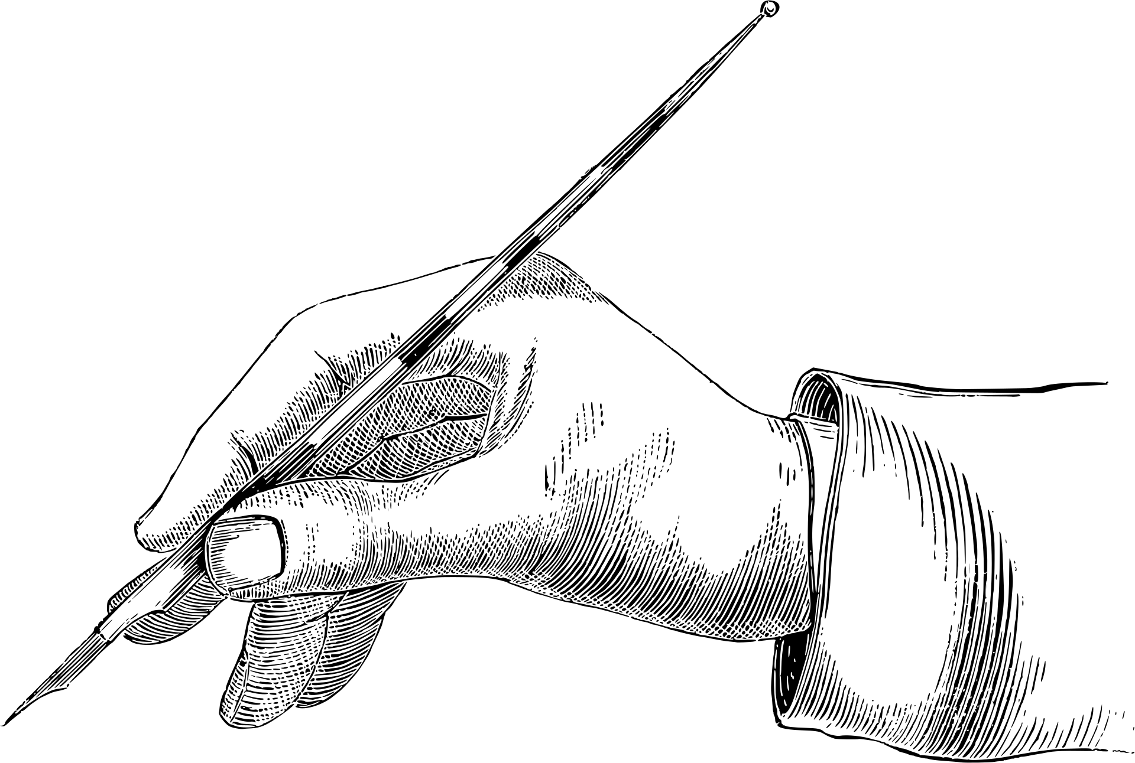
ACTIVITY
GRIEF FEELS LIKE...
GRIEF LOOKS LIKE...
Notes:
On a sheet of paper, ask students to draw a picture of someone who is grieving.
What would this person look like?
What body language or facial expressions might they have?
What would other people notice about them?
Most importantly - what might be going on internally (e.g. the thoughts or feelings we can't see?)

Slide 19
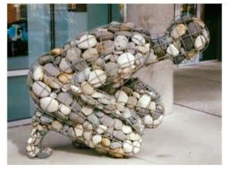
“The Weight Of Grief” - sculpture by Celeste Roberge
Notes:
Ask the class to silently reflect on this sculpture for a moment, then invite discussion.
What do they think the artist was trying to convey about grief?

Slide 20
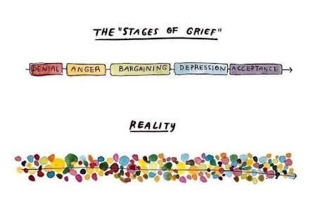
Notes:
Students may have heard about the "stages of grief" which is an older model used to explain how people may react to a loss. This can also be used to explain reactions to big life changes, like a divorce, serious illness/injury, etc. Even positive changes, like welcoming a new baby, can be stressful and cause a lot of emotions.
In reality, dealing with grief/change is not a linear process, and people do not move through the stages in a particular order.
It is important for young people to understand that feelings can be messy. All their feelings are valid, and there is no one right or wrong way to deal with change.

Slide 21

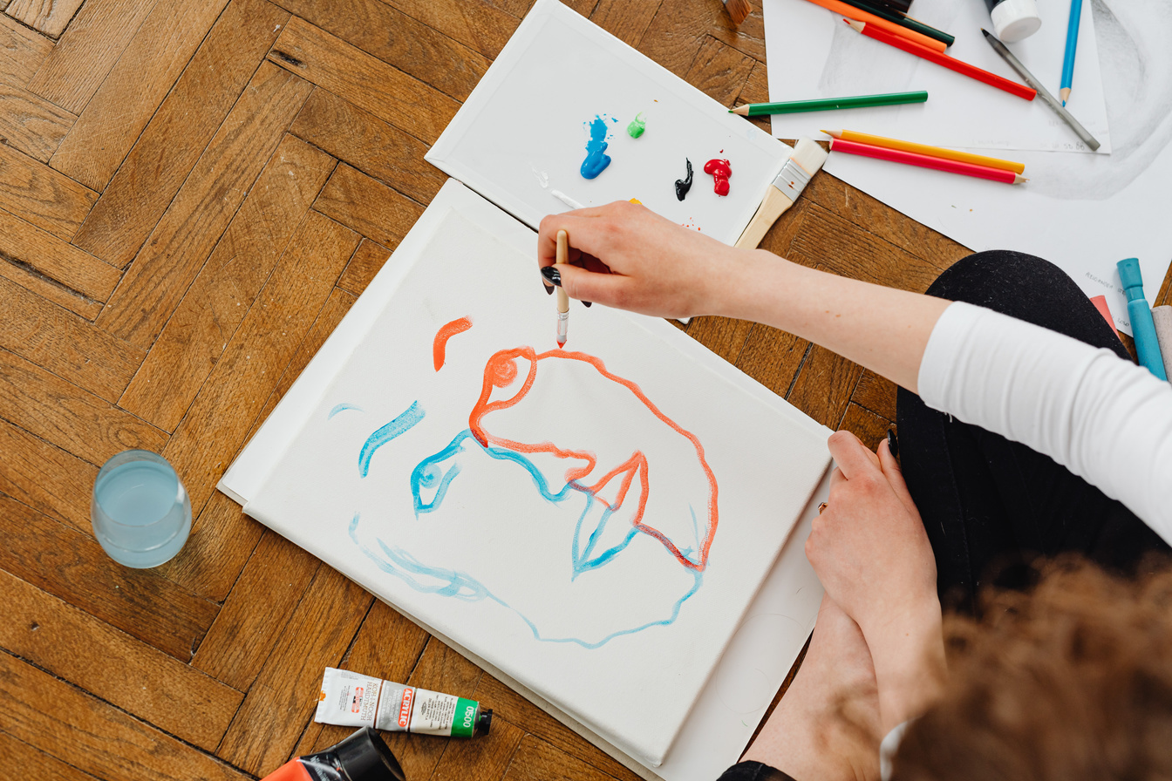


ACTIVITY: COPING STRATEGIES
Review the list of coping strategies and discuss the pros/cons of each.
Notes:
Using the coping strategies handout, have students identify the pros and cons of different ways to manage grief, or other big family changes like those discussed earlier.
You may choose to print the handout and have students complete individually or in groups/pairs, or if you prefer to minimise printing, read some of the strategies aloud and ask for class feedback on the pros/cons.

Slide 22
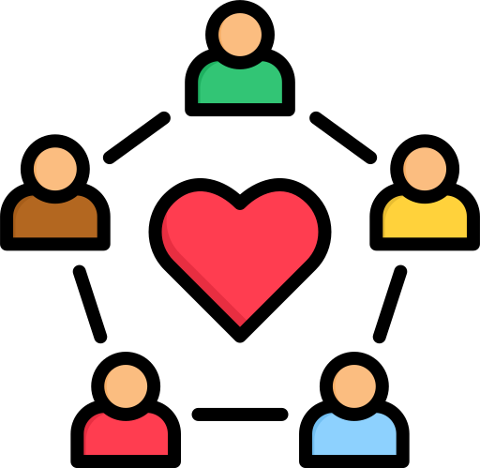
ONLINE SUPPORT
Winston’s Wish: https://winstonswish.org/
Child Bereavement UK: https://www.childbereavementuk.org/
Childline: https://www.childline.org.uk/
ON ISLAND SUPPORT
Cruse - https://www.cruse.org.im/
Isle Listen
Or speak to a trusted adult at home or at school.
Notes:
Ensure students know how they can access support in school, if needed.

Slide 23
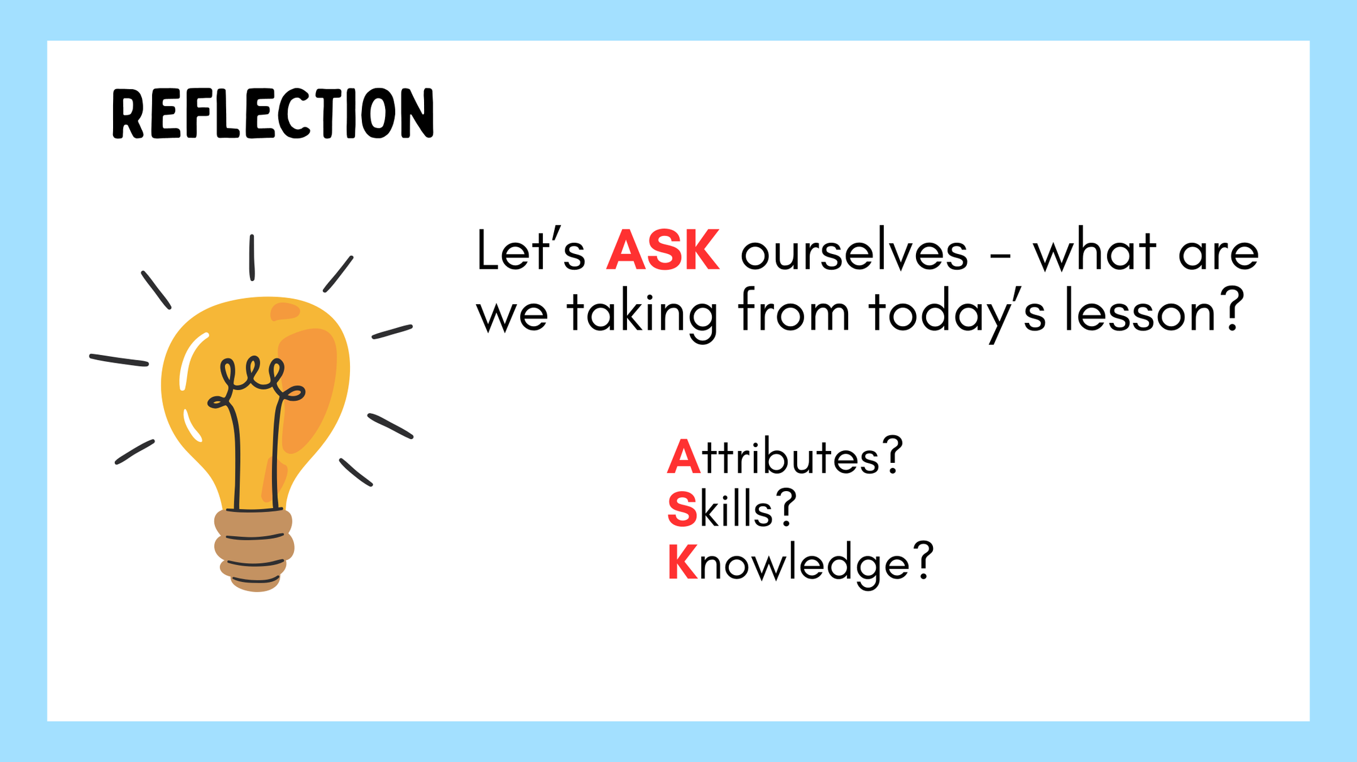
Notes:
If time permits, this slide can be further developed into a collective, group reflection.
Please ask students to discuss what Attributes (e.g. honesty, integrity, courage, humility, generosity, self-worth, kindness, trustworthiness etc) they have used during this lesson.
What Skills (e.g. oracy, empathy, compassion, presentation, assertiveness, active listening, interpersonal skills, positive peer pressure, capacity to resist unwelcome pressure, distinguish between fact & opinion , etc.
What Knowledge have they used, or developed during this lesson?

