Slide 1


Teachers slide
This lesson was created by Hannah Grove. If you wish to use it in any context other than the one intended, please seek permission beforehand. Thank you!
www.hannahpants.com
This lesson is about Abusive Relationships:
We will be looking at the early signs of abusive relationships, how to spot them, what impact they have, and how to seek help and advise if someone finds themselves (or someone they know) in an abusive situation.
  It is crucial to prioritise your emotional well-being and take care of yourself throughout this session as well as your students.
  Before you begin this session, take a deep breath and check in with your own emotions. Do you have anything bubbling under the surface that might make this a difficult lesson for you?
  Remember that you need to be a safe adult for your students, to potentially hear uncomfortable opinions, facts and potential safeguarding disclosures. If you think you are not able to do this, seek help and advice before the session begins. There is no shame in asking someone else to teach this lesson on your behalf, your emotional well being is important.
  We know that some students will live in homes with abusive relationships and may experience domestic abuse. Please ensure a safe place where students can go for support if they become distressed.

Slide 2
Teachers slide
Activity | Description | Timing
Introduction | Ask students to complete and briefly review the ‘do it now’ task and Introduce the learning objectives, revisit class agreements and read the trigger warning. | 10 minutes
What is ‘Domestic Abuse’ | Please use slide slides 8, 9, and 10 to explain what is meant by domestic abuse (and what it isn’t) and the importance of why we need to talk about DA. | 5 minutes
Five types of abuse that are part of DA | Please take a few minutes (slide 11) to see which of the five types of abuse students know. Having Explained the five types of abuse (slide 12). the next. 11 slides (12-23.) follow a similar pattern where students are asked to work in small groups to discuss what actions may constitute each of the five types of abuse | 15 minutes
Abusive Messages | Slides 24-34 consider five different text messages and ask students to identify what type of abuse each represents and what they would tell a friend if someone received a message like this. | 15 minutes
Remember! | Please use slide 35 as a plenary for students to synthesise their learning from this lesson. | 5 minutes
An Abusive Relationship | Slides 36 and 37 show a very similar film, which depicts an abusive teenage relationship. Each film is only. 1’20” Long the first film asks whether the young man would behave like this if he could see himself. The second asks whether the young woman recognizes that this is an abusive relationship. Please only use these films if there is adequate time for discussion. | 10 minutes
Reflection & Support | Ask students to reflect on slides 38 & 39 | 5 minutes
Notes:
Please note that these are only suggested timings

Slide 3



What is a ‘red flag’?
What are two things that could be a ‘red flag’ in a relationship.
A ‘Red flag’ in relationships is a warning sign that indicate unhealthy or manipulative behavior.
Notes:
Please ensure that this slide is displayed when the students come into the room.

Slide 4















Abusive Relationships

Slide 5
Learning outcomes
Students will:
1) Be able to give a definition of domestic abuse
2) Understand different categories of abuse
3) Have discussed how to identify some 'red flags’ in relationships
Notes:
Please ensure that the students are familiar with the intended learning outcomes for this lesson.

Slide 6


Class agreement
No Personal Comments
Right to pass
No such thing as a silly question
Kindness and respect
Notes:
Explain that you would like the class to create a list of 'agreements' for how everyone will behave and treat one another in the class. Ensure a common understanding. For example:
1. We will treat one another with kindness and respect (listening to each other, speaking one at a time, etc)
2. We all have the right to 'pass' on answering a question or participating in an activity that makes us feel uncomfortable.
3. We can disagree but will not pass judgments, make fun of, or or put anybody down. 'Challenge the opinion, not the person.'
4. Asking questions is encouraged and will be valued by our teacher. We do not ask questions to purposefully embarrass or belittle another.
*Feel free to change the agreements to suit your class, and ask whether there are any others they'd add to the list in order to create a safe, comfortable learning environment.

Slide 7
Trigger Warning
Please be aware that the content we will be discussing is sensitive and may be triggering for some individuals.
It is crucial to prioritize your emotional well-being and take care of yourself throughout this session.
We encourage you to step out if needed and seek support from:
Additionally, be mindful of others around you, offering kindness and understanding.
Notes:
Please take a moment to read through this trigger warning with the students and ensure that if a student does feel distressed, they know that they can leave the room and where they can go to be physically and emotionally safe.

Slide 8
This lesson is about domestic abuse.
What does domestic abuse mean?
Notes:
Please ask students to discuss in small groups and then, if you wish, share the following definition with them:
Domestic abuse is when someone in your family or a close relationship tries to have power and control over you. It's more than just physical hitting; it includes emotional harm (like insults or threats), financial control (taking your money), and sexual abuse. It makes the person being abused feel scared, trapped, and unsafe in their own home. It is never the victim's fault, and they deserve to be safe and respected.

Slide 9


The law about domestic abuse states:
Abusive behaviour(s) of a person towards another person if they are personally connected to each other.
This can include:
  Parents
  Foster carers
  close family members
  intimate partners
  ex partners
  Other similar people
This does not include:
  Work colleagues
  Friends
  Neighbours
  A person you met in the street
  A friend of a friend
Domestic Abuse Act 2020
There are many other laws that relate to and protect people from abuse in these situations
Notes:
Please briefly explain the difference between domestic abuse and abusive relationships in other settings.

Slide 10

Talking about domestic abuse, might feel like a difficult conversation.
But it’s really important to know about so that you can:
  Spot the early signs of abuse in a relationship
  Keep yourself and others safe
Notes:
Please briefly explain the rationale for why we need to talk about domestic abuse, even though it can be difficult.

Slide 11


Think, pair, share
According to the law, there are FIVE different types of abuse which are recognised under the Domestic Abuse Act 2020.
Which ones can you name?
1.
2.
3.
4.
5.
Notes:
Please ask the students to discuss, in small groups, the five different types of abuse which are each part of domestic abuse.
If they’re not sure, it’s not a problem, we are now going to explain it to them.

Slide 12





1.
Physical abuse
2.
Economical or financial abuse
3.
Emotional abuse
4.
Psychological abuse
5.
Sexual abuse
Notes:
Please teach the students the five forms of abuse and explain that we’re going to look at each one in detail..
N.B. the next 11 slides follow the same pattern where we ask students to work in small groups to discuss their behaviours that might be included in each of the five aspects of domestic abuse.

Slide 13




1.
Please work in small groups to discuss:
What behaviours are included in the term
PHYSICAL ABUSE?
Notes:
Please ask students to briefly discuss the behaviours which are included in the term physical abuse, before confirming these with the next slide.

Slide 14
1.
PHYSICAL ABUSE include (but is not limited to)
  Pinching
  Restraining
  Biting
  Misusing medication
  Drowning
  Suffocating
  Denying medical care
  Hitting
  Shaking
  Throwing
  Poisoning
  Slapping
  Hair pulling
  Kicking
  Burning
  Throwing objects
  Scalding
  Fabricating symptoms or deliberately inducing illness

Slide 15




2.
Please work in small groups to discuss:
What behaviours are included in the term ECONOMICAL or FINANCIAL ABUSE?
Notes:
Please ask students to briefly discuss the behaviours which are included in the term economic or financial abuse, before confirming these with the next slide.

Slide 16
ECONOMICAL or FINANCIAL ABUSE can include (but is not limited to)
2.
  Money or possessions being stolen or misused
  Fraud
  Exploiting (taking advantage of) someone's money or possessions
  Restricting someone's access to money
  Restricting or controlling someone’s education or employment
  Restricting or controlling someone’s possessions.
  Pressuring and coercing someone about their will, or inheritance
  Pimping
  Blackmail
  Creates debt in someone’s name

Slide 17




3.
Please work in small groups to discuss:
What behaviours are included in the term EMOTIONAL ABUSE?
Notes:
Please ask students to briefly discuss the behaviours which are included in the term emotional abuse, before confirming these with the next slide.

Slide 18
3.
EMOTIONAL ABUSE can include (but is not limited to)
  Shouts at you
  Sulks at you
  Glares at you,
  Texts you constantly
  Checks your phone
  Puts you down
  Implies that you’re not trustworthy
  Name calling
  Giving you the silent treatment
What is the difference between emotional and psychological abuse?

Slide 19





4.
Please work in small groups to discuss:
What behaviours are included in the term PSYCHOLOGICAL ABUSE?
Notes:
Please ask students to briefly discuss the behaviours which are included in the term psychological abuse, before confirming these with the next slide.

Slide 20
PSYCHOLOGICAL ABUSE can include (but is not limited to)
4.
  Makes you think abuse is your fault
  Makes you think you are worthless
  Threaten to kill or harm themselves to manipulate you
  Stops you seeing your friends and family
  Threatens to tell your secrets
  Promises to change
  Gaslighting
  Makes you question events

Slide 21


PSYCHOLOGICAL ABUSE and EMOTIONAL ABUSE
can look very similar and are sometimes used interchangeably.
A good way to remember the difference is:
PSYCHOLOGICAL ABUSE affects the way you think.
It can make you think the abuse is all your fault, or makes you think you are in the wrong, or make you think that someone is going to hurt themselves because of you.
EMOTIONAL ABUSE affects the way you feel
It can make you feel sad, or feel scared or feel insecure.

Slide 22




5.
Please work in small groups to discuss:
What behaviours are included in the term SEXUAL ABUSE?
Notes:
Please ask students to briefly discuss the behaviours which are included in the term sexual abuse before showing them the next slide.

Slide 23
5.
SEXUAL ABUSE can include (but is not limited to)
  Pressures you into doing sexual activities you don’t want to
  Manipulates you into having sex
  Rape
  Makes you send them explicit images or texts
  Shares those texts with friends or on the internet
  Tells you what to wear/what not to wear
  takes photos or videos of you without your knowledge
  Pays you or buys your things to manipulate you into doing sexual things.
  Doesn’t stop when asked

Slide 24
The following messages are fake!
They each show an example of a different type of domestic abuse, can you tell which is which?
Pair up, or in small groups, read out the scenarios.
You can be as dramatic as you like!
Notes:
They now follow five different examples of text messages. Students need to work in small groups to discuss whether this is abuse; what kind of abuse this could be. And if a friend told you they’d receive a message like this, what advice would you give them?

Slide 25
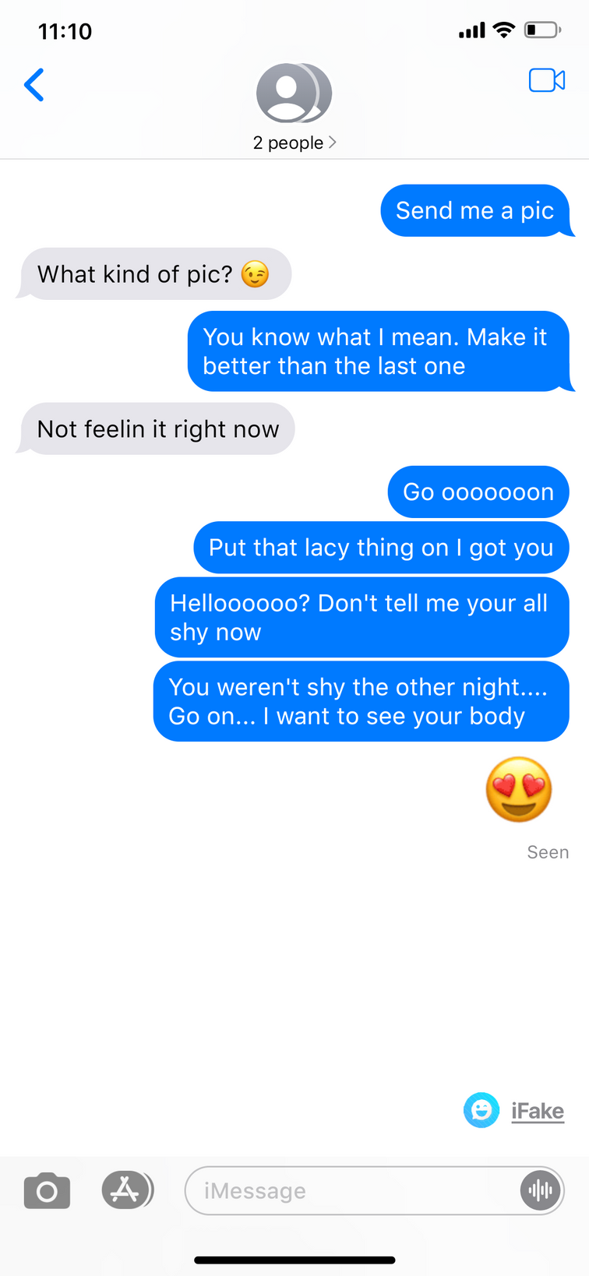

Slide 26

What kind of abuse could this be?
Do YOU think this is abuse?
Where would you place a ‘red flag’ in this conversation?
If a friend told you they’d received these messages, what advice would give them?

Slide 27
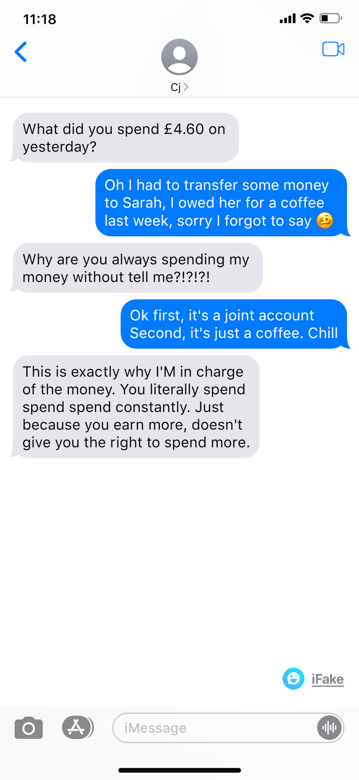

Slide 28
What kind of abuse could this be?
Do YOU think this is abuse?
Where would you place a ‘red flag’ in this conversation?
If a friend told you they’d received these messages, what advice would give them?

Slide 29
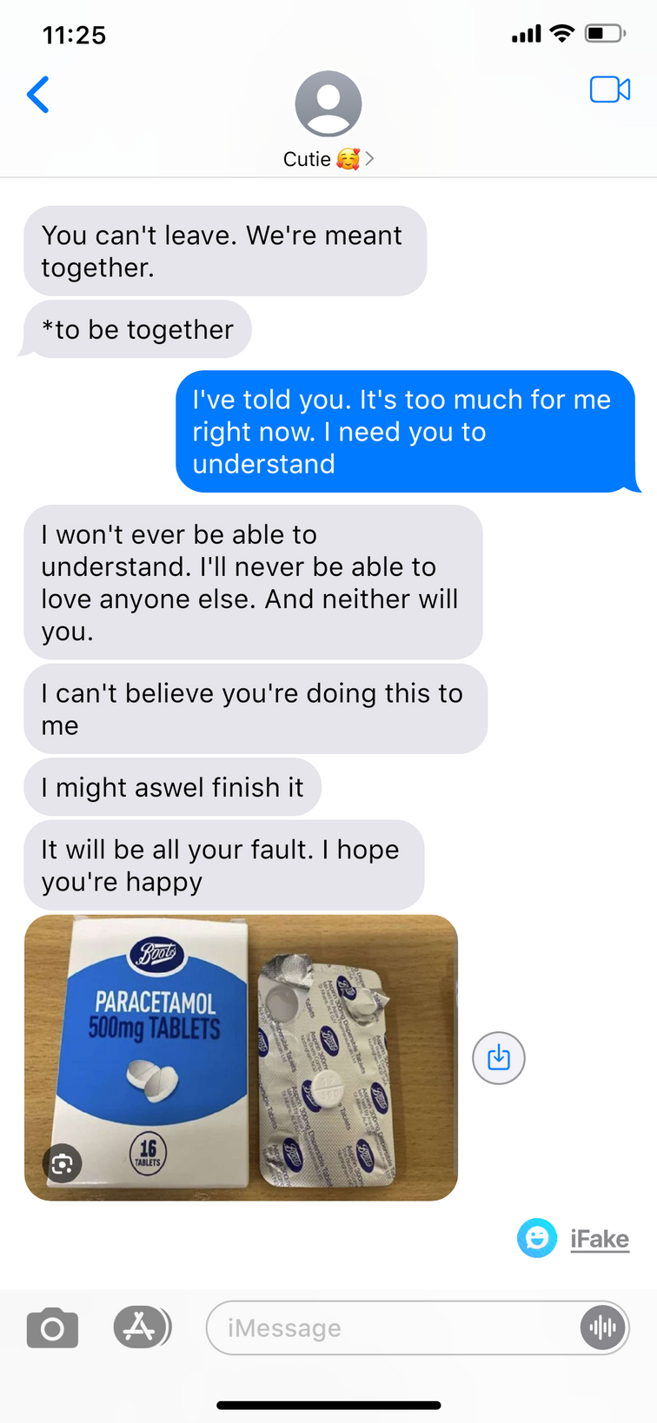

Slide 30
What kind of abuse could this be?
Do YOU think this is abuse?
Where would you place a ‘red flag’ in this conversation?
If a friend told you they’d received these messages, what advice would give them?

Slide 31
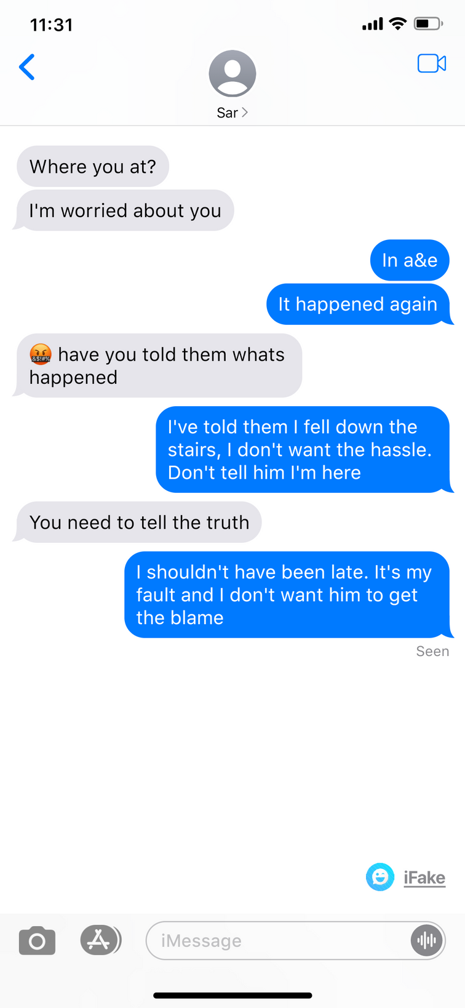

Slide 32
What kind of abuse could this be?
Do YOU think this is abuse?
Where would you place a ‘red flag’ in this conversation?
If a friend told you they’d received these messages, what advice would give them?

Slide 33
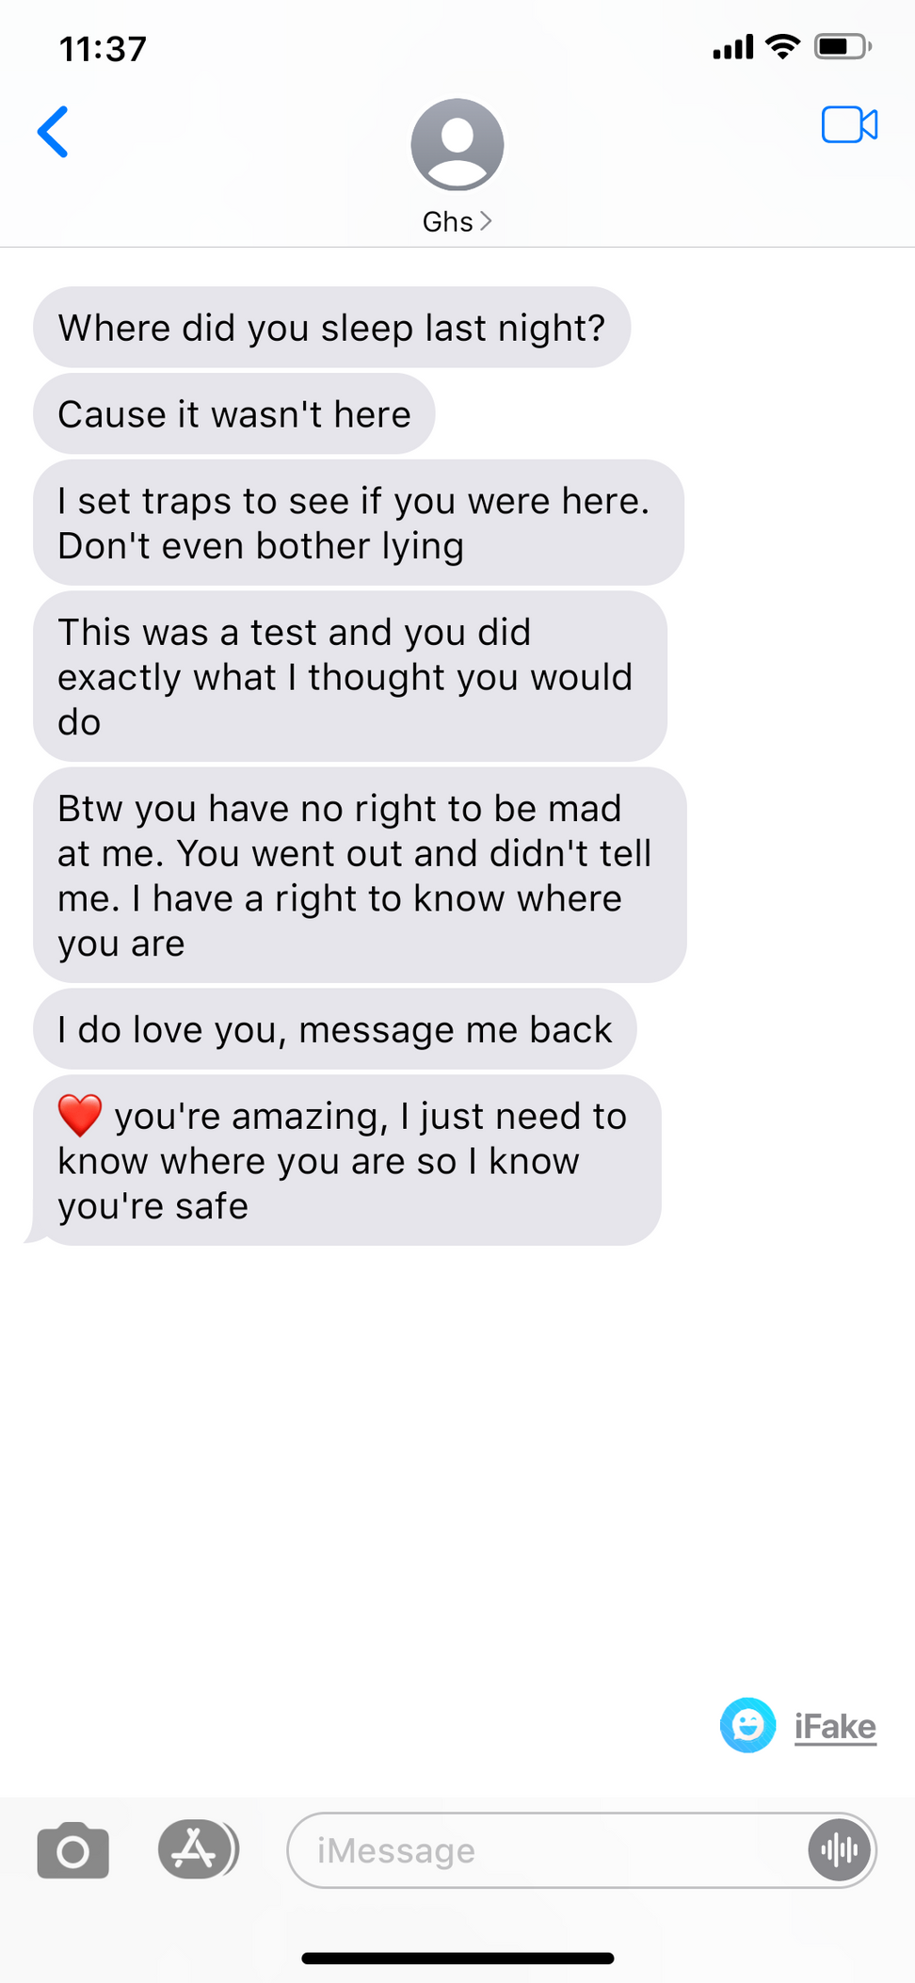

Slide 34
What kind of abuse could this be?
Do YOU think this is abuse?
Where would you place a ‘red flag’ in this conversation?
If a friend told you they’d received these messages, what advice would give them?

Slide 35

Remember
No one deserves to experience any form of abuse and every type of abuse is serious.
If someone saw any of these warning signs in a relationship, they could …

Slide 36
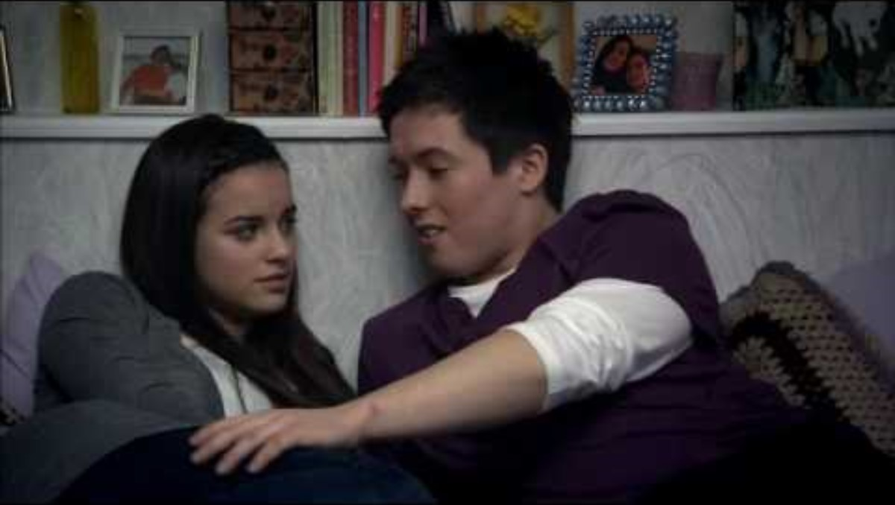
Notes:
There are now two films to watch, looking at the same circumstances from two slightly different perspectives. The video, although performed by actors shows an abusive relationship, please warn the students of this and make suitable arrangements for anybody who wishes to leave the room.
Both films need to be activated to play, but then are full screen
This first film is only 1’ 20” duration and is entitled Abuse in Relationships: would you stop yourself?
We recommend watching this first video and then having a class discussion about what students think about how the boy conduct himself (disgracefully and almost certainly illegal). Would he behave any differently if he could see himself?
When you are ready, please move onto the second film which shows the same scene but his entitled Abuse in Relationships: can you see it? This questions whether the young woman recognises the level of abuse in her relationship.

Slide 37
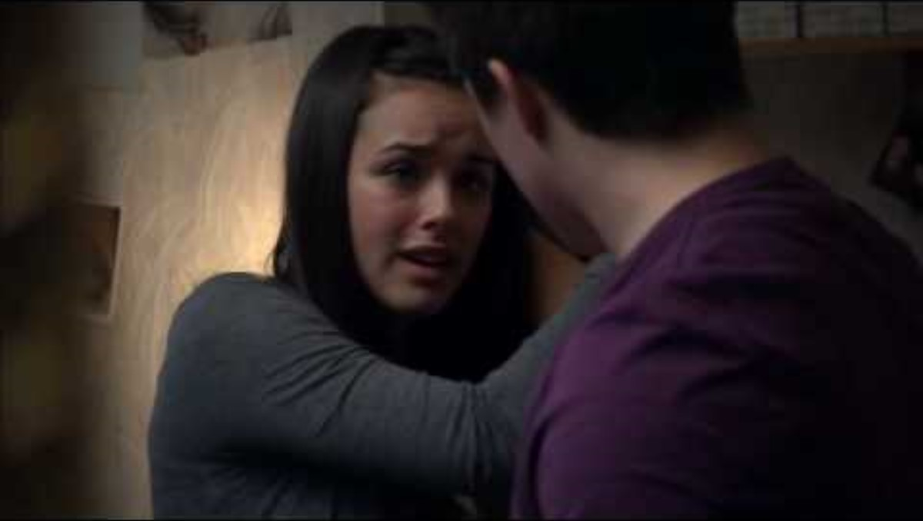
Notes:
Having discussed the first video, this second video plays the same scene but questions whether the young woman recognises the level of abuse in her relationship.
It is important not to ‘victim blame’ but it may be appropriate to discuss questions such as:
Do you think this is the first time the young man has behaved like this?
What would your advice to the young woman be?
What might be some of the reasons she doesn’t want to leave this abusive relationship?
If you were a friend of hers, how would you explain to her that this relationship is toxic and his behaviour unacceptable?

Slide 38

Reflection
ASK what are you taking from today’s lesson?
If anyone was concerned about anything from today’s lesson, where could they get help?

Slide 39
Get support
To talk with someone confidentially about how you feel, you can:
Contact Isle Listen: 01624 679118 www.islelisten.im
Text SHOUT to 85258 to contact the Shout textline
Call HOPELINE247 on 0800 068 4141 or the NHS on 111 and (select option 2)
Contact Childline by using 1-2-1 chat or calling 0800 1111
Isle of Man Constabulary: 01624 631212 (or 999 in an emergency), Crimestoppers on 0800 555 111.
Confidential support is also available from:
Victim Support Isle of Man: 01624 679950

