Slide 1
Teacher slide
Activity | Description | Timing
Introduction | Students complete do it now task. Introduce lesson & learning objectives | 5 mins
Definition & impact | Share definition of pornography. Split class into groups and ask them to discuss the questions posed about the impact of viewing pornography, before returning for whole class discussion. | 10-15 mins
Talking heads | You will be viewing 3 videos, each about 2 minutes in length. After each video, stop and invite the class to discuss the questions on the following slide, before moving on to the next video. | 10-15 mins
Porn vs real life | Split class into small groups, or this can be done individually. Using handout, ask them to decide if the statement is describing pornography, or a real life sexual relationship. Encourage class discussion. | 10 mins
The law | Revisit the sexual offences legislation (SOOP) and how this relates to pornography. It is crucial that young people understand it is a crime to possess indecent images of anyone under 18, even if they are also under 18. | 5 mins
Reflection | Ask students to reflect on the lesson using ASK acronym. Ensure they know where to get support if needed. | 5 mins

Slide 2
Do it now
What do you think about the following statements?
“I think most young people I know have seen sexual content online.”
“Seeing sexual content can give unrealistic ideas about relationships.”
“If I saw something online that made me uncomfortable, I would know what to do.”

Slide 3

EXPLICIT MATERIAL:
FACT OR FICTION?
YEAR 10

Slide 4

CLASS AGREEMENTS
Kindness and respect
Right to pass
Nonjudgmental
No such thing as silly
questions
any others?
Notes:
Explain that you would like the class to create a list of 'agreements' for how everyone will behave and treat one another in the class. Ensure a common understanding. For example:
1. We will treat one another with kindness and respect (listening to each other, speaking one at a time, etc)
2. We all have the right to 'pass' on answering a question or participating in an activity that makes us feel uncomfortable.
3. We can disagree but will not pass judgments, make fun of, or or put anybody down. 'Challenge the opinion, not the person.'
4. Asking questions is encouraged and will be valued by our teacher. We do not ask questions to purposefully embarrass or belittle another.
*Feel free to change the agreements to suit your class, and ask whether there are any others they'd add to the list in order to create a safe, comfortable learning environment.

Slide 5
Today we’re going to be discussing explicit material, also known as ‘pornography.’
We’re going to learn about what the law says, and how viewing these images might impact our ideas about relationships.
Notes:
Introduce the lesson by explaining that today you will be discussing explicit materials, sometimes referred to as pornography. Remind the class of the group agreements and the importance of ensuring this is a comfortable, safe session for everyone.

Slide 6

Have a think
How would you define the term pornography?
Notes:
Ask the students to spend a few moments thinking about the terms explicit material/pornography. How do they define it? Students can write a few ideas down on a sheet of paper, or discuss with the person next to them.

Slide 7

pornography is...
printed or visual material containing the explicit description or display of sexual organs or activity, intended to stimulate sexual excitement.
Oxford dictionary

Slide 8


let’s discuss
What do you think the impact of viewing pornography might be when it comes to...
...our body image or self esteem?
...how we view other people?
...our expectations of a relationship/sex?
...our behaviour?
...our health?
Notes:
Tell the class that you are now going to be discussing the impact that frequently viewing pornography can have. The idea is to get them thinking about the effect that pornography may have on a person’s self image, their expectations of relationships, their views on gender and sexual activity, and their health.
Split the class into small groups and ask them to discuss the prompts on the next slide. You may wish to have groups discuss each question, or assign one question to each group (one group focusing on the effects on health, another focusing on the effects on relationships etc).
After sufficient time (10-15 minutes), bring the groups back for feedback to the whole class. Share copies of handout A, and read through the known effects of pornography together.

Slide 9

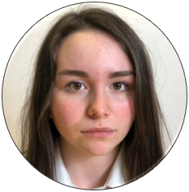

talking heads
“What’s the big deal?”
“Is this what’s expected of me?”
“Let’s get real.”
Notes:
Explain that you will now be sharing three brief videos of young people talking about pornography (these are from Childnet and are about 2 minutes in length each). Show each video and ask the class the questions on the accompanying slide.

Slide 10

Notes:
https://www.youtube.com/watch?v=cvzfqJOHrP8

Slide 11
Ryan says he started looking at pornography when he was 11.
At what age do you think young people might first see a pornographic image or video?
Is it usually accidentally or intentionally?
According to Ryan, he’s learnt everything he needs to know about sex from watching pornography.
Do you agree with Ryan that we can learn about sex from pornography?

Slide 12

Notes:
https://www.youtube.com/watch?v=Ey-ubI6sgfI

Slide 13
Beth says that she looks nothing like the women in porn.
Do you think that people in pornographic images represent a truthful image of real bodies?
Beth says that the other girls remain silent when porn is shown.
Why would someone choose to remain silent and not speak up?

Slide 14
Notes:
https://www.youtube.com/watch?v=aU1nfbexpnA

Slide 15
Sadie says that, ‘Everyone goes along with it and watches pornography.’
Do you think this is true and if so, why?
Sadie’s not afraid to speak her mind but gets called ‘frigid’ as a result.
Do you think it’s fair that she gets called this?

Slide 16
activity
Pornography vs Real Life
In your groups, read the statements on handout B. In your groups, try to decide whether the statement is describing things depicted in pornography, or things that are true for real life relationships.
Notes:
For the final activity, tell the class that you will be thinking about the difference between pornography and real life. You may wish to split the class into groups, or this can be done as an individual task. Provide students with handout B. Tell them that they are going to read a list of statements, and have to decide if the statement is describing pornography, or real life. They should put a tick in whichever box they think is correct, and there is room on the handout for any comments they may have. Handout B - teacher guidance is also included. After a few minutes, go through these statements with the class.
Note, there are 20 statements on handout B. Depending on timing and teacher preference, you may wish to omit some of these statements. The document has been left editable for you to amend as you wish.

Slide 17
the law
On the Isle of Man, we have legislation known as the ‘Sexual Offences and Obscene Publications Act’ (SOOPA) which outlines behaviour that is deemed to be harmful and illegal.
Notes:
Finally, review the slides explaining the new sexual offences legislation on the Isle of Man (SOOPA). Key messages are that any indecent images of a person under 18 is illegal, even if the person took the photo themselves; that pornography is legal to view except for that which depicts threats to life/serious harm, children, and non consensual acts; that it is illegal to take, distribute, or even threaten to take an intimate photo of someone without their knowledge or consent. The ‘quick guide’ to SOOPA legislation is included in the pack for this lesson.

Slide 18
PORNOGRAPHY & THE LAW
On the Isle of Man, it is illegal to:
Possess, create, or distribute (share) any indecent images of a person under 18
This includes any explicit photos or videos you take of yourself if you are under 18
Even if both people involved in sending/receiving the images are under 18, it is still an offence

Slide 19
PORNOGRAPHY & THE LAW
On the Isle of Man, it is illegal to:
Create, distribute, or threaten to distribute an intimate image of someone without their consent.
You cannot take or share any intimate images of a person under 18
Even if a person is over 18, you cannot take an intimate image without their consent or without them knowing (for instance, upskirting) or share an intimate image without their consent (sometimes known as ‘revenge porn’)
Threatening to do any of the above, even if you don’t intend to actually do it, is still a crime.

Slide 20
PORNOGRAPHY & THE LAW
On the Isle of Man, it is illegal to:
Be in possession of any pornographic material that shows:
any acts which threaten a person’s life
any acts which could or do cause serious harm or injury
any non-consensual activity
any person under the age of 18

Slide 21
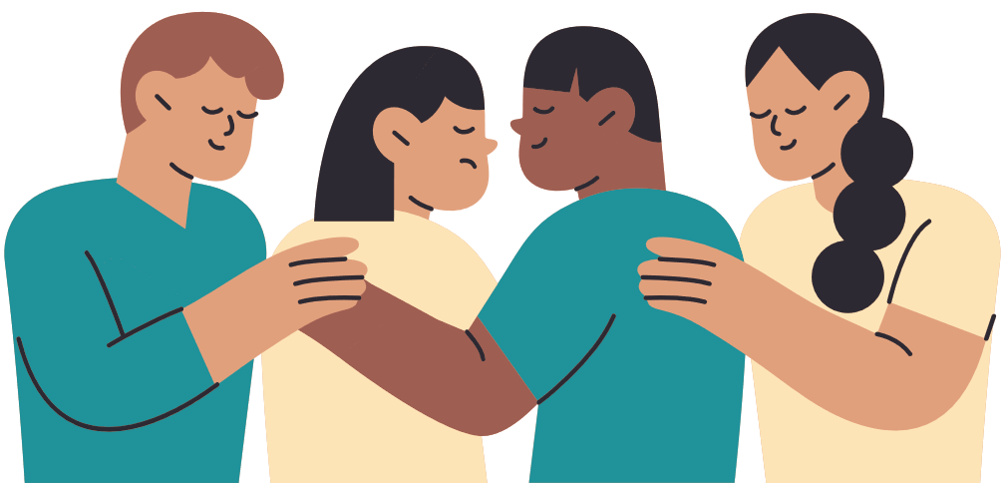
GET SUPPORT
ChildLine​
www.childline.org.uk​
If you're under 19 you can confidentially call, email or chat online about any problem big or small​
Freephone 24h helpline: 0800 1111​
Chat 1:1 with an online advisor ​

Slide 22

REFLECTION
Let’s ASK ourselves - what are we taking from today’s lesson?
Attributes?
Skills?
Knowledge?
Notes:
If time permits, this slide can be further developed into a collective, group reflection.
Please ask students to discuss what Attributes (e.g. honesty, integrity, courage, humility, generosity, self-worth, kindness, trustworthiness etc) they have used during this lesson.
What Skills (e.g. oracy, empathy, compassion, presentation, assertiveness, active listening, interpersonal skills, positive peer pressure, capacity to resist unwelcome pressure, distinguish between fact & opinion , etc.
What Knowledge have they used, or developed during this lesson?

