Slide 1
TEACHER SLIDE
This lesson is about different types of contraception. The idea is for students to learn about a particular contraceptive method and then present facts about this method to the class, rather than a teacher needing to provide all of this information.
Ensure the class understands that just because they are learning about contraception, this does not mean they should be having sex. Reinforce that the legal age of consent is 16 and that most people this age are not sexually active. However, it is important for them to have this information, should they choose to be sexually active in the future.

Slide 2
TEACHER SLIDE
Activity | Description | Timing
Introduction | Ask students to complete the ‘do it now’ task. Introduce learning objectives and revisit class agreements. | 5 minutes
Terminology and discussion | Share the definition of contraception and the various kinds listed. On slide 9, ask students to match the type of contraception to its definition. After a few minutes, share answers on slide 10. | 10 minutes
Presentations | Split the class into groups and provide each with information on a particular type of contraception. They should familiarise themselves with this method and then present information back to the class. | 20 minutes
EC & discussion | Share slides on emergency contraception and accessing sexual health services on the island. Remind students about consent, and that having access to contraception does NOT mean they should be having sex. | 5 minutes
True/False | Read each statement and ask the class to raise their hands or move around the room depending on whether they think the statement is true or false. | 5 minutes
Ending/Reflections | Use prompts to assess how much students have learned and what they will take away from the lesson. | 5 minutes

Slide 3

DO IT NOW
What is contraception? Why is it used? How many different types can you name?
Notes:
. Introduce the ‘do it now’ task and ask students to answer the questions individually.

Slide 4

CONTRACEPTION
YEAR 9
This presentation has been adapted for the Isle of Man from Scotland’s national resource for relationships, sexual health, and parenthood (RSHP) education.

Slide 5

CLASS AGREEMENTS
Kindness and respect
Right to pass
Nonjudgmental
No such thing as silly
questions
any others?
Notes:
Explain that you would like the class to create a list of 'agreements' for how everyone will behave and treat one another in the class. Ensure a common understanding. For example:
1. We will treat one another with kindness and respect (listening to each other, speaking one at a time, etc)
2. We all have the right to 'pass' on answering a question or participating in an activity that makes us feel uncomfortable.
3. We can disagree but will not pass judgments, make fun of, or or put anybody down. 'Challenge the opinion, not the person.'
4. Asking questions is encouraged and will be valued by our teacher. We do not ask questions to purposefully embarrass or belittle another.
*Feel free to change the agreements to suit your class, and ask whether there are any others they'd add to the list in order to create a safe, comfortable learning environment.

Slide 6
learning objectives
Identify the different types of contraception available
Explain how different contraceptive methods are used, and the pros/cons of each
Understand where to go for further support and advice on island

Slide 7
what is contraception?
Sometimes known as ‘birth control’
The methods people use to prevent pregnancy when having sex
Notes:
Ask the class if they are familiar with the term contraception and what they think it means. Explain that contraception refers to the methods used to prevent a pregnancy. Explain that contraception comes in many forms, which you will be talking about today.

Slide 8
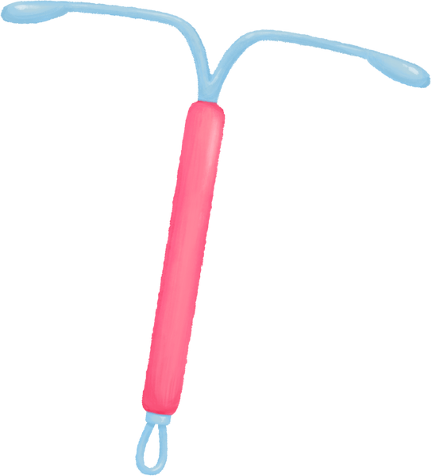
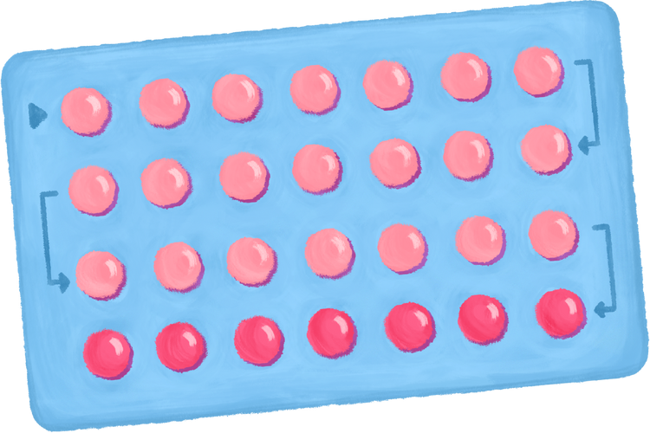

TYPES OF CONTRACEPTION
Condoms
Contraceptive pill
Patch
Implant
Injections
Withdrawal
Coil
Diaphragm
Notes:
Share slide with the list of different contraceptive methods - how many of these have they heard of? How many did they write down in the ‘do it now’ task?

Slide 9
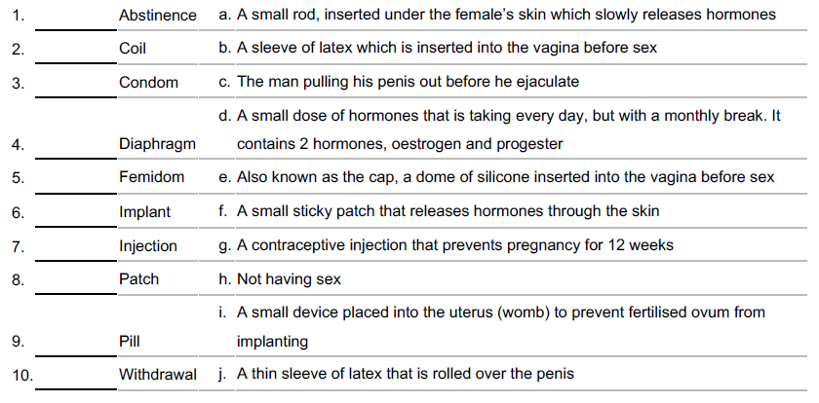
matching activity
Notes:
Matching activity: Either provide each student with a copy of the matching activity handout, or put slide 8 up on the board. Give the class a few minutes to work in pairs and try to match the contraceptive method to the correct definition. The answers are on the following slide.

Slide 10
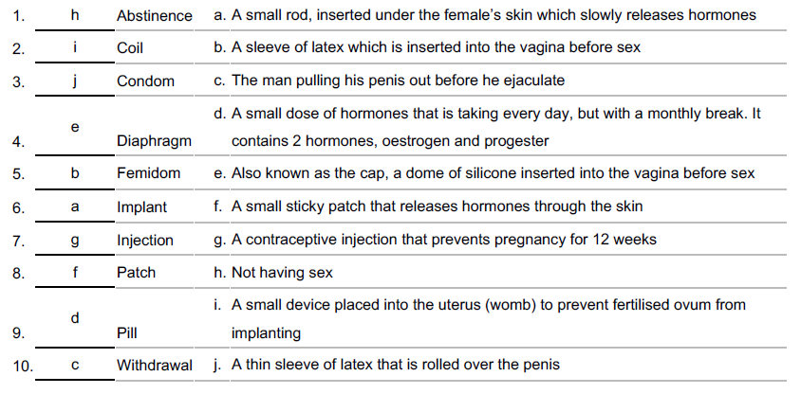
matching activity - answers

Slide 11
activity: presentations
Not all contraceptive methods are created equal - they all prevent pregnancy in slightly different ways, some are more effective than others, and all come with pros and cons. Some have the added bonus of protecting against STIs, but most don’t.
In groups, read about the contraceptive method you have been given to study. You will be asked to give brief presentations to the rest of the class about how your method works, how effective it is, pros and cons of use, etc.
Notes:
Presentations: Explain that each contraceptive method is different - they work to prevent pregnancy in different ways, and some are more effective than others. Tell the class that they will be splitting into groups, and each group will receive an information sheet on one type of contraception. Each group should read the information sheet and prepare to present their contraceptive method to the rest of the class, explaining how it works, the pros/cons, how effective it is, etc.

Slide 12
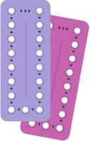

let’s chat
Why might people in opposite sex couples need to think about when choosing a method?
Why might people in same sex couples need to think about when choosing a method?

Slide 13
EMERGENCY CONTRACEPTION
People sometimes need to use emergency contraception if they’ve had unprotected sex, or if their contraception method has failed (for example if the condom breaks).
There are two types of emergency contraception: a pill, and ‘the coil.’
Notes:
Discuss emergency contraception. Ensure that the class is aware this is not the same thing as having an abortion, and that EC only prevents pregnancy if taken within a certain window after sex.

Slide 14
EMERGENCY CONTRACEPTION (EC)
The EC pill typically needs to be taken within 3 days (72 hours) of having sex, but some may work up to five days. The EC pill works by preventing a pregnancy from occurring by preventing or delaying ovulation.
The coil is another method - it is a small copper and plastic device which is put into the uterus. This must be fitted by a doctor or nurse.

Slide 15
EMERGENCY CONTRACEPTION (EC)
The sooner emergency contraception is taken, the better a chance it has of working.
Emergency contraception only works to prevent pregnancy.
It DOES NOT terminate an existing pregnancy.
Notes:
Ensure that students understand emergency contraception is NOT the same as a termination. They may have heard it being referred to as "the abortion pill" - this is incorrect and dangerous misinformation, and must be clarified.

Slide 16

SEXUAL HEALTH SERVICES ON ISLAND
On the Isle of Man, the MISH (Manx Integrated Sexual Health Centre) provide sexual health services, including:
Emergency contraception
Pregnancy testing
STI tests
Condoms
Cervical screening/smear tests
One to one sexual health education
Notes:
Remind students of services available on island, like the MISH (formerly GUM) clinic.

Slide 17
SEXUAL HEALTH SERVICES ON ISLAND
Manx Integrated Sexual Health Centre
You can self-refer, so you don’t need a GP to do it for you.
To make an appointment, call
+44 1624 650710
or +44 1624 650577

Slide 18
SEXUAL HEALTH SERVICES ON ISLAND
You can get emergency contraception for free.
​
You can get the emergency contraceptive pill from the MISH, your GP, the Family Planning Clinic or a local pharmacy.​
You can get the IUD/coil fitted at your GPs or the Family Planning Clinic.​
Notes:
Explain that contraception can be provided by GPs, MISH, and family planning clinic.

Slide 19
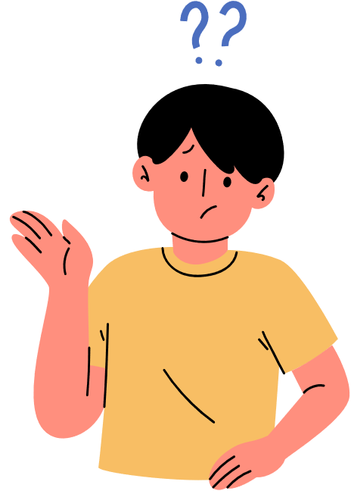
LET’S CHAT
Who is responsible for contraception?
Notes:
Ask the class who they think is responsible for contraception - make the point that it is everyone’s responsibility if they are sexually active. Show slide 20 and ensure understanding that having contraception is not the same thing as consenting to sex.

Slide 20

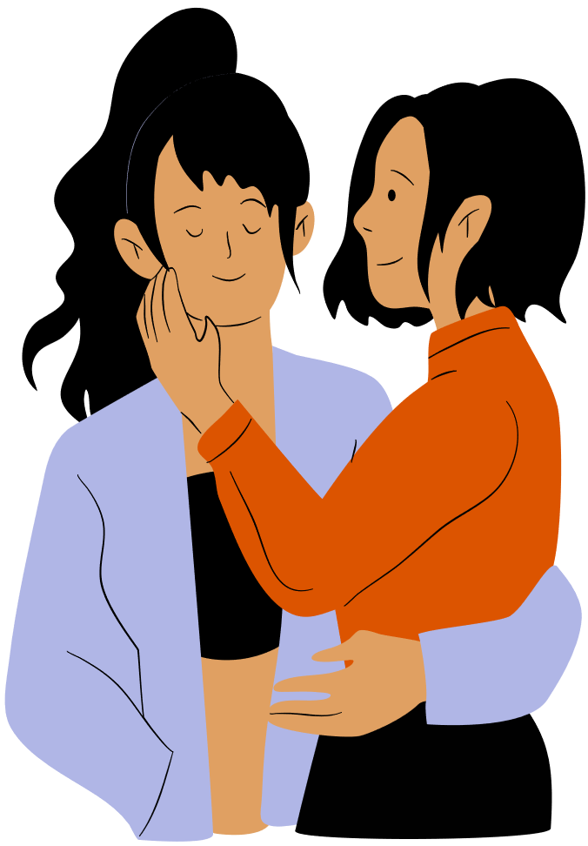
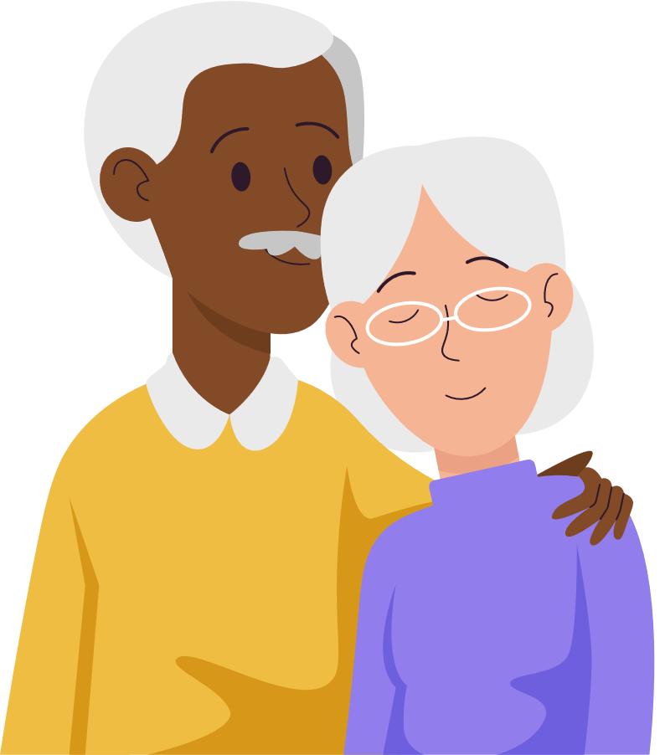
Everyone who is sexually active
is responsible for contraception.
Notes:
Reinforce the message that everyone who is sexually active is responsible for contraception.

Slide 21
REMEMBER CONSENT!
Just because someone has condoms, or is taking the contraceptive pill, it does not mean they want to have sex. It means they’re being smart, planning ahead, and taking control of their health. Remember, many girls and women take the contraceptive pill for other health reasons, including to maintain regular periods, and to clear their skin!
You should always ask for explicit consent before any sexual activity, and never make assumptions.
Notes:
Ensure students understand that simply obtaining contraception does not equal consent.
A person may have condoms, or be taking the pill - but this does not mean they are looking to have sex.
Explicit consent should always be sought for EVERY SEXUAL ACTIVITY.

Slide 22

True/False quiz
Notes:
True/False quiz: share each slide and ask the class to decide whether the statement is true or false before showing the answer on the following slide.

Slide 23
Condoms give 100% protection against
all sexually transmitted infections.
True or false?

Slide 24

Condoms give 100% protection against
all sexually transmitted infections.
True or false?
Although condoms reduce the risk of STI, no method is 100% effective,
even if the condom is used correctly.

Slide 25
There is a safe period for having sex to avoid pregnancy.
True or false?

Slide 26
There is a safe period for having sex to avoid pregnancy.
True or false?
Possibly!
Some adults try to avoid pregnancy when the woman is not ovulating, but this relies on a detailed knowledge of her menstrual cycle and only having sex at certain times of the month. It is far from a reliable method and not recommended. It also offers no protection against STIs.

Slide 27
By age 16, most teenagers still have not had sex.
True or false?

Slide 28

By age 16, most teenagers still have not had sex.
True or false?
Surveys over many years across the UK regularly confirm that most young people have not had sex before they are 16.
16 is the legal age of consent on the Isle of Man, although young people can access free, confidential services if they need to.

Slide 29
Taking the birth control pill will make it harder for me to have children in the future, if I choose to.
True or false?

Slide 30
Taking the birth control pill will make it harder for me to have children in the future, if I choose to.
True or false?
The contraceptive pill will not affect your ability to conceive when you stop taking it. Some women may find that their menstrual cycle can take a little bit of time to get back to normal once they come off the pill, but it will not affect their fertility in the long term.

Slide 31

REFLECTION
Let’s ASK ourselves - what are we taking from today’s lesson?
Attributes?
Skills?
Knowledge?
Notes:
If time permits, this slide can be further developed into a collective, group reflection.
Please ask students to discuss what Attributes (e.g. honesty, integrity, courage, humility, generosity, self-worth, kindness, trustworthiness etc) they have used during this lesson.
What Skills (e.g. oracy, empathy, compassion, presentation, assertiveness, active listening, interpersonal skills, positive peer pressure, capacity to resist unwelcome pressure, distinguish between fact & opinion , etc.
What Knowledge have they used, or developed during this lesson?

