Slide 1
TEACHER SLIDE
Before the session: In the days or week before facilitating this session, let young people know they will be talking about social media – particularly how to stay safe when using it.
Ask them to think about some of the dangers young people might experience through social media and whether the Isle of Man/UK should follow other countries in banning social media for young people at the age of 16.
This lesson includes a group activity using resources that should be printed ahead of time.

Slide 2
Activity | Description | Timing
Introduction | Ask students to complete do it now task. Introduce lesson and revisit ground rules. | 5 mins
Class discussion | Whole class discussion: why do young people use social media? What are some of the things they might see or do online? How could these things affect them, whether good or bad? | 5 mins
Social media apps | Ask the class to name as many social media apps/websites as they can in 2 minutes. Write these on the board. Again, engage in class discussion using prompts on the slides. | 10 mins
Small group work | Split the class into small groups and provide each group with a Safer Schools info sheet on a particular app. Give groups 10 minutes to answer questions, and then have each group provide a short presentation to the class on their app, its risks, and how to stay safe. | 15 mins
Discussion and video | Ask students to revisit their answers from the ‘do it now’ task. This can be done in groups or pairs. What do they think of social media bans? Should the IoM follow? Ask groups/pairs to feed back to the class. Watch video on ‘The Pressure to Stay Connected’ - does anyone ever feel this way? | 10 mins
Wrapping Up | Share information on Safer Schools. Ask students to reflect on the lesson using ASK acronym. | 5 mins

Slide 3

DO IT NOW
Recently, Australia announced new laws that will ban social media use for anybody under the age of 16. The Prime Minister of Australia has said that this is necessary in order to protect young people from the harm that social media can cause.
Take a few minutes to think about and answer the below questions.
What are some of the ‘harms’ on social media you think young people may face?
What do you think of the ban? What are the potential pros/cons?
Do you think the Isle of Man/UK should implement similar laws? Why/why not?
What other ways can young people be kept safe from social media harm?

Slide 4

SOCIAL MEDIA SAFETY
YEAR 9
This presentation has been adapted for the Isle of Man from Scotland’s national resource for relationships, sexual health, and parenthood (RSHP) education.
Notes:
Explain that this session will involve thinking about some of the more common social media apps/sites that young people use, and how to stay safe while using them.

Slide 5
LEARNING OBJECTIVES
Describe social media and why people use it.
Work as a team to present information about social media and how it can be used safely.
Understand why some countries are banning social media for under 16s and discuss opinions on this ban.

Slide 6

CLASS AGREEMENTS
Kindness and respect
Right to pass
Nonjudgmental
No such thing as silly
questions
any others?
Notes:
Explain that you would like the class to create a list of 'agreements' for how everyone will behave and treat one another in the class. Ensure a common understanding. For example:
1. We will treat one another with kindness and respect (listening to each other, speaking one at a time, etc)
2. We all have the right to 'pass' on answering a question or participating in an activity that makes us feel uncomfortable.
3. We can disagree but will not pass judgments, make fun of, or or put anybody down. 'Challenge the opinion, not the person.'
4. Asking questions is encouraged and will be valued by our teacher. We do not ask questions to purposefully embarrass or belittle another.
*Feel free to change the agreements to suit your class, and ask whether there are any others they'd add to the list in order to create a safe, comfortable learning environment.

Slide 7

LET’S CHAT
1) Why do (young) people use social media?
2) What could they see or do?
3) How could it affect them?
Notes:
Whole class discussion, some potential answers on the following slides.

Slide 8
WHY DO YOUNG PEOPLE USE SOCIAL MEDIA?
Some ideas:
confidence
belonging/connection
self expression
entertainment
education

Slide 9
WHAT COULD THEY SEE/DO?
Some ideas:
Stay in contact with friends and family
Access job searches and useful information
Have fun
See or share violent, sexual & pornographic content
Inaccurate or false information and extreme views
Promotion of harmful behaviours, including self-harm & eating disorders
Oversharing of personal information
Actively or unintentionally getting involved in bullying or hurtful behaviour

Slide 10
HOW COULD IT AFFECT THEM?
Stay in contact/connect with people, and have fun.
Fear of missing out leads to excessive use or exaggeration.
They get upset by things they have seen and are uncertain about what to do.
Engaging or being pressured into engaging in more risky behaviour, either by accident or design.
Developing unrealistic ideas of body image and gender.
Becoming subject to peer pressure or interactions that are intense or too difficult to handle.
Creating an online reputation that may cause problems in the future.

Slide 11

SOCIAL MEDIA - FACTS & FIGURES
In January 2024, 82.8% of UK population (56.2m people) were active social media users.
WhatsApp was used by 79% of Internet users in the UK.
The UK's most popular social media platforms are WhatsApp, Facebook, and Instagram.
UK users spend more time on TikTok than users in any other country.
Younger people are more active on social media. E.g. 99% of 16-24-year-olds use social media, compared to only 38% of those over 75.
(Statistica, 2024)
Notes:
Share the ‘facts & figures’ with the class. Get feedback - is there anything they were surprised by, or knew already?
What are their thoughts on these figures? What do they think about UK users spending more time on TikTok than any other country?
Do they feel this is an accurate representation of how they spend their time online?

Slide 12
HOW MANY SOCIAL MEDIA APPS & SITES CAN YOU NAME IN 2 MINUTES?
Notes:
Ask the class to name as many social media platforms as they can in 2 minutes. Write these on the board.

Slide 13









HOW MANY SOCIAL MEDIA APPS & SITES CAN YOU NAME IN 2 MINUTES?
Notes:
Once the class has finished naming apps/sites, ask for their thoughts and experiences.
Which are the most popular platforms?
Which do they like to use or not like to use?
Do they ever come across things that make them feel worried or uncomfortable?
How do they keep themselves safe?
Would they be OK with a younger sibling/cousin using these platforms? Why or why not?

Slide 14
SMALL GROUP ACTIVITY
In a moment you will be split into groups and given a Safer Schools information sheet about a popular social media app/site.
In your groups, read through the information provided and answer the below questions. You will be asked to share this information in a brief (2 minutes or less) presentation back to the rest of the class.
What is this app/site and why do young people use it?
What are some of the risks associated with this app/site?
How would you advise someone to stay safe while using this app/site?
Notes:
Prior to the lesson you should print out the information sheets about various social media platforms, developed by Safer Schools.
Split the class into groups and provide each group with an information sheet (each group should have a different app).
Instruct the groups to read their information sheets and answer the questions on the activity slide about the app.
Give 10 minutes for this, after which time each group will be asked to give a very brief (2 min or less) presentation to the class about their app.

Slide 15

LET’S CHAT
In your ‘do it now’ task, you were asked to think about the social media ban for under 16s that Australia will be implementing. The Prime Minister of Australia says the ban is necessary to protect young people from the ‘harms’ of social media, and many people agree. However, some critics question how the ban will work in practice, and the impact it may have on privacy and social connection.
What do you think?
Notes:
Revisit the ‘do it now’ task about the Australian social media ban. Ask the class to share their thoughts. What do they think of the ban? Should the Isle of Man follow suit? What kinds of harms do young people need to be protected from? Do they think the ban will be effective? Why or why not? How else can young people stay safe?

Slide 16

Notes:
https://www.youtube.com/watch?v=Pc-qk0t8ms4&list=PL8TjVyuBdsCmgnK3Cup8KUtJqSMyhfz_O&index=4
Play video ‘The pressure to stay connected’ and encourage discussion afterward - does the class ever feel this pressure? How can they improve their relationship with devices/social media? Share slide with ‘6 ways to improve your relationship with social media.’

Slide 17
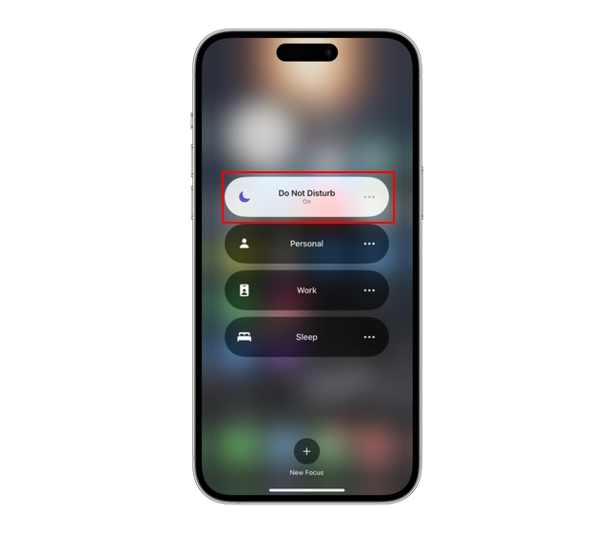
DO YOU EVER FEEL PRESSURE TO STAY CONNECTED?
HOW CAN WE HAVE A HEALTHIER RELATIONSHIP WITH OUR DEVICES/SOCIAL MEDIA?

Slide 18
6 WAYS TO IMPROVE YOUR RELATIONSHIP WITH SOCIAL MEDIA
Try to be aware of how social media is making you feel.
If certain friends, influencers etc. are upsetting you with their content, it’s ok to unfollow them.
Limit social media use 30 minutes before bedtime.
Many platforms now give insights into how long you spend on the platform each day - try to monitor your usage.
Set time limits for your usage each day.
At least once a week, try to refrain from using social media.

Slide 19
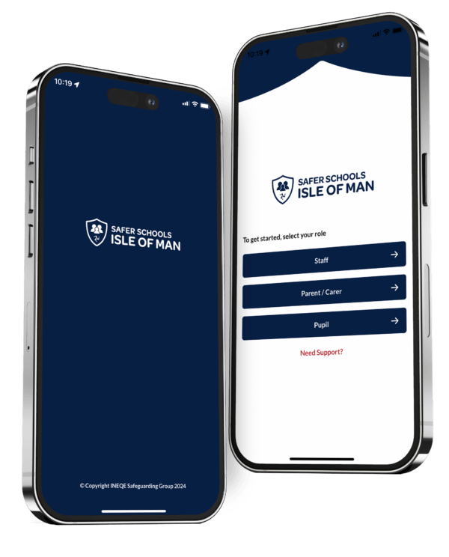
SAFER SCHOOLS ISLE OF MAN
Practical advice on the latest trends, apps, games, and social media platforms
How to seek further support
How to keep safe on and offline
How to keep your information private online
Notes:
Share information on the new Safer Schools app for the Isle of Man, which young people can access without creating accounts. The app includes information for staying safe online. Also share websites on slide 19 for further information and advice.

Slide 20

Information and advice:
https://www.childnet.com/young-people/secondary
ChildLine
www.childline.org.uk
If you're under 19 you can confidentially call, email or chat online about any problem big or small
Chat 1:1 with an online advisor

Slide 21

REFLECTION
Let’s ASK ourselves - what are we taking from today’s lesson?
Attributes?
Skills?
Knowledge?
Notes:
If time permits, this slide can be further developed into a collective, group reflection.
Please ask students to discuss what Attributes (e.g. honesty, integrity, courage, humility, generosity, self-worth, kindness, trustworthiness etc) they have used during this lesson.
What Skills (e.g. oracy, empathy, compassion, presentation, assertiveness, active listening, interpersonal skills, positive peer pressure, capacity to resist unwelcome pressure, distinguish between fact & opinion , etc.
What Knowledge have they used, or developed during this lesson?

