Slide 1
TEACHER SLIDE
This lesson explores sexual harassment. This means that young people will discuss scenarios which might touch on experiences in your setting – a young person or educator might be someone who has experienced sexual harassment as well as someone who may have behaved in such a way toward others.
The lesson supports young people to identify how school can be a place that challenges or can be free of sexual harassment – there is an opportunity then to share the young people’s suggestions for ways to tackle sexual harassment with school leadership.
Ensure that the class knows procedures for reporting/getting support in your setting.

Slide 2
Activity | Description | Timing
Introduction | Ask students to complete do it now task. Introduce lesson and revisit ground rules. | 5 mins
Definition/ examples | Share definition of sexual harassment and different types. Split students into pairs or small groups and assign each a type of harassment (multiple pairs/groups may be working on the same type). After 5 minutes, bring back for whole class feedback. Share the equality act/SOOP as these relate to sexual harassment. | 15 mins
Scenarios | Scenarios: Either split the class into groups to read/discuss each scenario, or complete as a whole class discussion. | 10 mins
Videos | Show videos on Linford Christie (explicit language) and sexual harassment in schools. Encourage discussion using slide prompts. What can be done to address sexual harassment in schools? Depending on time, this can be a class discussion, or students can create posters, or write letters to school leadership with ideas. | 15 mins
Reflections | Ask students to reflect on the lesson using ASK acronym. | 5 mins

Slide 3

DO IT NOW
Today we’re going to be talking about sexual harassment. Before we get started, take a few minutes to think and respond to the following questions:
What does ‘sexual harassment’ mean to you?
How do you think sexual harassment makes a person feel?

Slide 4

SEXUAL HARASSMENT
YEAR 9
This presentation has been adapted for the Isle of Man from Scotland’s national resource for relationships, sexual health, and parenthood (RSHP) education.
Notes:
Introduce the lesson along the following lines: The lesson continues consideration of gender and is about sexual harassment. There might be some things that are talked about today that young people have experienced personally.
So, two things to remember. Firstly, no-one is expected to talk about personal stuff in this class, what’s private is private, but if there are examples a young person has that they are okay with sharing that is fine, they can decide.
Secondly, if talking about sexual harassment helps a young person understand that this is happening to them, then there will be time at the end of the session about where and how a person can get personal support.

Slide 5
LEARNING OBJECTIVES
  Explain what sexual harassment is, and the impact it has on others
  Understand why people sometimes struggle to report sexual harassment
  Discuss ways we can tackle sexual harassment in our school

Slide 6

CLASS AGREEMENTS
  Kindness and respect
  Right to pass
  Nonjudgmental
  No such thing as silly
questions
any others?
Notes:
Explain that you would like the class to create a list of 'agreements' for how everyone will behave and treat one another in the class. Ensure a common understanding. For example:
1. We will treat one another with kindness and respect (listening to each other, speaking one at a time, etc)
2. We all have the right to 'pass' on answering a question or participating in an activity that makes us feel uncomfortable.
3. We can disagree but will not pass judgments, make fun of, or or put anybody down. 'Challenge the opinion, not the person.'
4. Asking questions is encouraged and will be valued by our teacher. We do not ask questions to purposefully embarrass or belittle another.
*Feel free to change the agreements to suit your class, and ask whether there are any others they'd add to the list in order to create a safe, comfortable learning environment.

Slide 7
WHAT IS SEXUAL HARASSMENT?
Sexual harassment is any unwanted sexual behaviour that makes someone feel upset, scared, offended, or humiliated, or is meant to make them feel that way.
Definition provided by Rape Crisis England and Wales

Slide 8
WHAT IS SEXUAL HARASSMENT?
Sexual harassment can be:
  verbal (someone saying things)
  non-verbal (how someone acts or looks at you)
  physical (someone touching you in some way)
It can range from rude remarks about your appearance to violence and assault.
Notes:
Ensure that the class understands harassment can be physical, verbal, or non-verbal, and can take place face to face or online.

Slide 9

WHAT IS SEXUAL HARASSMENT?
Sexual harassment can be:
  Face to face
  Indirect
  Online

Slide 10
ACTIVITY
In your groups, try to come up with some examples of behaviour that is either:
  Verbal sexual harassment (someone saying things)
  Non-verbal sexual harassment (how someone acts, or looks at you)
  Physical sexual harassment (someone touching you in some way)
Notes:
Split the class into groups and ask each group to come up with examples for a certain type of harassment (e.g. physical). You may need to split the class into several small groups, and there will be multiple groups working on the same type of harassment.
Give the class 5 minutes or so, and then invite back for whole class discussion and run through examples on the following slides.

Slide 11
VERBAL SEXUAL HARASSMENT CAN INCLUDE:
  Catcalling / wolf-whistling
  Sexual ‘jokes’
  Sexual innuendos or suggestive comments
  Sexual requests, or asking sexual favours
  Commenting on somebody’s body, appearance, or what they’re wearing
  Unwanted sexual advances or flirting
  Intrusive questions about a person’s sex life
  Spreading sexual rumours
Examples provided by Rape Crisis England and Wales
Notes:
Share slides 12-14 with examples of verbal, nonverbal, and physical sexual harassment.

Slide 12
NONVERBAL SEXUAL HARASSMENT CAN INCLUDE:
  Sexual gestures, even as a ‘joke’
  Leering, staring, or suggestive looks
  Standing too closely to someone
  Displaying or sharing sexual images
Examples provided by Rape Crisis England and Wales

Slide 13
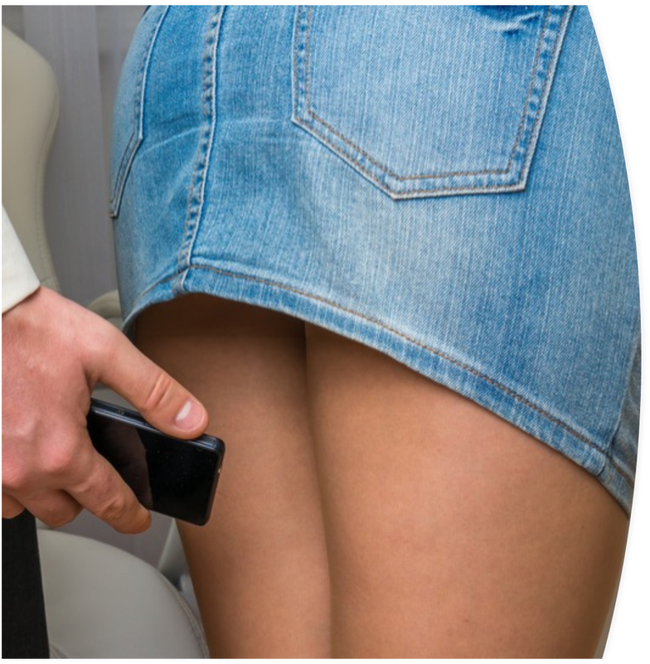
PHYSICAL SEXUAL HARASSMENT CAN INCLUDE:
  Brushing up against someone
  Hugging, kissing, or touching someone without their consent
  Stalking
  Taking a photo or video under another person’s clothing (‘upskirting’)
  Flashing
Examples provided by Rape Crisis England and Wales

Slide 14
EQUALITY ACT 2017
On the Isle of Man, sexual harassment is considered a type of discrimination under the Equality Act 2017.
This means that people are legally protected from sexual harassment in certain places – like at work, on transport, and at schools, colleges and universities.
If a person on the island feels they have been sexually harassed, they have the right to take action by contacting the relevant authorities.
Notes:
Explain that sexual harassment is prohibited under the island’s equality legislation, and that certain kinds of sexual harassment are crimes (according to the Sexual Offences and Obscene Publications Act 2021) - these include (but are not limited to) upskirting, flashing, and unwanted physical contact (assault).

Slide 15
SEXUAL OFFENCES
Additionally, some forms of sexual harassment are considered crimes on the island. This means a person can be arrested and charged with a criminal sexual offence if they:
  Physically touch another person in a sexual way without that person’s consent (this is considered sexual assault)
  Expose their genitals to another person without consent
  Take/record intimate images of another person without their consent - this includes upskirting
Notes:
Explain that sexual harassment is prohibited under the island’s equality legislation, and that certain kinds of sexual harassment are crimes (according to the Sexual Offences and Obscene Publications Act 2021) - these include (but are not limited to) upskirting, flashing, and unwanted physical contact (assault).

Slide 16
SCENARIOS
The science teacher has moved everybody around in the lab so that no-one can sit with their friends. He has mixed boys and girls up too. Mia has been told to sit next to Jack. They sit at the back of the class and the teacher can’t always see what’s going on. Every time Mia arrives at her seat Jack has his phone on and shows her pornographic pictures. During the class he brushes up against her. She has told her friend in the class, but they are both a bit frightened of Jack.
  Is this sexual harassment?
  What could be done?
  What might make this difficult to handle?
  What needs to be done and by whom?
Notes:
Scenarios: Either split the class into groups to read/discuss each scenario, or complete as a whole class discussion.
Scenarios are included on the PowerPoint slides to reduce printing, but a separate handout containing the scenarios is also available if you wish.

Slide 17
SCENARIOS
Joe is new in school. Whenever he walks past a big group of girls in his year they whistle at him and tell him he’s gorgeous, ask him if he has a girlfriend, and make jokes about how they’d go out with him. At frst Joe was pleased they had noticed him, but it’s getting embarrassing. He has started to avoid parts of the school where they might be.
  Is this sexual harassment?
  What could be done?
  What might make this difficult to handle?
  What needs to be done and by whom?

Slide 18
SCENARIOS
Ms. Jackson is a young teacher in the school. Some of the boys in the class talk loud enough so that she’ll hear them, saying that they fancy her, they make comments about her body. There’s a rumour going around that these boys have a bet about who can be frst to take a picture up Ms. Jackson’s skirt.
  Is this sexual harassment?
  What could be done?
  What might make this difficult to handle?
  What needs to be done and by whom?

Slide 19
SEXUAL HARASSMENT CAN HAPPEN TO PEOPLE OF ANY GENDER, AND CAN BE PERPETRATED BY PEOPLE OF ANY GENDER.
Notes:
Make the point that sexual harassment can happen to anyone, of any gender, and can also be perpetrated by any gender.

Slide 20
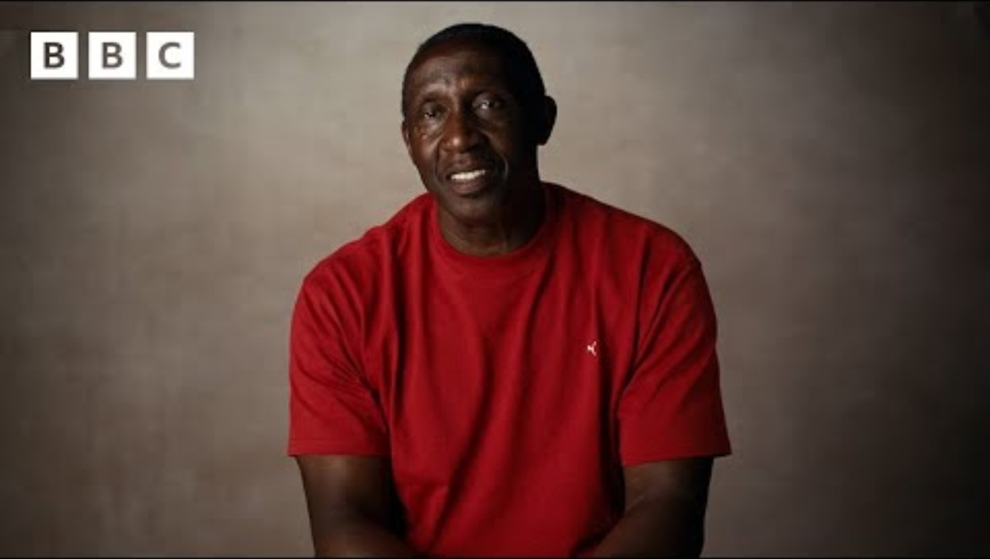
Notes:
https://www.youtube.com/watch?v=mlJAXaWM8W0
Play the BBC video about Olympic athlete Linsford Christie.
In this brief clip, he discusses being sexualised by the media and the impact this had on him.
Please note that this video does contain some explicit language, so prepare the class accordingly or omit if you don’t feel it is appropriate. After watching the video, ask the class for their reactions.

Slide 21
LET’S CHAT
Imagine: it’s the day after you’ve won a medal at the OIympics. But rather than focusing on your achievement, all anyone can talk about is your body - specifically, your genitals.
How do you think Linsford Christie felt?
What do you think of the comments from the Sun journalist who said he believed Linsford Christie was not affected?
Do you think sexual harassment is sometimes viewed as a joke?

Slide 22

Notes:
https://www.youtube.com/watch?v=5Mf-KjgRxIE
Play the next video about sexual harassment in schools. Ask the class for their thoughts, including whether sexual harassment is a problem in your school.

Slide 23
LET’S CHAT
Do you think sexual harassment is a problem in our schools?
What kind of things can happen in a school?

Slide 24
LET’S CHAT
If someone experiences sexual harassment at school, why do you think they might not report it?
Notes:
Ask the class to consider the reasons why a person might not report sexual harassment. What makes it difficult?
Research from GirlGuiding Scotland suggests some reasons that girls may not report harassment - does the class think it’s the same for boys? Why or why not?

Slide 25
ACCORDING TO RESEARCH BY GIRLGUIDING SCOTLAND, GIRLS MAY NOT REPORT HARASSMENT BECAUSE:
  Teachers often tell girls to ignore sexual harassment
  Teachers don’t understand what you might be going through
  You might not have a teacher you trust you can tell
  Teachers might dismiss sexual harassment as ‘banter’ or ‘boys mucking around’
  If you report it, you might worry it won’t be kept confidential
  There might not be private spaces to report things like this
  If you report sexual harassment, you might worry about being bullied or teased

Slide 26
If these are the reasons girls don’t report sexual harassment, do you think it’s the same for boys?
What might their reasons be for not reporting it?

Slide 27
WHAT COULD BE DONE IN OUR SCHOOL TO TACKLE SEXUAL HARASSMENT?
Notes:
Ask the class to think about the ways that sexual harassment can be tackled in your school.
This may be in the form of a discussion, creating posters, writing a letter to school leadership, etc - use a method that will work best for your class, and what you have time for.
Do they have any ideas? What needs to change in the school? What role can students play? What do teachers/school leadership need to know or do?

Slide 28

If you experience sexual harassment…
It is not your fault. It is never your fault.​
Speak to someone you trust at home or in school.​
Use ChildLine 1-2-1 counsellor chat for confidential support.
https://childline.org.uk/get-support/1-2-1-counsellor-chat/
Notes:
Make the point that if someone is a victim of sexual harassment, it is never their fault. Encourage anyone who has experienced sexual harassment to get help.
*****Explain where students can go in your school, and what the process is for addressing an allegation of sexual harassment.

Slide 29

REFLECTION
Let’s ASK ourselves - what are we taking from today’s lesson?
Attributes?
Skills?
Knowledge?
Notes:
If time permits, this slide can be further developed into a collective, group reflection.
Please ask students to discuss what Attributes (e.g. honesty, integrity, courage, humility, generosity, self-worth, kindness, trustworthiness etc) they have used during this lesson.
What Skills (e.g. oracy, empathy, compassion, presentation, assertiveness, active listening, interpersonal skills, positive peer pressure, capacity to resist unwelcome pressure, distinguish between fact & opinion , etc.
What Knowledge have they used, or developed during this lesson?

