Slide 1
TEACHER SLIDE
This is a sensitive and challenging topic and will need to be handled carefully. It is vital that students feel they are in a safe space to enable discussions to evolve, and issues be examined without any blame or heated arguments emerging. It is important to ensure students understand the group agreements.
It is also important that male students do not feel they are being targeted or personally blamed for wider societal issues. This lesson examines the appeal of toxic male influencers like Andrew Tate, who target young men often struggling with loneliness or a poor sense of personal identity. Feelings of shame or rejection only serve to drive young men toward these ideologies - it is important for everyone in class to remain kind and respectful when examining these issues.

Slide 2
TEACHER SLIDE
Prior to the lesson, print out Resource A and cut out each example. These will be given to students, who will be asked to stick these slips of paper on the whiteboard during an activity. Alternatively, if you do not wish to cut these out, you can hand out Resource A to students and ask them to write the examples on the whiteboard instead.

Slide 3
Activity | Description | Timing
Introduction | Ask students to complete the ‘do it now’ task. Introduce learning objectives and revisit class agreements - these are particularly important today. | 5 minutes
Misogyny | Define misogyny & ask students to determine whether the scenarios listed are examples of misogyny. Allow time for discussion. | 10 minutes
Harmful ideas of masculinity | Explain connection to misogyny. Complete “healthy or harmful?” activity. On the board, draw two columns (one for harmful and the other for healthy). Provide students with examples of traits/actions on Handout A and ask them to stick these examples under whichever heading they believe is correct. Discuss. | 10 minutes
Harms of misogyny | Do “who does misogyny harm?” activity and discuss after each example. The point is that misogyny is harmful to all people, regardless of gender. | 5-10 minutes
Discussion | Slides 26-28 ask students to consider why people, particularly young men, might be drawn to toxic role models and misogynistic content. Ensure discussion remains respectful and empathetic - it is not about blaming boys or villainising masculinity. | 10 minutes
Ending/Reflections | Ask students to view the list of harmful/healthy beliefs and actions on the board from the earlier activity - which do influencers like Andrew Tate embody? End with asking students to reflect on their ideas of what a ‘real man’ is from the do it now task - has anything changed? If time permits, use ASK slide. | 5 minutes

Slide 4


DO IT NOW
What does it mean to be a
‘REAL MAN’
in today’s world?
Write down whatever comes to mind.
Notes:
Provide students with paper and pens and ask them to complete the Do It Now task individually. After a few minutes, introduce the lesson and learning objectives. Revisit the class agreements, which will be particularly important for this lesson

Slide 5

MISOGYNY
YEAR 8

Slide 6
LEARNING OBJECTIVES
Define the term misogyny
Explain why misogyny is harmful to both men and women
Understand why some people are drawn to unhealthy role models

Slide 7

CLASS AGREEMENTS
Kindness and respect
Right to pass
Nonjudgmental
No such thing as silly
questions
any others?
Notes:
Explain that you would like the class to create a list of 'agreements' for how everyone will behave and treat one another in the class. Ensure a common understanding. For example:
1. We will treat one another with kindness and respect (listening to each other, speaking one at a time, etc)
2. We all have the right to 'pass' on answering a question or participating in an activity that makes us feel uncomfortable.
3. We can disagree but will not pass judgments, make fun of, or or put anybody down. 'Challenge the opinion, not the person.'
4. Asking questions is encouraged and will be valued by our teacher. We do not ask questions to purposefully embarrass or belittle another.
*Feel free to change the agreements to suit your class, and ask whether there are any others they'd add to the list in order to create a safe, comfortable learning environment.

Slide 8
Have you heard the word “misogyny” before? What do you think it means?
LET’S LEARN

Slide 9
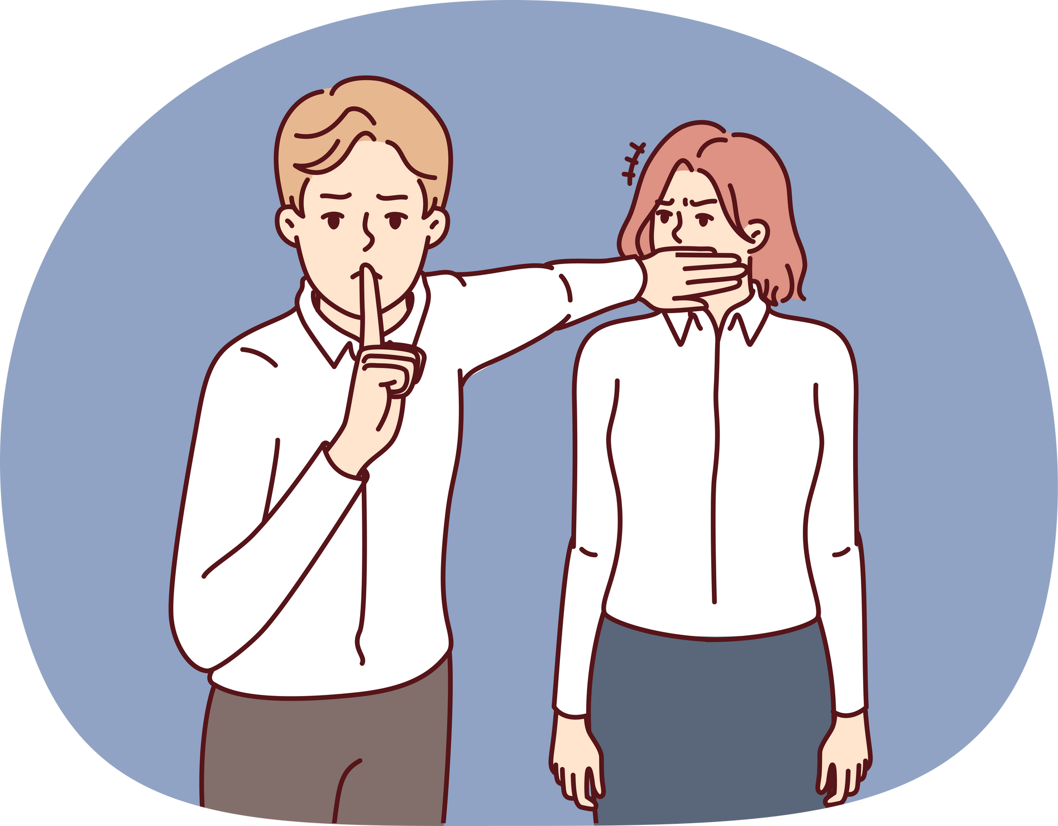
MISOGYNY
the hatred of, contempt for, or prejudice against women or girls.

Slide 10
Do you think these are examples of misogyny?
A man holds a door open for two women, saying “ladies first!”
After a student council meeting, the female students are asked to stay behind and clean up.
A boy who is good at maths is asked to tutor a female student who is struggling.
A girl says “I could never be friends with other girls - they’re so dramatic and catty.”
A group of boys playing Fortnite mock a female gamer, telling her to log off and “go make us a sandwich.”
MISOGYNY
NOT SURE
NOT MISOGYNY
Notes:
Share definition of misogyny and introduce the next activity - is this misogyny? Read out the examples on the slide and ask students to decide whether they think misogyny is being demonstrated. You may wish to have students raise their hands, or to get them out of their seats, they can position themselves on different sides of the classroom depending upon whether they believe it is misogyny, not misogyny, or they are unsure. After each example, ask students to share the reasons for their answers. Suggested responses:
A man holds a door open for two women, saying “ladies first!”
This is common polite behaviour and both males and females hold doors open foreach other. Some women and girl may feel uncomfortable with the ‘ladies first’language, however, this is unlikely to be a deliberate act of misogyny. Over time amove away from terms such as ‘ladies’ is likely, and this will help reduce the moresubtle misogyny that exists.
After a student council meeting, the female students are asked to stay behind and cleanup.
If girls are asked to tidy up (and it’s not a girls only school) this is misogyny. In amixed setting asking girls to tidy up and boys to do nothing or more ‘strenuous’ worke.g., stacking chairs reinforces stereotypes.
A boy who is good at maths is asked to tutor a female student who is struggling.
This is a tricky one. Are there also girls who are good at maths helping boys? Is peersupport used throughout the school? A good area for discussion and to tease outsome of the subtleties around stereotypes and misogyny.
A girl says “I could never be friends with other girls - they’re so dramatic and catty.”
This is an example of internalised misogyny - when women and girls perpetuatemisogynistic beliefs about other women.
A group of boys playing Fortnite mock a female gamer, telling her to log off and “gomake us a sandwich.”
This is an example of misogyny - it suggests that women/girls are not welcome in gaming spaces and reinforces harmful gender expectations.

Slide 11
harassment and bullying
Misogyny can take many forms.
discrimination
violence
Misogyny is not just something that men express - women can also hold misogynistic beliefs.
social norms that devalue women
rigid gender expectations
Notes:
Slides 11-13 explain the various forms misogyny can take, and its relationship to toxic masculinity.

Slide 12
Harmful ideas of MASCULINITY
harmful social norms and expectations about masculinity (traits we normally associate with men/boys). Men and boys can feel pressured to look, act, or feel a certain way, in order to be seen as a “real man.”

Slide 13

Harmful ideas of masculinity
Our ideas about masculinity and misogyny are connected: harmful ideas about being a man (sometimes called harmful or toxic masculinity) contribute to misogyny (the hatred of or prejudice against women).
Toxic masculinity tells us that being a man is all about power, dominance and control, and that women are weak and inferior. This reinforces (makes stronger) misogyny.
misogyny

Slide 14
ACTIVITY: healthy or harmful?
Decide whether the card describes harmful or positive behaviour/beliefs, and stick it up on the board wherever you think it belongs.
You will be given a selection of cards, each with a different behaviour or personality trait listed.
Notes:
For the activity Healthy or Harmful start by drawing two columns on the whiteboard with the headings ‘harmful’ and ‘healthy.’ Give students Resource A. They should decide whether the behaviour/trait listed is an example of toxic or healthy masculinity. If you have cut out the examples, they can stick them on the board with blue tac in whichever column they feel best fits; or, if you do not wish to cut these out, they can simply write the examples on the whiteboard in the corresponding columns. They can do this in groups.
Once this activity is complete, discuss with the class. Why did they label a particular behaviour as toxic or healthy? Does everyone agree/disagree? Why?

Slide 15

WHO DOES MISOGYNY HARM?
Think about the following examples of misogyny and decide whether it is harmful to men, women, or both.
Notes:
The next activity asks students to consider who is being harmed by misogyny, men or women (or both). This should be done as a whole class - they can either raise their hands after each example, or move to different parts of the room depending upon their answer. After each example, discuss with the class.

Slide 16
“Men are better suited to jobs in STEM (science, technology, engineering and maths) and women are better in caring roles like nursing or teaching.”

Slide 17
“If a girl says no, she’s just playing hard to get.”

Slide 18
“Real men don’t cry - man up.”

Slide 19
“Nobody wants to watch women’s sports - it’s so boring.”

Slide 20
“Women just want a strong man to take the lead.”

Slide 21
“Women are too emotional to be good leaders, they would start a war every time they have their period!”

Slide 22
“Men can’t be abused - just fight back.”

Slide 23
The truth is, misogyny and toxic masculinity harm both women AND men.

Slide 24

unfair treatment, due to beliefs that women are inferior, weak, or less capable
Misogyny hurts women and girls because it leads to:
limited opportunities in sports, employment, or anywhere seen as a traditionally “male” space
normalisation of harassment, violence, and abusive/controlling relationships
Notes:
Slides 24-25 explain how misogyny hurts everyone, regardless of gender, in different ways.

Slide 25
men feeling unable to express their emotions or seek support due to fear of being seen as weak or not manly enough - which can cause isolation and loneliness
Misogyny hurts men and boys because it leads to:
feeling pressure to be dominant, aggressive, or controlling, leading to unhealthy relationships or getting themselves into trouble
inability to truly be themselves and enjoy things just because they may be seen as traditionally ‘feminine’

Slide 26

Let’s talk
If misogyny is so harmful, why are some men and boys drawn to these messages?
What’s the appeal of certain influencers who promote these messages?
Notes:
Slides 26-30 focus on why people may be drawn to toxic influencers like Andrew Tate. Encourage discussion but ensure it stays respectful. Ask the class to look at the list of healthy and toxic behaviours on the whiteboard from the earlier activity - in which category would influencers fall? Why?

Slide 27
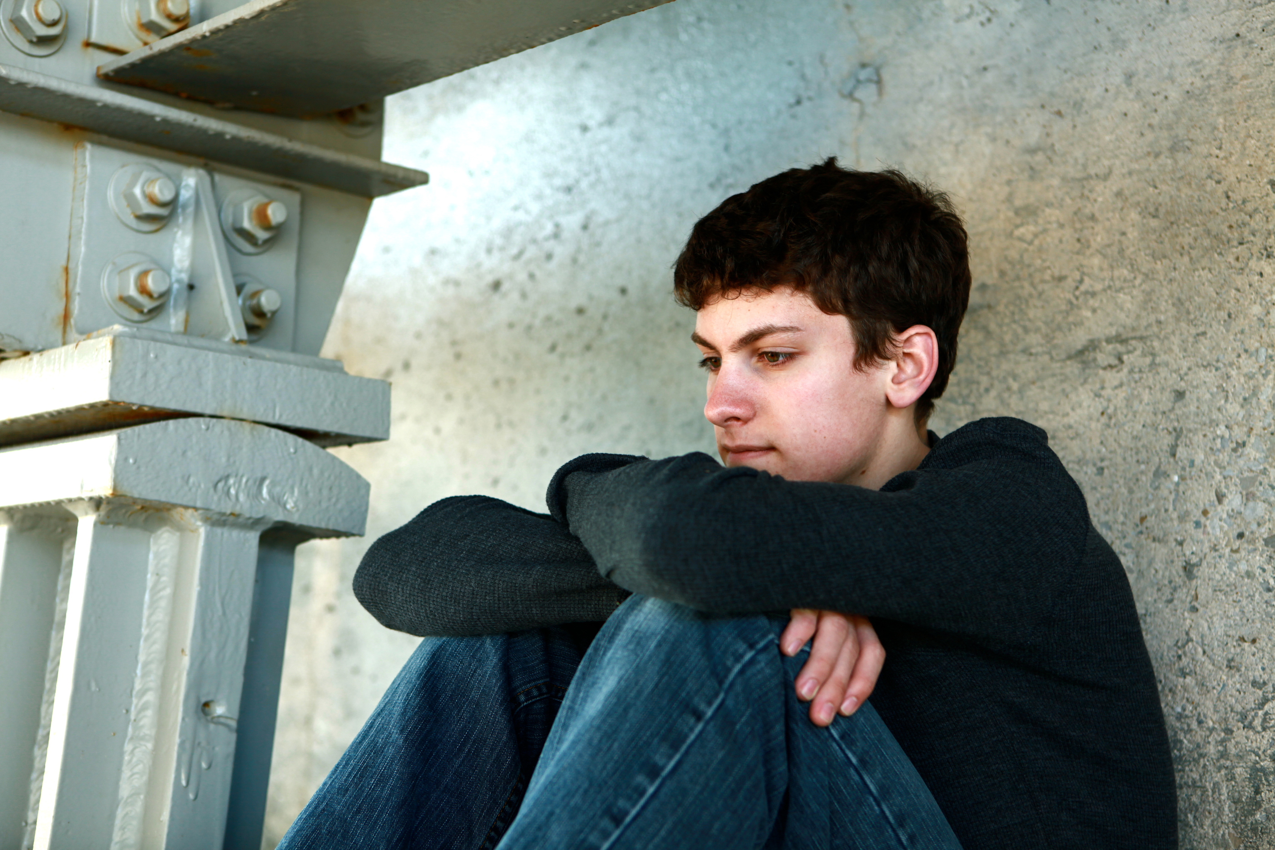
It’s a complex problem, but we think that some men and boys might be attracted to toxic role models because of:
poor mental health and feeling unable to seek support
feelings of loneliness and not fitting in
lack of a strong sense of identity and poor self esteem
feeling rejected or misunderstood
Some men and boys may also feel that, by trying to attain equality for women, that society views men as the problem - or that they’re being blamed simply for being men.

Slide 28
With many men/boys feeling lonely, isolated, blamed, rejected, and left behind – certain influencers and public figures then come along and:
promise power and success
give them someone to blame
provide a sense of community & belonging

Slide 29
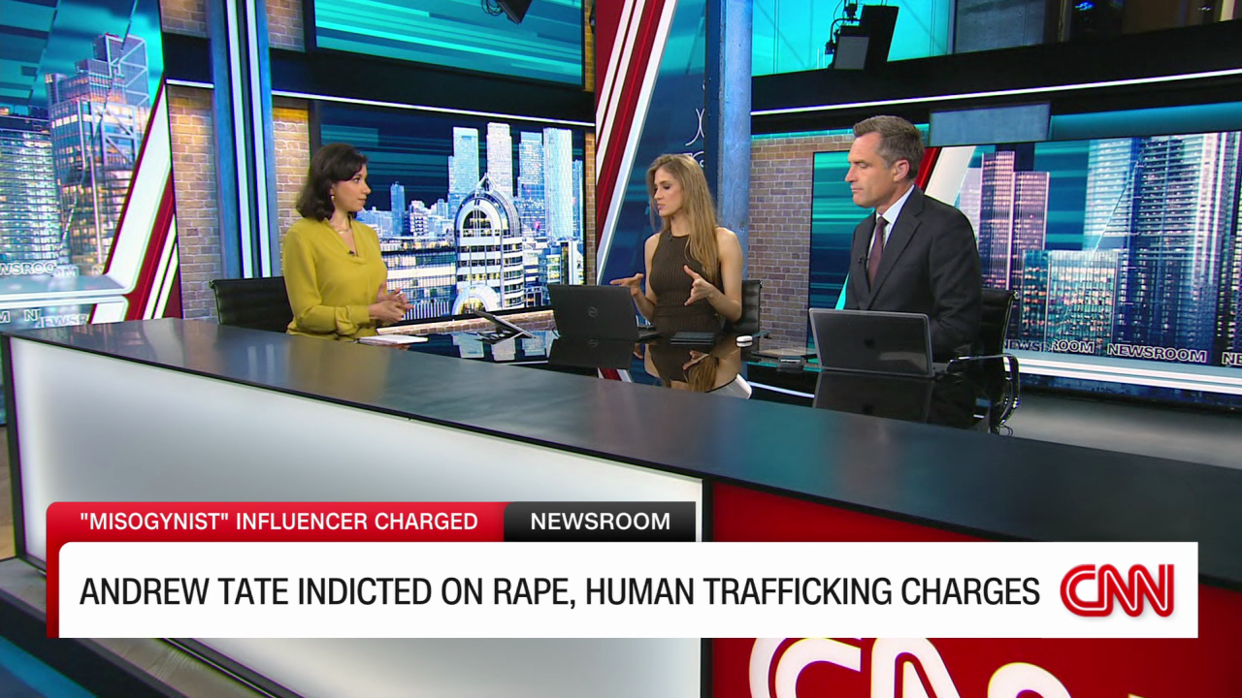
Are these good role models for men and boys?

Slide 30
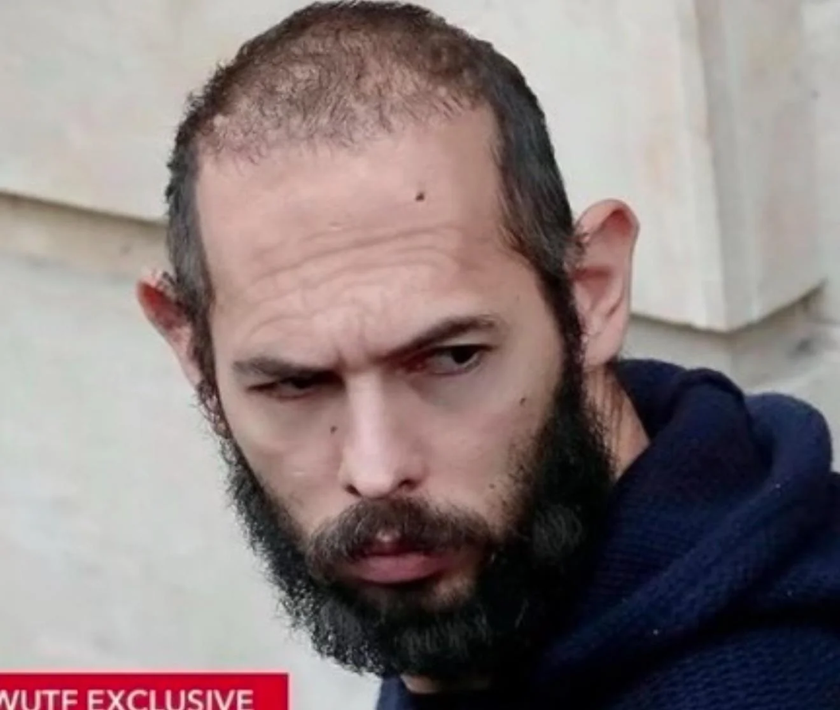
Look at the examples of positive masculinity and misogyny on the board – which are these influencers an example of?

Slide 31
At the beginning of the lesson, you were asked to write down everything that comes to mind when you think of what a “real man” means.
After today’s lesson, has anything changed?
Notes:
End the lesson with this brief question and explain that next time, you will be learning about positive ways to resist and fight back against the harms of misogyny.

Slide 32

REFLECTION
Let’s ASK ourselves - what are we taking from today’s lesson?
Attributes?
Skills?
Knowledge?
Notes:
If time permits, this slide can be further developed into a collective, group reflection.
Please ask students to discuss what Attributes (e.g. honesty, integrity, courage, humility, generosity, self-worth, kindness, trustworthiness etc) they have used during this lesson.
What Skills (e.g. oracy, empathy, compassion, presentation, assertiveness, active listening, interpersonal skills, positive peer pressure, capacity to resist unwelcome pressure, distinguish between fact & opinion , etc.
What Knowledge have they used, or developed during this lesson?

