Slide 1
TEACHER SLIDE
This lesson focuses on different types of relationships, how these can change over time, and how young people can seek support for navigating changes to relationships, including in families.
It is essential that teenagers to learn about relationship evolution because adolescence is a period of massive change across all social spheres. As teens develop a stronger sense of identity and independence, their relationship with parents naturally shifts, often involving a push for greater autonomy and more questioning of guidance.
At the same time, peer relationships transform from being activity-based to relying on shared values, intimacy, and loyalty, becoming central to identity formation.
Understanding these dynamic changes equips teenagers with essential life skills. It teaches them how to navigate the inevitable conflicts with family, handle the changing expectations in close friendships, and manage disagreements constructively.
Crucially, recognising that relationships are not static—they grow, shrink, or end—allows teens to set healthy boundaries, cope with breakups and loss, and identify toxic patterns, laying the groundwork for positive and resilient adult connections.

Slide 2
Activity | Description | Timing
Introduction | Ask students to complete and briefly review the ‘do it now’ task. Introduce learning objectives and revisit class agreements. | 5 minutes
Important vocabulary | Please briefly discuss, and ensure students understand, some of the key vocabulary for this learning. Move on to next slide and ensure students understand the difference between short- and long-term relationships. | 10 minutes
Why are relationships important? | Please ask students to work in small groups to discuss the importance of relationships at different stages of life. | 10 minutes
Imagine a relationship and changes | Please use Slides 10 and 11 to discuss some of the key aspects of relationships, how they may change, and how to manage feelings caused by these changes. | 10 minutes
Support Mind Map | Ask students to think about different support networks and how these groups of people can help them when navigating relationship changes. | 10 minutes
Reflection & Support | Ask students to reflect on slide 13 and signpost to support services on slide 14. | 5 minutes
Notes:
Please note that these are only suggested timings

Slide 3

DO IT NOW
Think about the different types of relationships you have right now — friends, family, teachers, teammates. How do you think these relationships might change as you grow older?
For example, what might stay the same, and what might be different, by the time you leave secondary school?
Notes:
Please ensure that this slide is visible as students enter the room.
Please have a brief discussion to respond to these questions. You may wish to remind students that we have relationships from the moment we are born until the time that we die, and that these remain important across the lifespan, as humans are hardwired for emotional connections with other people.

Slide 4

Relationship
changes
YEAR 8

Slide 5
LEARNING OBJECTIVES
Students will be able to:
describe the different relationships that someone can have over their lifetime and the benefits of these
analyse factors that can cause a relationship to change
explain how someone can be affected by changes to relationships, including familial relationships, and how they can seek support for navigating these changes.
Notes:
Please ensure that the students understand the purpose of this lesson.

Slide 6

CLASS AGREEMENTS
No personal comments
Kindness and respect
Right to pass
No such thing as silly
questions
any others?
Notes:
Explain that you would like the class to create a list of 'agreements' for how everyone will behave and treat one another in the class. Ensure a common understanding. For example:
1. We will treat one another with kindness and respect (listening to each other, speaking one at a time, etc)
2. We all have the right to 'pass' on answering a question or participating in an activity that makes us feel uncomfortable.
3. We can disagree but will not pass judgments, make fun of, or or put anybody down. 'Challenge the opinion, not the person.'
4. Asking questions is encouraged and will be valued by our teacher. We do not ask questions to purposefully embarrass or belittle another.
*Feel free to change the agreements to suit your class, and ask whether there are any others they'd add to the list in order to create a safe, comfortable learning environment.

Slide 7
Some important vocabulary
Word:
Relationship
Friendship
Kin
Family
Definitions
How two or more people are connected to each other
A relationship between friends who get on well with each other or might share a close emotional bond
A relative either through blood relation, adoption, or marriage
A group of two or more people connected by being kin, or who share a close emotional bond and provide support for each other
Notes:
Our recommended approach is that you show the four words and ask students to work in small groups to arrive at a definition before comparing it with a definition on the slide.

Slide 8
Short vs long term relationships
Some of our relationships might be short-term, meaning they only last for a brief period. These relationships might be based on a shared experience, like being in the same class, living on the same street, or having mutual interests. When one of these things change (we move away, we finish school, etc), the relationship may end.
Long term relationships tend to be between people who share a strong emotional bond. They may be related, very close friends, or have made a commitment to one another like through marriage or civil partnership. While these last for a long period, they can also change over time.
Note: both short- and long-term relationships can be meaningful and important.

Slide 9

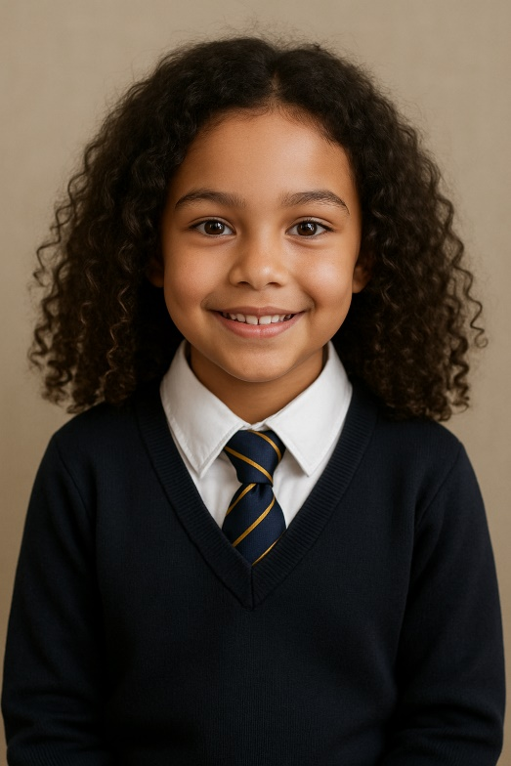



Why are relationships important?
Age 0-4
Age 5-10
Age 11-16
Age 16-20
Age 21+
What relationships might someone have at each of these life stages?
What are some of the benefits these relationships might have in a person’s life?
Notes:
Please ask the students to work in small groups to respond to these questions. You may prefer to have each group work on a different life stage, or if time permits groups can work on several or all life stages. Once groups have had sufficient time to work, bring all groups back for a whole class discussion, and ask each group to share the relationships they have identified for each life stage.
If students are struggling, provide some examples. Types of relationships at different life stages are: parents/carers, siblings, teachers, boy/girlfriends, grandparents, colleagues, neighbours, classmates etc.
Benefits: Having someone to spend time with; someone to learn from; someone to have fun with; someone you can depend on for support; etc
Ensure the following points have been covered:
Infants and young children need to have close relationships with their caregivers (parents, carers, other family members or trusted adults) as these people are responsible for keeping them safe and healthy. However, as they grow older, their relationships with their parents/carers or family members will change. For example, as teenagers and young adults seek greater independence, they may wish to make their own decisions and take on greater responsibility for their own safety and wellbeing. They may also form new relationships with their peers or other adults, which helps them to develop their own identity.
Relationships that develop as people grow older can be very significant, and can become committed, long-term relationships. For example, someone might form a close friendship which develops into a relationship similar to that of siblings, or someone might begin a long-term romantic relationship, and may decide to marry or form a civil partnership.
Benefits of short-term relationships, such as with a classmate, a colleague, or a teacher might include: having someone to pursue interests with, being able to bond with people who have things in common, having a support network of people who have a shared experience or who can offer support within a specific context.
Benefits of long-term relationships, such as with family members, close friends, or a life partner, might include: having supportive relationships based on trust and care, sharing a close and more intimate bond with another person, building a family or community to share life experiences with.

Slide 10

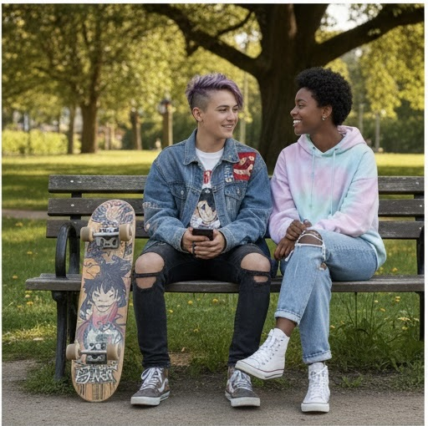
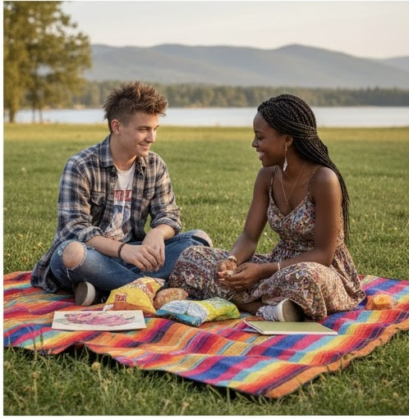
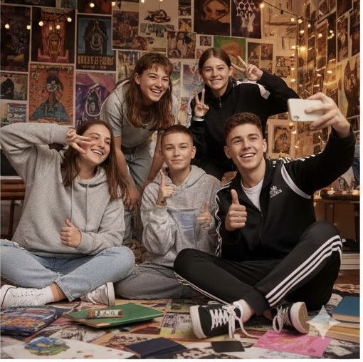
Imagine a relationship
Please work in small groups and consider one of the images below. Create a ‘back story’ for your image.
What are their names?
What is the relationship between the people in the image (friends, partners, siblings, cousins, classmates, etc)?
What do you think their relationship is like? What are the benefits?
Notes:
We recommend asking students to work in eight small groups so that two groups can reflect on each image. This allows for better discussion and exploration of values.
Please give students a few minutes to create a narrative around each image.
If you do arrange for two different groups of students to discuss each image, their creations are bound to be different and comparison may not be useful, but it will be interesting to see how different groups of students interpret the different images.
Ask them to consider the benefits of these relationships.

Slide 11
Changes
Now think about some of the changes that the characters in your picture might be going through. Perhaps they’ve just broken up, or one of them is moving away, or someone new has joined the group.
How might the characters be feeling about these changes?
How could they manage these feelings?
Notes:
Now ask students to come up with a change scenario that the characters in their picture might be experiencing. For instance if they’re friends, perhaps they’re going off to different universities; if they’re partners, maybe they’ve broken up (or maybe a friend has introduced a new boy/girlfriend to the friend group). Maybe they’re siblings whose parents have recently gotten divorced.
Ask students to come up with a scenario and answer the prompting questions. Bring together for class discussion.

Slide 12
support mind map
Support services can …
Friends can …
When navigating a changing relationship, how can these groups of people offer support?
Any others?
Family can …
A teacher / tutor can …
Notes:
In groups or as a whole class, ask students to think about who they can go to for support, when navigating changing relationships. What support can they get from friends? Teachers? Family? Support services like Isle Listen?

Slide 13

reflection
Let’s ASK ourselves - what are we taking from today’s lesson?
Attributes?
Skills?
Knowledge?
Notes:
If time permits, this slide can be further developed into a collective, group reflection.
Please ask students to discuss what Attributes (e.g. honesty, integrity, courage, humility, generosity, self-worth, kindness, trustworthiness etc) they have used during this lesson.
What Skills (e.g. oracy, empathy, compassion, presentation, assertiveness, active listening, interpersonal skills, positive peer pressure, capacity to resist unwelcome pressure, distinguish between fact & opinion , etc.
What Knowledge have they used, or developed during this lesson?

Slide 14
Get support
To talk with someone confidentially about how you feel, you can:
Contact the Talk Service (Isle Listen): 01624 679118 https://talk.islelisten.im/
Text SHOUT to 85258 to contact the Shout textline
Call HOPELINE247 on 0800 068 4141 or the NHS on 111 and select option 2
Contact Childline by using 1-2-1 chat or calling 0800 1111
Notes:
Please ensure that you show the students this slide, they should be familiar with most of this information but it may also be worth holding this for future reference

