Slide 1

TEACHER SLIDE
This is the third of a series of lessons for Y8 about respectful and cohesive communities and inclusion. These lessons have been inspired by the work of the PSHE Association and adapted for children on the Isle of Man.
This lesson focuses on the Equality Act (2010 in UK, 2017 in IoM), the importance of protected characteristics, and the basics of discrimination.

Slide 2
Activity | Description | Timing
Introduction | Ask students to complete the ‘do it now’ task. Introduce learning objectives and revisit class agreements. | 5 mins
Discrimination & Equality Act | Introduce ‘discrimination and explain the Equality Act. Show list of protected characteristics, and ask the class to match the characteristic to the definition. | 5-10 mins
Inclusion | Explain that there is a difference between discrimination and inclusion, and that sometimes positive action is necessary to “level the playing field.” Discuss difference between equality and equity. Play video and invite discussion. | 10 mins
Discrimination or inclusion? | In small groups, ask students to review the scenarios on the included handout, or read the scenarios aloud as a class. Ask them to decide if this is an example of discrimination or inclusion. This can be done as a discussion, a vote, etc. | 10 mins
Circles of support | Ask students to review the scenarios (as a class or small groups) and identify what other people can do to support the person experiencing discrimination. | 10 mins
Reflection / Get support | Please ensure that the students have a few minutes to reflect on their learning and remind them of sources of support. | 5 mins
Notes:
Please note these timings are advisory, and you will have to adjust things depending on your timetable and the needs of the class.

Slide 3

DO IT NOW – is this discrimination?
An employer refuses to hire a woman because she wears a headscarf.
A shop assistant follows a customer around the store, because of their skin colour.
A school gives extra time in exams to a pupil with a learning disability.
A landlord refuses to rent a flat to a same-sex couple.
A football coach doesn’t select someone for the team because they weren’t fast enough.
Notes:
Please display this slide on the board as the students are walking into the room

Slide 4

Discrimination &
The Protected characteristics
YEAR 8
Notes:
Please briefly explain the purpose of this lesson

Slide 5
LEARNING OBJECTIVES
By the end of this lesson, students should be able to:
identify examples of discriminatory behaviour & its effects
explain what is meant by the term ‘protected characteristics’
suggest ways to safely challenge and seek help in relation to discrimination
Notes:
Please ensure that students are clear about the purpose of this and subsequent lessons

Slide 6

CLASS AGREEMENTS
No personal comments
Kindness and respect
Right to pass
No such thing as silly questions
Any others?
Notes:
Please revisit the ground rules as necessary
1. No one should ask personal questions or make personal comments about other people.
2. We will treat one another with kindness and respect (listening to each other, speaking one at a time, etc)
3. We all have the right to 'pass' on answering a question or participating in an activity that makes us feel uncomfortable.
4. We can disagree but will not pass judgments, make fun of, or or put anybody down. 'Challenge the opinion, not the person.’
5. Asking questions is encouraged and will be valued by our teacher. We do not ask questions to purposefully embarrass or belittle another.
*Feel free to change the agreements to suit your class, and ask whether there are any others they'd add to the list in order to create a safe, comfortable learning environment.

Slide 7
What is discrimination?
Confirmation bias
Discrimination is treating a person or group of people differently from others (usually less favourably) because of their characteristics.

Slide 8

EQUALITY ACT 2017
aims to create equal opportunities and fair treatment for all on our island
establishes legal rights and protects people from discrimination based on certain characteristics, known as the protected characteristics
Notes:
Explain that on the Isle of Man, we have legislation known as the Equality Act 2017.
The Equality Act aims to create equal opportunities and fair access for people in our community. The Act establishes both legal rights and legal obligations. The rights provide protection for individuals from different types of prohibited behaviour in specific situations. The types of behaviour are known as discrimination, harassment or victimisation. The Act also creates a legal obligation to make reasonable adjustments for people with disabilities.
Discrimination means treating someone unfairly because of who they are.
The Equality Act 2017 protects those who possess a certain characteristic known as 'protected characteristics' – we all have some of these characteristics.
These characteristics are:
age
disability
gender reassignment
marriage or civil partnership (in employment only)
pregnancy and maternity
race
religion or belief
sex
sexual orientation

Slide 9
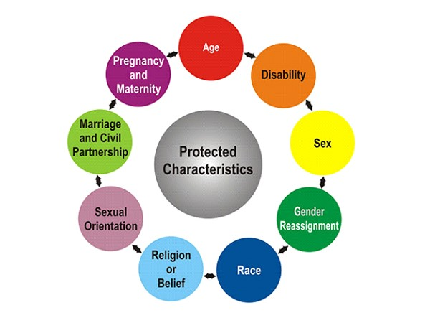
The protected characteristics
Confirmation bias
Notes:
Introduce the protected characteristics, and explain that the law prohibits discrimination (treating someone unfairly) based on these. On the following slide, you will ask students to match the characteristic to its definition.

Slide 10
The protected characteristics
Confirmation bias
People belonging to a particular age group. For example, under 18s or over 50s.
Notes:
The matching characteristic is AGE

Slide 11
The protected characteristics
Confirmation bias
People who are pregnant or who have had a baby in the past 26 weeks.
Notes:
The matching characteristic is PREGNANCY & MATERNITY

Slide 12
The protected characteristics
Confirmation bias
People who propose to, are undergoing, or have completed a process to reassign their sex.
Notes:
The matching characteristic is GENDER REASSIGNMENT

Slide 13
The protected characteristics
Confirmation bias
Can include people’s skin colour, nationality or ethnic background.
Notes:
The matching characteristic is RACE

Slide 14
The protected characteristics
Confirmation bias
People who have entered into a civil partnership or marriage, including same sex and mixed sex couples who are married or civil partners.
Notes:
The matching characteristic is MARRIAGE/CIVIL PARTNERSHIP

Slide 15
The protected characteristics
Confirmation bias
People with long-term physical or mental conditions that have a substantial negative effect on their day-to-day activities.
Notes:
The matching characteristic is DISABILITY

Slide 16
The protected characteristics
Confirmation bias
Being a man or a woman.
Notes:
The matching characteristic is SEX

Slide 17
The protected characteristics
Confirmation bias
Any religion and religious or philosophical belief, or not having these. For example, being a Christian, or being an atheist.
Notes:
The matching characteristic is RELIGION/BELIEF

Slide 18
The protected characteristics
Confirmation bias
Whether a person is attracted to people of the same sex as them or of a different sex, or both. For example, being heterosexual, gay/lesbian, or bisexual.
Notes:
The matching characteristic is SEXUAL ORIENTATION

Slide 19
The Equality ACT 2017
Confirmation bias
Please remember:
There is no order of priority for the protected characteristics – they are all equally important.
Notes:
Please explain that all the protected characteristics have equal value.
Discuss, if appropriate, why some people might feel that some protected characteristics are more important than others?

Slide 20
The Equality ACT 2017
Did you know….
Confirmation bias
Everyone has a protected characteristic, and some people have more than one.
It is unlawful for you to be discriminated against just because you’re female, and it’s also unlawful to be discriminated against just because you’re male.
It’s unlawful for you to be discriminated against just because you’re black, and it’s unlawful to be discriminated against just because you’re white.
Notes:
Explain that we all have protected characteristics, and some people have more than one.

Slide 21
inclusion
Confirmation bias
There is a difference between actions which are discrimination, and actions which help to promote the inclusion of those with a protected characteristic, or to make things more equitable.
For example: A school decides to provide free or lower cost sports kits to pupils whose families cannot afford them.
This is not discrimination against pupils who can afford the sports kits. It is a positive, inclusive action to ensure that those who can’t are given the same opportunity as their peers.

Slide 22
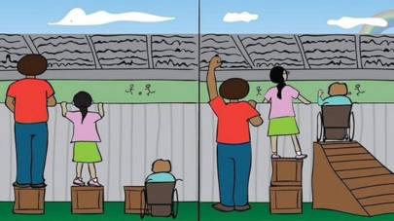

Should we treat everybody equally, or equitably?
Confirmation bias
Equality: everyone is treated the same
Equity: people get different help based on their needs so the outcome is fair
Notes:
Discuss the first question: should we treat everybody equally?

Slide 23
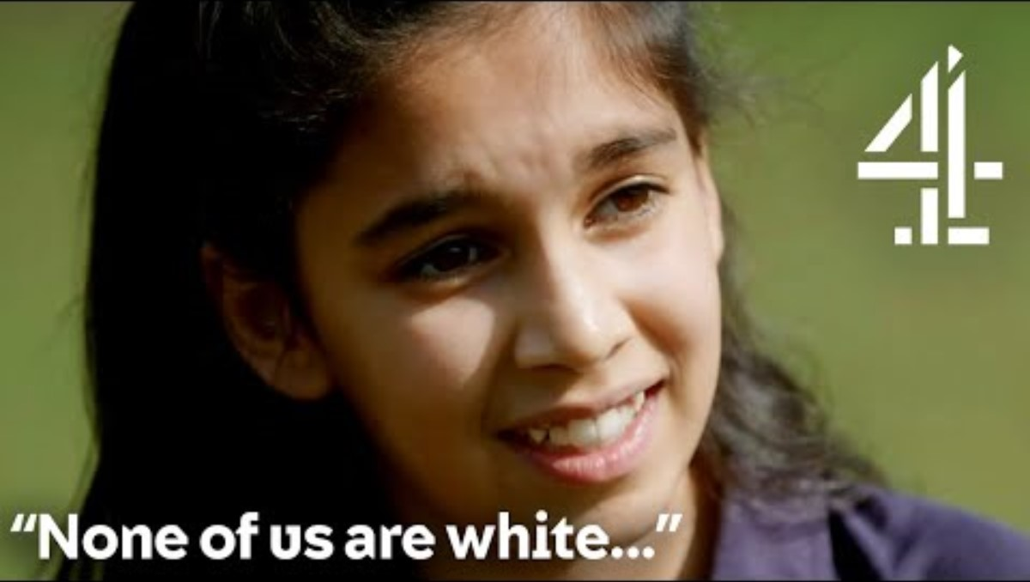
Confirmation bias
Notes:
Play video and then encourage class discussion – what do they think the message of the video is? Does this help them to better understand the idea that everyone has a different “starting point” and that sometimes, action is needed to mitigate some disadvantages that people might have?

Slide 24
Confirmation bias
Activity: discrimination or inclusion?
Notes:
Provide students with handout “Discrimination or inclusion” and split them into groups, asking each group to review a scenario and decide whether this is an example of discriminatory behaviour or inclusive behaviour. Ask them to discuss how the person in the example might be feeling, depending on whether they are being discriminated against or excluded.
Or, if you prefer to minimise printing, you can read the scenarios aloud and ask the class to vote, then discuss their answers.

Slide 25
Circles of support
Confirmation bias
When a person experiences discrimination, it is important that they receive support. Supportive action can come from several places, including:
The person themselves
The person’s family & friends
The school community
The wider community (e.g. the town the person lives in, a group they’re a part of, or even the island as a whole)
Notes:
Either provide students with handout “Discrimination or inclusion” and split them into groups, asking each group to review a scenario and decide whether this is an example of discriminatory behaviour or inclusive behaviour. Ask them to discuss how the person in the example might be feeling, depending on whether they are being discriminated against or excluded.
Or, if you prefer to minimise printing, you can read the scenarios aloud and ask the class to vote, then discuss their answers.

Slide 26
Individuals
Wider/island community
School community
Individuals
family
friends

Slide 27
Circles of support
The below are scenarios where a person is experiencing discrimination. What kind of support could they receive from their different circles? What could be done by a person’s family, friends, school, or wider community to help?
Confirmation bias
Anna noticed some racist graffiti outside the school. It said horrible things about people with her skin colour.
After coming out as gay to his close friends, Brian starts to be excluded from friendship groups and is called a slur by someone on his football team.
Oliver, who is a young carer, is assumed to be less capable academically and is not considered for leadership roles in school.
Notes:
Either split class into groups or do as a whole class discussion – each scenario describes a person who is experiencing discrimination. Ask students to think about what kinds of support can be offered in the different circles. For instance, in the case of Anna, her friends may offer comfort and emotional support; her school may consider putting on an assembly or writing some PSHE lessons about the impact of racism, and in the wider community, the police or local politicians can get involved to raise awareness and take action against those who wrote the graffiti.

Slide 28

REFLECTION
Let’s ASK ourselves - what are we taking from today’s lesson?
Attributes?
Skills?
Knowledge?
Notes:
If time permits, this slide can be further developed into a collective, group reflection.
Please ask students to discuss what Attributes (e.g. honesty, integrity, courage, humility, generosity, self-worth, kindness, trustworthiness etc) they have used during this lesson.
What Skills (e.g. oracy, empathy, compassion, presentation, assertiveness, active listening, interpersonal skills, positive peer pressure, capacity to resist unwelcome pressure, distinguish between fact & opinion , etc.
What Knowledge have they used, or developed during this lesson?

Slide 29
Get support
To talk with someone confidentially about how you feel, you can:
Contact Isle Listen: 01624 679118 www.islelisten.im
Text SHOUT to 85258 to contact the Shout textline
Call HOPELINE247 on 0800 068 4141 or the NHS on 111 and select option 2
Contact Childline by using 1-2-1 chat or calling 0800 1111
If you or someone else is seriously hurt, this is an emergency.
You should:
Call 999 and ask for an ambulance
Tell an adult you trust and ask them to call 999 for help
Notes:
Please ensure that students are made aware of these, and any other sources of support.

