Slide 1

TEACHER SLIDE
  This is the first of a series of lessons for Y8, which focuses on respectful and cohesive communities and inclusion.
  This lesson explores the similarities and differences between people within a community and how communities can foster feelings of belonging.
  For the activity “Similarities & Differences” you will be splitting the class into 6 small groups (or less, if your class is already small). You may wish to print the handout “Scoill Mannin” with enough copies (each group should have at least 1 copy).

Slide 2
Activity | Description | Timing
Introduction | Ask students to complete the ‘do it now’ task. Introduce learning objectives and revisit class agreements. | 5 minutes
What is community & what benefits? | Slides 7 and 8 are used to respond to the first two questions of the ‘do it now’ task | 5 mins
The Human Givens | Explain that British psychologists, Joe Griffin and Ivan Tyrrell suggest that there are nine things that all humans need. Please click your way through the list and give examples of where somebody might find each of these ‘human givens’ – please only ask students to comment if you feel they will be emotionally safe. | 5 mins
Links and limitations | Slides 10 & 11. Ask students to discuss some other things that might make it harder for people to feel included and some of the things that might make it easier. | 5-10 mins
Similarities and difference | This activity requires either printing out at least six copies of the ‘Scoill Mannin’ handout or displaying slides 12-14. Split the class into six groups – each group will take the role of a character, with the goal of finding similarities and differences between them. See notes on slide 12. | 15 mins
Alternative activity - A new student | OPTONAL, use this instead of “similarities & differences” if you prefer. | 10 mins
Tackling limitations | Students work in small groups to create a list of possible strategies to ensure that everyone feels included and strategies to reduce harmful experiences. Record strategies on the board and decide which is the best strategy and alternatives. | 5 mins
Reflection / Get support | Slides 17 & 18 please ensure that the students have a few minutes to reflect on their learning and remind them of sources of support | 5 mins
Notes:
Please note these timings are advisory, and you will have to adjust things depending on your timetable and the needs of the class.

Slide 3

DO IT NOW
What is a community?
What are the benefits of being part of a community?
What can prevent someone feeling part of a community?
What can someone do if they feel excluded from a community?
Notes:
Please display this slide on the board as the students are walking into the room

Slide 4

Identity & community
YEAR 8
Notes:
Please briefly explain the purpose of this lesson

Slide 5
LEARNING OBJECTIVES
By the end of this lesson, students should:
Be able to describe some of the ways that people can be similar and different to one another
Have thought about what may affect whether somebody feels part of a community
Have discussed strategies that might help people to feel they belong in a community
Notes:
Please ensure that students are clear about the purpose of this and subsequent lessons

Slide 6

CLASS AGREEMENTS
  No personal comments
  Kindness and respect
  Right to pass
  No such thing as silly questions
Any others?
Notes:
Please revisit the ground rules as necessary
1. No one should ask personal questions or make personal comments about other people.
2. We will treat one another with kindness and respect (listening to each other, speaking one at a time, etc)
3. We all have the right to 'pass' on answering a question or participating in an activity that makes us feel uncomfortable.
4. We can disagree but will not pass judgments, make fun of, or or put anybody down. 'Challenge the opinion, not the person.’
5. Asking questions is encouraged and will be valued by our teacher. We do not ask questions to purposefully embarrass or belittle another.
*Feel free to change the agreements to suit your class, and ask whether there are any others they'd add to the list in order to create a safe, comfortable learning environment.

Slide 7
what is a community?
A community is a group of people who live in the same place or share something in common.
They might live in the same neighbourhood,
Go to the same school, or
Play on the same sports team.
Notes:
Please use this slide as a definition of ‘a community’ in response to the first question of the ‘do it now’ task.
Explain that we will briefly discuss the second question (what are the benefits of being part of a community?) in the next slide and then address the other questions throughout the lesson

Slide 8
what are the benefits of being part of a community?
Feelings of belonging and connecting with others.
Opportunities for learning and exploring interests.
Support and encouragement.
Notes:
Ask students how they responded to the second question of the ‘do it now’ task, before suggesting these benefits.
What are the benefits of the students concluded?

Slide 9

The human givens
Suggests that there are 9 things that all humans need:
Security and safe territory
A sense of autonomy and control
The need for attention (give & receive it)
Friendship, fun, love, intimacy
Being part of a wider community
Emotional connection to others
A sense of status
Self-esteem – achievement
The need for meaning
How might being part of a community contribute to these essential factors?
Notes:
Please explain that two British psychologists, Joe Griffin and Ivan Tyrrell suggest that there are nine things that all humans need.
Please click your way through the list and give examples of where somebody might find each of these ‘human givens’ – please only ask students to comment if you feel they will be emotionally safe.
Point 7 Status, is not just in terms of wealth or position but an innate sense of self-worth because of ‘what I bring to the party’. It refers to the need to feel valued and have a secure, recognised place within social groups. It's about having respect, attention, and appreciation from others, which is crucial for self-esteem and feeling safe in the world.
Ask students to discuss the final statement: how might being part of the community contribute to these essential factors?

Slide 10
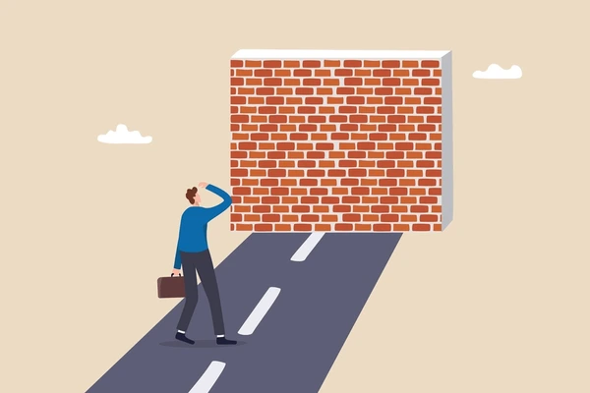
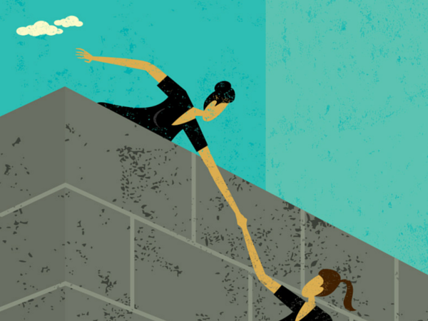
Limitations & Links
Limitations:
What are some of the things that might make it harder for people to feel included?
Links:
What are some of the things that could make people feel included?
Notes:
As we have just seen, feeling a sense of connection and belonging in a community can support a persons well-being, but there can be differences in how connected somebody might feel and whether they feel that they really belong.
Please ask the students to work in small groups to write down lists of limitations-things that make it feel harder for somebody to feel included in a group or community
And
Links: what are some of the things that make somebody feel included in a group or community

Slide 11
Limitations & Links
Differences in interest/personality
A lack of access or support
A lack of representation
Not being shown in (social) media.
Feeling their voice is not listened to
Being ignored or feeling unwelcome
Bullying or discriminatory behaviour
Shared interests
Events that include different groups
Local representation
‘People that look like me’
Opportunities to share my views
Feeling valued and included
Safe spaces to meet
Notes:
Once students have completed their lists, please discuss their lists with those on this slide
Examples of limitations could include:
Difference in interest/personality. E.g. people may feel nervous in social situations but I need support and kindness to feel comfortable.
Examples of links could be events that reflect different groups e.g. LGBT allies cultural celebrations etc
If appropriate, you may wish to ask students whether they know of any displays in school that feature people with disabilities, those with black or brown skin or those who are LGBT.

Slide 12
Similarities and differences (1)
Sarah lives with her daughter Minnie, who is in Year 7. Sarah has just volunteered to become a parent governor at the school to help make decisions about how things are run.
She was disappointed that Minnie didn’t learn much about Nigeria and the people who came to help Britain after the Second World War. Minnie was a bit disappointed that she didn’t see anyone who looked like her in the storybooks in school.
Sarah wants everyone to feel part of the school community.
Sheridan is in Year 10 and really enjoys Maths and Drama. Sheridan has started seeing a student from another school and was worried about how their friends might react.
Sheridan felt reassured after speaking to their best friend Charley, who said that everyone would be ok, and that they would always stick up for Sheridan if ever there was a problem.
Sheridan has known some people in the school for a long time, as their parents went to Scoill Mannin together.
Notes:
This activity involves learning about six different characters and trying to spot the similarities and differences between them.
Split the class into 6 groups (or fewer, if you have a smaller class). Each group should be assigned a character to roleplay. For example, group 1 would be Sarah, group 2 would be Sheridan, and so on. Give each group at least one copy of the “Scoill Mannin” handout, so they can learn about their character. Once everyone is ready, ask the groups to mingle and speak with other ‘characters’ in the other groups, trying to learn about the other’s interests and background. They should try to find similarities between themselves and these other characters (e.g. Carys and Jan both have an interest in films).
After 10 minutes, invite the class back together for a discussion – what similarities were discovered? Were there any differences? Do they have any ideas for how these differences can be shared, celebrated, or bridged in some way?

Slide 13
Similarities and differences (2)
Jan, in Year 11, has volunteered to buddy new students in school, helping them feel welcome.
Jan speaks several languages, including Polish, which they speak at home with grandad. Jan’s family moved to the area because grandad got a new job.
Jan has joined the after-school film club because they show films from different countries. Jan really likes the ones that are set in the past because Jan loves history.
Azhar is a geography teacher at the school and has worked there for 15 years. He enjoys tennis and was captain of his local cricket team.
Azhar helps with the school choir but has also set up a multifaith prayer room for students and staff, as a ‘pupil voice’ survey suggested that the school should have one.
Azhar is Muslim but wants everyone to feel respected and have a safe space to pray or reflect..
Notes:
Please see notes from slide 12

Slide 14
Similarities and differences (3)
Carys loves PE, especially when she gets to play badminton and rugby. She also plays for the local women’s rugby team.
Carys would like to become a filmmaker and has been writing scripts for her drama group, which includes students from all year groups.
Carys has also volunteered to be a mentor for students in Y8 and Y7.
Douggie joined the school in Year 7 but has not found it easy to settle. He finds some of the communal spaces, like the dining area, overwhelming.
Douggie has tried to make friends in his new school, but he has only recently moved into the area with his mum, dad and younger brother. He went to a Church of England primary; his religion is important to him, and he found starting the day with a prayer was emotionally settling.
He really likes basketball and would like to join the school club to make some friends.
Notes:
Please see notes from slide 12
After 10 minutes, invite the class back together for a discussion – what similarities were discovered? Were there any differences? Do they have any ideas for how these differences can be shared, celebrated, or bridged in some way?

Slide 15
Alt. activity
A new student starts in your class.
What are 3 things that you could do to make them feel welcome?
Would you change what you do if:
They support a different football team?
They don’t like sport?
They are the opposite sex from you?
They have different faith/religious beliefs?
They try to get you to do something you feel is wrong?
Notes:
Use this activity as an alternative to the “similarities & differences” activity if you prefer.

Slide 16
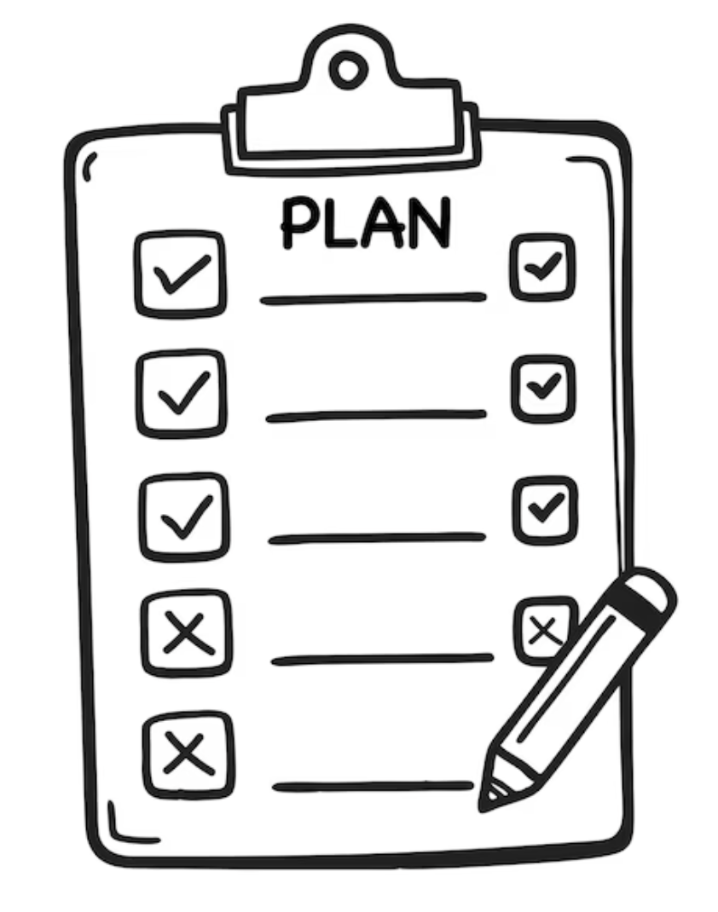
Tackling Limitations
Please think back to the limitations you noted earlier.
In small groups, make a list of how a community could:
Ensure that people feel heard
Make sure that people feel included
Reduce harmful experiences
Notes:
Ask students to work in small groups to create a list of possible strategies to ensure that everyone in a community feels heard, that everyone feels included and strategies to reduce harmful experiences.

Slide 17

reflection
ASK what are you taking from today’s lesson?
Attributes?
Skills?
Knowledge?
Notes:
Review: Quickly recap the main points of the lesson: humans need and benefit from living in communities with shared interests. Please review some of the ways that this can be done effectively.
Please ask students to reflect on what attributes (e.g. honesty, integrity, courage, humility, generosity, self-worth, kindness, trustworthiness etc) they have used during this lesson,
What skills (e.g. Oracy, Empathy, Compassion, Presentation, Assertiveness, Active listening, Interpersonal skills, Positive peer pressure , Resist unwelcome pressure, Distinguish between fact & opinion) etc
What knowledge have they used or acquired during this lesson?

Slide 18
Get support
To talk with someone confidentially about how you feel, you can:
Contact Isle Listen: 01624 679118 www.islelisten.im
Text SHOUT to 85258 to contact the Shout textline
Call HOPELINE247 on 0800 068 4141 or the NHS on 111 and select option 2
Contact Childline by using 1-2-1 chat or calling 0800 1111
If you or someone else is seriously hurt, this is an emergency.
You should:
Call 999 and ask for an ambulance
Tell an adult you trust and ask them to call 999 for help
Notes:
Please ensure that students are made aware of these, and any other sources of support.

