Slide 1

TEACHER SLIDE
This is the final of a series of 6 lessons for Y8 which focuses on respectful and cohesive communities.
These lessons have been inspired by the work of the PSHE Association and adapted for children on the Isle of Man.
This lesson focuses on how young people can contribute to their community.
Effective provision of this lesson will require teachers to print 2 copies of slides 12, 13, 14 and 15, so that students can work in small groups, with two groups discussing the same scenario.
Teachers will also need to print two copies of slides 18 & 19. If you don’t wish to print, please ensure that students have read and understood the slides prior to doing the activities.
Contributing to their local community offers young people tangible developmental benefits. They gain real world skills including teamwork, leadership, and problem-solving. This helps to boost self-esteem and confidence by demonstrating their capacity to make a positive impact.
It also helps to foster a stronger sense of social responsibility and empathy, connecting them to diverse people and issues, which broaden their perspective and supports personal development and future career readiness.

Slide 2
Activity | Description | Timing
Introduction | Ask students to complete the ‘do it now’ task. Introduce learning objectives and revisit class agreements. | 5 minutes
Let’s discuss & do it now reflection | Students should spend 2-3 minutes reflecting on the communities that they belong to. Some students may struggle beyond ‘school’ and their town/village but they could also consider other communities to which the students may belong such as scouts, youth group, choir, church, sports team, etc. | 5 mins
How good a citizen is someone who .. & Think Pair share | Please select EITHER slide Slide 9 or 10 to encourage students to discuss whether somebody is a good citizen or not. | 5-10 mins
4 scenarios | The four scenarios are introduced on slide 11. Teachers may wish to print two copies of each of slides 12, 13, 14 and 15 to enable students to work in small groups with two groups discussing each of the four scenarios. | 10-15 mins
What makes for a good citizen? | Please use Slides 16 and 17 to enable students to reflect on actions and skills required for a good citizen and what they can do. | 15 minutes
Reflection & get support | Please ensure that the students have a few minutes to reflect on their learning and remind them of sources of support | 5 mins
Notes:
Please note these timings are advisory, and you will have to adjust things depending on your timetable and the needs of the class.

Slide 3

DO IT NOW
What does it mean to be a good citizen?
Notes:
Please display this slide on the board as the students are walking into the room

Slide 4

Contributing to
my community
YEAR 8
Notes:
Please briefly explain the purpose of this lesson

Slide 5
LEARNING OBJECTIVES
By the end of this lesson, students should be able to:
Understand the qualities of a good citizen
Reflect on personal values and behaviour
Identify ways to build a respectful & inclusive environment
Notes:
Please ensure that students are clear about the purpose of this lesson

Slide 6

CLASS AGREEMENTS
No personal comments
Kindness and respect
Right to pass
No such thing as silly questions
Any others?
Notes:
Please revisit the ground rules as necessary
1. No one should ask personal questions or make personal comments about other people.
2. We will treat one another with kindness and respect (listening to each other, speaking one at a time, etc)
3. We all have the right to 'pass' on answering a question or participating in an activity that makes us feel uncomfortable.
4. We can disagree but will not pass judgments, make fun of, or or put anybody down. 'Challenge the opinion, not the person.’
5. Asking questions is encouraged and will be valued by our teacher. We do not ask questions to purposefully embarrass or belittle another.
*Feel free to change the agreements to suit your class, and ask whether there are any others they'd add to the list in order to create a safe, comfortable learning environment.

Slide 7
Let’s discuss
Please work in small groups and discuss:
What are some of the communities we belong to?
How do members show that they belong to a community?
How does each community ensure that members feel safe and welcome?
Notes:
Please ask students to spend a few minutes reflecting on some of the communities that they belong to and how these communities demonstrate their membership.
Some students may get stuck beyond ‘school’ and their hometown/village, but encourage them to think more broadly of some of the groups that other young people may join such as scouts, a youth club, a sports team (either as a player or a fan) etc.
Briefly discuss how members show that they belong to a particular community (uniform? badges? Shared traditions? etc) before asking them to reflect on the final question.

Slide 8
DO IT NOW - reflection
What does it mean to be a good citizen?
A good citizen is someone who helps make their community a better place.
They follow rules and laws, show respect and kindness to others, take care of the environment, and try to help people when they can.
A good citizen also works with others to solve problems and makes sure everyone is treated fairly.
Can someone break the law and still be a good citizen?
Notes:
Please ask students for their comments before giving them the definition, and then pose the question: can someone break the law and still be a good citizen – ask students to discuss in small groups, and then feedback their thinking to the whole class.

Slide 9
How good a citizen is someone who …?
1 | 2 | 3 | 4 | 5
Poor | Needs improvement | OK | Good | Great
Offers to help clear up a mess they did not create.
Vapes on the park swings in front of little kids.
Carves their girl/boyfriends initials on a tree / park bench.
Listens respectfully to other peoples’ ideas.
Takes plastic bottles out of the general waste and puts them in the recycling.
Notes:
Please use EITHER slide 9 or slide 10, there is unlikely to be time to complete both.
This slide (9) is simpler than slide 10.

Slide 10

Think, pair, share …
Can somebody break the law and still be a good citizen?
If a friend committed a minor crime, should you report it to the police?
Is peaceful protest ever justified for the greater good of society?
Should a good citizen sacrifice personal comfort for the well-being of the community?
Is it acceptable to break a law to help make things better?
When does following an unfair rule or law become wrong?
Notes:
Colleagues choosing to use this slide with higher attaining groups, can ask students to discuss each of the six questions or, you may prefer to ask the students to work in six more groups and discuss a statement each.
This activity is not about getting a ‘right’ answer but encouraging oracy and critical thinking.

Slide 11
4 scenarios …
Please work in small groups to discuss one of the following:
Scenario 1: The hungry brother
Scenario 2: The graffiti artist
Scenario 3: The school protest
Scenario 4: The secret shortcut
Notes:
We recommend asking the students to work in eight small groups and for two groups to discuss one of the four scenarios.
To provide this lesson effectively, teachers will need to print off two copies of slides 12, 13, 14 and 15 so that the small groups can have a scenario each. If you cannot print, ensure each group understands their scenario and discussion questions.

Slide 12
Think, pair, share …
Scenario 1: The hungry brother
Lena and her little brother haven’t eaten all day because their parents lost their jobs.
When she walks past a bakery, Lena sees some cakes on display. She knows it’s wrong to steal, but she takes a cake so her brother can eat.
Discussion Questions:
Was Lena wrong to take the bread?
Can someone break the law and still be a good person?
Should rules always be followed, no matter what?
What would you have done in her situation?
Notes:
Please ask two groups of students to discuss this scenario and then provide feedback on their thinking about each of the discussion questions.

Slide 13
Think, pair, share…
Scenario 2: The graffiti artist A local teenager paints colourful murals on the walls of old buildings in town. The paintings make people smile and brighten up the neighbourhood, but the police say it’s vandalism and against the law.
Discussion Questions:
Is the graffiti artist helping or harming the community?
Do the artist’s intentions matter when it comes to the law?
Can doing something illegal ever make a place better?
Who decides what’s good for the community?
Notes:
Please ask two groups of students to discuss this scenario and then provide feedback on their thinking about each of the discussion questions.

Slide 14
Think, pair, share…
Scenario 3: The school protest Students at Riverdale School are upset because the school cafeteria stopped serving vegetarian options. A group of students organise a peaceful protest during lunch, even though the school rules say: “no protests on school grounds.”
Discussion Questions:
Are the students doing the right thing by standing up for what they believe in?
Should they follow the school rules, even if they think the rules are unfair?
How can people make change in their community without causing trouble?
What makes a good citizen: obedience or action?
Notes:
Please ask two groups of students to discuss this scenario and then provide feedback on their thinking about each of the discussion questions.

Slide 15
Think, pair, share…
Scenario 4: The secret shortcut In a small town, there’s a park where people aren’t supposed to walk on the grass to protect new plants. But everyone starts cutting across the grass because it’s a faster way home. Soon, the rule is ignored by almost everyone.
Discussion Questions:
If everyone breaks a rule, does it stop being wrong?
Why do communities make rules, and when should they change them?
Should rules reflect what most people do, or what’s best for everyone?
Is following small rules part of being a good citizen?
Notes:
Please ask two groups of students to discuss this scenario and then provide feedback on their thinking about each of the discussion questions.

Slide 16
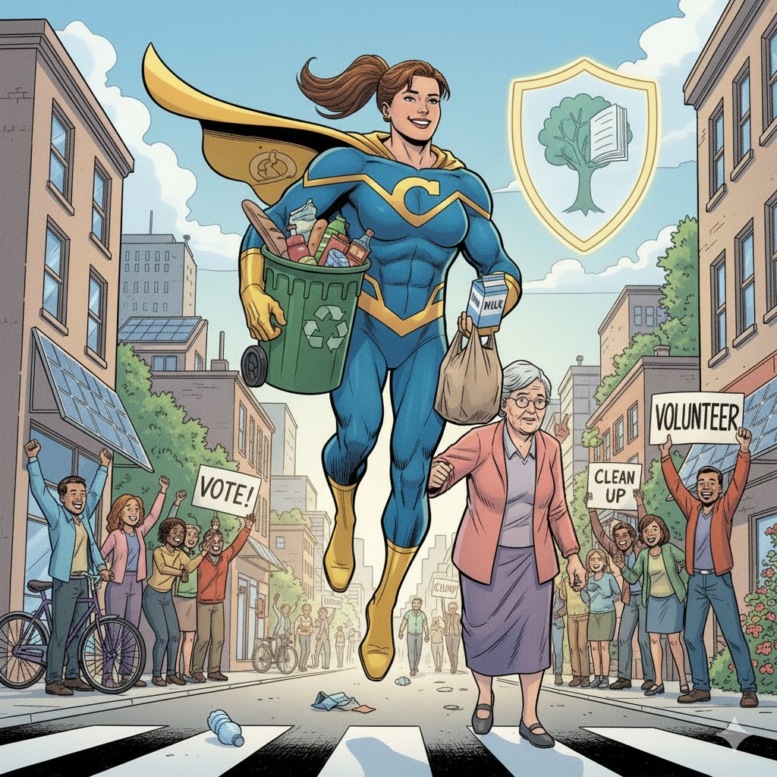
What makes for a good citizen?
What actions should they take?
e.g. volunteer
What skills and attributes should they have?
e.g. empathy (skill)
self confidence (attribute)
Notes:
Please ask students to work in small groups to reflect on the actions and skills/personal attributes.
This can be done as a whole class activity to then feedback their thinking to the board

Slide 17
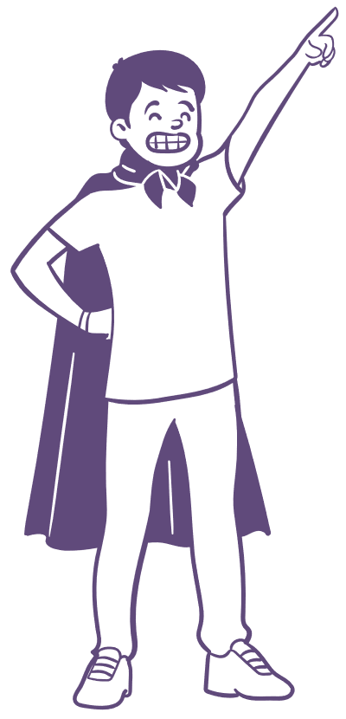
What makes for a good citizen?
Please privately consider:
Something you already do that makes you a good citizen.
Something that you plan to do to make you an even better citizen.
Notes:
Please ask students to privately reflect on these questions.

Slide 18
4 Key actions of a good citizen (1):
1. Respects the rules (The Foundation):
They follow laws, even if they sometimes disagree with them, because they understand rules are necessary for order and fairness.
They show courtesy and respect to other people, property and the environment..
2. Stays Informed (The Thinker):
They try to learn about important issues by reading, watching the news, or having thoughtful discussions.
They don't just accept everything they hear; they ask questions and think for themselves.
Notes:
Please talk through this slide and slide 19 before asking students to work in small groups and prepare for the activity on slide 20.
In simple terms: A good citizen is someone who is a team player, who cares about their community and works both to follow the rules and to improve them.

Slide 19
4 Key actions of a good citizen (2):
3. Contributes and Helps (The Doer):
They volunteer, help a neighbour, or participate in school or community campaigns.
They vote (when they are old enough) and let their leaders know what they think is important.
4. Stands Up for Fairness (The Advocate):
They speak up (respectfully) when they see something unfair or wrong happening.
They understand that sometimes being a good citizen means challenging a rule or law peacefully to make the community more just for everyone.
Notes:
Please read through this slide as a follow on from slide 18.

Slide 20
Create a character
Please focus on 1 of the 4 key actions of a good citizen:
1. Respects the Rules (The Foundation)
2. Stays informed (The Thinker)
3. Contributes and helps (The Doer)
4. Stands up for fairness (The Advocate)
Work in your small group to create a short story which shows how your character contributes to their community as a good citizen. Which of the above key actions do they do?
Please be ready to share your story.
Notes:
We recommend asking students to work in eight small groups, so that two groups can discuss each of the four key actions.
Each small group showed follow the instructions on the slide to create a character & short story to show how they character contributes to their community as a good citizen.
These can simply be read, explained or performed.

Slide 21

reflection
ASK what are you taking from today’s lesson?
If anyone was concerned about anything from today’s lesson, where could they get help?
Notes:
Please ask students to reflect on what attributes (e.g. honesty, integrity, courage, humility, generosity, self-worth, kindness, trustworthiness etc) they have used during this lesson,
What skills (e.g. Oracy, Empathy, Compassion, Presentation, Assertiveness, Active listening, Interpersonal skills, Positive peer pressure , Resist unwelcome pressure, Distinguish between fact & opinion) etc
What knowledge have they used or acquired during this lesson?

Slide 22
Get support
To talk with someone confidentially about how you feel, you can:
Contact Isle Listen: 01624 679118 www.islelisten.im
Text SHOUT to 85258 to contact the Shout textline
Call HOPELINE247 on 0800 068 4141 or the NHS on 111 and select option 2
Contact Childline by using 1-2-1 chat or calling 0800 1111
If you or someone else is seriously hurt, this is an emergency.
You should:
Call 999 and ask for an ambulance
Tell an adult you trust and ask them to call 999 for help
Notes:
Please ensure that students are made aware of these, and any other sources of support.

