Slide 1

TEACHER SLIDE
This is the second of a series of lessons for Y8 learning about respectful and cohesive communities and inclusion.
These lessons have been inspired by the work of the PSHE Association and adapted for children on the Isle of Man.
This lesson focuses on different types of bias and stereotypes and how these patterns of thinking can affect behaviour.

Slide 2
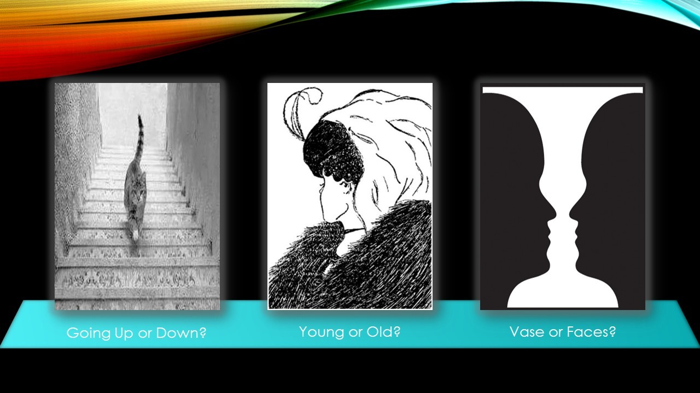
Do it now: what do you see?
Notes:
Have slide on as students come in. Ask them to sit quietly as they look at the different images.

Slide 3
Activity | Description | Timing
Introduction | Ask students to complete the ‘do it now’ task. Introduce learning objectives and revisit class agreements. | 5 minutes
Responding to the do it now task and baseline | Ask students to share their thoughts from the do it now task. Move on to asking students to define what a bias is and ensure they understand the different types of biases you will be discussing today. | 5 mins
Examples of bias | Slides 11-15 pose different scenarios – in small groups or as a whole class, ask students to identify which bias is being described. | 10 mins
How do biases develop and persist? | Ask students to think about where biases come from – how do we learn them, and why do they persist? Give them a few minutes to think/discuss before providing answers. | 5-10 mins
Stereotypes | Make connection between biases and stereotypes, and introduce stereotype activity described on slide 21. Following this activity, ask students to discuss effective strategies for responding to stereotypes. | 10-15 mins
Reflection / Get support | Please ensure that the students have a few minutes to reflect on their learning and remind them of sources of support | 5 mins
Notes:
Please note these timings are advisory, and you will have to adjust things depending on your timetable and the needs of the class.

Slide 4

DO IT NOW
What do you think the word bias means?
Can you think of any examples of bias?
Notes:
Please display this slide on the board as the students are walking into the room

Slide 5

understanding bias
& stereotypes
YEAR 8
Notes:
Please briefly explain the purpose of this lesson

Slide 6
LEARNING OBJECTIVES
By the end of this lesson, students should be able to:
explain what a bias is, how it is formed, and why it sometimes persists
discuss the impact of biases on individuals and communities
identify strategies for responding to bias
Notes:
Please ensure that students are clear about the purpose of this and subsequent lessons.

Slide 7

CLASS AGREEMENTS
No personal comments
Kindness and respect
Right to pass
No such thing as silly questions
Any others?
Notes:
Please revisit the ground rules as necessary
1. No one should ask personal questions or make personal comments about other people.
2. We will treat one another with kindness and respect (listening to each other, speaking one at a time, etc)
3. We all have the right to 'pass' on answering a question or participating in an activity that makes us feel uncomfortable.
4. We can disagree but will not pass judgments, make fun of, or or put anybody down. 'Challenge the opinion, not the person.’
5. Asking questions is encouraged and will be valued by our teacher. We do not ask questions to purposefully embarrass or belittle another.
*Feel free to change the agreements to suit your class and ask whether there are any others they'd add to the list to create a safe, comfortable learning environment.

Slide 8
Notes:
Now ask students to share the first things they saw in these images. Ask if anybody was able to see both perspectives e.g. the cat going up and down, the young and old woman, etc. What does this say about perspectives? How does this relate to thinking biases? Make the point that this simple optical illusion was to demonstrate that people may see things slightly differently, and our brains can sometimes automatically come to a conclusion without us consciously thinking it – similar to how biases work.

Slide 9
What is a bias?
Definition:
Our feelings in favour of, or against, a person, group, or idea based on someone’s experiences, opinions or beliefs.
There are different types of biases, which we’ll explore further.

Slide 10
Explicit bias is a biased belief about something that a person is aware of. A person might make conscious decisions based on these attitudes. Explicit bias can include racism, sexism, and homophobia.
Implicit (or unconscious) bias is when feelings and stereotypes affect someone’s beliefs about something. They may be unaware that this is affecting their thinking.
Confirmation bias is when someone seeks, or only pays attention to, information or opinions that match or agree with their existing beliefs and attitudes.
Notes:
Explicit Bias: is a conscious bias. The person is fully aware of their attitudes or beliefs toward a person or group, and those attitudes are openly expressed.
E.g.: A student refuses to work with someone in a group project because they’re from a different religion.
Implicit Bias (Unconscious Bias): is an unconscious preference for or against a person or group. It is an automatic judgment or stereotype that a person may not even know they hold, and it can go against their declared values.
E.g.: A teacher who always picks on boys to answer maths questions.
Confirmation Bias: is the tendency to search for, interpret, favour, and recall information in a way that confirms or supports one's prior beliefs or values. It's not necessarily about a social group, but about reinforcing any existing idea.
Example: You believe that another student in class doesn’t like you, and you only notice/remember times when they seemed disinterested or unfriendly towards you, even if there were plenty of times they seemed happy to talk to you.

Slide 11
What kind of bias is this?
Examples of bias (1)
An influencer on TikTok makes a video about her new favourite makeup product – you immediately trust her, because she has over a million followers.
Implicit bias
Carley is a Liverpool fan. She only ever reads news articles that praise LFC and ignores anything that criticises the team.
Confirmation bias
A student refuses to work on a group project with a classmate from another country, because they don’t believe non-Manx people are smart enough.
Explicit bias
Notes:
Please ask students to work individually or in small groups and review each of the three statements.
Ask them to decide whether they think the statement demonstrates implicit (or unconscious) bias, confirmation bias, or explicit bias. Invite for whole class discussion afterward.

Slide 12
What kind of bias is this?
Examples of bias (2)
Alex has chosen GCSE psychology and is annoyed because there are so many boys in the class. She looks through some test scores and selects examples of when girls have done better than boys in exams, to complain to the teacher.
Confirmation bias
When people meet Matthew for the first time, they are surprised that he is down to earth and friendly, because they know he goes to a private school.
Implicit
bias
Sheridan plays football. When a teammate makes a mistake, Sheridan shouts a sexist comment because they are so angry.
Explicit bias
Notes:
Please continue with a similar exercise, asking students to identify the type of bias that each statement is describing.

Slide 13
Examples of bias
Confirmation bias
Aisha wears a headscarf due to her religious and cultural beliefs. Although her classmates find her nice and good to talk to, she is rarely invited to hang out after school or on weekends. When Aisha asks a girl in her class why she wasn’t invited to the cinema recently, her classmate appeared surprised and responded that they didn’t think she was allowed to do those kinds of things.
What kind of bias is this?
Notes:
Please read through the text on this slide before asking students to work in small groups or individually to respond to the final question.
This is implicit or unconscious bias – because Aisha wears a headscarf and follows a certain religion, her classmates assume that she is strict and unable to partake in the same activities they enjoy, without asking her.

Slide 14
Examples of bias
Confirmation bias
Colin is really interested in fashion and has started a YouTube channel where he discusses the latest trends. Colin is not gay or trans, but some people from his school have begun leaving homophobic and transphobic insults on his videos.
What kind of bias is this?
Notes:
This is an example of explicit bias. Anyone leaving messages on Colin’s channel should know that homophobic and trans phobic comments are unacceptable and possibly illegal.
Discuss what Colin could or should have done when the first messages started to appear. Would this have been easy? What if Colin made some comments and the trolls got worse?
What could other viewers/classmates have done to support Colin and/or challenge the views of the trolls? Why might they have chosen not to do this?

Slide 15
Examples of bias
Taylor is in Ms Brown’s English class. Taylor usually does well and has a good relationship with their teacher. However, last week, Taylor received a low mark on their essay, and today they were told off for chatting during a lesson.
On the walk home from school, Taylor begins grumbling to a friend that Ms Brown obviously hates them and starts trying to remember all the times that Ms Brown has “picked on” them.
Confirmation bias
What kind of bias is this?
Notes:
Having confirmed that Taylor is experiencing confirmation bias, you may wish to discuss why Taylor thinks that Ms Brown doesn’t like them. Could there be a different perspective?

Slide 16
Where do you think biases come from? How do they develop?
Notes:
Whole class or small group/pair discussion – ask students to have a think about how biases can develop – what influences our perceptions of people/places/things?

Slide 17
Biases can form because of:
Personal experiences, which we then generalise to a whole group
“I was bullied by someone with blonde hair, so all blondes must be bullies.”
Media influence
TV shows with blonde villains or bullies; news stories about blonde people being more likely to be mean.
Beliefs learned from our friends, families, or communities
My Dad says blonde kids are dangerous, and doesn’t want me to be friends with them.
Notes:
Whole class or small group/pair discussion – ask students to have a think about how biases can develop – what influences our perceptions of people/places/things?

Slide 18
Why do biases persist?
Notes:
Ask students to think about why our biases, once learned, can sometimes be persistent and difficult to change.

Slide 19
Biases can persist because of:
Confirmation bias (only paying attention to information that agrees with us)
All the blonde kids in my class are pretty mean (except for those other blonde students who were quite nice to me, but I won’t remember those!)
Social reinforcement
Whenever I talk about how much I dislike blonde people, my friends and family agree with me.
Social media echo chambers
Because I engage with videos that make fun of blonde people, the TikTok algorithm keeps sharing more videos that make them look bad.
Lack of exposure to counter examples
I actually don’t know that many blonde people, and I never see them portrayed positively on TV or online.
Notes:
Whole class or small group/pair discussion – ask students to have a think about how biases can develop – what influences our perceptions of people/places/things?

Slide 20
How are biases
and stereotypes related?
Notes:
Stereotypes come from bias When you already prefer or dislike something, you look for simple labels that fit that feeling. Stereotypes are those quick labels your brain uses to organize people. Bias makes stereotypes stick
If you expect a group to act a certain way, you notice examples that match the label and ignore the ones that don’t. That keeps the stereotype alive.
Stereotypes make biased actions more likely Acting on a stereotype (like excluding someone from a team) is biased behaviour. That behaviour can hurt people and make unfair situations repeat.
They feed each other Stereotypes create biased expectations, and those expectations change how people behave or how others treat them, which then seems to “prove” the stereotype.
If someone believes teens are irresponsible (stereotype), they might give fewer chances to a teen to lead a project (bias in action). The teen gets less practice and might actually struggle later, which some people then point to as proof that the stereotype was right.

Slide 21
Activity: stereotypes
Athlete
Rapper
Fashion designer
Scientist
Parent
Gamer
Vegetarian
Refugee
Artist
Grandparent
Model
Coder
Cyclist
Dancer
Activist
Biker
Nurse
Tradesperson
Notes:
Split the class into small groups. Assign each group a character (note you do not have to use all of the above labels, and you can come up with your own if you wish), and ask the groups to spend a few minutes writing or drawing as many words/images that come to mind to describe that character. For example, if a group is assigned the word “athlete” they may write things like tall, lean, fast, male, young, etc or they may draw these attributes.
After a few minutes, ask each group to present their character and the traits they came up with. Ask the rest of the class to poke holes in these stereotypical portrayals – do they know any athletes who are older, or female, or in a larger body, or not fast (if their sport doesn’t require it)? The idea is to get the class to recognise that as many stereotypes as there are, there are equally as many people who defy those stereotypes!

Slide 22
Questions to challenge stereotypes
What are some of the questions we could ask to challenge stereotypes?
Where did you first hear that?
Is that true for every person you know from that group?
Is that a fair way to describe someone you haven’t even met?
Has someone ever said something untrue about a group you belong to?
What does being X have to do with being Y?
E.g. What does being a boy have to do with being good at sport?
Notes:
Please ask students to work individually or in small groups and give them 2-3 minutes to consider some questions that could be asked to challenge stereotypes.
Questions to Challenge Stereotypes
"Can you think of an example that goes against that idea?"
Why it works: It shifts the focus from the general rule to the exception, which proves the stereotype isn't universal.
"Where did you first hear that?"
Why it works: It makes the person reflect on the source of the stereotype, which is often unreliable, historical, or biased.
"If we switched [the group being discussed], would that statement still sound true?"
Why it works: It uses the "switch test" to expose bias. For example, if someone says, "All are bad at math," the question, "If we switched with , would you still say that?" often reveals that the statement is rooted in prejudice, not fact.
"Is that true for every single person you know from that group?"
Why it works: It forces a recognition of individual differences and the vast diversity within any population group.
"What does being have to do with being ?" (e.g., "What does being a boy have to do with being good at sport?”)
Why it works: It asks for a logical connection between the group and the trait, which is usually non-existent or based on a false assumption.
"Has someone ever said something untrue about a group you belong to?"
Why it works: It encourages empathy by asking the person to consider how it feels to be unfairly judged by a broad generalization.
"Is that a fair way to describe someone you haven't even met?"
Why it works: It highlights the unfairness of prejudgment and encourages judging people based on their actual character and actions.
"What would you like people to know about your group that isn't a stereotype?"
Why it works: This is a positive, inclusive question that shifts the conversation away from negative generalizations and toward complex, positive realities.

Slide 23
I think I might have a bias!
Am I a bad person?
Having biases doesn’t make you a bad person – it makes you human!
We are all influenced by our communities, our personal experiences, and the media we consume, so it’s inevitable that some biases will form. Sometimes our brains will automatically produce a biased thought, without us wanting it to.
We can’t always control the thoughts we have (including our automatic biases and assumptions) but what we can control is making sure we recognise and respond to these kinds of thoughts.
If you notice yourself having a biased thought, it’s important to identify it, and try to ask yourself some questions (like those on the previous slide) to consider an alternative perspective.

Slide 24

reflection
ASK what are you taking from today’s lesson?
Attributes?
Skills?
Knowledge?
Notes:
Review: Quickly recap the main points of the lesson: humans need and benefit from living in communities with shared interests. Please review some of the ways that this can be done effectively.
Please ask students to reflect on what attributes (e.g. honesty, integrity, courage, humility, generosity, self-worth, kindness, trustworthiness etc) they have used during this lesson,
What skills (e.g. Oracy, Empathy, Compassion, Presentation, Assertiveness, Active listening, Interpersonal skills, Positive peer pressure , Resist unwelcome pressure, Distinguish between fact & opinion) etc
What knowledge have they used or acquired during this lesson?

Slide 25
Get support
To talk with someone confidentially about how you feel, you can:
Contact Isle Listen: 01624 679118 www.islelisten.im
Text SHOUT to 85258 to contact the Shout textline
Call HOPELINE247 on 0800 068 4141 or the NHS on 111 and select option 2
Contact Childline by using 1-2-1 chat or calling 0800 1111
If you or someone else is seriously hurt, this is an emergency.
You should:
Call 999 and ask for an ambulance
Tell an adult you trust and ask them to call 999 for help
Notes:
Please ensure that students are made aware of these, and any other sources of support.

