Slide 1
TEACHER SLIDE
As the title suggests, this lesson focuses on developing students understanding of friendship, and the role that empathy plays in creating, sustaining and, where necessary, repairing relationships. It also includes opportunities for students to explore strategies for making new friendships. This latter expectation is central to many students' experience of starting secondary school.
Developing empathy is crucial for students of this age when it comes to building and maintaining relationships.
Developing empathy also supports conflict resolution, helping young people see disagreement from a friends’ point of view, leading to more constructive mutual understanding rather than just focusing on their own anger or hurt.
By recognising when a friend is upset, young people can offer genuine support and comfort which deepens trust and makes the friendship feel emotionally safe and reliable.
Understanding non-verbal cues and emotional context improves communication, ensuring that young people respond appropriately, not just in friendships but also in all relationships, hence contributing to employability skills.
Additional resources about empathy can be found via www.empathystudios.com – which uses the power of film and storytelling to develop the skills of empathy in young people aged 5-18.

Slide 2
Activity | Description | Timing
Introduction | Ask students to complete the ‘do it now’ task. Introduce learning objectives and revisit class agreements. | 5 mins
DIN reflect(1) | Please use slides 7 & 8 to teach the difference between sympathy and empathy | 5 mins
Please don’t say / how to show empathy. | Please discuss the six statements on slide 9 and ask students to why these statements are probably neither sympathetic or empathic. Then move to slide 10 to demonstrate how statements can be sympathetic but subtly adjusted to become empathic | 10 mins
The empathy Walk | Please spend a few minutes encouraging students to consider how they physically show a particular emotion. NB, this slide uses the music from the pink panther if you wish. | 5 mins
Benefits of friendships | Please revisit the second part of the ‘do it now task’ and ask students to identify the benefits of friendship, | 10 mins
Think, pair, share | Please ask students to work in small groups to discuss one of the eight statements – if you prefer to conduct the next activity (Good friendships) please use that activity instead of this. | 10 mins
Optional – Good Friendships | If time permits, please ask students to work in small groups to discuss one of the four questions on slide 15 | 10 mins
Optional - Friendship strategies | Please only use this slide if you have time and/or need to extend the discussion. Please ask students to work in small groups to discuss some of these strategies to get to know people even better. | 5 mins
Advice and support | Please use the ASK reflection for their learning and signpost students to where they can get help. | 5 mins
Notes:
Please note, timings are indicative and will vary according to Teacher expectations and the needs of students.

Slide 3

DO IT NOW
What do you think empathy means?
What are three benefits of friendship?
Notes:
Please ensure that this slide is visible to students as they come into the room.

Slide 4

Friendship & Empathy
YEAR 7

Slide 5
LEARNING OBJECTIVES
  By the end of the lesson, students should be able to:
identify a range of strategies for making and maintaining positive friendships
describe or demonstrate how to empathise with peers
analyse the effectiveness of strategies that can be used to include others
Notes:
Please ensure the students are clear about the learning objective for this lesson.

Slide 6

CLASS AGREEMENTS
  No personal comments
  Right to pass
  Nonjudgmental
  No such thing as silly
questions
any others?
Notes:
Explain that you would like the class to create a list of 'agreements' for how everyone will behave and treat one another in the class. Ensure a common understanding. For example:
1. We will treat one another with kindness and respect (listening to each other, speaking one at a time, etc)
2. We all have the right to 'pass' on answering a question or participating in an activity that makes us feel uncomfortable.
3. We can disagree but will not pass judgments, make fun of, or or put anybody down. 'Challenge the opinion, not the person.'
4. Asking questions is encouraged and will be valued by our teacher. We do not ask questions to purposefully embarrass or belittle another.
*Feel free to change the agreements to suit your class, and ask whether there are any others they'd add to the list in order to create a safe, comfortable learning environment.

Slide 7
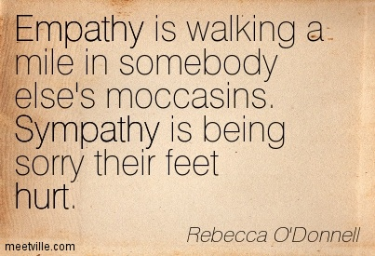
Do it now reflection (2)
What is empathy?
Empathy means understanding how someone else feels and caring about their feelings.
When you have empathy, you listen, care, and try to help others feel better.
What is sympathy?
Sympathy: feelings of pity and sorrow for someone else's misfortune. (Chambers dictionary)
Notes:
Please engage students in some discussion/conversation about the difference between empathy and sympathy. Please use this, and the next slide, to teach about the difference between empathy and sympathy.
Empathy means feeling with someone.
💬 Sympathy means feeling for someone.
Imagine your friend falls and scrapes their knee:
If you say, “Ouch! That must really hurt. I’ve felt that before,” and you feel sad with them — that’s empathy. You’re putting yourself in their shoes.
If you say, “I’m sorry that happened to you,” but you don’t really feel what they’re feeling — that’s sympathy. You care, but you’re not feeling it the same way.
Think of it like this:
Empathy is like being on the same team with someone’s feelings. Sympathy is cheering for them from the sidelines.

Slide 8
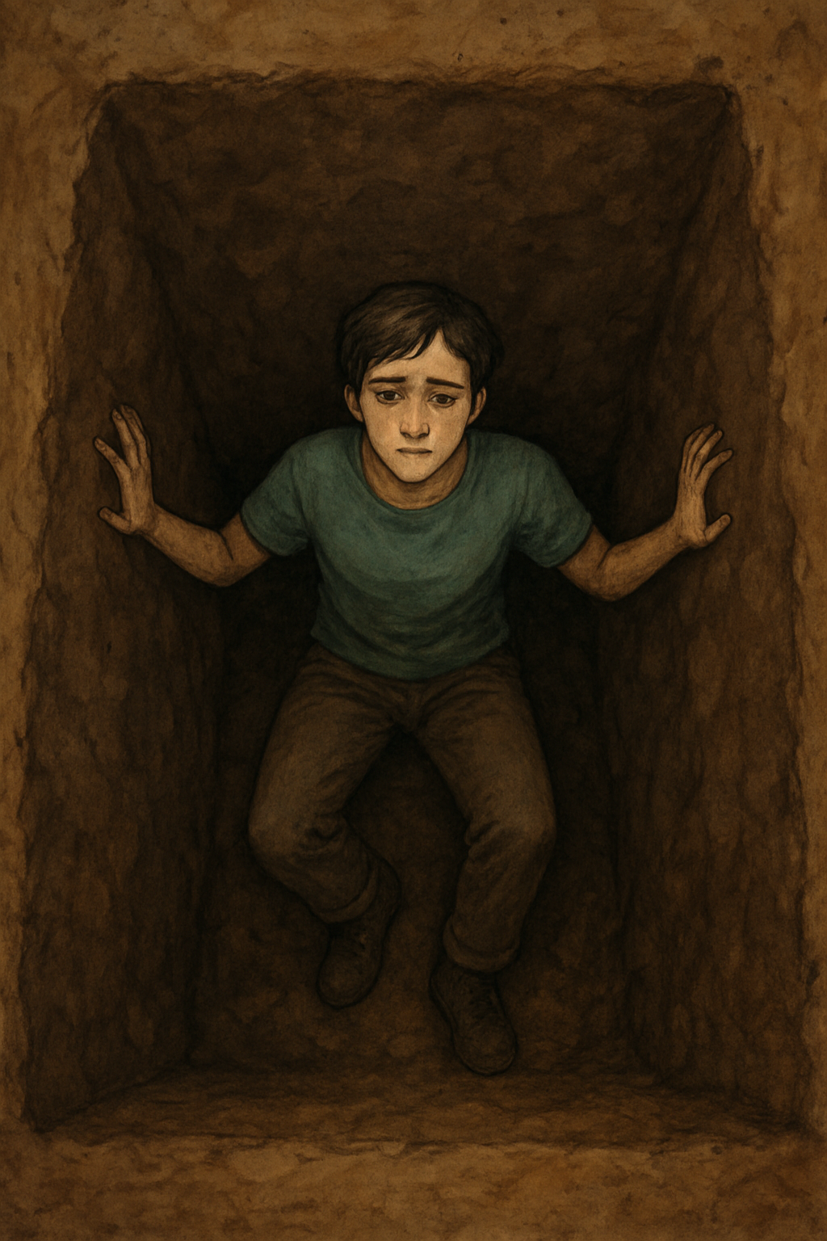
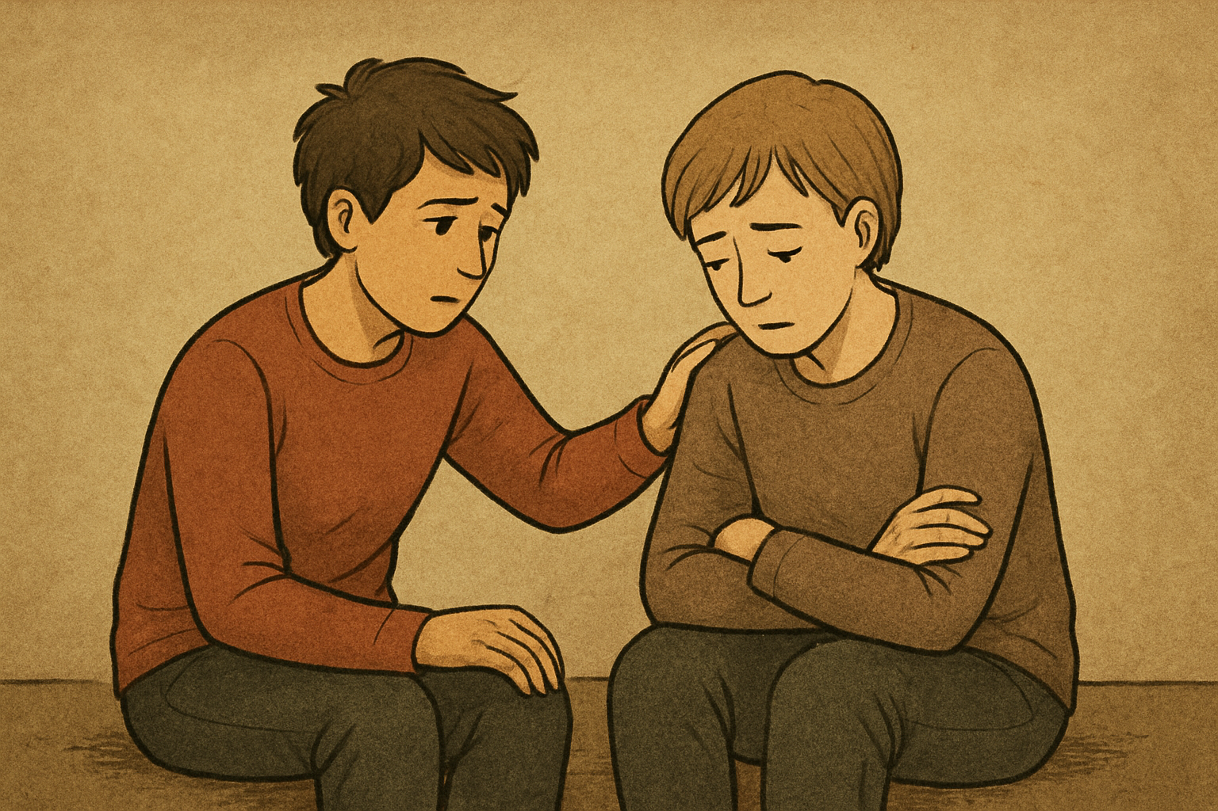
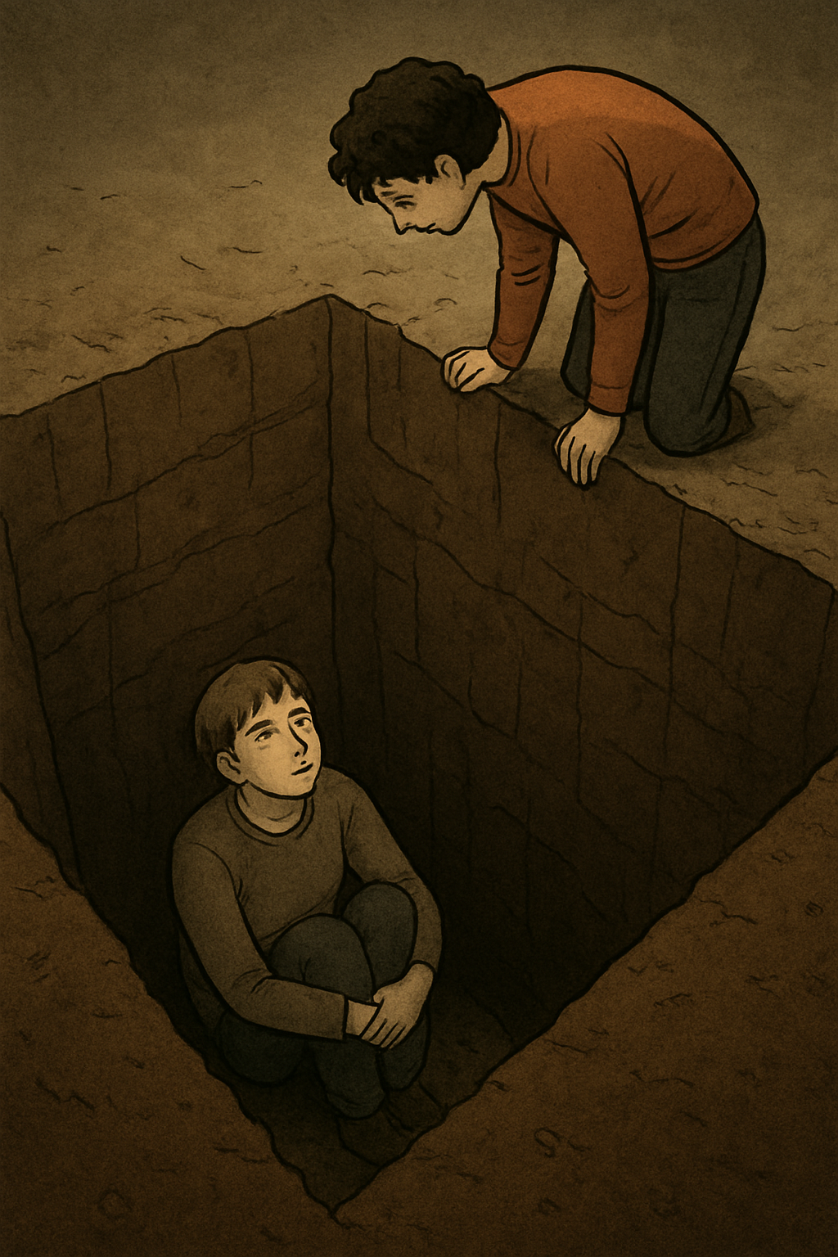
What is the difference between sympathy
& empathy?
I know what it feels like to be scared.
I’ll just sit with you.
I feel sorry for you. At least I’m not in the hole.
I’m stuck in this hole! It’s dark & I’m scared.
Notes:
Please use this slide to teach about the difference between sympathy and empathy.
Ask students why empathy may be more powerful than sympathy.
Has anyone ever seen a card “with deepest sympathy”? Would it be better if this card were rewritten to read:” with deepest empathy”?

Slide 9
Sympathy or empathy, please don’t say:
These phrases are not ‘bad’ and many people may say this sort of thing, but why don’t these show sympathy or empathy?
“You’ll get over it.”
“That’s not a big deal.”
“Stop crying.”
“Just be happy.”
“It could be worse/other people have it worse.”
“I know exactly how you feel.” (when you really don’t)
Notes:
Please use these phrases and discuss with students why they fail to show either sympathy or empathy.

Slide 10
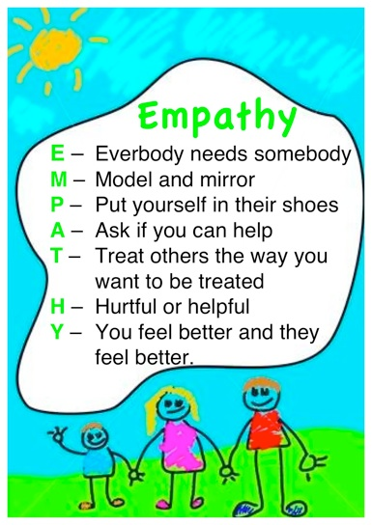
How to show Sympathy & empathy
I’m really sorry you’re going through that, it sounds really hard.
That must’ve been upsetting, I hope things get better soon.
I’m sorry that happened to you, you didn’t deserve that.
I get why you’re sad, what are you going to do now?
I am sorry you’re going through that, what can I do to help?
That must have been upsetting, I can only imagine how difficult this must be.
I am sorry that happened to you, I’m just wondering what I can do to help?
I get why you are sad, you have every right to feel like that.
Notes:
First, please discuss the five statements which show sympathy. How can these be changed slightly to become more empathic? Please then click through the next five statements.

Slide 11
The empathy walk
When asked, please walk around the room.
When the music stops, freeze!
Your teacher will call out an emotion, and you have to demonstrate the facial expressions and body language that shows that emotion!
Notes:
If you prefer not to use this slide, don’t!
If your students are reasonably playful, you may wish to play the tune as they walk around the room.
Please pause the music and call out one of the following emotions, which the students then have to demonstrate with their facial expression and body language:
Happiness; sadness; frustration; confusion; surprise; fear; pride/confidence.

Slide 12
Do it now reflection (2)
What are the benefits of friendship?
Friends:
Make you feel happy and loved
Help you when you’re feeling sad
Make playing and learning more fun
Cheer you up when you’re feeling down
Teach you to share and care
Help you to feel less lonely
Encourage you to try new things
Celebrate your successes with you
Listen when you need to talk
Make life more interesting every day
Notes:
Please now revisit the second part of the ‘do it now’ conversation.
Students were asked to identify three benefits of friendship; let’s see if we can get a class list of 10 benefits for showing this slide. Is there anything on this slide we haven’t discussed?
What have we discussed that isn’t on this slide?

Slide 13
Think, pair, share
Who catches you when you fall? How can friends support you when life gets tough?
Shared secrets and inside jokes; why is trust essential for a strong friendship?
One friend or many? Discuss the benefit benefits of having different types of friends.
Imagine break time alone. How does a good friend make daily life better?
If everyone was exactly the same? How can friends help us learn new perspectives?
Can friends disagree and still stay close? How can we resolve conflict with friends?
The best advice you ever got came from… How can friends be guides and advisor?
Loyalty is a gift. What does it mean to be a truly loyal friend to someone?
Notes:
This and the following slide (14) are optional, depending on how much time you have left.
If you use this slide, we recommend asking students to work in small groups and have one group discuss each of the statements before drawing together for a plenary.

Slide 14
Good friendships
Please work in small groups to discuss:
The key features of a positive friendship
How can people get to know each other and become friends?
What should friends do to maintain their friendship?
How could friends deal with any disruption to their friendship?
Notes:
This slide can be missed if you have completed the previous activity (slide 13).
If you prefer to use this slide, we recommend asking students to work in eight small groups and having two small groups discuss each of the statements, please give students time to reflect on their thinking before sharing in a plenary.

Slide 15
Strategies for getting to know people
Starting conversations | With people you know: Hi have you watched…? With people you don’t know: Hi, I’m Sam, I saw you watching the football …
Using questions to get to know someone | What kind of music do you like?
Including people | Have you heard about the drawing club, would you like to try it with me?
Picking up on social clues | Body language …
Asking questions about what someone has said | Who do you think is going to win? (TV, reality, sporting contest?)
What are some other ways to develop positive friendships?
Notes:
You may wish to ask students, a whole class to briefly discuss some of the questions that people can ask to engage other people to get to know them better.
If you prefer to ask the students to work in small groups and focus on one particular statement from the left-hand column, that’s fine!

Slide 16

Reflection
ASK what are you taking from today’s lesson?
If anyone was concerned about anything from today’s lesson, where could they get help?
Notes:
Review: Quickly recap the main points of the lesson: how do we show friendship and empathy?
Key Takeaway: End the lesson by reinforcing the message of self-worth and safety. Emphasise that a healthy relationship should make them feel happy, safe, and respected. No one deserves to be in a relationship where they feel diminished or controlled.
Please ask students to reflect on what attributes (e.g. honesty, integrity, courage, humility, generosity, self-worth, kindness, trustworthiness etc) they have used during this lesson,
what skills (e.g. Oracy, Empathy, Compassion, Presentation, Assertiveness, Active listening, Interpersonal skills, Positive peer pressure , Resist unwelcome pressure, Distinguish between fact & opinion) etc
What knowledge have they used, or developed during this lesson?

Slide 17
Get support
To talk with someone confidentially about how you feel, you can:
Contact Isle Listen: 01624 679118 www.islelisten.im
Text SHOUT to 85258 to contact the Shout textline
Call HOPELINE247 on 0800 068 4141 or the NHS on 111 and select option 2
Contact Childline by using 1-2-1 chat or calling 0800 1111
Notes:
Please remind the students they can talk to you, and they can access support via Childline, and Isle Listen

