Slide 1
TEACHER SLIDE
This lesson focuses on menstruation. It is important that male students in the class understand why they are being taught this information. By including male students in learning about periods, we aim to:
Normalise talking about periods and reduce embarrassment/shame
Dispel myths and misconceptions
Encourage empathy and understanding
You may also wish to invite students to write any questions they have about menstruation on a piece of paper and submit after class, if they’re not comfortable asking the question during class.

Slide 2
Activity | Description | Timing
Introduction | Ask students to complete do it now task. Introduce lesson and revisit ground rules. | 5 mins
What is menstruation? | Introduce menstruation and watch video, checking for understanding/questions afterward. Ask students to think of ways to minimise period pain. They should understand that while periods can be uncomfortable/painful at times, if the pain is severe or debilitating, they should see a doctor. | 10 mins
Hygiene products | Show video on period products/hygiene, asking students to compare to their ‘do it now’ answers. Students should then be split into 5 small groups. Each group should be given one period product poster, and each student in the group should have an information table. Further instructions on slide 14. | 15-20 mins
Discussion | Does the class think that boys should learn about menstruation? Why or why not? | 5-10 mins
Myth busting/Reflections | As a final activity, review common period myths with the class and ensure students understand the facts. Ask students to reflect on the lesson using ASK acronym. | 10 mins

Slide 3

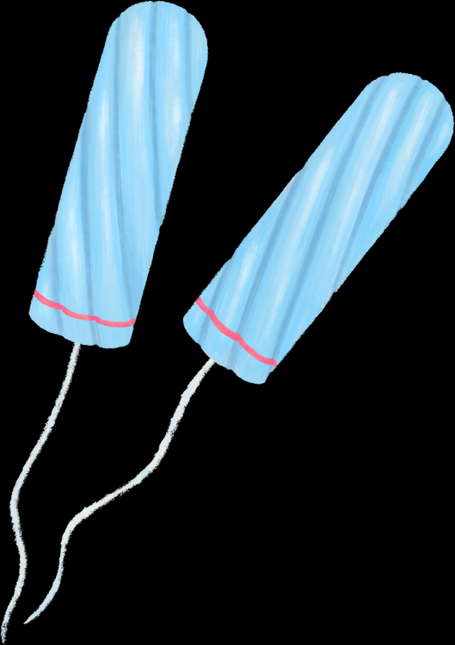



These images show different products that women/girls may use when they have their period. How many do you recognise? What are they called and how are they used?
DO IT NOW
Notes:
This can be done individually, in pairs, or small groups. Ask students to see if they can identify the period products on the slide, and how they are used.

Slide 4

MENSTRUATION
YEAR 7
This presentation has been adapted for the Isle of Man from Scotland’s national resource for relationships, sexual health, and parenthood (RSHP) education.

Slide 5
LEARNING OBJECTIVES
Explain what menstruation is
Describe different period products that are available
Understand where to go for help if I have a question or worry

Slide 6

CLASS AGREEMENTS
Kindness and respect
Right to pass
Nonjudgmental
No such thing as silly
questions
any others?
Notes:
Explain that you would like the class to create a list of 'agreements' for how everyone will behave and treat one another in the class. Ensure a common understanding. For example:
1. We will treat one another with kindness and respect (listening to each other, speaking one at a time, etc)
2. We all have the right to 'pass' on answering a question or participating in an activity that makes us feel uncomfortable.
3. We can disagree but will not pass judgments, make fun of, or or put anybody down. 'Challenge the opinion, not the person.'
4. Asking questions is encouraged and will be valued by our teacher. We do not ask questions to purposefully embarrass or belittle another.
*Feel free to change the agreements to suit your class, and ask whether there are any others they'd add to the list in order to create a safe, comfortable learning environment.

Slide 7
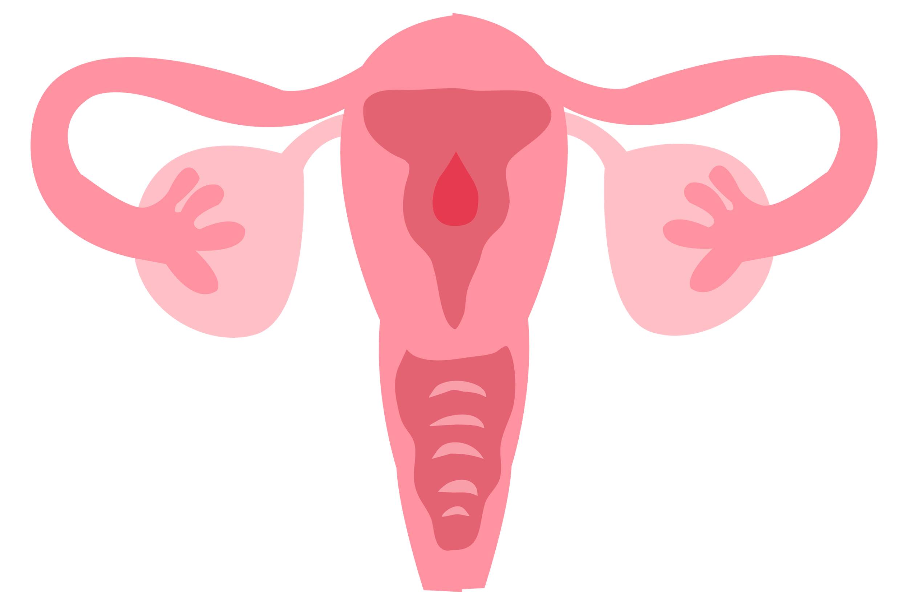
WHAT IS MENSTRUATION?
Each month, the female body prepares for the possibility of pregnancy. An egg is released from the ovaries, and the lining of the uterus thickens.
If an egg is not fertilised and no pregnancy occurs, the uterus will break down this lining (basically to get rid of what it doesn’t need!)
The lining will then come out through the vagina in the form of bleeding and other fluids. This is what’s known as menstruation, or as most people call them, periods.

Slide 8
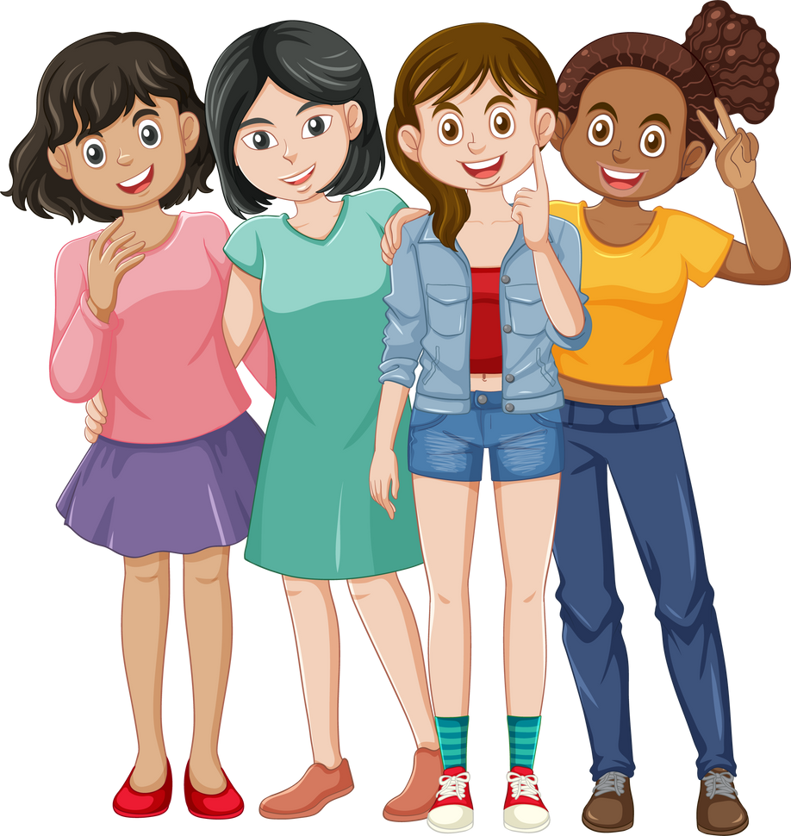
Most girls start their period between the age of 10 and 16.
Some girls start earlier, some later.
All girls are different and unique.
Notes:
Emphasise the point that girls will start their periods at different times, and that this is completely normal.

Slide 9

Notes:
If embedded video doesn’t work, you can find it here: https://www.youtube.com/watch?v=ypMyH0W1trs

Slide 10
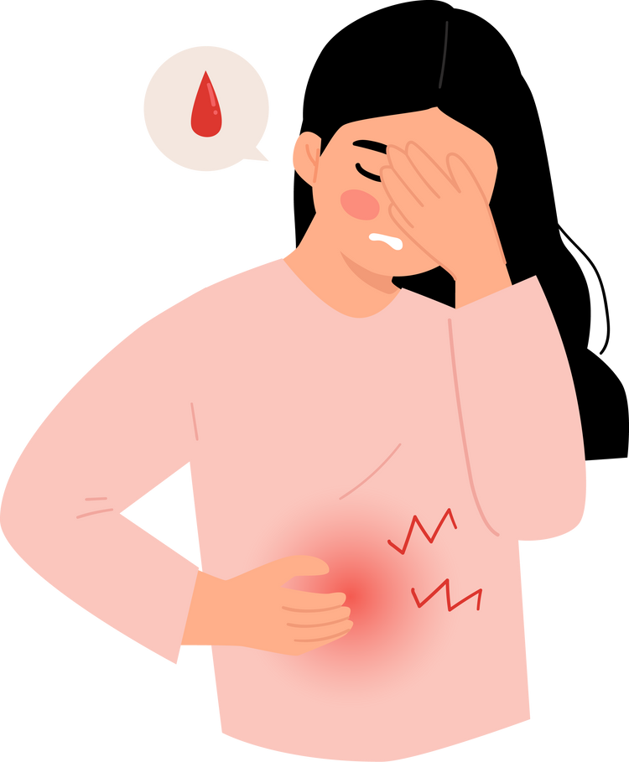
DO PERIODS HURT?
Some girls may experience pain or discomfort during their periods.
This may begin a few days before a period starts and can also happen during the first few days of a period.
You may notice a sharp or dull ache in your lower abdomen.
Notes:
Explain that some pain and discomfort is normal during a period.
Before showing slide 11, ask the class if they can think of any ways that period pain can be managed.
Show slide 11 and ask if the class would add anything to the list.
Move on to slide 12 and explain that while some pain is normal, severe/debilitating pain should be investigated by a doctor.

Slide 11
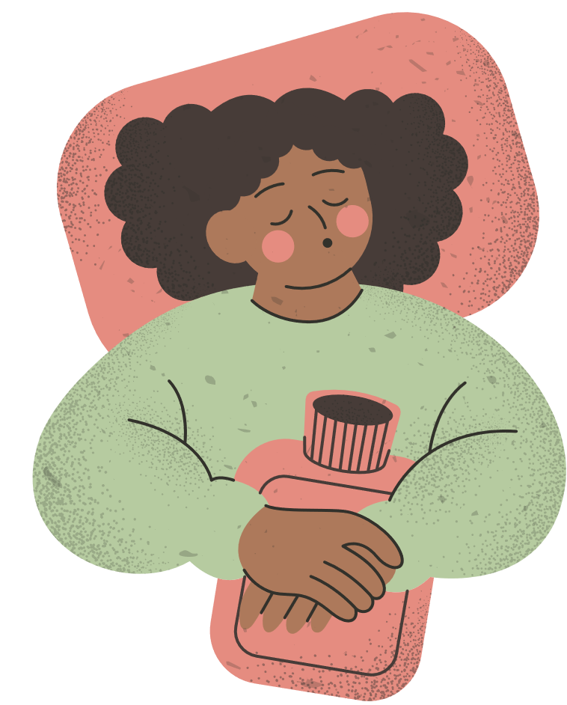
HOW CAN YOU EASE PERIOD PAIN?
Warm baths or showers
Hot water bottle
Pain relief medication (paracetamol, ibuprofen)
Gentle exercise (walking, yoga stretches, swimming)
Massage lower abdomen/back

Slide 12
DO PERIODS HURT?
While some pain and discomfort is (unfortunately!) totally normal, period pain should not be severe. If you are concerned about pain, please tell an adult you trust, and they can help you to make a GP appointment and check for any problems that might be causing it.

Slide 13
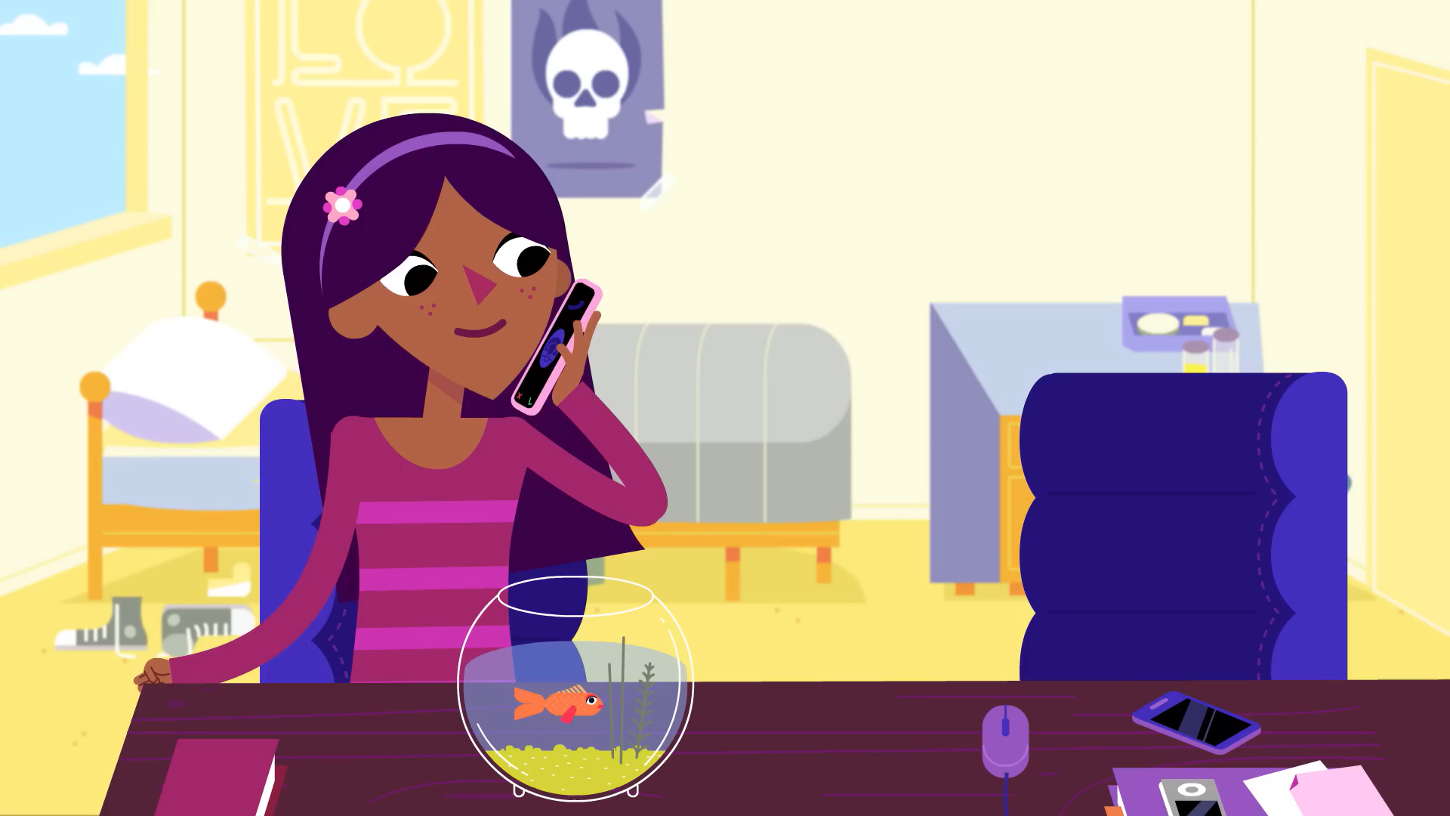
Notes:
If embedded video doesn’t work, you can find it here: https://www.youtube.com/watch?v=kmWbOC8Fbb0
Introduce the Amaze video on period products/hygiene. After viewing, ask the class to revisit their “Do It Now” task - how many products did they correctly identify?

Slide 14
ACTIVITY
You will be split into small groups, and each group will be given an information poster about a common period product. In your group, fill in the table for your product using the information from the poster. You will then share this information with the rest of the class. By the end, everyone should have a table full of information!
Notes:
Split the class into 5 groups.
Explain that each group will receive a poster for one common period product, and an information table.
As a group, they should read the poster and fill out the parts of their table that correspond to the product on their poster.
So, if they receive a poster for tampons, they should fill out the part of the table for tampons.
Give them 10 minutes to work on this and then ask each group to present their poster, so the students in other groups can fill out their information table. Once every group has presented, everyone should have a full information table.

Slide 15
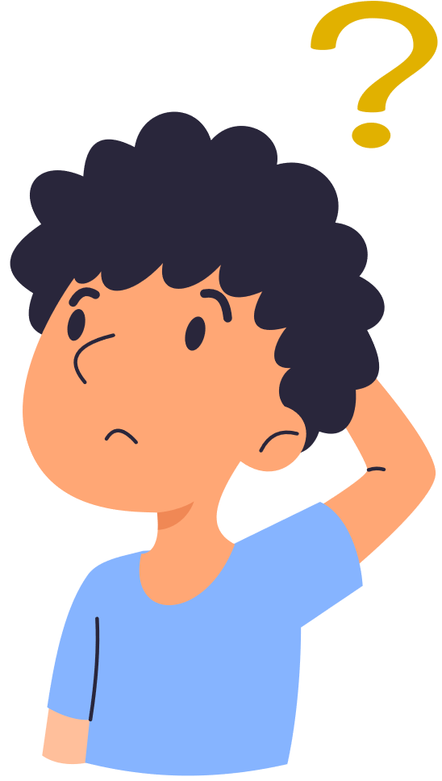
LET’S CHAT
Do you think it’s important for boys/men to learn about periods? Why or why not?
Notes:
Ask the class if they think it’s important for boys/men to learn about periods. Why or why not?
The aim is to help them understand that it is very important for reducing stigma, helping to normalise talking about periods/reduce shame and embarrassment, develop empathy, and because they probably have someone in their life (mum, sister, friend, etc) who experiences or will experience a period at some point.

Slide 16

MYTH BUSTING
Have you heard any of these ideas about periods?
Notes:
Go through the following slides about common period myths. You can show the myth slide first and ask students whether or not they think it's true, and why/why not.
Ask the class if they have heard any others.

Slide 17
Everyone can tell when you’ve started your period.
©2024 HEY GIRLS CIC

Slide 18
Everyone can tell when you’ve started your period.
MYTH
No-one can tell when you’ve started your period unless you choose to tell them. Periods are private, but don’t have to be a secret. It’s perfectly normal and perfectly natural
FACT
©2024 HEY GIRLS CIC

Slide 19
You can’t go swimming if you have your period.
©2024 HEY GIRLS CIC

Slide 20
You can’t go swimming if you have your period.
MYTH
There is no reason to not go swimming when you have your period (you won’t turn the whole pool red, and you won’t be eaten by sharks!). Unfortunately, you can’t really go in the water with a pad on, but using tampons or a cup, and changing them regularly, your period is secured whatever activity you take on.
FACT
©2024 HEY GIRLS CIC

Slide 21
Exercise is bad for you when you have your period.
©2024 HEY GIRLS CIC

Slide 22
Exercise is bad for you when you have your period.
MYTH
Exercising is almost always good for you. If you have cramps during your period, exercise is actually the most effective cure, releasing endorphins into the blood and relieving cramps.
FACT
©2024 HEY GIRLS CIC

Slide 23
Your period comes exactly every 28 days.
©2024 HEY GIRLS CIC

Slide 24
Your period comes exactly every 28 days.
MYTH
Cycles vary from person to person and can be anywhere from 25 to 35 days long. In the first few years your cycle is likely to be very irregular, but it should then settle down. After changes to your cycle can be caused by stress, travelling between time zones, strenuous exercise, illness, or drastic changes in weight and diet.
FACT
©2024 HEY GIRLS CIC

Slide 25
If you don’t get your period you’re definitely pregnant!
©2024 HEY GIRLS CIC

Slide 26
If you don’t get your period you’re definitely pregnant!
MYTH
There are many factors that can delay your period. So a delay in your period doesn’t necessarily mean you’re pregnant. Your period could be late due to stress, weight gain or loss or other life changes.
FACT
©2024 HEY GIRLS CIC

Slide 27
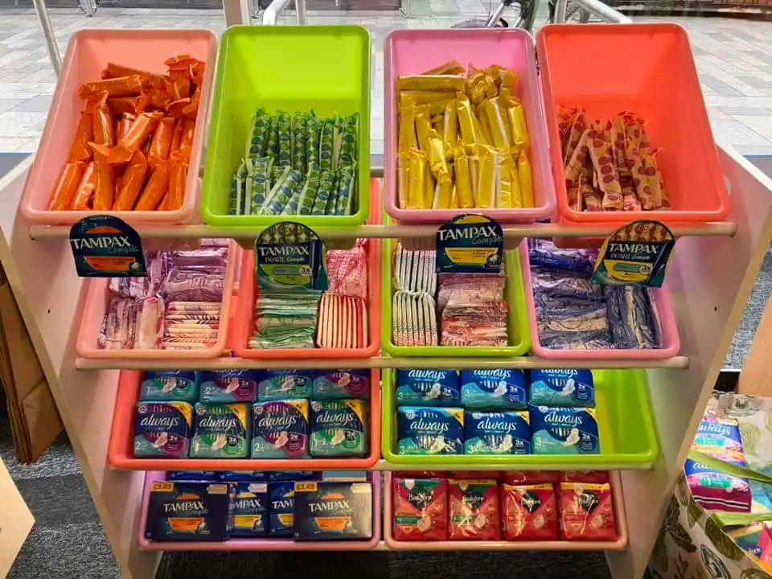
FREE PERIOD PRODUCTS
In Henry Bloom Noble Library in Douglas, you can now find a ‘Pick n Mix’ station for period products! These are free to anyone who needs them.
Notes:
Inform the class that free period products are available at Henry Bloom Noble Library in Douglas.
This is also a good opportunity to tell students how they can access period products at school, if these are available.

Slide 28

REFLECTION
Let’s ASK ourselves - what are we taking from today’s lesson?
Attributes?
Skills?
Knowledge?
Notes:
If time permits, this slide can be further developed into a collective, group reflection.
Please ask students to discuss what Attributes (e.g. honesty, integrity, courage, humility, generosity, self-worth, kindness, trustworthiness etc) they have used during this lesson.
What Skills (e.g. oracy, empathy, compassion, presentation, assertiveness, active listening, interpersonal skills, positive peer pressure, capacity to resist unwelcome pressure, distinguish between fact & opinion , etc.
What Knowledge have they used, or developed during this lesson?

Slide 29
IF YOU HAVE ANY QUESTIONS OR WORRIES ABOUT PERIODS...
Talk to a trusted adult
Childline
https://www.childline.org.uk/info-advice/you-your-body/puberty/
Hey Girls...
https://www.heygirls.co.uk/learn/you/

