Slide 1
TEACHER SLIDE
The material in this activity draws from both the RSHP and the Dove self-esteem project. Teachers/educators can register online and access resources and activity plans that would support further work on the issues addressed in this lesson.
https://www.dove.com/uk/dove-self-esteem-project.html

Slide 2
Activity | Description | Timing
Introduction | Ask students to complete do it now task. Introduce lesson and revisit ground rules. | 5 mins
Body image/self esteem | Recap body image from the last lesson, and introduce topic of self esteem. Ask the class to consider how gender stereotypes might impact self esteem, discussing the scenarios on the following slides. | 10 mins
Video/Take 5 | Play short clip (45 seconds) “Boys are Affected Too.” Ask class for feedback. Discuss how people can protect themselves from negative messages and influences. Split class into small groups or pairs to do “Take 5” activity, which encourages them to identify 5 things they like about their peers. Follow with whole class reflection on how the activity felt. | 10-15 mins
Building good self esteem | Share tips for building good self esteem and ask class if there is anything they would add. Split class again into pairs or small groups and ask them to come up with a poster/song/rap/poem/dance/etc that encourages good self esteem or shares a positive message. | 15-20 mins
Reflections | Ask students to reflect on the lesson using ASK acronym. | 5 mins

Slide 3

DO IT NOW
Today we’re going to continue our learning about body image, as well as self-esteem. In our last lesson, we learned about the ways that social media and other factors can influence the way we feel about how we look.
What do you think that a poor body image, or low self-esteem, can do to a young person? How might this affect the way they think, feel, or behave?
Notes:
Students should reflect on this question either individually or in pairs, before feeding back to the class.

Slide 4

BODY CONFIDENCE
YEAR 7
This presentation has been adapted for the Isle of Man from Scotland’s national resource for relationships, sexual health, and parenthood (RSHP) education.

Slide 5
LEARNING OBJECTIVES
Describe how popular culture and social media promote stereotypes and unrealistic representations that can affect body image and self esteem.
Describe myself positively and can talk about my unique attributes and interests.
Understand and accept diversity amongst peers.

Slide 6

CLASS AGREEMENTS
Kindness and respect
Right to pass
Nonjudgmental
No such thing as silly
questions
any others?
Notes:
Explain that you would like the class to create a list of 'agreements' for how everyone will behave and treat one another in the class. Ensure a common understanding. For example:
1. We will treat one another with kindness and respect (listening to each other, speaking one at a time, etc)
2. We all have the right to 'pass' on answering a question or participating in an activity that makes us feel uncomfortable.
3. We can disagree but will not pass judgments, make fun of, or or put anybody down. 'Challenge the opinion, not the person.'
4. Asking questions is encouraged and will be valued by our teacher. We do not ask questions to purposefully embarrass or belittle another.
*Feel free to change the agreements to suit your class, and ask whether there are any others they'd add to the list in order to create a safe, comfortable learning environment.

Slide 7
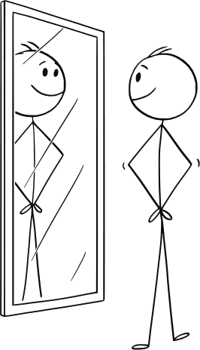
RECAP: WHAT IS BODY IMAGE?
Body image describes our idea of how our body looks and how we think it is viewed by others.
This can include our thoughts and feelings about our height, weight, shape, skin, colour, and our appearance and attractiveness more broadly.
We can have positive or negative body image. We might think positively or negative because of things like what we see around us in our family and friends and what we see and hear online.
Notes:
Recap ‘what is body image?’ from previous lesson.

Slide 8
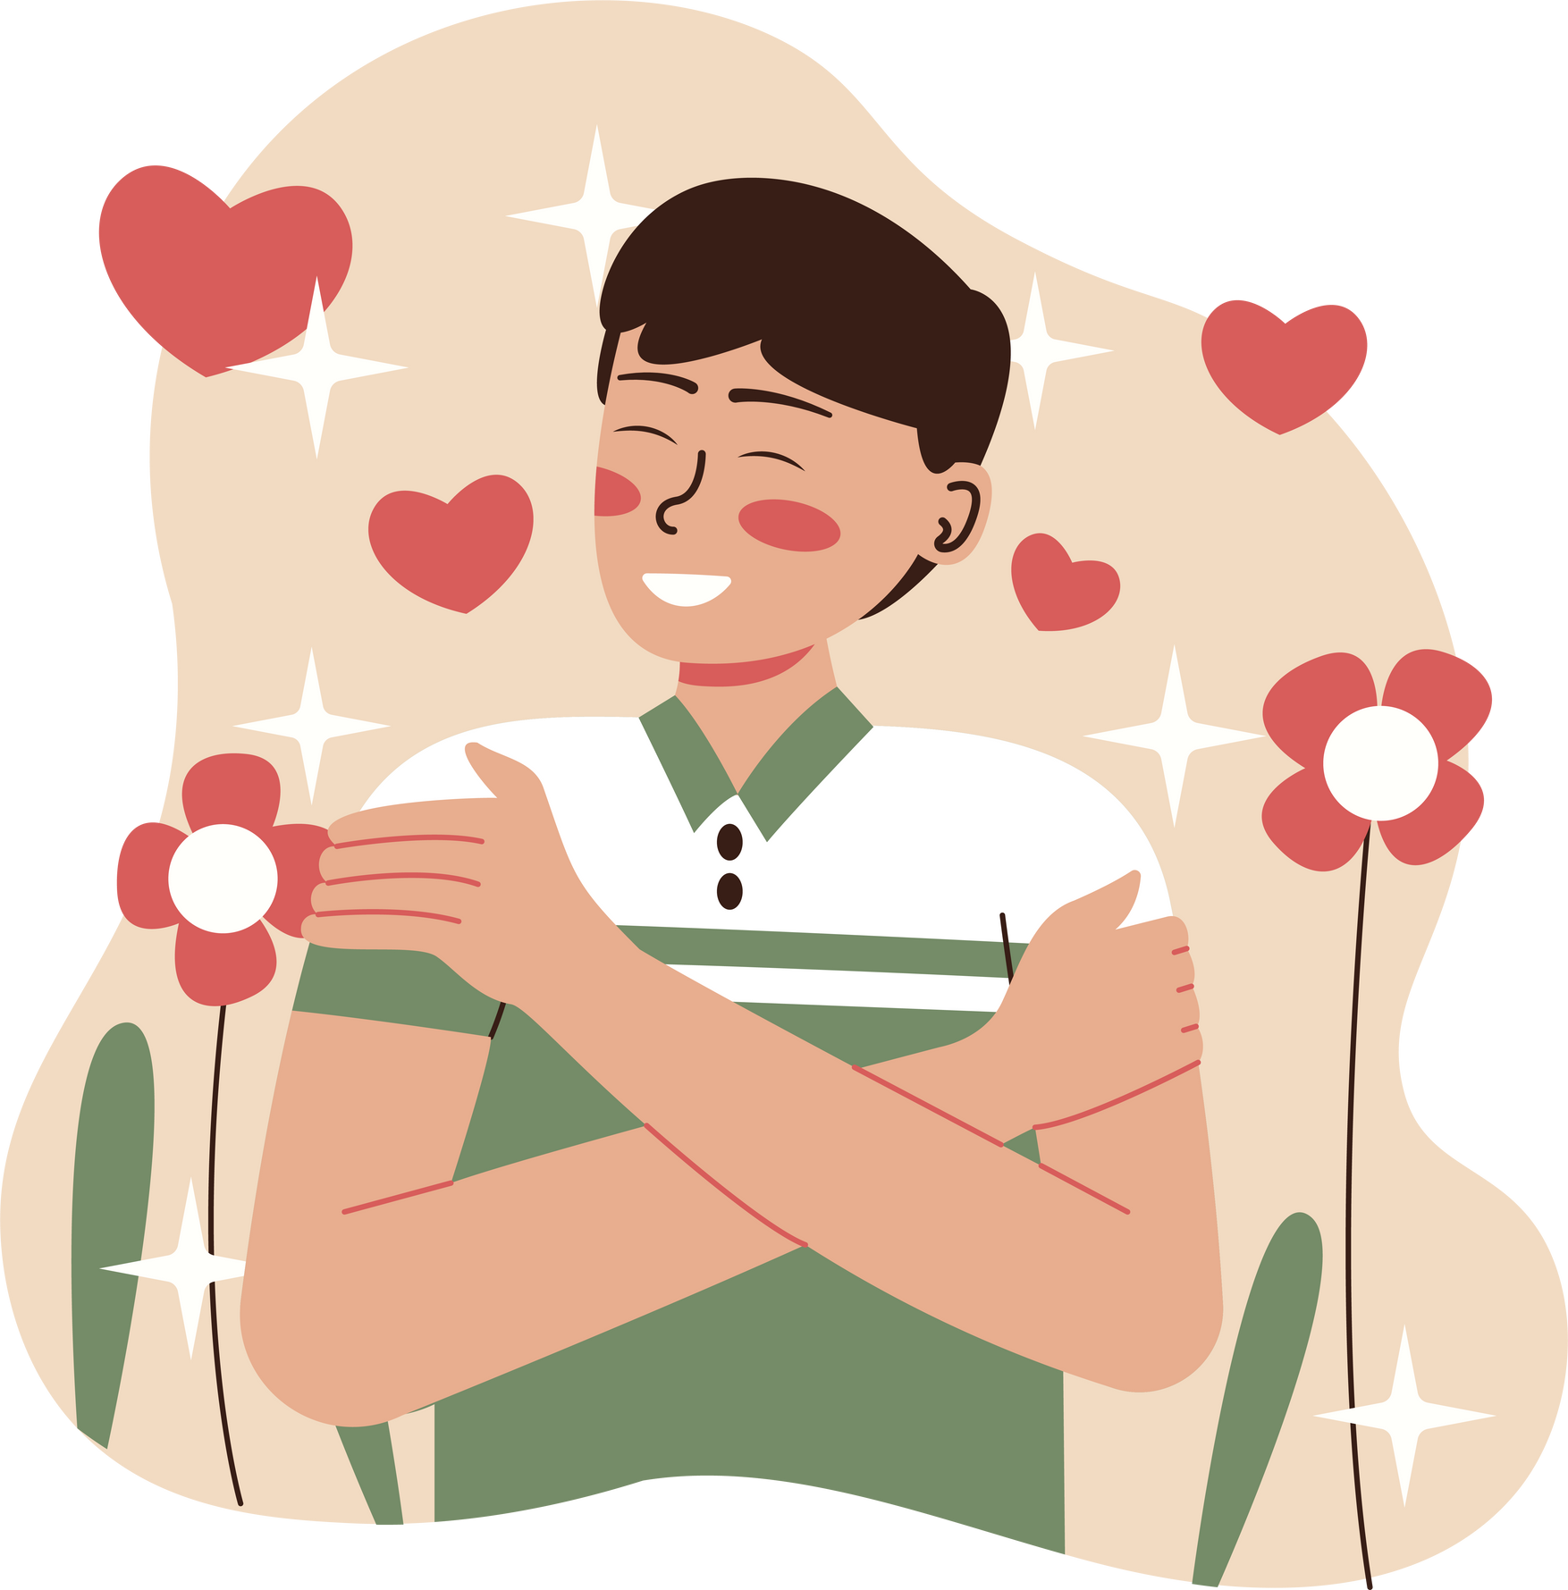
WHAT IS SELF ESTEEM?
Self esteem is about how much we like and believe in ourselves. It’s about feeling good about who we are, even when things don’t go perfectly.
You can think of it as a little inner voice - when our self esteem is high, that voice usually says nice things about us. When our self esteem is low, the voice might be more critical or demanding.
It’s normal for self esteem to go up and down sometimes, and positive self esteem takes work!
Notes:
Introduce self esteem.

Slide 9
HOW MIGHT GENDER STEREOTYPES AFFECT OUR IMAGE OF OURSELVES?
Notes:
Tell the class that you’re going to spend some time thinking about how stereotypes, particularly gender stereotypes, can affect how we see ourselves - not only physically, but our value as people.
Explain that you are going to read a few slides about what it means to be a “real” man or woman, and invite the class to discuss (either in groups or as a whole class, depending on your preference).
After each slide is read, invite students to share their thoughts.

Slide 10
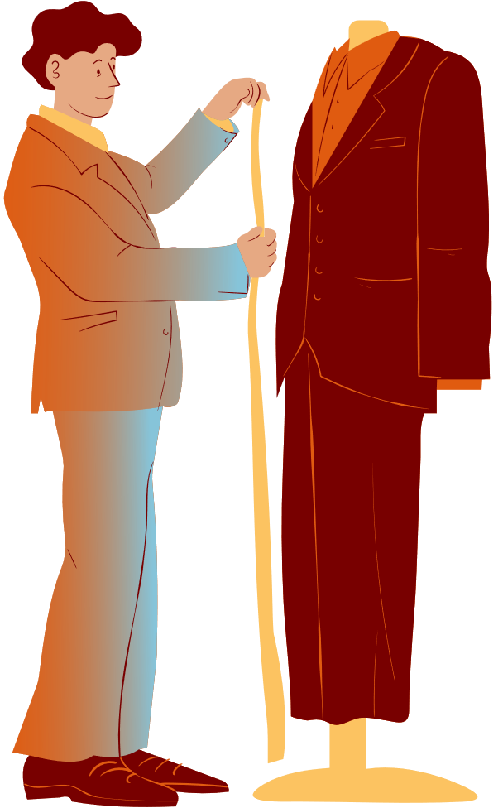
LET’S CHAT: WHAT DOES IT MEAN TO BE A (WO)MAN?
Andrew has always loved being creative, using colours and fabrics to make clothes and soft furnishings. Can he still be a ‘real man’?
Can you name 3 famous men who design clothes, fragrances or interior design?

Slide 11
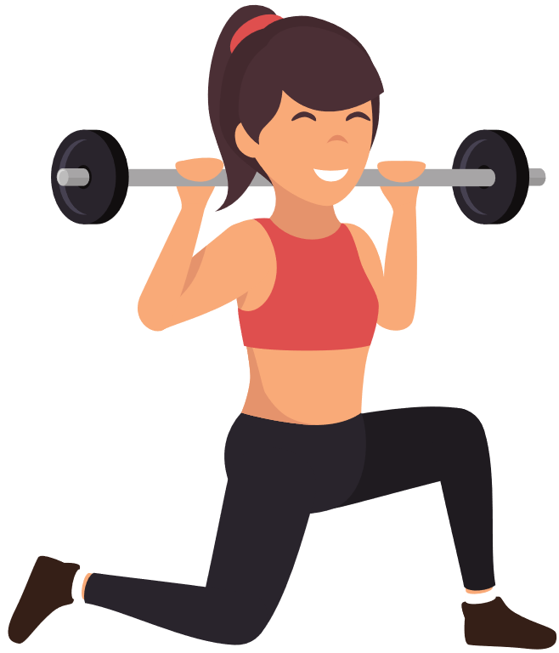
LET’S CHAT: WHAT DOES IT MEAN TO BE A (WO)MAN?
Sarah loves all sports and has recently started playing rugby and started weight training. Can she still be a ‘real woman’?
Can you name 3 famous women who are known for their athletic or physical ability?

Slide 12
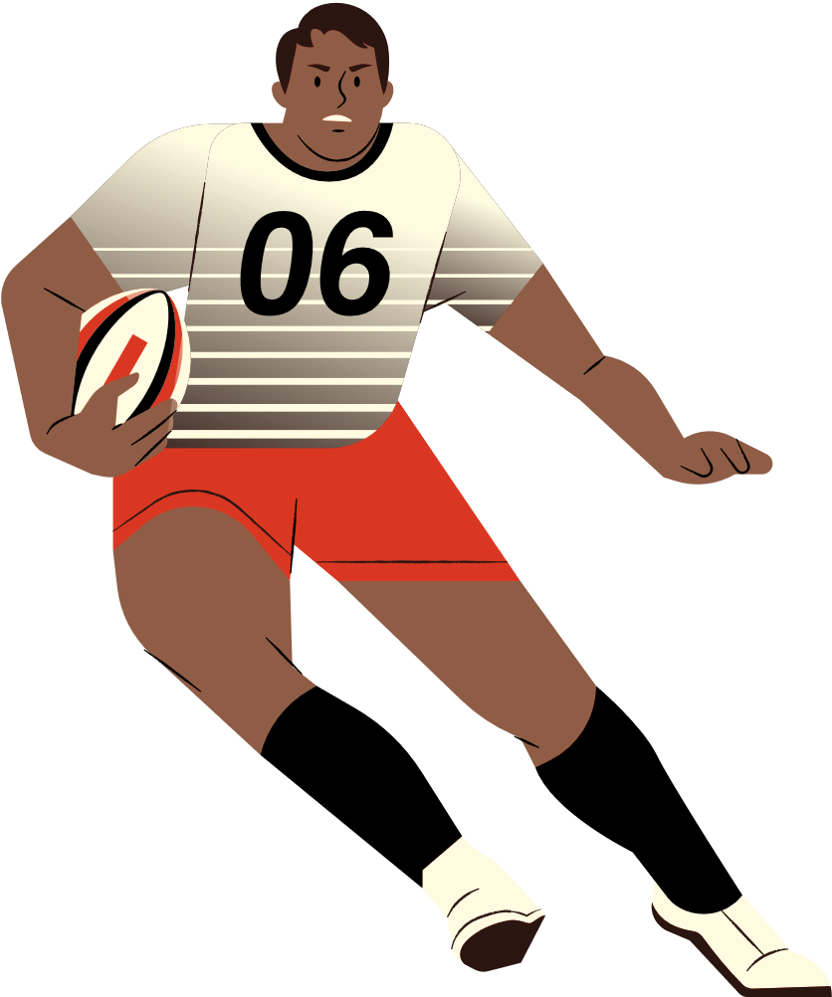
LET’S CHAT: WHAT DOES IT MEAN TO BE A (WO)MAN?
Dave is an excellent rugby player and he finds other men attractive. Can he still be a ‘real man’?
Can you name 3 famous male athletes who are gay?

Slide 13
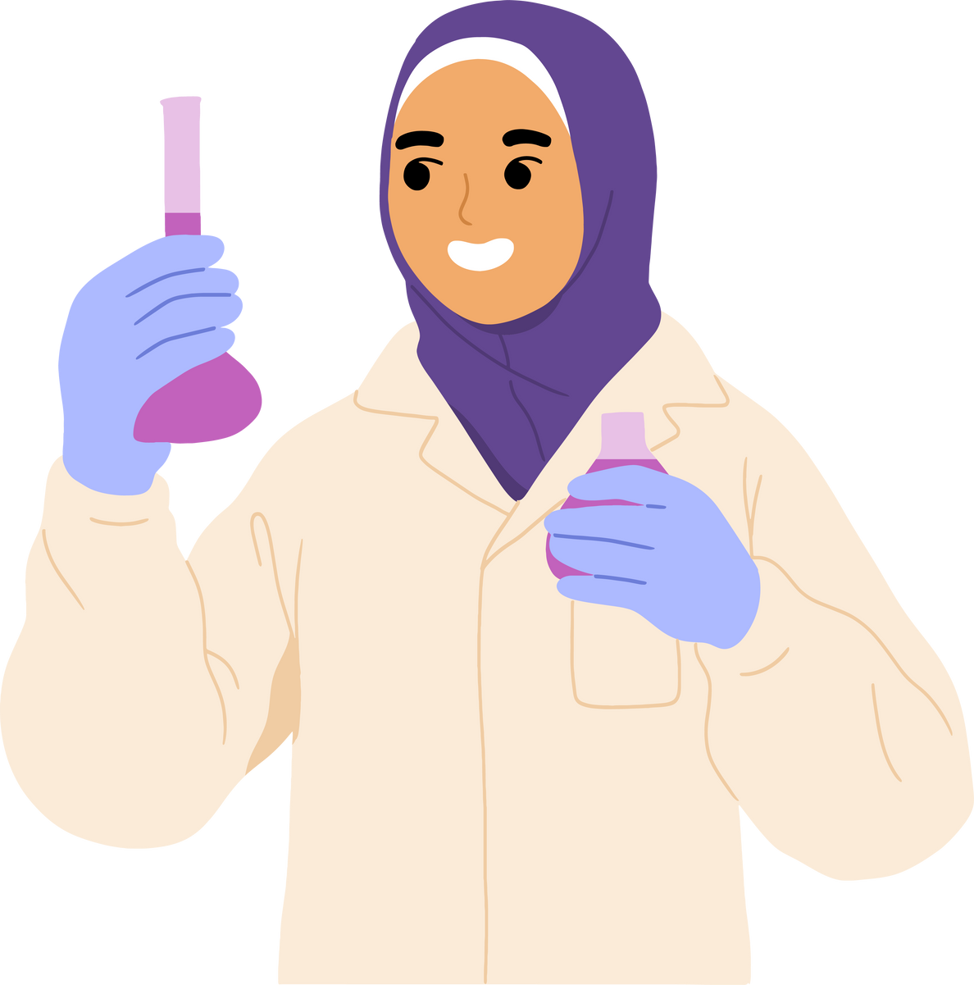
LET’S CHAT: WHAT DOES IT MEAN TO BE A (WO)MAN?
Aisha is fascinated by science and would love to run her own research laboratory someday. When she told her friends, some of them laughed and said scientists are usually men.
Can you name 3 women who are successful scientists?

Slide 14
How might rigid gender stereotypes have affected the way that Andrew, Sarah, Dave, and Aisha felt about themselves, or their abilities?
Why is it important for our self-esteem to have role models that break gender stereotypes?
Notes:
Students should consider that rigid gender stereotypes can have a negative impact on self esteem and body image.
For example, men who enjoy traditionally 'feminine' pursuits may feel they are not 'manly enough.' Athletic women whose bodies do not adhere to the strict societal ideas of femininity might feel unattractive or less than.
It is important to have role models that break gender stereotypes because it shows us that anyone can follow their dreams, no matter what others expect. It helps everyone feel free to be themselves and reminds us that talents and interests aren’t limited by gender.

Slide 15
Boys Are Affected Too
Notes:
Could not download & embed video, so go to this website:
https://www.bbc.co.uk/newsround/46311187
Watch the short clip ‘Boys are affected too.’ (45 seconds)
As a reminder that these issues and pressures affect boys too. Discuss any issues that arise and ask the class for their thoughts. Can they think of any examples of how body image issues affect boys (e.g. feeling insecure if they are not as physically developed as their friends; purchasing dangerous supplements to chase unrealistic fitness ideals, etc)

Slide 16
LET’S CHAT
So, what can we do?
Do we need to protect ourselves from the negative images and messages we get from social media?
How?
Notes:
Reflect back to young people that they have been considering the way that images can be manipulated, that we all get messages about how we should look that then in turn manipulate how we feel about ourselves.
Share the slide/pose the question for small or full group conversation:
Do we need to protect ourselves from the negative images and messages we get from
social media?

Slide 17
ACTIVITY
Self Portrait: Gimme 5
This is a self-portrait with a difference – no drawing, just talking. In a pair or small group, talk about each other one at a time. The group is to identify 5 things that describe each person positively
Notes:
Explain that this is a self-portrait with a difference – no drawing, just talking.
In a pair/3s, young people are to talk about each other one at a time.
The group is to identify 5 things that describe this person positively – there will be no group feedback about what they decide, but the group will talk about how it felt to do it.
Complete the task, and then have that discussion.

Slide 18
DISCUSSION
Self Portrait: Gimme 5
How did it feel to do this activity?
Were you surprised by any of the positive things people said about you?
What kinds of positive things can you say about yourself?

Slide 19
TIPS FOR BUILDING GOOD SELF ESTEEM & BODY IMAGE
1.Remember what you see online might be fake (or at least a bit fake)
2.Stop criticising yourself – be your own friend.
3.Don’t put you or your body down, be kind to yourself.
4.Find things to like about yourself – both physical and the kind of person you are.
5.Think about what you can do, not just what you find difficult or can’t do.
Notes:
Share with the class and invite feedback. Is there anything they would add?

Slide 20
TIPS
6. Understand your body – know when to rest or when to be active.
7. Get enough sleep.
8. Be active every day.
9. Keep a healthy weight but avoid ‘diets’
10. If you feel worried or anxious or have questions – talk to someone.
11. Think about spending less time online…..

Slide 21

ACTIVITY
Last week we talked about ways to make our school a place where we promote positive body image.
This week, let’s focus on self esteem. In your groups, design a poster that promotes good self esteem - this could be positive messages about self acceptance, encouragement to try new things, or ways to uplift your peers.
YOU ARE VALUABLE!
Notes:
Split class into small groups and ask them to come up with a poster/poem/rap/song that promotes positive self esteem.

Slide 22

REFLECTION
Let’s ASK ourselves - what are we taking from today’s lesson?
Attributes?
Skills?
Knowledge?
Notes:
If time permits, this slide can be further developed into a collective, group reflection.
Please ask students to discuss what Attributes (e.g. honesty, integrity, courage, humility, generosity, self-worth, kindness, trustworthiness etc) they have used during this lesson.
What Skills (e.g. oracy, empathy, compassion, presentation, assertiveness, active listening, interpersonal skills, positive peer pressure, capacity to resist unwelcome pressure, distinguish between fact & opinion , etc.
What Knowledge have they used, or developed during this lesson?

