Slide 1


This lesson was created by Hannah Grove. If you wish to use it in any context other than the one intended, please seek permission beforehand. Thank you!
www.hannahpants.com
Teachers slide
This lesson focuses on teaching the correct and effective use of condoms.
Video Resource
The lesson includes a helpful video designed to ease the conversation and support teachers in delivering the content confidently and without discomfort. The video is divided into two parts:
  Part 1: Clear, straightforward instructions on how to properly put on a condom.
  Part 2: Step-by-step guidance for students to follow along, provided they have access to condom demonstrators and condoms.
If condom demonstrators are not available, please show only the first part of the video.
Materials Needed:
  Projector
  Whiteboard
  Post-it notes or scrap paper
  Prizes or merits for student engagement

Slide 2
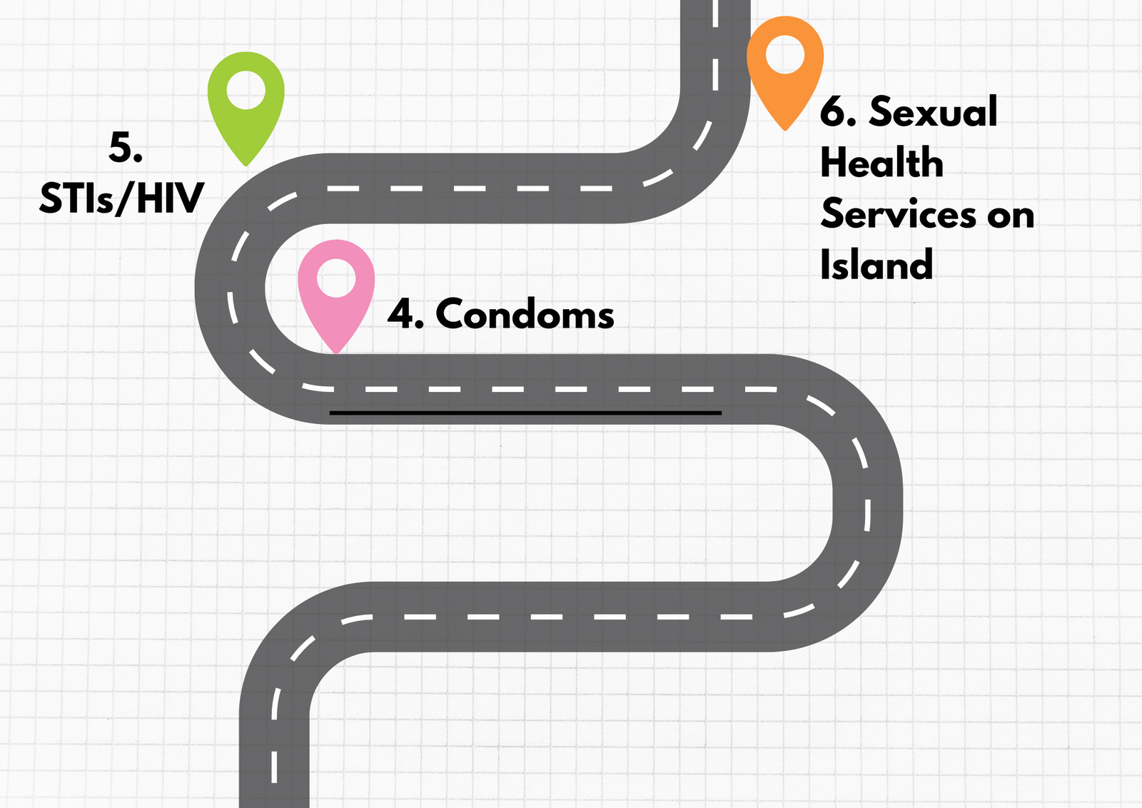
Our ‘Roadmap’ for this block

Slide 3















Condoms
Block 3 lesson 4

Slide 4

This symbol means, discuss in groups or pairs- you’ll find it throughout this lesson!
Notes:
(2 mins)

Slide 5

Class agreement
Respect other people’s opinions
Right to pass
No such thing as a silly question
Non judgemental

Slide 6



Discuss: What is a condom?
Identify: Two reasons why a person may choose to use a condom.

Slide 7
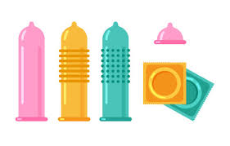
A condom is a thin sheath, typically made of latex.
A condom can be used during sexual activity to prevent unwanted pregnancy and reduce the risk of sexually transmitted infections (STIs).

Slide 8
Condoms
Block 3 lesson 4

Slide 9
Learning outcomes
Students will learn :
1) What a condom is
2) The benefits of using a condom
3) How to use a condom correctly

Slide 10

There are condoms designed for female people to use as well. They work in a similar way- speak to your GP or staff at the MISH clinic, if you think this option works better for you!
Today’s lesson focuses on Male Condoms:
They fit over a penis and can be used for
all types of penetrative sex.
Notes:
oral, anal, vaginal sex

Slide 11

Remember:
The age of consent is 16 on the
Isle of Man
You can access information and confidential advice about sexual health, contraception and STI testing from the MISH clinic or your GP
even if you are not yet 16.

Slide 12



Condoms can be called a
BARRIER METHOD of contraception because they create a barrier between two people.
Semen, viruses and bacteria can’t get
THROUGH a condom

Slide 13
How effective are condoms?
Will a condom ALWAYS prevent pregnancy?
(If a male and female person are having sexual intercourse)

Slide 14

No, condoms are not the most effective form of contraception
Condoms can be effective when used correctly, but other methods of hormonal contraception (e.g.IUD and implants) have a better rate of preventing pregnancy.
To minimise the risk of pregnancy and STI’s
You and your partner can choose to use a different type of contraception AND a condom!

Slide 15
How effective are condoms?
Will a condom ALWAYS prevent the transmission of STI’s?

Slide 16
When used correctly,
condoms are highly effective at preventing the spread of sexually transmitted infections or STI’s.
(HIV, gonorrhoea, and chlamydia etc)
However, they are not 100% effective!
Using a condom won't completely eliminate the risk of catching an STI, especially those spread through
skin-to-skin contact
(pubic lice, genital herpes, genital warts etc)

Slide 17
They may not be 100% effective
BUT
Condoms reduce the risk of pregnancy and spreading STI’s.
It’s important to do everything you can, to protect yourself AND your partner.

Slide 18

Notes:
Play the first part of the video here.

Slide 19


Draw a grid like this onto a piece of paper
Notes:
Play the first part of the video here.

Slide 20
What can you remember from the video?
Write down 1 thing in each box
Notes:
Play the first part of the video here.

Slide 21
Condom BINGO
Notes:
Using a condom reduces risk of pregnancy
Using a condom reduces risk of STI transmission
Condoms are free from GP and MISH
Check the date
Check for Damage
Check for CE mark or kitemark
Don’t use anything sharp to open the packet
The rolled rim should be on the outside
Penis should be erect
Pull the foreskin back gently
Pinch the tip of the condom
Pinch and roll
A good fit is a snug fit
If it’s inside out, throw it away and start again
Only use water or silicone based lubricants
Remove carefully
Tie the used condom in a knot
Wrap the used condom in a tissue
Through the used condom in a bin
Contact MISH clinic if a condom breaks or falls off during sex.

Slide 22



Three things to remember BEFORE using a condom
Check the packet
for the use by DATE
Check the packet for DAMAGE
Check the packet for the CE MARK

Slide 23





Roll the condom down to the base of the penis.
Ensure the rolled edges are on the outside of the condom.

Slide 24



Three things to remember AFTER using a condom
Take the used condom off carefully
Tie the used
condom in a knot
Wrap the used condom in a tissue and throw the used
condom in a bin

Slide 25
Some STI’s can be transmitted through
direct skin to skin contact
Some examples are:
Herpes
HPV
Pubic lice
Syphilis

Slide 26
Some STI’s can be transmitted through
the transference of bodily fluids such as
semen, vaginal fluid, anal fluid and blood
Some examples are:
Chlamydia
Hepatitis B and C
HIV
Gonorrhoea

Slide 27

Let’s have a look at how effective use of a condom reduces the risk of catching an STI
This person
Has unprotected sexual intercourse with two people

Slide 28
And they each have unprotected sex...

Slide 29
And then they have unprotected sex...

Slide 30

The person shown in pink has an STI which can be transmitted through bodily fluids
eg: chlamydia
Using a whiteboard marker, circle everyone who is likely to have caught the STI.

Slide 31
Using a whiteboard marker, circle everyone who is likely to have caught the STI.

Slide 32
Answer
People shown in pink are likely to have caught the STI.

Slide 33

This person has used a condom
Using a whiteboard marker, circle everyone who is likely to have caught the STI

Slide 34
Using a whiteboard marker, circle everyone who likely to have caught that STI.

Slide 35
Answer
People shown in pink are likely to have caught the STI

Slide 36
Using a whiteboard marker, circle everyone who is likely to have caught the STI

Slide 37
Answer
People shown in pink are likely to have caught the STI

Slide 38

Remember
Condoms are really effective at
REDUCING the RISK of unwanted pregnancy
and REDUCING the spread of STI’s.
Always do everything you can to protect yourself and your partner.

Slide 39
Contact the MISH clinic for
information, advice or treatment
M.I.S.H
(Manx integrated Sexual health clinic)
650710

