Slide 1


Teachers slide
This lesson was created by Hannah Grove. If you wish to use it in any context other than the one intended, please seek permission beforehand. Thank you!
www.hannahpants.com
This lesson is about communication.
Good communication enables us to:
  Express our emotions
  Share our thoughts and feelings
  Build and strengthen relationships
The students will spend much of this lesson in group discussion, which is a great way for them to practise communication skills such as active listening, sharing ideas, building confidence, getting to know each other better, hearing different/ conflicting ideas and opinions.
For this lesson you will also need:
Paper for each groups/ table
Print outs of option A, B, C from the lesson plan or alternatively, write Option A, B C on three separate pieces of paper and stick to three separate walls around the room.

Slide 2
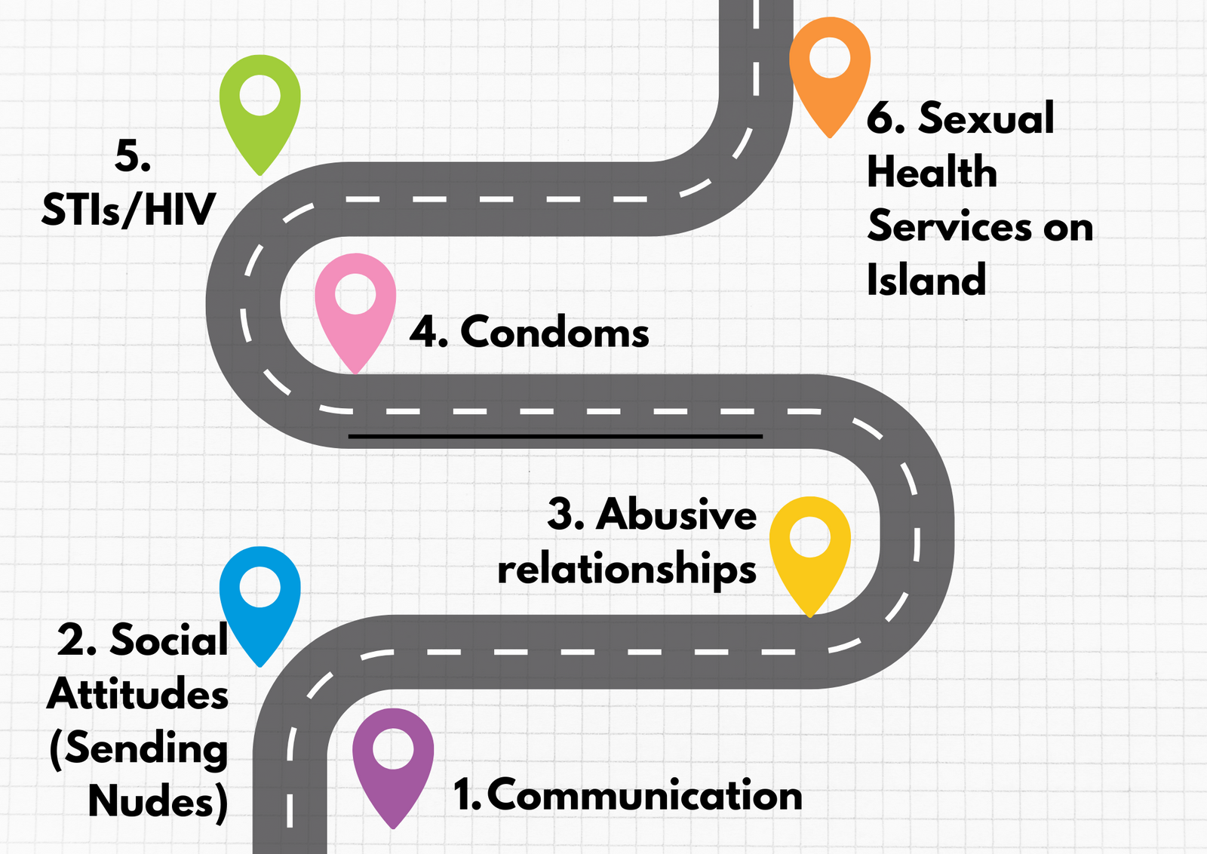
Our ‘roadmap’ for this block

Slide 3















Communication
Block 3 lesson 1

Slide 4

This symbol means, discuss in groups or pairs- you’ll find it throughout this lesson!
Notes:
(2 mins)

Slide 5



Write down as many
different types of
communication
as you can think of....
Notes:
Finish this task on slide 8

Slide 6

Class agreement
Respect other people’s opinions
Right to pass
No such thing as a silly question
Non judgemental

Slide 7
Communication
Block 3 lesson 1

Slide 8
Learning outcomes
Students will learn that:
1) There are different types of communication
2) We can choose how we communicate with other people
3) Communication is essential in relationships

Slide 9
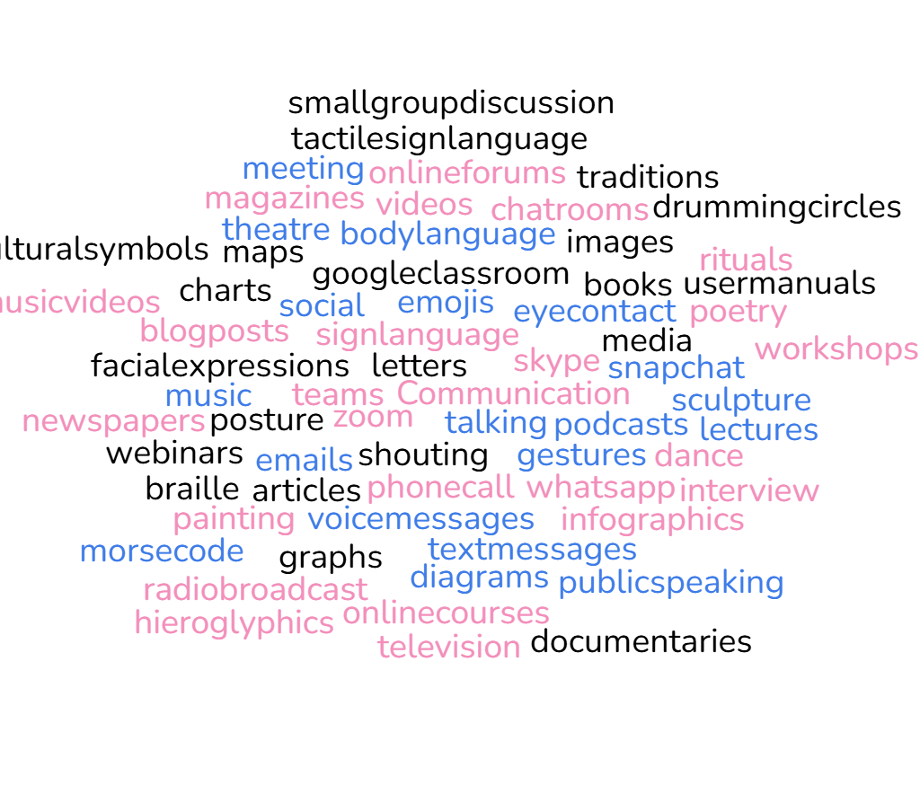
Notes:
Word Cloud:
how many types of communication did the students think of in their 'do it now task'?
Allow them time to look through and hopefully point out some that I’ve missed! (5 mins)

Slide 10


Humans have been communicating with one another for a veeeeeeeeeery long time!
We have invented so many different ways of communicating because it’s so important to us as a species.

Slide 11


Communication is considered a fundamental need for humans.
Communication is fundamental because it allows us to:
  Express our emotions
  Share our thoughts
  Build relationships
Notes:
*Please make sure you have also read through the lesson plan provided for this session.

Slide 12

What is being communicated?

Slide 13
What is being communicated?
  hunger
  cold
  hot
  uncomfortable
  scared lonely
  A basic human need is not being met
What would happen if this baby couldn’t communicate?
Or
If no one was around to understand what the baby needs?

Slide 14
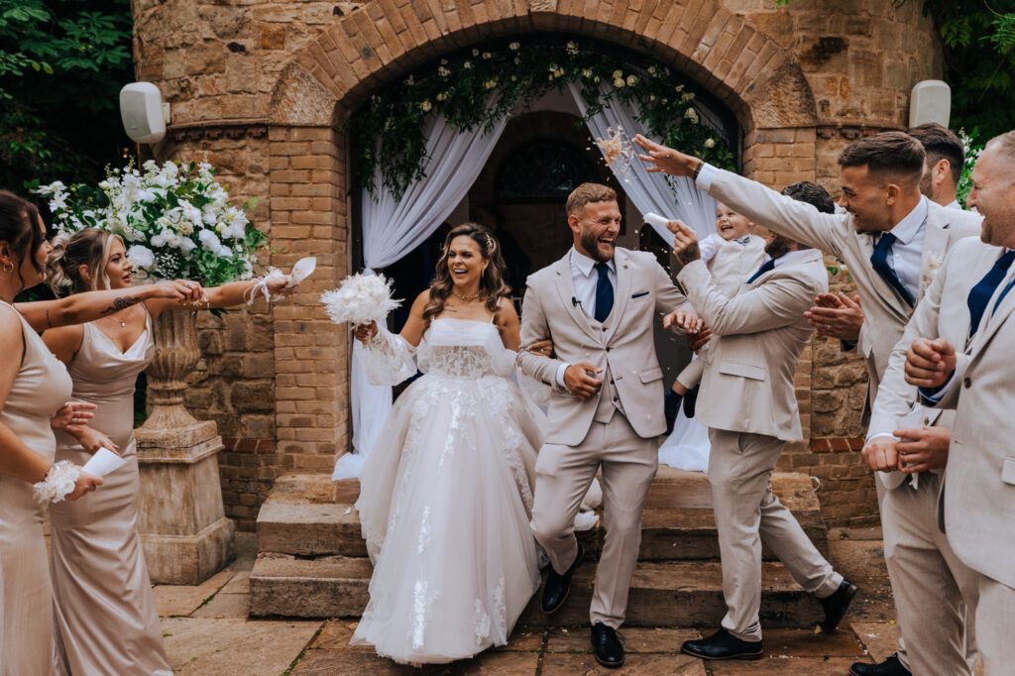
What is being communicated?

Slide 15

What is being communicated?
  Love
  commitment
  sharing joy with family/ bringing a family together
  shared values
The first recorded evidence of marriage ceremonies uniting one woman and one man dates from about 2350 B.C., in Mesopotamia (modern day Iraq).
What would our world look like if marriage had never been ‘invented’?

Slide 16
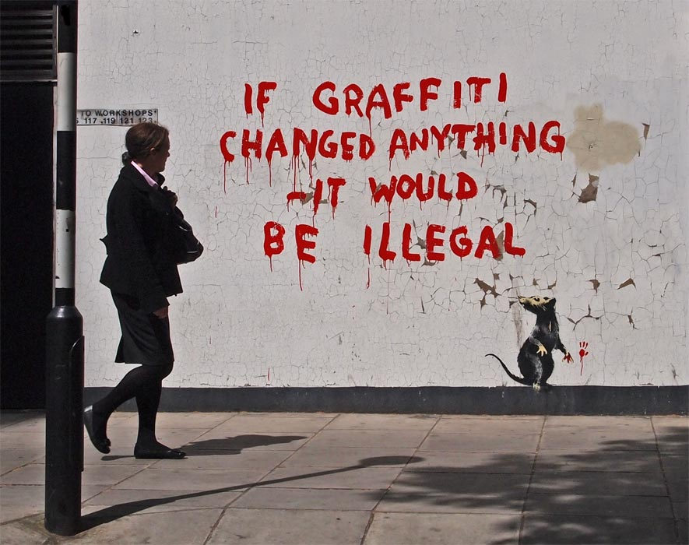
What is being communicated?

Slide 17
What is being communicated?
  A critique of authority
  A challenge to authority
  Irony
  A joke
  Raising awareness
What is the difference between graffiti (tagging) and Street art?
Are they communicating something different?

Slide 18
We can choose how we communicate with other people

Slide 19
This is especially important with people that we are in relationships with because it helps us to:
  Express our emotions
  Share our thoughts and feelings
  Build relationships and make them stronger

Slide 20

The term ‘Relationship’ means everyone that you are connected with.
This could be :
  Teacher
  Classmates
  Close family members
  Romantic Partner
  Best friend
It could also be :
  Next door neighbour
  Best friends parents
  Extended family
  sports coach
  youth worker
This could be :
  Teacher
  Classmates
  Close family members
  Romantic Partner
  Best friend

Slide 21
Vote with your feet
OPTION
A
OPTION
B
OPTION
C
Stand by the option that you agree with the most
You can have your own opinion- you don’t have to choose the same as the person next to you!

Slide 22
It’s your best friend’s birthday, you’ve known them since you were in nursery, they’re really special to you. Will you...
A) Drop them a text message
B) Send them a card with a special message
C) Wish them a happy birthday face to face

Slide 23

Which option would mean the most to YOUR best friend? This might be different to other people.
How would your best friend feel if you had chosen one of the other options?

Slide 24

Your parent is away on a work trip, you had some friends round and her favourite vase got accidentally smashed. Will you...
A) Send them a photo on whatsapp with this emoji
B) Facetime them so that you can apologise straight away
C) Buy a replacement vase and apologise face to face, once they’re home

Slide 25

Which option would strengthen YOUR relationship the most?
Do you want to move to a different option?

Slide 26
You are walking down the street at night, you see a pregnant woman being followed by a drunk and aggressive man.
Will you...
A) Head straight towards him to confront him
B) Do nothing ‘none of my business’
C) Call the police quietly from a safe distance

Slide 27

Why have you made the choice you have?
What is stopping you from making a different choice?

Slide 28
You need to resign from your saturday job due to other commitments. Will you...
A) Drop them a text message
B) Send them an email
C) Write your boss a formal resignation letter and hand it in person

Slide 29

On a scale of 1-10 how awkward is the choice you made?
Are there any long term consequences to your decision?

Slide 30
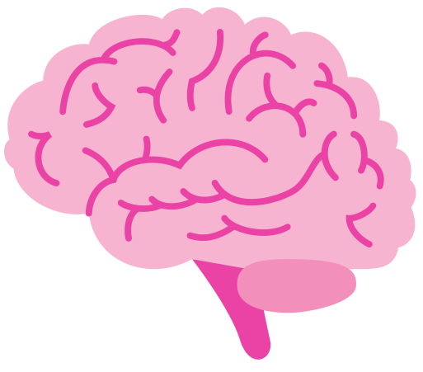
Remember
You can choose how you communicate with the people around you.
Making good choices helps you to:
  Express your emotions
  Share your thoughts and feelings
  Build and strengthen your relationships

Slide 31
Our ‘roadmap’ for this block
Notes:
Please share this slide at the end, so that students know what their topic will be next PSHE lesson.

