Slide 1
Teacher slide
This lesson has been developed by the PSHE Association in collaboration with the Alice Ruggles Trust to promote awareness of unhealthy relationship behaviours and stalking in order to help protect young people from the potential risks in such situations.
Make sure you have read the accompanying teacher guidance notes before teaching this lesson for guidance on establishing ground rules, the limits of confidentiality, communication and handling questions effectively.
Please note the ‘Do It Now’ task, and slide with local resources, were written by the Isle of Man Department of Education, Sport, and Culture, to ensure that these resources are as relevant as possible for young people on the Isle of Man.

Slide 2
Teacher slide
This lesson includes a timeline activity. The original instructions for the lesson ask you to split the class into groups, and to print out the timelines located in the resources document. Each group receives one of the two timelines. Ask the students looking at Cerys’ perspective to annotate their timeline with comments exploring how better self-awareness could have led Cerys to seek help to stop her behaviour escalating.
Ask the students looking at Roe’s perspective to suggest where Roe could have acted differently to better support Li if they had been more alert to the signs of stalking. Inform students that this activity is not about ‘blaming’ Roe for what happened – it is to highlight ways that people can unwittingly contribute to an escalation of a difficult situation and delay help-seeking so we can see how to better support those around us.
Once students have had time to review their character’s perspective, ask students to swap so they can compare the two perspectives. Explore key ideas as a class – teacher notes are provided.
**Due to teacher feedback, these timelines have also been included on the slides if you wish to read them together as a class and discuss. A simplified timeline is available in the documents (Resource 1A) if you wish for students to work on this instead, to save time. The way you do this activity is entirely up to you and the needs of your class.

Slide 3
Do It Now
If somebody is receiving unwanted attention from another person, why do you think they might not seek help? What kinds of barriers might be in the way?
Notes:
Although we would like the students to have this as a thinking activity before the lesson fully starts, the questions do not need to be answered here – they will be addressed later in the lesson.

Slide 4
REDUCING inappropriate behaviours

Slide 5
Ground rules
Listen to and respect each other
One person speaking at a time
Openness but no personal stories
No such thing as a silly question
During discussions we have the right to pass
We won’t laugh at, judge, or make assumptions about anyone else in the group
Notes:
Revisit or introduce ground rules.

Slide 6
Learning outcomes
Recognise when romantic attention is unwanted or unacceptable, including online
Explain how perpetrators and their peers can safely address potential perpetrator behaviours
Notes:
Introduce the learning objectives and outcomes – today’s lesson focus is on reducing the impacts of stalking by discussing how perpetrators, targets and friends can act to end stalking behaviour before it spirals.

Slide 7
Overheard conversation
People play hard to get, so it’s important not to give up at the first ‘no’. It’s expected you’ll keep asking to show you really like someone.
Notes:
Ask students to imagine they have overheard this comment. Ask them to explain how far they agree/disagree with the statement and what they could do if someone said that to them.
This is an opportunity to check understanding of prior lessons around unacceptable and illegal behaviours. It is also an opportunity to explore where romantic pursuit becomes stalking.
This could involve discussion of media messages around characters persisting to try and win the partner of their dreams, and using ‘grand gestures’ to overcome initial reluctance to date/continue dating.
Discussion could also include conversation suggestions to discuss what is acceptable or unacceptable with friends and could dispel any barriers to doing so (e.g. embarrassment, not knowing what to say, not wanting to seem like preaching).

Slide 8
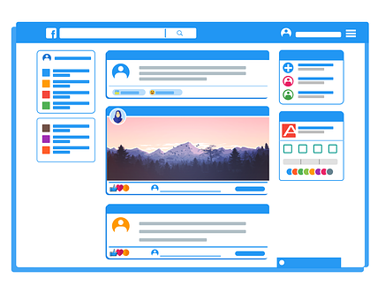
Timeline activity
GROUP A: Cerys
Annotate her timeline to highlight how she could have stopped her behaviour escalating.
GROUP B: Roe
Annotate her timeline with comments on how she could have reduced risks to Li.
Notes:
Split class into two halves to look at different perspectives on cyber-enabled stalking of a ‘crush’ in Resource 1: Stalking scenario timeline. One side focus on the perpetrator’s perspective, the other on the friend of a target’s perspective.
In the scenario, Li clearly rejected Cerys’ attentions but the stalker’s obsessive behaviours, unwittingly supported by Roe’s behaviours, have led to an escalation of the situation.
Ask the students looking at Cerys’ perspective to annotate their timeline with comments exploring how better self-awareness could have led Cerys to seek help to stop her behaviour escalating.
Ask the students looking at Roe’s perspective to suggest where Roe could have acted differently to better support Li if they had been more alert to the signs of stalking. Inform students that this activity is not about ‘blaming’ Roe for what happened – it is to highlight ways that people can unwittingly contribute to an escalation of a difficult situation and delay help-seeking so we can see how to better support those around us.
Once students have had time to review their character’s perspective, ask students to swap so they can compare the two perspectives. Explore key ideas as a class – teacher notes are provided.
Support: Use the differentiated sheet which shows a simplified version. Ask students to identify how Cerys acted in unhealthy ways and how the characters could get help to stop the stalking behaviour getting worse.
Extension: Ask students to annotate both perspectives before comparing with others.

Slide 9
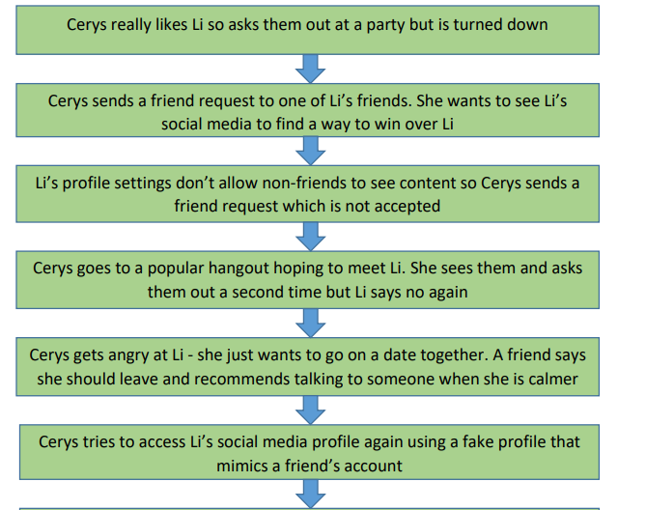
Timeline - Cerys

Slide 10
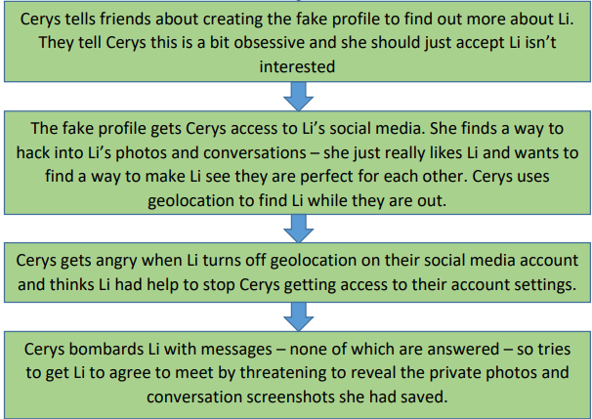
Timeline - Cerys

Slide 11
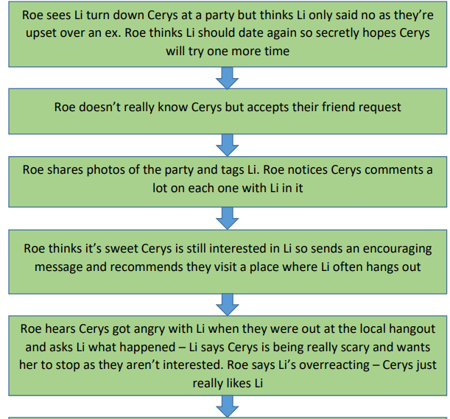
Timeline - Roe

Slide 12
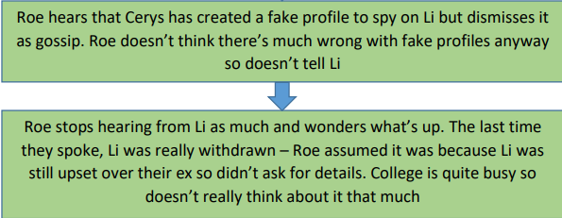
Timeline - Roe

Slide 13
Barriers to help seeking
1. People might delay seeking help as they are worried about being seen to over-react, or about getting people into trouble unnecessarily.
2. Someone who shames their partner deserves to be made to feel scared and uncomfortable.
3. Inappropriate behaviour is to be expected if someone’s upset.
Notes:
Allocate one of the statements (using Resource 2: barriers to help-seeking if preferred) to a group/pair of students. Ask them to read the statement and identify the barrier to early help-seeking. Ask students to explain why any assumptions are unhelpful and provide advice to challenge the assumption.
During feedback, ensure all statements are considered. Elicit the following key points:
No-one deserves to be stalked, whatever they may or may not have done.
The importance of early help-seeking and trusting your instincts – if something doesn’t feel right, speak to someone who can help.

Slide 14
Barriers to help seeking
4. It can be hard to judge if someone’s interested or not, so it’s worth trying a few times so people don’t miss out on something great.
5. It might just be a coincidence when someone keeps bumping into a person, particularly in a small community.
6. The police don’t take stalking seriously so there’s no point contacting them.
Notes:
Ask students to explain why any assumptions are unhelpful and provide advice to challenge the assumption.
During feedback, ensure all statements are considered. Elicit the following key points:
Checking in with a trusted person around new relationships can help if someone commonly finds reading social cues difficult.
There have been times in the past when not every case of stalking has been taken as seriously as it should have. Share the outline of Alice Ruggles’ story on the next slide to help explain how past tragedies have led to police procedural changes.

Slide 15
Sources of support
At school - tutors, school nurse, safeguarding team
Police – 999
Victim Support IOM – 679 950 or go online https://victimsupport.im/
National Stalking Helpline - 0808 802 0300 email support & online tools www.stalkinghelpline.org
24-hour National Domestic Violence Freephone Helpline - 0808 2000 247
Respect - support for those exhibiting controlling behaviours 0808 802 4040
Men’s Advice Line - supports men with controlling partners 0808 801 0327

Slide 16
Police changes
Sometimes news stories can create concerns that reporting to police is not helpful.
Alice Ruggles was killed by an ex-partner who had been stalking her for a number of months.
Alice took time to seek help as she did not initially recognise the risks she faced. When she did contact the police, the procedures at the time meant she did not get the protection she needed.
Notes:
This outline of Alice Ruggles’ story helps explain how past tragedies have led to police procedural changes.

Slide 17
Police changes
Campaigners have tried to reduce the risk of similar tragedies occurring.
Many police forces have worked hard to change how they deal with stalking and harassment, including updating training for front-line officers.
New laws like the Stalking Protection Act 2019 also provide better protection for people experiencing stalking.
Notes:
This outline of Alice Ruggles’ story helps explain how past tragedies have led to police procedural changes.

Slide 18
IF being stalked
Call the police
Seek support
Tell trusted people
Be cyber secure:
change passwords
check privacy settings
scan for spyware
visit getsafeonline.org
Avoid contact
Vary routines
Record all contact
Notes:
Remind students of the above guidance for those experiencing stalking.
Call the police: Stalking is a crime. Those being stalked should call the police on 101 or 999 in an emergency and say they are being stalked.
Seek support: Stalking support services can help including the National Stalking Helpline: www.stalkinghelpline.org.
Tell people: Tell as many trusted people as possible about what is happening and keep track of who has been told (e.g. GP, tutor etc)
Be cyber secure: Change passwords, check privacy settings, scan for spyware, visit getsafeonline.org.
Avoid contact: As long as it feels safe to do so, keep contact with the stalker to an absolute minimum.
Vary routines: Avoid going to the same coffee shop at the same time each day, for example, and make sure a trusted person knows your location in case of emergency.
Record all contact: Capture everything: screenshots, call logs, keep a diary: time, dates, locations of incidents, any witnesses and include how the behaviours felt at the time in any entries. This helps the police do their job to protect a target of stalking.

Slide 19
Overheard conversation
People play hard to get, so it’s important not to give up at the first ‘no’. It’s expected you’ll keep asking to show you really like someone.
Notes:
Revisit the baseline quote and ask students how the lesson has added to their understanding on this issue.

Slide 20
What have you learned?
Notes:
To evidence progress, ask students to write a paragraph on an exit postcard about how this series of lessons has supported their understanding of unhealthy relationships and stalking, and any new understanding around seeking support for themselves or others.
Ask students to hand this in as they leave to assess progress and identify any future learning which may be required.

Slide 21
Identify interest
Notes:
Ask students to suggest situations, dialogue, non-verbal cues that might show that someone’s attentions might be welcome e.g. smiling, flirting, agreeing to share numbers, or unwelcome e.g. walking away, blocking online contact.

