Slide 1
Teacher slide
Before the session: In the days or week before facilitating this session, please tell your students that they will be learning about online sexual harassment, although our ground rules will be in place, if any students are concerned, they should discuss this with you or an appropriate member of staff prior to the lesson.
Please refresh your knowledge of your school’s reporting procedures, and if necessary, speak to your Designated Safeguarding Lead (DSL) about how the school supports students who make a report.
Notes:
Although we would like the students to have this as a thinking activity before the lesson fully starts, the questions do not need to be answered here – they will be addressed later in the lesson.

Slide 2
Do It Now
What are some of the things someone should do (and not do!) if they are subject to online sexual harassment?

Slide 3
Responding to Online sexual harassment
YEAR 10
This presentation has been adapted for the Isle of Man from Scotland’s national resource for relationships, sexual health, and parenthood (RSHP) education.

Slide 4
LEARNING OBJECTIVES
Students will be able to:
Recognise examples of victim blaming in response to online sexual harassment
Explore the gendered context in which online sexual harassment takes place
Respond to online sexual harassment in sympathetic, helpful and supportive ways

Slide 5
CLASS AGREEMENTS
Kindness and respect
Right to pass
Nonjudgmental
No such thing as silly
questions
any others?

Slide 6
Have a think
What is ‘victim blaming’ and why do you think it happens?
What is ‘slut shaming’ and why do you think it happens?
What do you think the ‘online disinhibition effect’ means?

Slide 7
What is ‘victim blaming’?
Victim blaming occurs when others hold a victim accountable for the harm that was committed against them. Victims may also blame themselves for the harm that has come to them.
Why does it happen?
Societal norms - Sometimes people refer to a victim as being at fault for being in the wrong place at the wrong time, or wearing inappropriate clothing, whilst the perpetrator’s behaviour goes unchallenged.
Self-protection - The human brain has a tendency to seek out predictability.
Peer pressure - To avoid the risk of being on the outside of a peer group, some people may join in with victim-blaming to show they are not a victim either.
Notes:
Societal norms: We may hear of high profile harassment or abuse cases in the media or within our local communities being discussed around us. For example, news stories
might refer to a victim as being at fault for being in the wrong place at the wrong time, or wearing inappropriate clothing, whilst the perpetrator’s behaviour goes unchallenged.
Self-protection: The human brain has a tendency to seek out predictability. If something bad happens at random to someone for no apparent reason, people can feel threatened that something similar could happen to them. Victim-blaming may be a subconscious strategy young people employ to dissociate themselves from the threat of becoming a victim themselves.
Peer pressure:
Young people often want to align with strong peer groups. To avoid the risk of being on the outside of a peer group, young people may join in with victim-blaming to show they are not a victim either.

Slide 8
What is ‘slut-shaming’?
Slut shaming occurs when people harass or abuse (mostly) girls and women for example, because of how they look, what they wear or their presumed or invented levels of sexual activity
Why does it happen?
Societal norms: Modern society can sometimes be seen to encourage women and girls to be valued in terms of their sexual appeal. If girls seem to be ‘breaking the rules’ of socially acceptable sexual behaviour, they can face punishment and shame for normal sexual expression or if they seem to be deviating from this.
Victim blaming behaviour Slut shaming is a particular form of victim blaming and can stem from similar reasons..

Slide 9
What is the ‘online disinhibition effect’?
Sometimes known as ‘keyboard warriors’, in an online environment (young) people may be more uninhibited and expressed themselves more openly.
Why is this?
• The anonymous nature of the internet
• Being physically ‘invisible’ when online
• Conversations may happen outside of ‘real time’ with long pauses between replies
• Signs such as body language, tone of voice and context are not as easily identifiable online

Slide 10
Victim blaming – an example
You’ve made yourself a hot drink.
You put the mug down on the table in front of you.
The person sitting opposite you reaches over and pushes the mug off the table. It falls to the ground and spills everywhere. You turn to the other people who saw it happen to ask for help.
You get the following comments:
“You’re so clumsy!”
“You shouldn’t have put your mug there.”
“It’s your fault.”
“Why did you want a drink in the first place?”
“You were asking for that to happen.”
Discuss:
How might the victim feel?
What could they do about this situation?

Slide 11
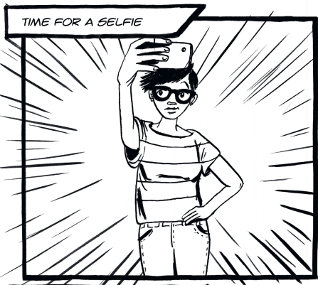
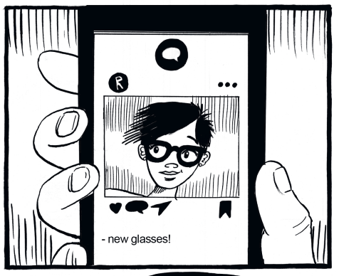
The story board 1/5
Images from: https://www.childnet.com/resources/step-up-speak-up/teaching-toolkit/step-up-speak-up-lesson-plans/
Notes:
Teacher to explain that we are now going to watch a series of storyboard images, students will need to remember the ‘plot’ and be ready to discuss after the fifth storyboard slide slide.
Please note:
Online sexual harassment takes place within the wider setting of popular culture and media. Young people are increasingly being exposed to sexualised imagery online, such as advertising, music videos, vloggers, celebrities and online pornography. Access to sophisticated editing tools means young people have the ability to edit their photos to look like the unrealistic images they see online and share these within their peer groups. Society offers very narrow expectations of what males and females should act and look like, and these are often very stereotypical, with no room for uniqueness or individuality.

Slide 12
The story board 2/5
Images from: https://www.childnet.com/resources/step-up-speak-up/teaching-toolkit/step-up-speak-up-lesson-plans/

Slide 13
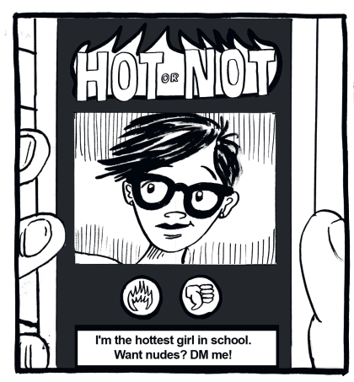
The story board 3/5
Images from: https://www.childnet.com/resources/step-up-speak-up/teaching-toolkit/step-up-speak-up-lesson-plans/

Slide 14
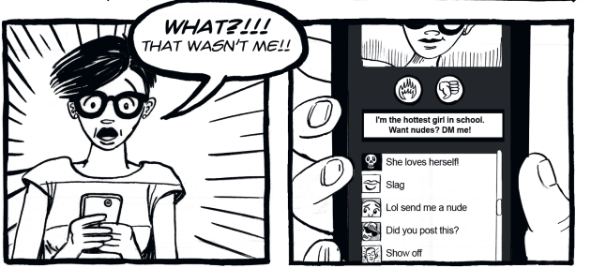
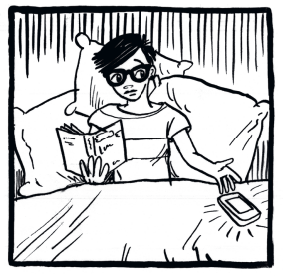
The story board 4/5
Images from: https://www.childnet.com/resources/step-up-speak-up/teaching-toolkit/step-up-speak-up-lesson-plans/

Slide 15
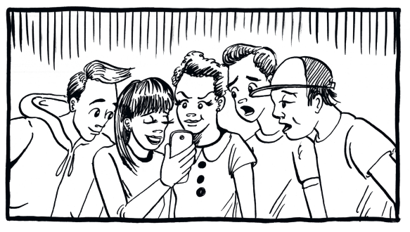
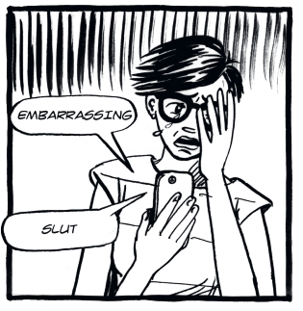
The story board 5/5
Images from: https://www.childnet.com/resources/step-up-speak-up/teaching-toolkit/step-up-speak-up-lesson-plans/

Slide 16
The story board - discussion
Who posted the photo on the ‘hot or not’ page?
Who is getting the blame for it? Why?
How do you think the victim feels?
Why are the people who re-posted the selfie not being blamed?
The victim gets comments that blame her.
Do you think people would say these things to her face-to-face? Why?
What is the difference between being ‘to blame’, and being ‘responsible?’
If something happens online can you be responsible without being to blame, or vice versa?
What do you think the victim wishes those comments said instead?
Notes:
We suggest that students work in small groups to discuss each of these questions.
Some teachers may prefer to ask a different small groups to discuss each of the questions.

Slide 17
The storyboard – different perspectives
Please work in small groups to discuss each of the perspectives*.
1. The boy who posted the photo said:
“If my photo was posted on the ‘hot or not’ page, people wouldn’t say anything mean about it. If they did, I wouldn’t care anyway.”
2. The bystander(s) said:
“Of course, she got all that harassment. Girls always get judged more harshly than boys online.”
3. The victim said:
“People are saying it was my fault and I should’ve known my photo with end up on that site. How could I have guessed that would happen? Why are people saying things things about me? Maybe they’re right…”
Notes:
We suggest that two groups consider each of the three perspectives.

Slide 18
Discussion
If I saw someone getting targeted online by sexual rumours or gossip, I would ...
If someone I knew had their nude or nearly nude photo shared online without their permission, I would make them feel better by saying...
If my friend was being harassed with unwanted sexual messages and images, I would support them by...
If my friend was getting bullied online because people thought they were gay, lesbian, bisexual or transgender/sexual, I would help them by...
If someone I knew had a fake profile set up about them to share sexual images or messages, I would support them by saying...
In small groups, please share your positive statements with each other.
How does hearing the supportive comments and advice make you feel?
Notes:
Before showing the film on the next slide (which lasts 2.28m) please ask the students to reflect on the comments they have just made to the comments made by these young people around the world.

Slide 19
Please play this video as a full screen.
Notes:
Before showing this film (which lasts 2.28m) please ask the students to reflect on the comments they have just made to the comments made by these young people around the world.
https://youtu.be/nRHJB8Ejo-0

Slide 20
SAFER SCHOOLS ISLE OF MAN
Practical advice on the latest trends, apps, games, and social media platforms
How to seek further support
How to keep safe on and offline
How to keep your information private online

Slide 21
Information and advice:
https://www.childnet.com/young-people/secondary
ChildLine
www.childline.org.uk
If you're under 19 you can confidentially call, email or chat online about any problem big or small
Chat 1:1 with an online advisor

Slide 22
REFLECTION
What are three things you’ll remember from today’s lesson?

