Slide 1
TEACHER SLIDE
Before the session: In the days or week before facilitating this session, please tell your students that they will be learning about online sexual harassment, although our ground rules will be in place, if any students are concerned, they should discuss this with you or an appropriate member of staff prior to the lesson.
Please refresh your knowledge of your school’s reporting procedures, and if necessary, speak to your Designated Safeguarding Lead (DSL) about how the school supports students who make a report.
The lesson also includes an optional activity, ‘Hot Desk’ if there is time left in the lesson (at least 15-20 minutes) otherwise you can skip this or use it in another lesson.

Slide 2

DO IT NOW
How would you define ‘online sexual harassment’ ?

Slide 3

RECOGNISING ONLINE SEXUAL HARASSMENT
YEAR 10
This presentation has been adapted for the Isle of Man from Childnet

Slide 4

CLASS AGREEMENTS
  Kindness and respect
  Right to pass
  Nonjudgmental
  No such thing as silly
questions
any others?
Notes:
Explain that you would like the class to create a list of 'agreements' for how everyone will behave and treat one another in the class. Ensure a common understanding. For example:
1. We will treat one another with kindness and respect (listening to each other, speaking one at a time, etc)
2. We all have the right to 'pass' on answering a question or participating in an activity that makes us feel uncomfortable.
3. We can disagree but will not pass judgments, make fun of, or or put anybody down. 'Challenge the opinion, not the person.'
4. Asking questions is encouraged and will be valued by our teacher. We do not ask questions to purposefully embarrass or belittle another.
*Feel free to change the agreements to suit your class, and ask whether there are any others they'd add to the list in order to create a safe, comfortable learning environment.

Slide 5
LEARNING OBJECTIVES
  Define the term online sexual harassment
  Recognise examples of online sexual harassment
  Understand the emotional impact of online sexual harassment can have on those involved
Notes:
Introduce lesson: young people have been thinking and talking about relationships, and may be thinking about
whether a relationship should include sex – acknowledge some in the group/class may have had
sexual experiences, some won’t have.
Explain this lesson is not about individuals talking about that personal stuff, and the plan is to be respectful of each other and respect the privacy of
others. With that in mind, it’s good to consider what makes a person ready for sex, either for
the first time for them, or the first time in a relationship (this point is about considering that
there is a first time in every relationship).
Reinforce ground rules including respect for others

Slide 6

SCENARIO 1
A photo was taken of Jane, hugging Callum, who was not her boyfriend. Jane and Callum are really close friends and always joke that people will think they are a couple. They have a running in-joke that Jane has lots of different boyfriends.
Jane posted the photo online, and Callum sent Jane a direct message saying ‘slag ‘
Notes:
Introduce lesson: young people have been thinking and talking about relationships, and may be thinking about
whether a relationship should include sex – acknowledge some in the group/class may have had
sexual experiences, some won’t have.
Explain this lesson is not about individuals talking about that personal stuff, and the plan is to be respectful of each other and respect the privacy of
others. With that in mind, it’s good to consider what makes a person ready for sex, either for
the first time for them, or the first time in a relationship (this point is about considering that
there is a first time in every relationship).
Reinforce ground rules including respect for others

Slide 7
REFLECTION
  How would you describe Jane and Callum’s relationship?
  Why did Callum send that message to Jane?
  Callum sent his message privately, not publicly. Why?
Notes:
Introduce lesson: young people have been thinking and talking about relationships, and may be thinking about
whether a relationship should include sex – acknowledge some in the group/class may have had
sexual experiences, some won’t have.
Explain this lesson is not about individuals talking about that personal stuff, and the plan is to be respectful of each other and respect the privacy of
others. With that in mind, it’s good to consider what makes a person ready for sex, either for
the first time for them, or the first time in a relationship (this point is about considering that
there is a first time in every relationship).
Reinforce ground rules including respect for others

Slide 8
SCENARIO 2
A photo was taken of Jane, hugging Callum, who was not her boyfriend.
It got sent around to people in their school and other schools in the area. People took screenshots and posted it to their online stories, commenting with terms like ‘slut’, ‘slag’ and ‘cheater.
Notes:
Introduce lesson: young people have been thinking and talking about relationships, and may be thinking about
whether a relationship should include sex – acknowledge some in the group/class may have had
sexual experiences, some won’t have.
Explain this lesson is not about individuals talking about that personal stuff, and the plan is to be respectful of each other and respect the privacy of
others. With that in mind, it’s good to consider what makes a person ready for sex, either for
the first time for them, or the first time in a relationship (this point is about considering that
there is a first time in every relationship).
Reinforce ground rules including respect for others

Slide 9
REFLECTION
  Why did other people take screenshots of Jane’s photo?
  What effect do you think it had on Jane and Callum when other people shared the photo?
  Who is responsible for Ama’s photo getting shared around with a wider group of people?
Notes:
Introduce lesson: young people have been thinking and talking about relationships, and may be thinking about
whether a relationship should include sex – acknowledge some in the group/class may have had
sexual experiences, some won’t have.
Explain this lesson is not about individuals talking about that personal stuff, and the plan is to be respectful of each other and respect the privacy of
others. With that in mind, it’s good to consider what makes a person ready for sex, either for
the first time for them, or the first time in a relationship (this point is about considering that
there is a first time in every relationship).
Reinforce ground rules including respect for others

Slide 10
REFLECTION
  What do you think the difference is between Callum’s actions and the actions of the other young people?
  Would the consequences be different if it had been Callum who posted the photo, and not Jane?
  Is either Scenario 1 or Scenario 2 online sexual harassment?
Notes:
Introduce lesson: young people have been thinking and talking about relationships, and may be thinking about
whether a relationship should include sex – acknowledge some in the group/class may have had
sexual experiences, some won’t have.
Explain this lesson is not about individuals talking about that personal stuff, and the plan is to be respectful of each other and respect the privacy of
others. With that in mind, it’s good to consider what makes a person ready for sex, either for
the first time for them, or the first time in a relationship (this point is about considering that
there is a first time in every relationship).
Reinforce ground rules including respect for others

Slide 11
ACTIVITY
Scenario 2 (when other people shared the photo and made unkind comments) is known as peer to peer sexual harassment.
In small groups or pairs, come up with some examples of behaviours that you think count as online sexual harassment between peers.
What do you think is the connection between consent and online sexual harassment?
Notes:
Introduce lesson: young people have been thinking and talking about relationships, and may be thinking about
whether a relationship should include sex – acknowledge some in the group/class may have had
sexual experiences, some won’t have.
Explain this lesson is not about individuals talking about that personal stuff, and the plan is to be respectful of each other and respect the privacy of
others. With that in mind, it’s good to consider what makes a person ready for sex, either for
the first time for them, or the first time in a relationship (this point is about considering that
there is a first time in every relationship).
Reinforce ground rules including respect for others

Slide 12
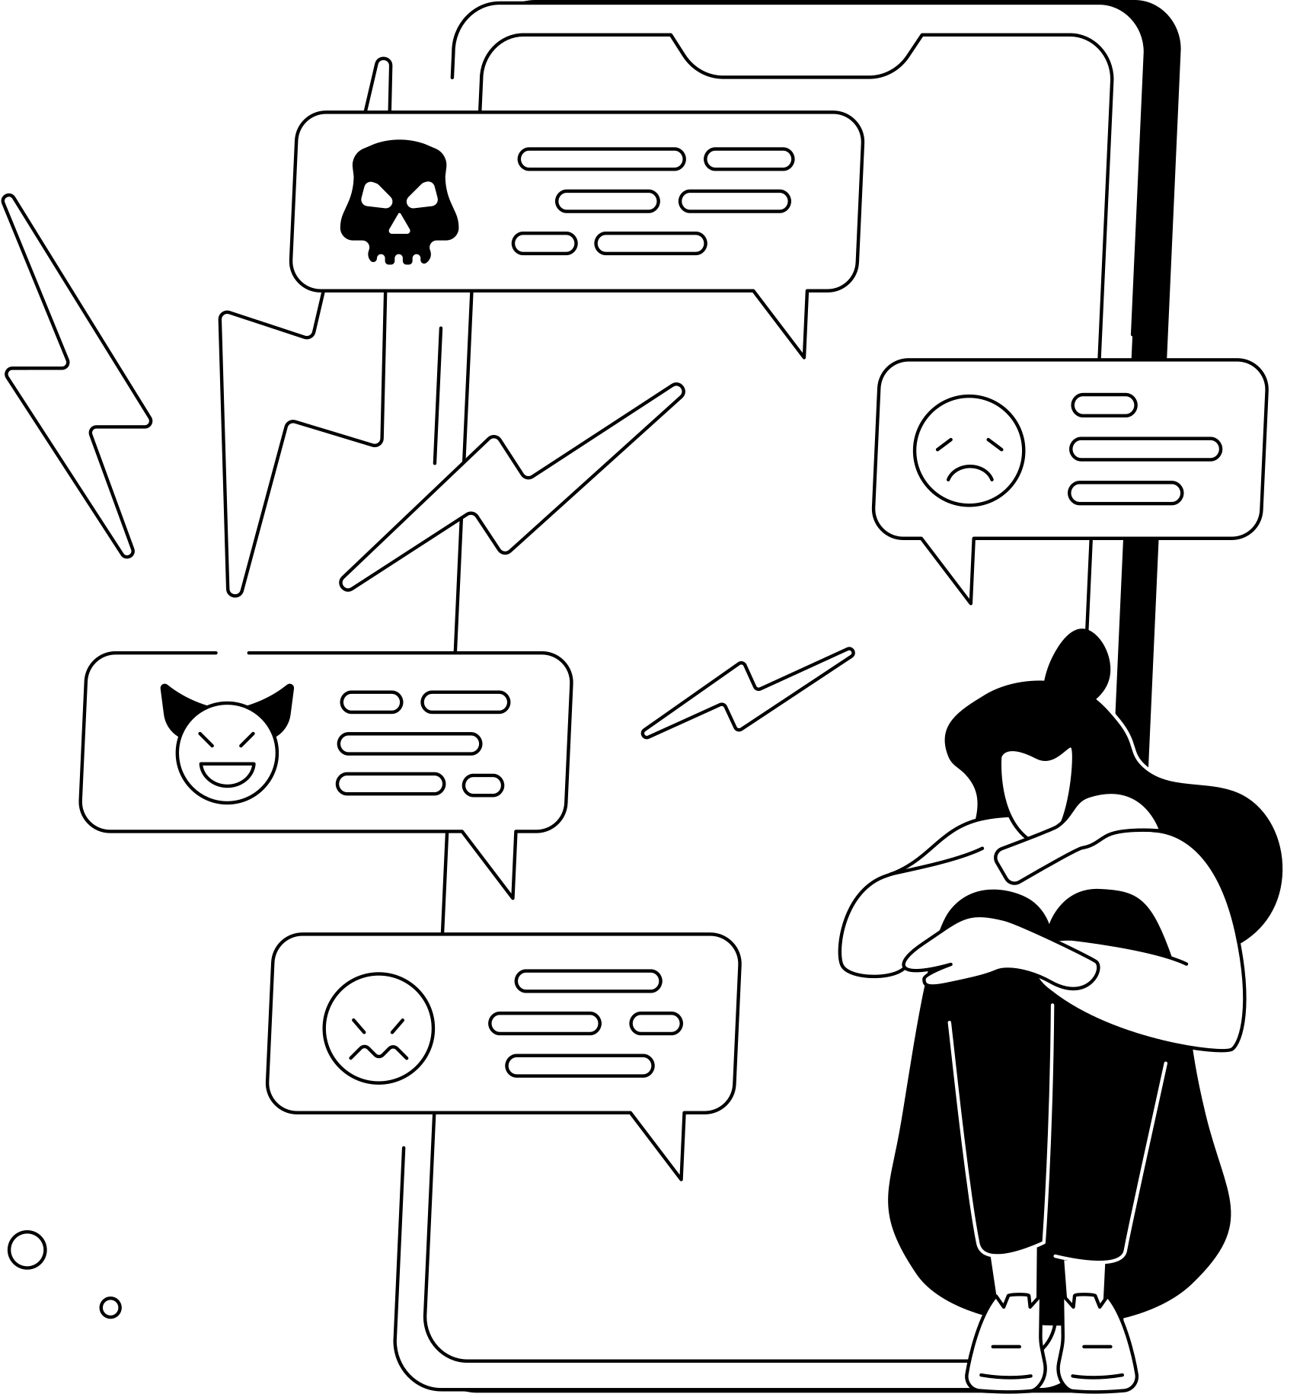
Online sexual harassment can include:
• Receiving sexual threats
• Being coerced to participate in sexual behaviour online
• Being blackmailed with sexual content
• Unsolicited sexual content shared online
• Image-based sexual abuse
• Sexual coercion, threats, and intimidation online
Notes:
Introduce lesson: young people have been thinking and talking about relationships, and may be thinking about
whether a relationship should include sex – acknowledge some in the group/class may have had
sexual experiences, some won’t have.
Explain this lesson is not about individuals talking about that personal stuff, and the plan is to be respectful of each other and respect the privacy of
others. With that in mind, it’s good to consider what makes a person ready for sex, either for
the first time for them, or the first time in a relationship (this point is about considering that
there is a first time in every relationship).
Reinforce ground rules including respect for others

Slide 13
ACTIVITY
As we look at the following scenarios, have a think and decide where the behaviour falls on the following spectrum:
FUN & FLIRTING
HARASSMENT & ABUSE
Notes:
Introduce lesson: young people have been thinking and talking about relationships, and may be thinking about
whether a relationship should include sex – acknowledge some in the group/class may have had
sexual experiences, some won’t have.
Explain this lesson is not about individuals talking about that personal stuff, and the plan is to be respectful of each other and respect the privacy of
others. With that in mind, it’s good to consider what makes a person ready for sex, either for
the first time for them, or the first time in a relationship (this point is about considering that
there is a first time in every relationship).
Reinforce ground rules including respect for others

Slide 14
Nifa was messaging with a boy. She really liked him, and was hoping their friendship could turn into a relationship. He asked for nudes, she wasn’t sure, so avoided the question. He kept asking and asking, so she blocked him.
FUN & FLIRTING
HARASSMENT & ABUSE
Notes:
Introduce lesson: young people have been thinking and talking about relationships, and may be thinking about
whether a relationship should include sex – acknowledge some in the group/class may have had
sexual experiences, some won’t have.
Explain this lesson is not about individuals talking about that personal stuff, and the plan is to be respectful of each other and respect the privacy of
others. With that in mind, it’s good to consider what makes a person ready for sex, either for
the first time for them, or the first time in a relationship (this point is about considering that
there is a first time in every relationship).
Reinforce ground rules including respect for others

Slide 15

Nifa was messaging with a boy. She really liked him, and was hoping their friendship could turn into a relationship. He asked for nudes, she wasn’t sure, so avoided the question. He kept asking and asking, so she blocked him.
FUN & FLIRTING
HARASSMENT & ABUSE
Harassment. The requests were unwanted and continued even when Nifa did not respond.
Notes:
Introduce lesson: young people have been thinking and talking about relationships, and may be thinking about
whether a relationship should include sex – acknowledge some in the group/class may have had
sexual experiences, some won’t have.
Explain this lesson is not about individuals talking about that personal stuff, and the plan is to be respectful of each other and respect the privacy of
others. With that in mind, it’s good to consider what makes a person ready for sex, either for
the first time for them, or the first time in a relationship (this point is about considering that
there is a first time in every relationship).
Reinforce ground rules including respect for others

Slide 16
Maya takes a selfie with her best friend. She comments on it with ‘love you slag xxx’
FUN & FLIRTING
HARASSMENT & ABUSE
Notes:
Introduce lesson: young people have been thinking and talking about relationships, and may be thinking about
whether a relationship should include sex – acknowledge some in the group/class may have had
sexual experiences, some won’t have.
Explain this lesson is not about individuals talking about that personal stuff, and the plan is to be respectful of each other and respect the privacy of
others. With that in mind, it’s good to consider what makes a person ready for sex, either for
the first time for them, or the first time in a relationship (this point is about considering that
there is a first time in every relationship).
Reinforce ground rules including respect for others

Slide 17
Maya takes a selfie with her best friend. She comments on it with ‘love you slag xxx’
FUN & FLIRTING
HARASSMENT & ABUSE
Not harassment. The context suggests the sexual language is being used in a familiar and friendly way.
Notes:
Introduce lesson: young people have been thinking and talking about relationships, and may be thinking about
whether a relationship should include sex – acknowledge some in the group/class may have had
sexual experiences, some won’t have.
Explain this lesson is not about individuals talking about that personal stuff, and the plan is to be respectful of each other and respect the privacy of
others. With that in mind, it’s good to consider what makes a person ready for sex, either for
the first time for them, or the first time in a relationship (this point is about considering that
there is a first time in every relationship).
Reinforce ground rules including respect for others

Slide 18
Kamil posts a few selfies online, then receives some anonymous comments describing
his body in a sexual way and making sexual suggestions.
FUN & FLIRTING
HARASSMENT & ABUSE
Notes:
Introduce lesson: young people have been thinking and talking about relationships, and may be thinking about
whether a relationship should include sex – acknowledge some in the group/class may have had
sexual experiences, some won’t have.
Explain this lesson is not about individuals talking about that personal stuff, and the plan is to be respectful of each other and respect the privacy of
others. With that in mind, it’s good to consider what makes a person ready for sex, either for
the first time for them, or the first time in a relationship (this point is about considering that
there is a first time in every relationship).
Reinforce ground rules including respect for others

Slide 19
Kamil posts a few selfies online, then receives some anonymous comments describing
his body in a sexual way and making sexual suggestions.
FUN & FLIRTING
HARASSMENT & ABUSE
Harassment. Kamil has not given his consent to receive those comments, as he does not know who the person contacting him is.
Notes:
Introduce lesson: young people have been thinking and talking about relationships, and may be thinking about
whether a relationship should include sex – acknowledge some in the group/class may have had
sexual experiences, some won’t have.
Explain this lesson is not about individuals talking about that personal stuff, and the plan is to be respectful of each other and respect the privacy of
others. With that in mind, it’s good to consider what makes a person ready for sex, either for
the first time for them, or the first time in a relationship (this point is about considering that
there is a first time in every relationship).
Reinforce ground rules including respect for others

Slide 20
Amy was born a girl, but identifies as a boy. Amy wants to be known as Aidan and
for people at school to refer to him as ‘he’ and ‘him’. Aidan changes his online profile names to his new name. Some people ‘like’ the change and some make comments asking about it.
FUN & FLIRTING
HARASSMENT & ABUSE
Notes:
Introduce lesson: young people have been thinking and talking about relationships, and may be thinking about
whether a relationship should include sex – acknowledge some in the group/class may have had
sexual experiences, some won’t have.
Explain this lesson is not about individuals talking about that personal stuff, and the plan is to be respectful of each other and respect the privacy of
others. With that in mind, it’s good to consider what makes a person ready for sex, either for
the first time for them, or the first time in a relationship (this point is about considering that
there is a first time in every relationship).
Reinforce ground rules including respect for others

Slide 21
Amy was born a girl, but identifies as a boy. Amy wants to be known as Aidan and
for people at school to refer to him as ‘he’ and ‘him’. Aidan changes his online profile names to his new name. Some people ‘like’ the change and some make comments asking about it.
FUN & FLIRTING
HARASSMENT & ABUSE
It depends. Why have people liked the name change? What sort of
comments are posted? If they are discriminatory or transphobic (mean words about changing your gender), the behaviour could be harassment. If they were supportive, it may not be harassment.
Notes:
Introduce lesson: young people have been thinking and talking about relationships, and may be thinking about
whether a relationship should include sex – acknowledge some in the group/class may have had
sexual experiences, some won’t have.
Explain this lesson is not about individuals talking about that personal stuff, and the plan is to be respectful of each other and respect the privacy of
others. With that in mind, it’s good to consider what makes a person ready for sex, either for
the first time for them, or the first time in a relationship (this point is about considering that
there is a first time in every relationship).
Reinforce ground rules including respect for others

Slide 22
Hamir and Laura are in the first stages of a relationship. They text each other a lot, and
have quite flirty conversations. Hamir tells Laura she’s ‘hot’ which Laura takes as a compliment.
FUN & FLIRTING
HARASSMENT & ABUSE
Notes:
Introduce lesson: young people have been thinking and talking about relationships, and may be thinking about
whether a relationship should include sex – acknowledge some in the group/class may have had
sexual experiences, some won’t have.
Explain this lesson is not about individuals talking about that personal stuff, and the plan is to be respectful of each other and respect the privacy of
others. With that in mind, it’s good to consider what makes a person ready for sex, either for
the first time for them, or the first time in a relationship (this point is about considering that
there is a first time in every relationship).
Reinforce ground rules including respect for others

Slide 23
Hamir and Laura are in the first stages of a relationship. They text each other a lot, and have quite flirty conversations. Hamir tells Laura she’s ‘hot’ which Laura takes as a compliment.
FUN & FLIRTING
HARASSMENT & ABUSE
Not harassment. The comments are part of a respectful conversation, and are not unwanted. If the comment made Laura uncomfortable, but Hamir continued to say it, this would then become harassment.
Notes:
Introduce lesson: young people have been thinking and talking about relationships, and may be thinking about
whether a relationship should include sex – acknowledge some in the group/class may have had
sexual experiences, some won’t have.
Explain this lesson is not about individuals talking about that personal stuff, and the plan is to be respectful of each other and respect the privacy of
others. With that in mind, it’s good to consider what makes a person ready for sex, either for
the first time for them, or the first time in a relationship (this point is about considering that
there is a first time in every relationship).
Reinforce ground rules including respect for others

Slide 24
LET’S CHAT
  Which scenarios were easy to categorise?
  Which were difficult? Why?
  Why might different people have different opinions on whether each scenario is fun & flirting or harassment?
  What could each of the characters have done to check for consent in each scenario?
Notes:
Introduce lesson: young people have been thinking and talking about relationships, and may be thinking about
whether a relationship should include sex – acknowledge some in the group/class may have had
sexual experiences, some won’t have.
Explain this lesson is not about individuals talking about that personal stuff, and the plan is to be respectful of each other and respect the privacy of
others. With that in mind, it’s good to consider what makes a person ready for sex, either for
the first time for them, or the first time in a relationship (this point is about considering that
there is a first time in every relationship).
Reinforce ground rules including respect for others

Slide 25
LET’S CHAT
Think about the person carrying out the online sexual harassment in each scenario. Why do you think they behave in that way?
Who do you think has the final say on whether something is online sexual harassment or not – the victim, the perpetrator or bystanders (people who saw it happen but were not involved)?
Notes:
Introduce lesson: young people have been thinking and talking about relationships, and may be thinking about
whether a relationship should include sex – acknowledge some in the group/class may have had
sexual experiences, some won’t have.
Explain this lesson is not about individuals talking about that personal stuff, and the plan is to be respectful of each other and respect the privacy of
others. With that in mind, it’s good to consider what makes a person ready for sex, either for
the first time for them, or the first time in a relationship (this point is about considering that
there is a first time in every relationship).
Reinforce ground rules including respect for others

Slide 26

JANE’S STORY
We’re going to revisit Jane, who we talked about earlier in the lesson. Jane is going to share her story of online sexual harassment.
As you listen, write down how you think Jane might be feeling at different points in the story. You can use words or drawings.
What advice would you give Jane to make the situation better?
Notes:
Introduce lesson: young people have been thinking and talking about relationships, and may be thinking about
whether a relationship should include sex – acknowledge some in the group/class may have had
sexual experiences, some won’t have.
Explain this lesson is not about individuals talking about that personal stuff, and the plan is to be respectful of each other and respect the privacy of
others. With that in mind, it’s good to consider what makes a person ready for sex, either for
the first time for them, or the first time in a relationship (this point is about considering that
there is a first time in every relationship).
Reinforce ground rules including respect for others

Slide 27
People who experience online sexual harassment might feel lots of emotions, including:
  Threatened
  Exploited
  Coerced
  That their dignity is lost
  Humiliated or degraded
  Upset
  Sexualised
  Discriminated against (because of their gender or sexual orientation)
  Guilty or like they are to blame
Notes:
Introduce lesson: young people have been thinking and talking about relationships, and may be thinking about
whether a relationship should include sex – acknowledge some in the group/class may have had
sexual experiences, some won’t have.
Explain this lesson is not about individuals talking about that personal stuff, and the plan is to be respectful of each other and respect the privacy of
others. With that in mind, it’s good to consider what makes a person ready for sex, either for
the first time for them, or the first time in a relationship (this point is about considering that
there is a first time in every relationship).
Reinforce ground rules including respect for others

Slide 28
OPTIONAL ACTIVITY - HOT SEAT
Work in small groups, or as a whole class. How did each character play a part in Jane’s scenario?
Characters:
  Jane– the main character who experiences online sexual harassment
  Callum – Jane’s best friend, who gets targeted by the online sexual harassment too
  Alfie – Jane’s classmate, who she suspects spread the rumours and the photo
  The bystanders who shared the rumours and the photo
Notes:
Introduce lesson: young people have been thinking and talking about relationships, and may be thinking about
whether a relationship should include sex – acknowledge some in the group/class may have had
sexual experiences, some won’t have.
Explain this lesson is not about individuals talking about that personal stuff, and the plan is to be respectful of each other and respect the privacy of
others. With that in mind, it’s good to consider what makes a person ready for sex, either for
the first time for them, or the first time in a relationship (this point is about considering that
there is a first time in every relationship).
Reinforce ground rules including respect for others

Slide 29

SAFER SCHOOLS ISLE OF MAN
  Practical advice on the latest trends, apps, games, and social media platforms
  How to seek further support
  How to keep safe on and offline
  How to keep your information private online

Slide 30

Information and advice:
  https://www.childnet.com/young-people/secondary
  ChildLine
    www.childline.org.uk
    If you're under 19 you can confidentially call, email or chat online about any problem big or small
    Chat 1:1 with an online advisor

Slide 31

REFLECTION
What are three things you’ll remember from today’s lesson?

