Slide 1

GENDER EQUALITY
& EQUITY
YEAR 10
This presentation has been adapted for the Isle of Man from Scotland’s national resource for relationships, sexual health, and parenthood (RSHP) education.

Slide 2

CLASS AGREEMENTS
  Kindness and respect
  Right to pass
  Nonjudgmental
  No such thing as silly
questions
any others?
Notes:
Explain that you would like the class to create a list of 'agreements' for how everyone will behave and treat one another in the class. Ensure a common understanding. For example:
1. We will treat one another with kindness and respect (listening to each other, speaking one at a time, etc)
2. We all have the right to 'pass' on answering a question or participating in an activity that makes us feel uncomfortable.
3. We can disagree but will not pass judgments, make fun of, or or put anybody down. 'Challenge the opinion, not the person.'
4. Asking questions is encouraged and will be valued by our teacher. We do not ask questions to purposefully embarrass or belittle another.
*Feel free to change the agreements to suit your class, and ask whether there are any others they'd add to the list in order to create a safe, comfortable learning environment.

Slide 3
HAVE A THINK
What does ‘equality’ mean to you?
Notes:
Explain that in this lesson young people will be exploring equality, thinking especially about equality between men and women –known as gender equality.
Ask the class to consider the question of what they believe is meant by the term ' equality.'
Give the class time to share their thoughts. Then, explain that typically, when people talk about equality, they tend to mean that people should be treated the same way, and have the same rights and opportunities.

Slide 4
HAVE A THINK
What does ‘equity’ mean to you?
Notes:
Ask the class if they have heard of the term equity - what does this mean? What's the difference?
Give the class a chance to respond, and then explain that equity is similar to equality, but it takes into account the fact that people may have different needs and circumstances.
Equality generally is about giving people the same thing; equity is about giving people what they need, in order to have the best opportunities to thrive.

Slide 5
WHAT’S THE DIFFERENCE?
equality = treating people the same, regardless of differences.
equity = recognises differences in needs/circumstances and giving people what they need
Notes:
Ask the class if they have heard of the term equity - what does this mean? What's the difference?
Give the class a chance to respond, and then explain that equity is similar to equality, but it takes into account the fact that people may have different needs and circumstances.
Equality generally is about giving people the same thing; equity is about giving people what they need, in order to have the best opportunities to thrive.

Slide 6
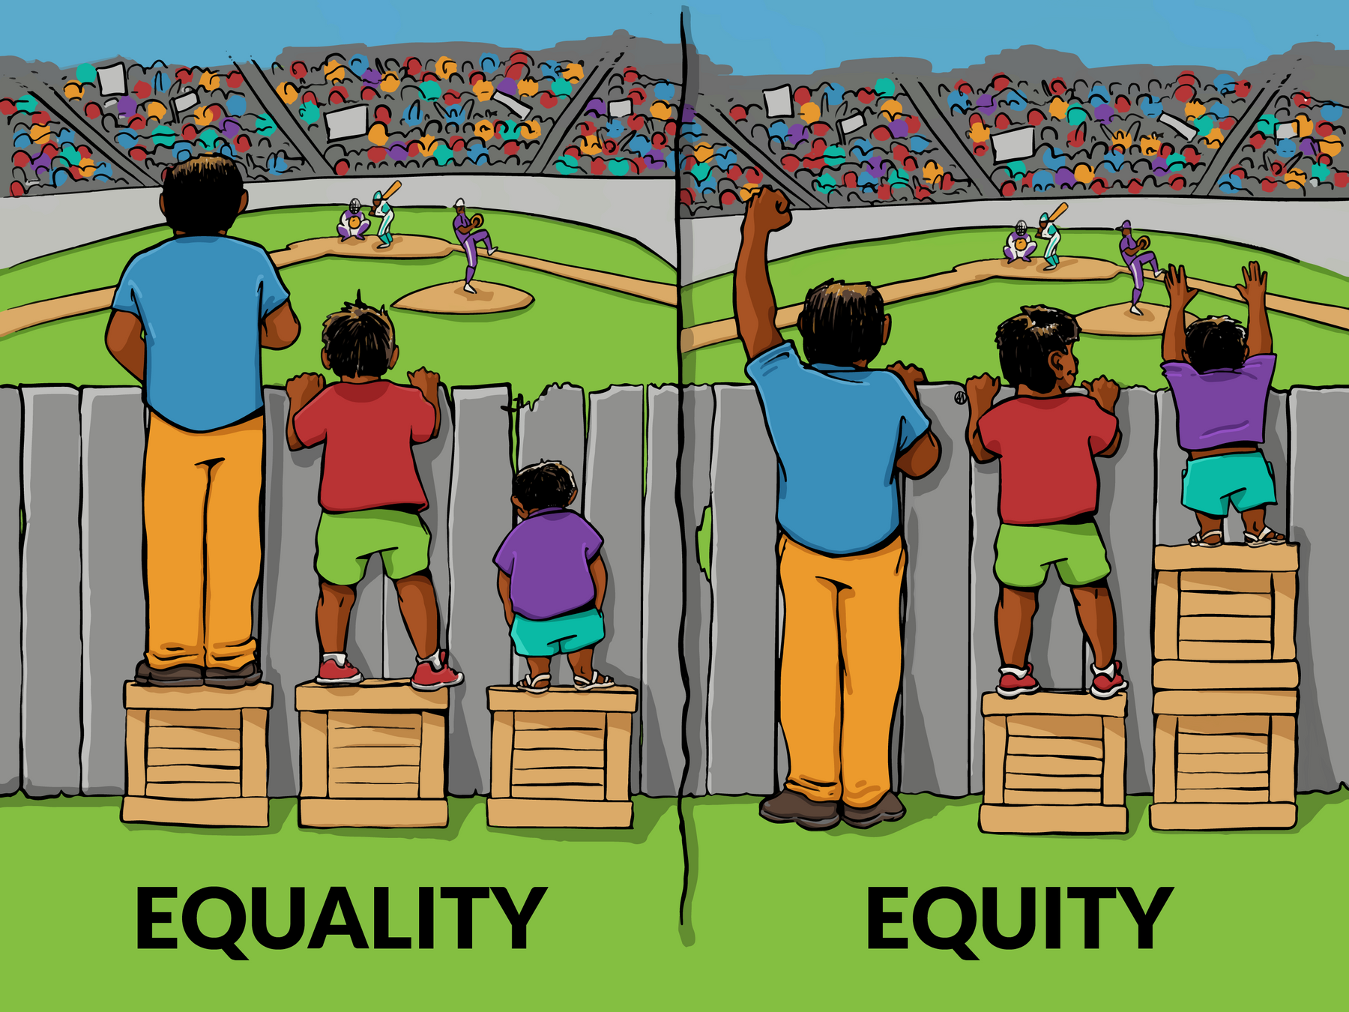
Notes:
Using this picture, ask the class if they can describe what's happening.
On the left, all three people have been given the same size box to stand on to see over the fence. They have been given equal resources, which works fine for the taller people. However, the shorter person still cannot see, despite having the same size box.
On the right, it was recognised that the shorter person needs more boxes to stand on. Technically they have more boxes than the other two people, which is not equal, but this is what they needed in order to be able to see. The tallest person did not need a box, and the middle person needed only one. Now all three can see because they were given what they needed. That is equity.

Slide 7

HAVE A THINK
HOW DOES THIS RELATE TO GENDER?
Notes:
Based on what they now know about equality and equity, ask the class how these concepts might relate to gender.
Split the class into small groups or pairs to have a discussion, and then feed back to the wider group.

Slide 8
GENDER EQUITY
Equity recognises that certain groups of people, such as those from different ethnic communities, or those who identify as LGBTQ+, have experienced discrimination based on these characteristics.
Women/girls are another group of people who have historically experienced discrimination, based on their gender.
Notes:
Explain that equity recognises that certain groups of people have been discriminated against, and that this includes women/girls.

Slide 9
GENDER EQUITY
Equity recognises that certain groups of people, such as those from different ethnic communities, or those who identify as LGBTQ+, have experienced discrimination based on these characteristics.
Women/girls are another group of people who have historically experienced discrimination, based on their gender.
Notes:
Gender Equality in Relationships: Use the prompt slides one at a time and ask young people to
work in small groups to consider these statements.
the task asks them to provide
examples of what men or women might experience if their relationships were equal.
Give an
example or two if it helps:
So, if men and women were equal in the family they might share how
they bring up their child...
So, if men and women were equal in society, they might get paid the
same wages....
• Equality between men and women in the family/at home. What would this mean?
• Equality between men and women in friendships. What would this mean?
• Equality between men and women if they are in a relationship. What would this mean?
• Equality between men and women in society, in general. What would this mean?

Slide 10
WHAT WOULD IT LOOK LIKE IF...
Men and women were equal at home?
Notes:
Gender Equality in Relationships: Use the prompt slides one at a time and ask young people to
work in small groups to consider these statements.
the task asks them to provide
examples of what men or women might experience if their relationships were equal.
Give an
example or two if it helps:
So, if men and women were equal in the family they might share how
they bring up their child...
So, if men and women were equal in society, they might get paid the
same wages....
• Equality between men and women in the family/at home. What would this mean?
• Equality between men and women in friendships. What would this mean?
• Equality between men and women if they are in a relationship. What would this mean?
• Equality between men and women in society, in general. What would this mean?

Slide 11
WHAT WOULD IT LOOK LIKE IF...
Men and women were equal at work?
Notes:
Gender Equality in Relationships: Use the prompt slides one at a time and ask young people to
work in small groups to consider these statements.
the task asks them to provide
examples of what men or women might experience if their relationships were equal.
Give an
example or two if it helps:
So, if men and women were equal in the family they might share how
they bring up their child...
So, if men and women were equal in society, they might get paid the
same wages....
• Equality between men and women in the family/at home. What would this mean?
• Equality between men and women in friendships. What would this mean?
• Equality between men and women if they are in a relationship. What would this mean?
• Equality between men and women in society, in general. What would this mean?

Slide 12
WHAT WOULD IT LOOK LIKE IF...
Boys and girls were equal in school?
Notes:
Gender Equality in Relationships: Use the prompt slides one at a time and ask young people to
work in small groups to consider these statements.
the task asks them to provide
examples of what men or women might experience if their relationships were equal.
Give an
example or two if it helps:
So, if men and women were equal in the family they might share how
they bring up their child...
So, if men and women were equal in society, they might get paid the
same wages....
• Equality between men and women in the family/at home. What would this mean?
• Equality between men and women in friendships. What would this mean?
• Equality between men and women if they are in a relationship. What would this mean?
• Equality between men and women in society, in general. What would this mean?

Slide 13
WHAT WOULD IT LOOK LIKE IF...
Men and women were equal in relationships?
Notes:
Gender Equality in Relationships: Use the prompt slides one at a time and ask young people to
work in small groups to consider these statements.
the task asks them to provide
examples of what men or women might experience if their relationships were equal.
Give an
example or two if it helps:
So, if men and women were equal in the family they might share how
they bring up their child...
So, if men and women were equal in society, they might get paid the
same wages....
• Equality between men and women in the family/at home. What would this mean?
• Equality between men and women in friendships. What would this mean?
• Equality between men and women if they are in a relationship. What would this mean?
• Equality between men and women in society, in general. What would this mean?

Slide 14
ACTIVITY
Do these scenarios describe an equal relationship?
Notes:
Explain that this activity is about thinking a bit more about what a relationship would be like if it was experienced as equal by both people.
Explain “an equal relationship is one where one person doesn’t use power to put down or control their partner. There are 15 scenarios to be read out, do they describe an equal relationship or not?"

Slide 15
SCENARIO
You are expected to clean or tidy up your partner’s stuff.
Notes:
Explain that this activity is about thinking a bit more about what a relationship would be like if it was experienced as equal by both people.
Explain “an equal relationship is one where one person doesn’t use power to put down or control their partner. There are 15 scenarios to be read out, do they describe an equal relationship or not?"

Slide 16
SCENARIO
Your partner wants to know the password to your social media.
Notes:
Explain that this activity is about thinking a bit more about what a relationship would be like if it was experienced as equal by both people.
Explain “an equal relationship is one where one person doesn’t use power to put down or control their partner. There are 15 scenarios to be read out, do they describe an equal relationship or not?"

Slide 17
SCENARIO
You like to spend time with each other.
Notes:
Explain that this activity is about thinking a bit more about what a relationship would be like if it was experienced as equal by both people.
Explain “an equal relationship is one where one person doesn’t use power to put down or control their partner. I am going to read out a scenario, do they describe an equal relationship or not?"

Slide 18
SCENARIO
Your partner tells you what to do.
Notes:
Explain that this activity is about thinking a bit more about what a relationship would be like if it was experienced as equal by both people.
Explain “an equal relationship is one where one person doesn’t use power to put down or control their partner. I am going to read out a scenario, do they describe an equal relationship or not?"

Slide 19
SCENARIO
Your partner puts you down in front of pals.
Notes:
Explain that this activity is about thinking a bit more about what a relationship would be like if it was experienced as equal by both people.
Explain “an equal relationship is one where one person doesn’t use power to put down or control their partner. I am going to read out a scenario, do they describe an equal relationship or not?"

Slide 20
SCENARIO
You both like to pay for things when you are out.
Notes:
Explain that this activity is about thinking a bit more about what a relationship would be like if it was experienced as equal by both people.
Explain “an equal relationship is one where one person doesn’t use power to put down or control their partner. I am going to read out a scenario, do they describe an equal relationship or not?"

Slide 21
SCENARIO
You can say “‘No I won’t be able to see you tonight.”
Notes:
Explain that this activity is about thinking a bit more about what a relationship would be like if it was experienced as equal by both people.
Explain “an equal relationship is one where one person doesn’t use power to put down or control their partner. I am going to read out a scenario, do they describe an equal relationship or not?"

Slide 22
SCENARIO
Your partner grabs you by the arm and it hurts.
Notes:
Explain that this activity is about thinking a bit more about what a relationship would be like if it was experienced as equal by both people.
Explain “an equal relationship is one where one person doesn’t use power to put down or control their partner. I am going to read out a scenario, do they describe an equal relationship or not?"

Slide 23
SCENARIO
Your partner pressures you to have sex.
Notes:
Explain that this activity is about thinking a bit more about what a relationship would be like if it was experienced as equal by both people.
Explain “an equal relationship is one where one person doesn’t use power to put down or control their partner. I am going to read out a scenario, do they describe an equal relationship or not?"

Slide 24
SCENARIO
You like to buy each other presents.
Notes:
Explain that this activity is about thinking a bit more about what a relationship would be like if it was experienced as equal by both people.
Explain “an equal relationship is one where one person doesn’t use power to put down or control their partner. I am going to read out a scenario, do they describe an equal relationship or not?"

Slide 25
SCENARIO
You can both see your friends without each other also being there.
Notes:
Explain that this activity is about thinking a bit more about what a relationship would be like if it was experienced as equal by both people.
Explain “an equal relationship is one where one person doesn’t use power to put down or control their partner. I am going to read out a scenario, do they describe an equal relationship or not?"

Slide 26
LET’S CHAT
Regardless of gender, in an equal relationship, how would you want to feel? How would we want our partner to feel?
Notes:
Class wide discussion - use the following prompt to get ideas from the class. What would they expect in an equal relationship, regardless of gender? How would they like to feel? How would they like their partner to feel?

Slide 27

reflection
what’s one thing you’ll take away from today’s session?

