Slide 1

CONTRACEPTION
YEAR 10
This presentation has been adapted for the Isle of Man from Scotland’s national resource for relationships, sexual health, and parenthood (RSHP) education.

Slide 2

CLASS AGREEMENTS
  Kindness and respect
  Right to pass
  Nonjudgmental
  No such thing as silly
questions
any others?
Notes:
Explain that you would like the class to create a list of 'agreements' for how everyone will behave and treat one another in the class. Ensure a common understanding. For example:
1. We will treat one another with kindness and respect (listening to each other, speaking one at a time, etc)
2. We all have the right to 'pass' on answering a question or participating in an activity that makes us feel uncomfortable.
3. We can disagree but will not pass judgments, make fun of, or or put anybody down. 'Challenge the opinion, not the person.'
4. Asking questions is encouraged and will be valued by our teacher. We do not ask questions to purposefully embarrass or belittle another.
*Feel free to change the agreements to suit your class, and ask whether there are any others they'd add to the list in order to create a safe, comfortable learning environment.

Slide 3
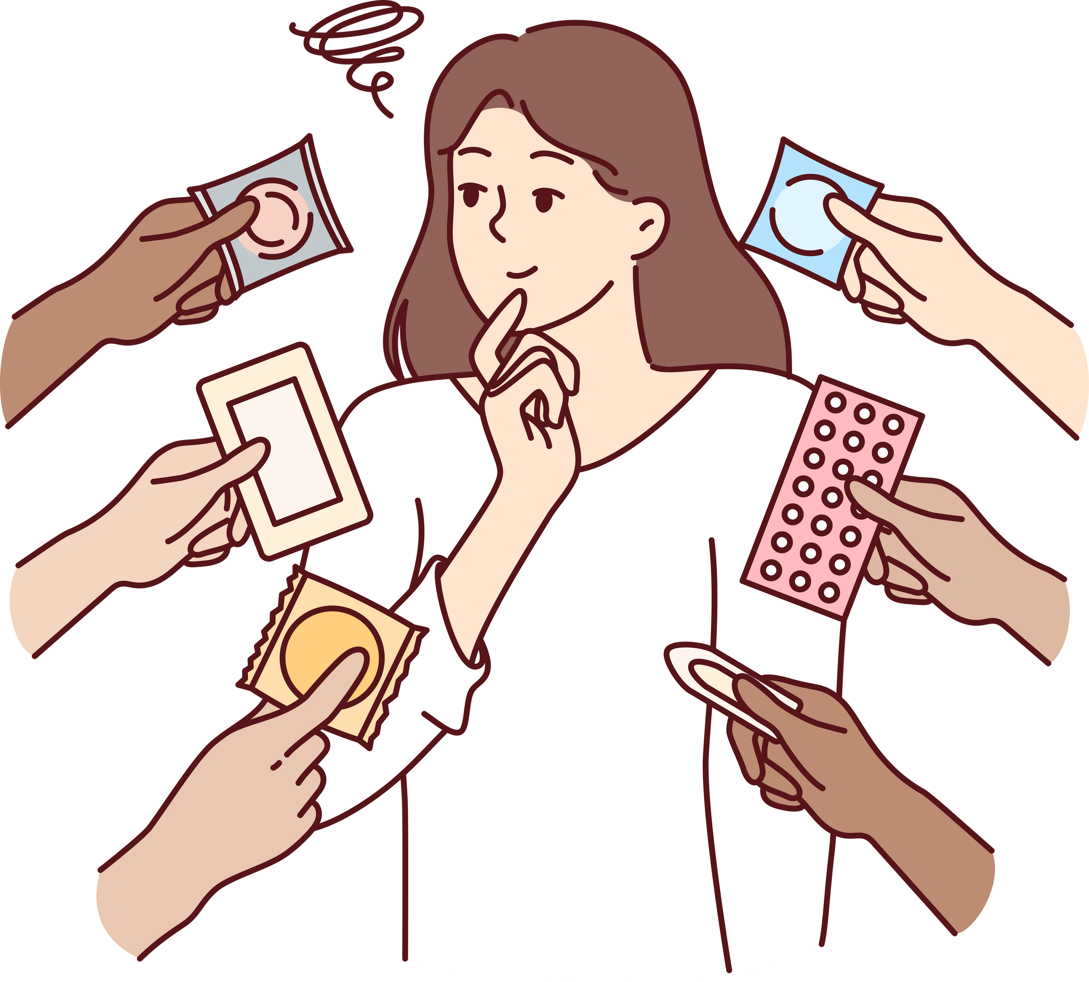
HAVE A THINK
What is contraception?
Notes:
Introduce today’s lesson by sharing that you will be talking about contraception. Ask the class if they are familiar with the term and what they think it means.
Explain that contraception refers to the methods used to prevent a pregnancy. Explain that contraception comes in many forms, which you will be talking about today.
At this early stage and throughout, address both young men and young women equally and engage all in discussion. State explicitly that there’s no assumption young people are having sex, and nothing today is personal, so let’s make sure everyone respects confidentiality.

Slide 4
LET’S CHAT
What kinds of contraception have you heard of?
Notes:
Ask the class to share any types of contraception they may have heard of (and remind students that we are not sharing any personal experiences.)

Slide 5
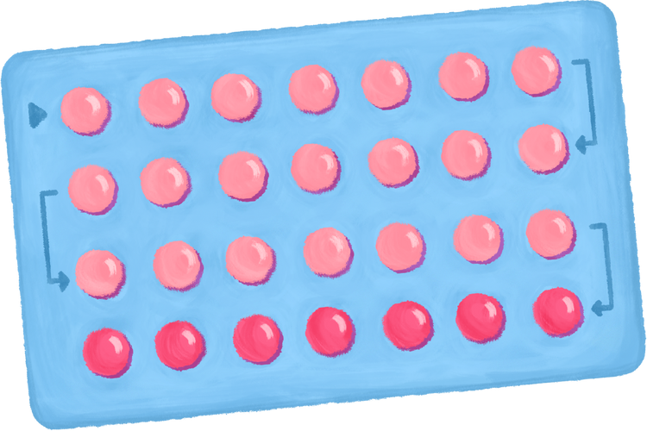

TYPES OF CONTRACEPTION
  Condoms
  Contraceptive pill
  Patch
  Implant
  Injections
  Emergency contraception
Notes:
Explain that you are going to be talking about the most common forms of contraception, one by one.

Slide 6
CONDOMS
Condoms do two things:
  Prevent pregnancy (by stopping the sperm from meeting the egg)
  Protect both men and women from the spread of sexually transmitted infections (STIs)
Notes:
Share the following slides about specific types of contraception. Invite students to ask questions, or write them down if they do not want to ask publicly.
If you are unsure of the answer to a question, let the students know that you will come back to them with an answer next time.

Slide 7

MALE CONDOMS
Condoms work by collecting the semen and sperm when the man ejaculates during sex. ​
​
This stops the semen and sperm travelling up the vagina and meeting the egg.​
​
Male condoms are 98% effective at preventing pregnancy is used correctly.​
Notes:
Share the following slides about specific types of contraception. Invite students to ask questions, or write them down if they do not want to ask publicly.
If you are unsure of the answer to a question, let the students know that you will come back to them with an answer next time.

Slide 8
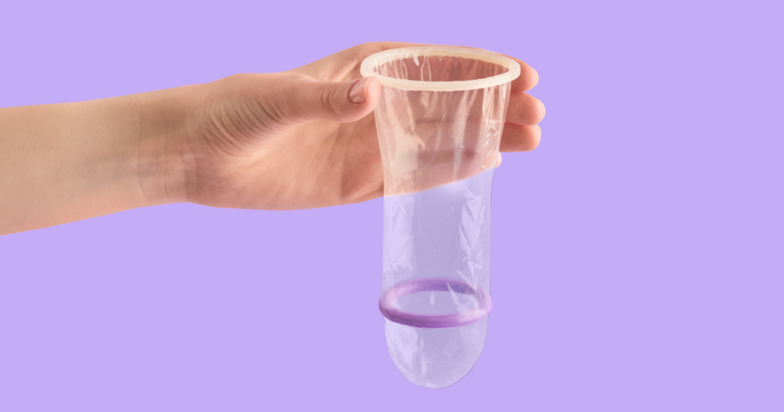
FEMALE CONDOMS
A woman’s condom fits inside her vagina.​
​
When the man puts his penis inside her vagina during sex and ejaculates, the semen and sperm collects in the condom.​
​
Female condoms are 95% effective at preventing pregnancy if used correctly.
Notes:
Share the following slides about specific types of contraception. Invite students to ask questions, or write them down if they do not want to ask publicly.
If you are unsure of the answer to a question, let the students know that you will come back to them with an answer next time.

Slide 9
CONTRACEPTIVE PILL
Sometimes also known as ‘birth control pills’ or ‘the pill’ and is used by females.
There are different types of contraceptive pills, but they work by releasing hormones into the body (oestrogen and progestogen) which prevent pregnancy by:
  preventing ovulation
  making it difficult for sperm to get to an egg
  thinning the womb lining, so there is less chance an egg will attach to it
Notes:
Share the following slides about specific types of contraception. Invite students to ask questions, or write them down if they do not want to ask publicly.
If you are unsure of the answer to a question, let the students know that you will come back to them with an answer next time.

Slide 10
CONTRACEPTIVE PILL
Sometimes also known as ‘birth control pills’ or ‘the pill’ and is used by females.
When taken correctly, the contraceptive pill is over 99% effective at preventing pregnancy.
The contraceptive pill only works to prevent pregnancy.
It DOES NOT end a pregnancy that has already occurred.
Notes:
Share the following slides about specific types of contraception. Invite students to ask questions, or write them down if they do not want to ask publicly.
If you are unsure of the answer to a question, let the students know that you will come back to them with an answer next time.

Slide 11
CONTRACEPTIVE PILL
Sometimes also known as ‘birth control pills’ or ‘the pill’ and is used by females.
Some women take the pill not to prevent pregnancy, but to treat symptoms of health conditions such as:
  heavy, painful, or irregular periods
  PCOS (polycystic ovary syndrome)
  endometriosis
Notes:
Share the following slides about specific types of contraception. Invite students to ask questions, or write them down if they do not want to ask publicly.
If you are unsure of the answer to a question, let the students know that you will come back to them with an answer next time.

Slide 12
THE PATCH, IMPLANT, AND INJECTIONS
Other methods used by females.
  The patch is a sticky patch that you stick on your body. It releases hormones to prevent pregnancy and is 99% effective, but needs to be changed often, usually weekly.
  The implant is a little plastic rod that is inserted into your arm by a doctor. The implant also releases hormones to prevent pregnancy and is 99% effective. The implant typically lasts for a few years, usually 3.
  Injections also work by releasing hormones to prevent pregnancy, and usually last between 8-13 weeks, depending on the injection.
Notes:
Share the following slides about specific types of contraception. Invite students to ask questions, or write them down if they do not want to ask publicly.
If you are unsure of the answer to a question, let the students know that you will come back to them with an answer next time.

Slide 13

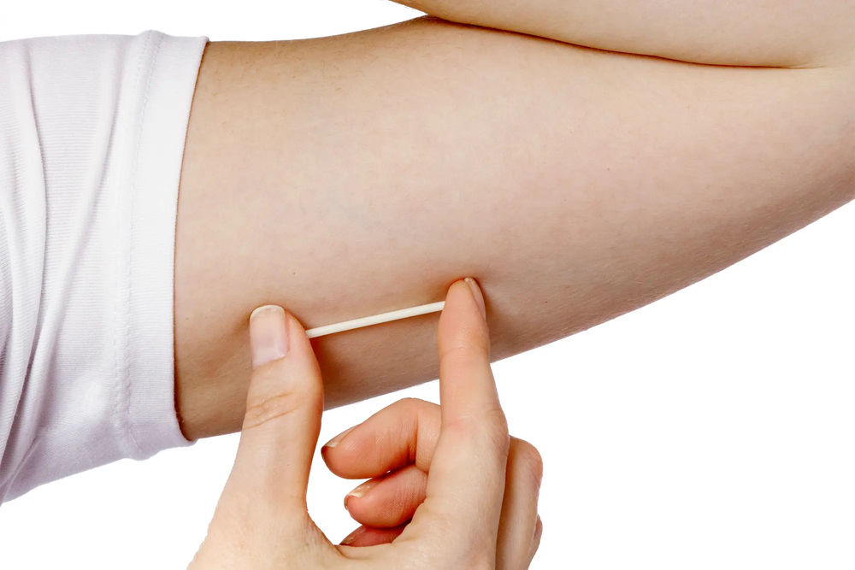
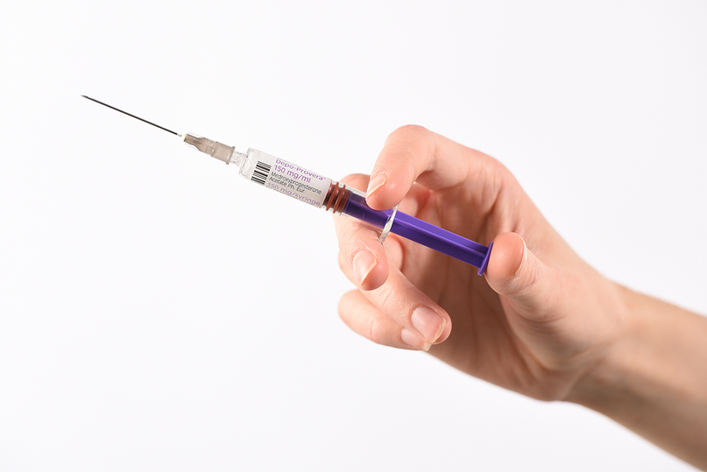
THE PATCH, IMPLANT, AND INJECTIONS
Notes:
Share the following slides about specific types of contraception. Invite students to ask questions, or write them down if they do not want to ask publicly.
If you are unsure of the answer to a question, let the students know that you will come back to them with an answer next time.

Slide 14
EMERGENCY CONTRACEPTION
People sometimes need to use emergency contraception if they’ve had unprotected sex, or if their contraception method has failed (for example if the condom breaks).
There are two types of emergency contraception: a pill, and ‘the coil.’
Notes:
Share the following slides about specific types of contraception. Invite students to ask questions, or write them down if they do not want to ask publicly.
If you are unsure of the answer to a question, let the students know that you will come back to them with an answer next time.

Slide 15
EMERGENCY CONTRACEPTION (EC)
The EC pill typically needs to be taken within 3 days (72 hours) of having sex, but some may work up to five days. The EC pill works by preventing a pregnancy from occurring by preventing or delaying ovulation.
The coil is another method - it is a small copper and plastic device which is put into the uterus. This must be fitted by a doctor or nurse.
Notes:
Share the following slides about specific types of contraception. Invite students to ask questions, or write them down if they do not want to ask publicly.
If you are unsure of the answer to a question, let the students know that you will come back to them with an answer next time.

Slide 16
EMERGENCY CONTRACEPTION (EC)
  The sooner emergency contraception is taken, the better a chance it has of working.
  Emergency contraception only works to prevent pregnancy.
  It DOES NOT terminate an existing pregnancy.
Notes:
Ensure that students understand emergency contraception is NOT the same as a termination. They may have heard it being referred to as "the abortion pill" - this is incorrect and dangerous misinformation, and must be clarified.

Slide 17
SEXUAL HEALTH SERVICES ON ISLAND
On the Isle of Man, the GUM Clinic (Genito Urinary Medicine) provide sexual health services, including:
  Emergency contraception
  Pregnancy testing
  STI tests
  Condoms
  Cervical screening/smear tests
  One to one sexual health education
Notes:
Remind students of services available on island, like the GUM clinic.

Slide 18
SEXUAL HEALTH SERVICES ON ISLAND
GUM Clinic (Genito Urinary Medicine)
You can self-refer, so you don’t need a GP to do it for you.
To make an appointment, call
+44 1624 650710
or +44 1624 650577
Notes:
Remind students of services available on island, like the GUM clinic.

Slide 19
SEXUAL HEALTH SERVICES ON ISLAND
You can get emergency contraception for free.
​
You can get the emergency contraceptive pill from the GUM Clinic, your GP, the Family Planning Clinic or a local pharmacy.​
You can get the IUD/coil fitted at your GPs or the Family Planning Clinic.​
Notes:
Explain that contraception can be provided by GPs, the GUM clinic, and family planning clinic.

Slide 20

LET’S CHAT
Who is responsible for contraception?
Notes:
Encourage class discussion, either as a whole class or in small groups.
Who is responsible for contraception?

Slide 21

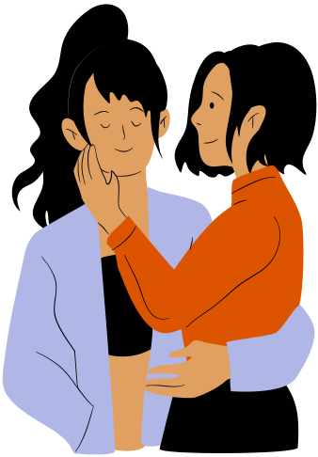

Everyone who is sexually active
is responsible for contraception.
Notes:
Reinforce the message that everyone who is sexually active is responsible for contraception.

Slide 22
REMEMBER CONSENT!
Just because someone has condoms, or is taking the contraceptive pill, it does not mean they want to have sex. It means they’re being smart, planning ahead, and taking control of their health.
You should always ask for explicit consent before any sexual activity, and never make assumptions.
Notes:
Ensure students understand that simply obtaining contraception does not equal consent.
A person may have condoms, or be taking the pill - but this does not mean they are looking to have sex.
Explicit consent should always be sought for EVERY SEXUAL ACTIVITY.

Slide 23

reflection
what’s one thing you’ll take away from today’s session?

