Slide 1
TEACHER SLIDE
This lesson builds upon previous learning about contraception. The idea is for students to learn about a particular contraceptive method and then present facts about this method to the class, rather than a teacher needing to provide all of this information.
Ensure the class understands that just because they are learning about contraception, this does not mean they should be having sex. Reinforce that the legal age of consent is 16 and that most people this age are not sexually active. However, it is important for them to have this information, should they choose to be sexually active in the future.

Slide 2

DO IT NOW
What is contraception? Why is it used? How many different types can you name?

Slide 3

CONTRACEPTION
YEAR 11
This presentation has been adapted for the Isle of Man from Scotland’s national resource for relationships, sexual health, and parenthood (RSHP) education.

Slide 4

CLASS AGREEMENTS
  Kindness and respect
  Right to pass
  Nonjudgmental
  No such thing as silly
questions
any others?
Notes:
Explain that you would like the class to create a list of 'agreements' for how everyone will behave and treat one another in the class. Ensure a common understanding. For example:
1. We will treat one another with kindness and respect (listening to each other, speaking one at a time, etc)
2. We all have the right to 'pass' on answering a question or participating in an activity that makes us feel uncomfortable.
3. We can disagree but will not pass judgments, make fun of, or or put anybody down. 'Challenge the opinion, not the person.'
4. Asking questions is encouraged and will be valued by our teacher. We do not ask questions to purposefully embarrass or belittle another.
*Feel free to change the agreements to suit your class, and ask whether there are any others they'd add to the list in order to create a safe, comfortable learning environment.

Slide 5
learning objectives
  Identify the different types of contraception available
  Explain how different contraceptive methods are used, and the pros/cons of each
  Understand where to go for further support and advice on island

Slide 6
what is contraception?
  Sometimes known as ‘birth control’
  The methods people use to prevent pregnancy when having sex
Remember, the BEST way to avoid pregnancy is to not have sex.
The legal age of consent for sex in the Isle of Man (and UK) is
16 for both opposite sex and same sex couples.

Slide 7
What types of contraception have you heard of?

Slide 8
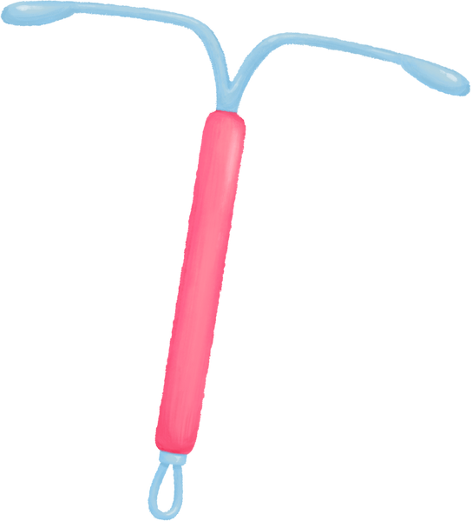
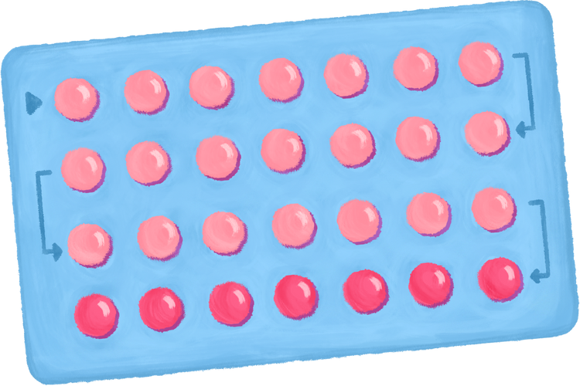

TYPES OF CONTRACEPTION
  Condoms
  Contraceptive pill
  Mini pill
  Patch
  Implant
  Injections
  Coil
  Diaphragm

Slide 9
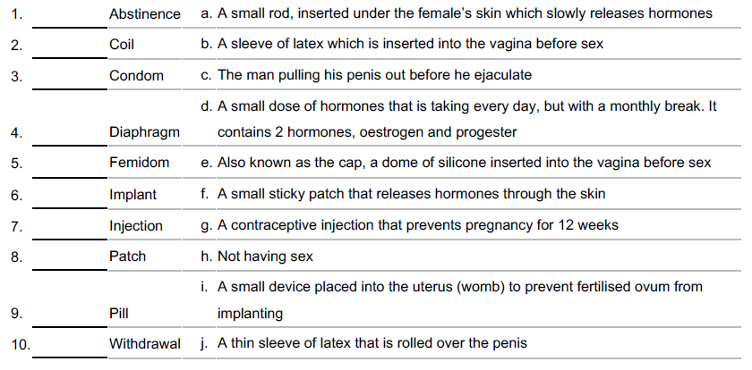
matching activity
s

Slide 10
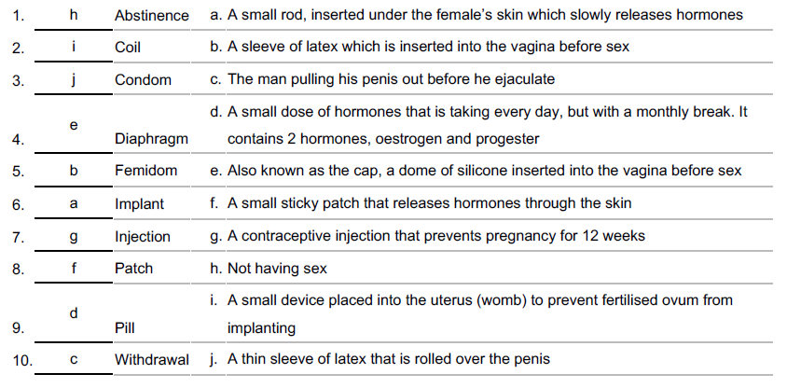
matching activity - answers
s

Slide 11
activity: presentations
Not all contraceptive methods are created equal - they all prevent pregnancy in slightly different ways, some are more effective than others, and all come with pros and cons. Some have the added bonus of protecting against STIs, but most don’t.
In groups, read about the contraceptive method you have been given to study. You will be asked to give brief presentations to the rest of the class about how your method works, how effective it is, pros and cons of use, etc.

Slide 12
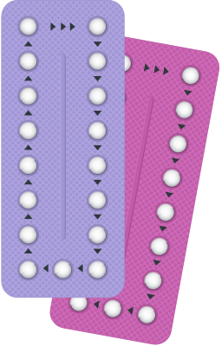
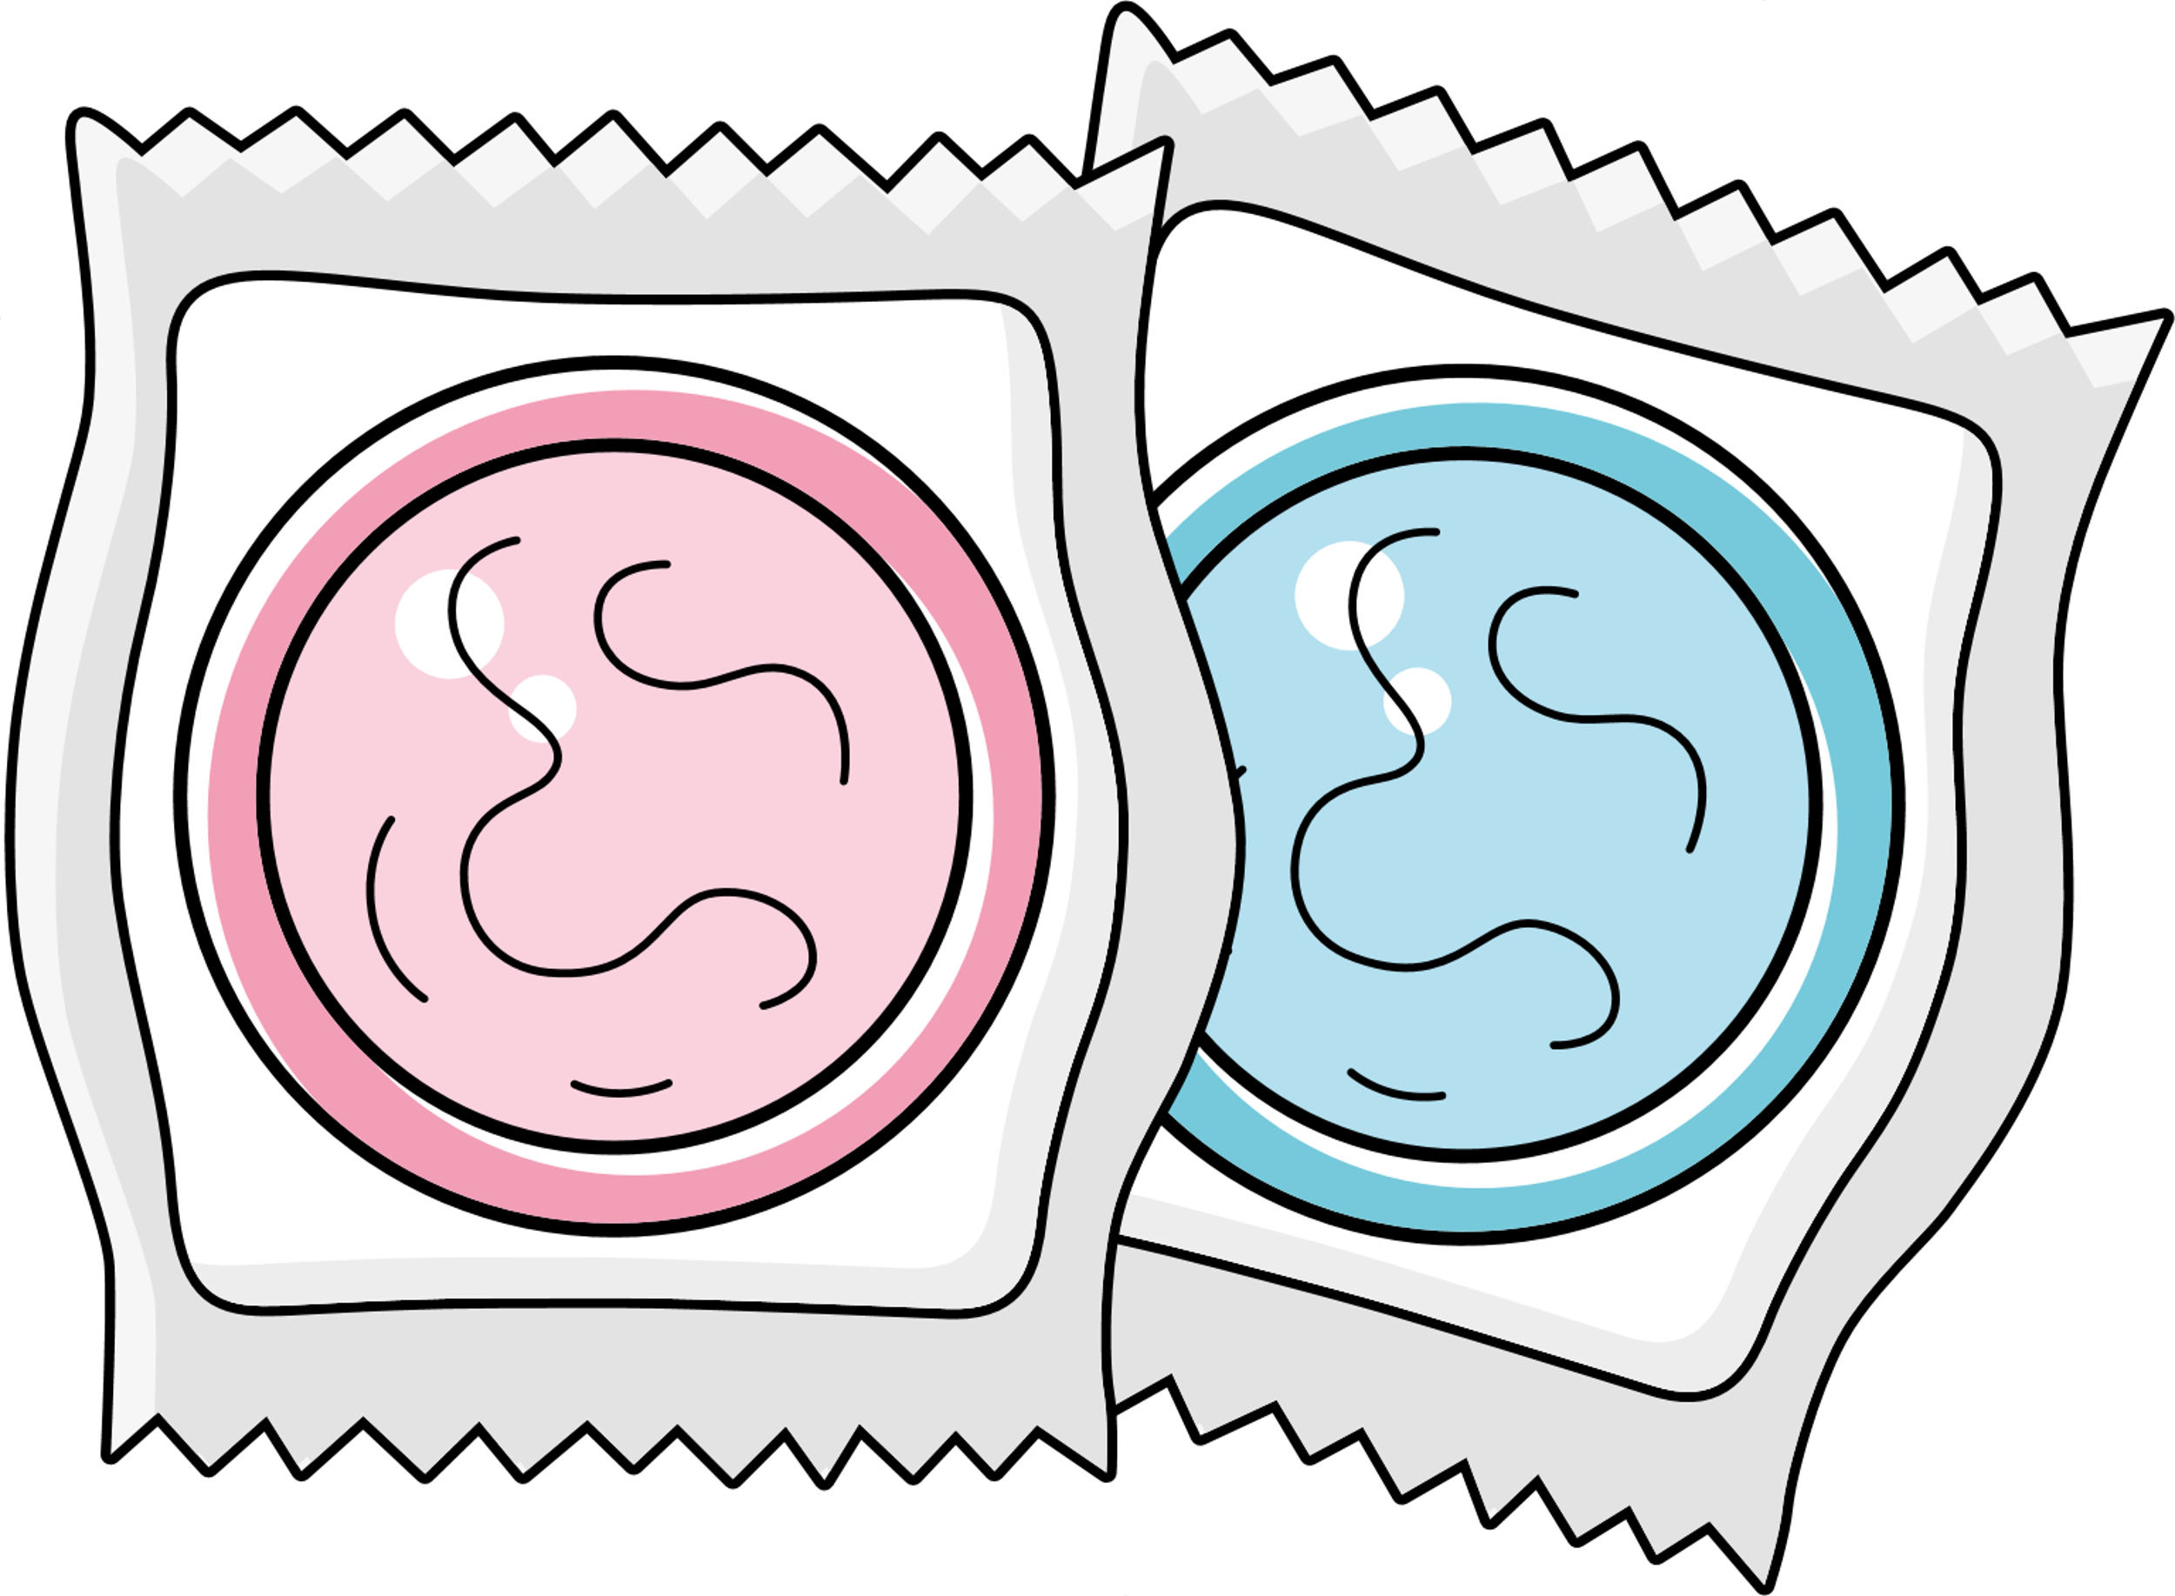
let’s chat
Why might people in opposite sex couples choose to use contraception?
What do they need to think about?
Why might people in same sex couples choose to use barrier methods?
What do they need to think about?

Slide 13
EMERGENCY CONTRACEPTION
People sometimes need to use emergency contraception if they’ve had unprotected sex, or if their contraception method has failed (for example if the condom breaks).
There are two types of emergency contraception: a pill, and ‘the coil.’

Slide 14
EMERGENCY CONTRACEPTION (EC)
The EC pill typically needs to be taken within 3 days (72 hours) of having sex, but some may work up to five days. The EC pill works by preventing a pregnancy from occurring by preventing or delaying ovulation.
The coil is another method - it is a small copper and plastic device which is put into the uterus. This must be fitted by a doctor or nurse.

Slide 15
EMERGENCY CONTRACEPTION (EC)
  The sooner emergency contraception is taken, the better a chance it has of working.
  Emergency contraception only works to prevent pregnancy.
  It DOES NOT terminate an existing pregnancy.
Notes:
Ensure that students understand emergency contraception is NOT the same as a termination. They may have heard it being referred to as "the abortion pill" - this is incorrect and dangerous misinformation, and must be clarified.

Slide 16

SEXUAL HEALTH SERVICES ON ISLAND
On the Isle of Man, the MISH (Manx Integrated Sexual Health Centre) provide sexual health services, including:
  Emergency contraception
  Pregnancy testing
  STI tests
  Condoms
  Cervical screening/smear tests
  One to one sexual health education
Notes:
Remind students of services available on island, like the MISH (formerly GUM) clinic.

Slide 17
SEXUAL HEALTH SERVICES ON ISLAND
Manx Integrated Sexual Health Centre
You can self-refer, so you don’t need a GP to do it for you.
To make an appointment, call
+44 1624 650710
or +44 1624 650577

Slide 18
SEXUAL HEALTH SERVICES ON ISLAND
You can get emergency contraception for free.
​
You can get the emergency contraceptive pill from the MISH, your GP, the Family Planning Clinic or a local pharmacy.​
You can get the IUD/coil fitted at your GPs or the Family Planning Clinic.​
Notes:
Explain that contraception can be provided by GPs, MISH, and family planning clinic.

Slide 19

LET’S CHAT
Who is responsible for contraception?
Notes:
Encourage class discussion, either as a whole class or in small groups.
Who is responsible for contraception?

Slide 20

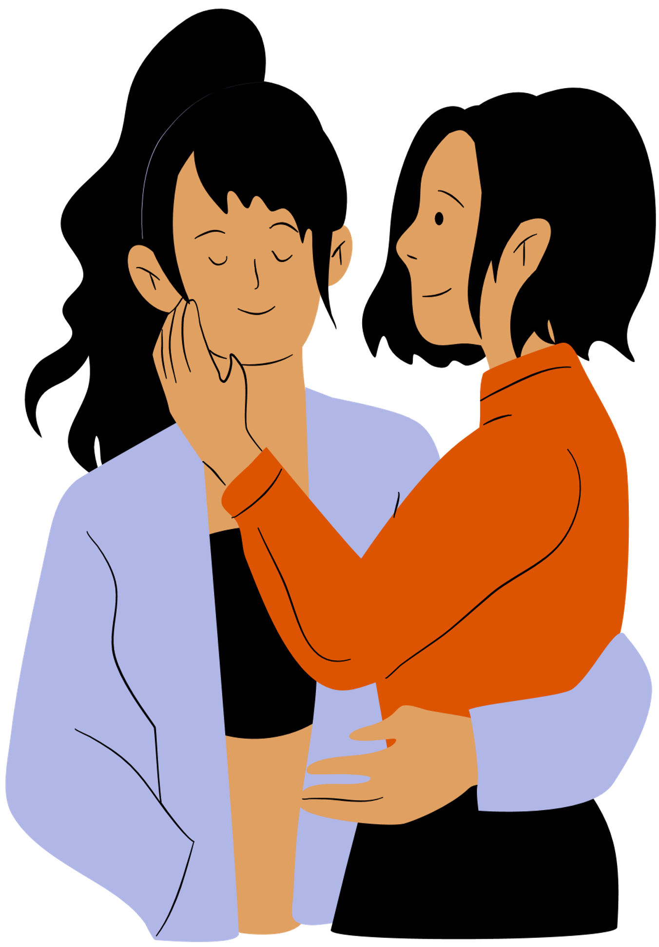

Everyone who is sexually active
is responsible for contraception.
Notes:
Reinforce the message that everyone who is sexually active is responsible for contraception.

Slide 21
REMEMBER CONSENT!
Just because someone has condoms, or is taking the contraceptive pill, it does not mean they want to have sex. It means they’re being smart, planning ahead, and taking control of their health.
You should always ask for explicit consent before any sexual activity, and never make assumptions.
Notes:
Ensure students understand that simply obtaining contraception does not equal consent.
A person may have condoms, or be taking the pill - but this does not mean they are looking to have sex.
Explicit consent should always be sought for EVERY SEXUAL ACTIVITY.

Slide 22

True/False quiz

Slide 23
Condoms give 100% protection against
all sexually transmitted infections.
True or false?

Slide 24

Condoms give 100% protection against
all sexually transmitted infections.
True or false?
Although condoms reduce the risk of STI, no method is 100% effective,
even if the condom is used correctly.

Slide 25
There is a safe period for having sex to avoid pregnancy.
True or false?

Slide 26
There is a safe period for having sex to avoid pregnancy.
True or false?
Possibly!
Some adults try to avoid pregnancy when the woman is not ovulating, but this relies on a detailed knowledge of her menstrual cycle and only having sex at certain times of the month. It is far from a reliable method and not recommended. It also offers no protection against STIs.

Slide 27
By age 16, most teenagers still have not had sex.
True or false?

Slide 28

By age 16, most teenagers still have not had sex.
True or false?
Surveys over many years across the UK regularly confirm that most young people have not had sex before they are 16. 16 is the legal age of consent although young people can access free, confidential services if they need to.

Slide 29
Taking long acting reversible contraception (birth control) will make it harder for me to have children in the future, if I choose to.
True or false?

Slide 30
Taking long acting reversible contraception (birth control) will make it harder for me to have children in the future, if I choose to.
True or false?
Contraceptives will not affect your ability to conceive when you stop taking it. Some women may find that their menstrual cycle can take a little bit of time to get back to normal once they come off the pill, but it will not affect their fertility in the long term.

Slide 31

Notes:
https://www.youtube.com/watch?v=utUH0W3t_jc

Slide 32
Scenario
Lee and Ryan, both 17, have been in a relationship for over a year. Recently, they have been discussing the idea of having sex for the first time.
Ryan does not believe they need to use condoms, because as they are both males, there is no risk of pregnancy. Lee is unsure.
If Lee and Ryan visited the sexual health clinic on island, what do you think the nurses would recommend? Why?

Slide 33
Scenario
Lea and Alex, both 18, have been sexually active for a while. Lea has been taking the contraceptive pill, but she no longer wishes to use it. Lea has suggested that she and Alex can practice the withdrawal method, as she heard someone on TikTok say it’s pretty effective.
If Lea and Alex visited the sexual health clinic on island, what do you think the nurses would recommend? Why?

Slide 34

reflection
what’s one thing you’ll take away from today’s session?

Slide 35
SEXUAL HEALTH SERVICES ON ISLAND
Manx Integrated Sexual Health Centre
You can self-refer, so you don’t need a GP to do it for you.
To make an appointment, call
+44 1624 650710
or +44 1624 650577

