Slide 1

GETTING ALONG & MANAGING CONFLICT
YEAR 11
This presentation has been adapted for the Isle of Man from Scotland’s national resource for relationships, sexual health, and parenthood (RSHP) education.

Slide 2

CLASS AGREEMENTS
  Kindness and respect
  Right to pass
  Nonjudgmental
  No such thing as silly
questions
any others?
Notes:
Explain that you would like the class to create a list of 'agreements' for how everyone will behave and treat one another in the class. Ensure a common understanding. For example:
1. We will treat one another with kindness and respect (listening to each other, speaking one at a time, etc)
2. We all have the right to 'pass' on answering a question or participating in an activity that makes us feel uncomfortable.
3. We can disagree but will not pass judgments, make fun of, or or put anybody down. 'Challenge the opinion, not the person.'
4. Asking questions is encouraged and will be valued by our teacher. We do not ask questions to purposefully embarrass or belittle another.
*Feel free to change the agreements to suit your class, and ask whether there are any others they'd add to the list in order to create a safe, comfortable learning environment.

Slide 3
HAVE A THINK
Our task from last week was...
Pay attention in the next few days to how other people communicate with you. Do they use verbal or non-verbal communication? ​
Thinking also about empathy: Do you see and do you show empathy?​
Notes:
Start the lesson with a re-cap/remembering the focus of the last lesson was on the importance of communication in our relationships - the class/group looked at different kinds of communication –verbal, non-verbal, written and visual communication. Since then (slide as a reminder of the task set) did they notice their use of different kinds of communication with others? Did anyone experience or show empathy?

Slide 4
LET’S CHAT
What kinds of things do you think help to nurture a relationship?
What kinds of things do you think spoil or hurt a relationship?
Notes:
About relationships. A task for pairs/3s to start.
Young people are asked to identify things that will help and nurture a relationship / things that will spoil or ruin a relationship – the first item is named as communication / lack of communication, with space to identify 4 other things.
After some time, get some feedback and then share the pre-prepared slide, find differences and similarities with the young people’s lists. Explore where they have put most emphasis.

Slide 5
Things that will help and nurture a relationship:​
  Communication​
  Freedom​
  Trust​
  Equality​
  Respect​
Things that will spoil or hurt a relationship:​
  Lack of communication​
  Insecurity​
  Lack of trust​
  Jealousy​
  Assumptions ​
Notes:
find differences and similarities with the young people’s lists. Explore where they have put most emphasis.

Slide 6

WHAT IS CONFLICT?
Conflict is when two or more people want different things. We tend to think of conflict as more than just a disagreement. ​
​
It’s normal to have times when you don’t get on with a partner. Conflict is a situation in which one or both parties feel some kind of threat. Conflict can make people feel emotions very strongly. It can leave people feeling stressed, upset or angry. It makes it hard to see the other person’s point of view.​
Notes:
Acknowledge that there are times in any relationship when people don’t get on. If it becomes conflict, then this is a bit more serious. Recognise that conflict can happen when some of the things that have been spoken about come into play in a relationship – things like lack of trust, jealousy etc. Share the slide, read, check understanding and discuss any questions that arise.
Explain that conflict can lead to 2 things – people remain unhappy or stressed or spilt up, or they try to resolve what the conflict is about. Share the slide regarding conflict resolution.

Slide 7

WHAT IS CONFLICT RESOLUTION?
Conflict resolution is a way for two or more parties to find a peaceful solution to a disagreement. The disagreement may be personal, financial, political, or emotional. When a dispute arises, often the best course of action is negotiation to resolve the disagreement.​

Slide 8
10 TIPS TO DEAL WITH CONFLICT
1. Be direct, say what’s bothering you.
2. Talk about how you feel without blaming your partner.
3. Never say never or always: as in “You never speak to me about....” Or “You’re always on
your phone...”
4. Deal with one thing – focus on one issue rather than lots of things.
5. Really listen – pay attention and don’t interrupt.
6. Don’t automatically object to your partner’s complaints – try not to get defensive from
the start.
7. Try to understand where they are coming from.
8. Respect the other person’s perspective – don’t put them down or be sarcastic.
9. Don’t be negative about everything.
10. Take time out, take a breath, go calm down

Slide 9
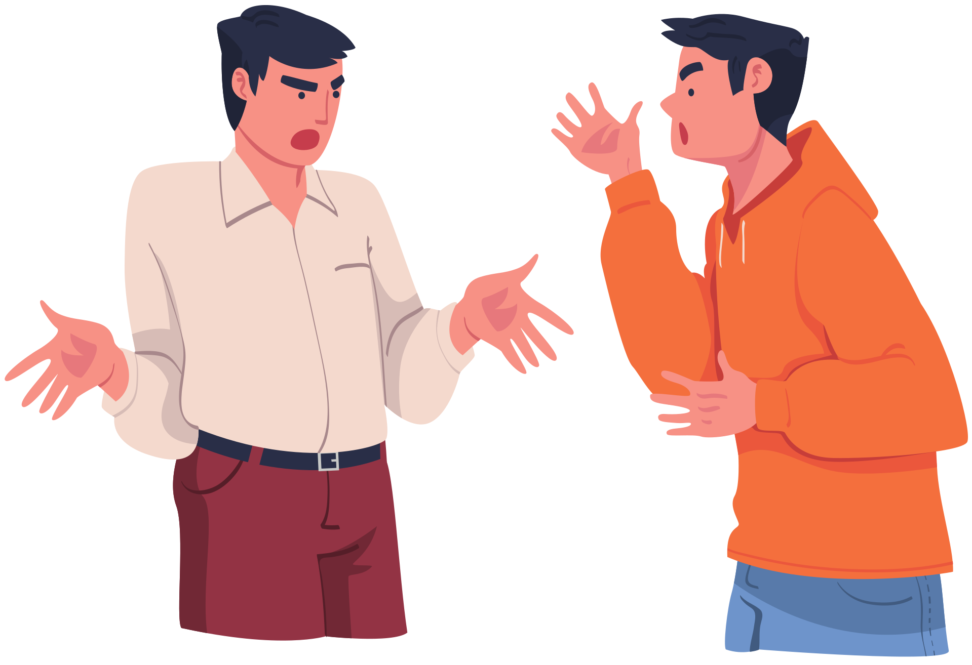
ACTIVITY: CONFLICT SCENARIOS
Notes:
Ask young people to work in 3s. There are 4 conflict scenarios to be shared (Handout A), ask the young people to discuss a scenario and the questions posed. After some time, swap scenarios around until each small group has discussed at least 3 of the 4.

Slide 10
ACTIVITY: CONFLICT SCENARIOS
What suggestions will de-escalate the conflict and lead to a better outcome?
What suggestions will escalate and cause further problems?
Notes:
Bring the group/class back together, have young people read out the 4 scenarios.
Having discussed
at least 3 each ask for some feedback and discuss what the young people suggest the protagonists
do. Keep in mind as young people feedback (questions on slide):
What suggestions will de-escalate the conflict and lead to a better outcome? What suggestions will escalate and cause further problems?
(NOTE: The Joe and Archie scenario needs to involve discussion of consent and can
draw on other work the young people have done on this issue).

Slide 11
REMINDER
Conflicts are normal in relationships. Abuse is not.
A disagreement or argument is never an excuse to be emotionally, physically, or sexually abusive.
Notes:
Clarify that conflict and abuse are NOT the same things.

Slide 12
REMINDER
If you are worried about yourself or another person, you must reach out to a trusted adult.
This may be a family member, a sports coach, or a teacher at school.

Slide 13
CHILDLINE
Childline provides free confidential advice and support for all young people your age. ​
Whatever your worry, if it’s about you or someone you love, Childline counsellors are there to help. ​
Speak to them by phone, online or email 24 hours a day.​
Information and chat online https://www.childline.org.uk/
​
Phone 0800 1111​

Slide 14

reflection
what’s one thing you’ll take away from today’s session?

