Slide 1

ONLINE DATING
YEAR 11
This presentation has been adapted for the Isle of Man from Scotland’s national resource for relationships, sexual health, and parenthood (RSHP) education.

Slide 2

CLASS AGREEMENTS
  Kindness and respect
  Right to pass
  Nonjudgmental
  No such thing as silly
questions
any others?
Notes:
Explain that you would like the class to create a list of 'agreements' for how everyone will behave and treat one another in the class. Ensure a common understanding. For example:
1. We will treat one another with kindness and respect (listening to each other, speaking one at a time, etc)
2. We all have the right to 'pass' on answering a question or participating in an activity that makes us feel uncomfortable.
3. We can disagree but will not pass judgments, make fun of, or or put anybody down. 'Challenge the opinion, not the person.'
4. Asking questions is encouraged and will be valued by our teacher. We do not ask questions to purposefully embarrass or belittle another.
*Feel free to change the agreements to suit your class, and ask whether there are any others they'd add to the list in order to create a safe, comfortable learning environment.

Slide 3
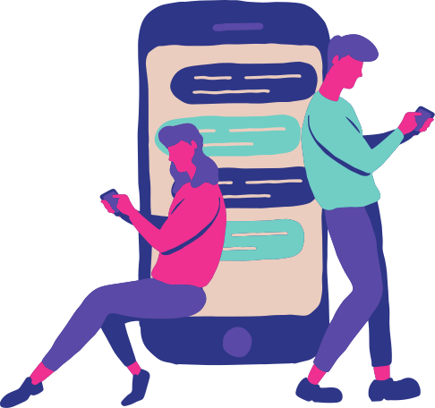
let’s chat
Do you feel braver when you’re online?
Does meeting someone online feel different than face-to-face?
Notes:
Explain that this session, as with much of RSE, asks people to respect privacy and confidentiality –so no sharing of private information that belongs to others. Also that in conversation you don’t expect young people to share private information about what they do online.
Use the slide to pose the questions, thinking about it as a group: Do you feel freer or braver when you are online? Does meeting someone online feel different to meeting face-to-face? After some contributions ask the young people to keep in the back of their minds how they feel when they are interacting online.

Slide 4
exploring your identity online
We all feel different sometimes. It can feel like it’s hard to find people who get you: people who are into the same things, share the same experiences, and know where you’re coming from.
How true do you think this statement is?
Notes:
Share the slide, acknowledge that older people may not understand that young people explore and experience who they are online as much as they might do in other social situations.
Then pose a question for the class/group: How true is this statement do you think?
Do you think there are some young people who particularly look to online relationships to meet others and explore who they are? (Young people might identify people with a particular interest or a shared characteristic, such as being LGBTQ+).
For LGBTQ+ young people being online can be particularly useful. 96% of LGBTQ+ young people say the internet has helped them understand more about their sexual orientation and/or gender identity, and 93% say they found the advice and support they needed through the internet (source: Stonewall, Staying Safe Online, 2012).

Slide 5

exploring your identity online
What’s it like on the Isle of Man?
Notes:
This may be especially true for people living somewhere like the Isle of Man, which at times may feel ‘small’ or where it might be difficult to connect with people like you.

Slide 6






have a think
What apps do people use to meet others? And specifically if they are wanting to ‘date’?
Notes:
Keep in mind that young people might think about platforms like Instagram or Facebook that everyone has and where you can meet people, but also ‘dating’ apps.
What apps do people use to meet others? And specifically if they are wanting to ‘date’?
Also, when thinking about social media platforms like these, most have minimum age
requirements, but they are not necessarily legal, most dating apps expect users to be at least 17 or 18, something called age verification.
Thinking about the sites/apps mentioned ask: Do young people pay attention to age rules/verification? Do they work?

Slide 7
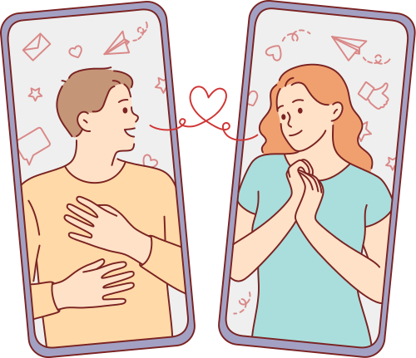
let’s chat
Why do you think so many people are meeting/dating online?
Notes:
Ask the class: why do you think so many people meet and get together online?
This can be a whole class discussion.

Slide 8

warning signs
So you are chatting online…. they seem nice.
You have chatted a few times.
Then there is something that doesn’t feel right…. ​
What are the warning signs that someone could be fake or an abuser?​
​
Notes:
In pairs or groups, ask the class to discuss the following prompt:
So you are chatting online.... They seem nice. You have chatted a few times. Then there is something that doesn’t feel right....
What are the warning signs that someone could be fake or an abuser?

Slide 9
warning signs
• They are just too good to be true. They share all your interests, they give you lots of
attention, they make you feel special, things are moving fast...
• Flattery. They praise pictures on your profile, say you’re sexy, fit.... It’s hard to think
critically because they are praising you.
• Let’s talk about sex. They try to get you to talk about sex...
• Got any sexy pictures? They are asking you for pictures....
• Can we go somewhere more private? They ask for private chats....
• Our little secret? They don’t want other people to know you are chatting.
• Mood swings. They flatter you and pay attention, then they ask for something, you hesitate
or say ‘no’ so they take that attention away or turn nasty.
• My camera’s broken. They don’t want you to see them.
Notes:
After the groups have had time to discuss, bring them back for a whole class discussion and share the common warning signs on the next slide.

Slide 10
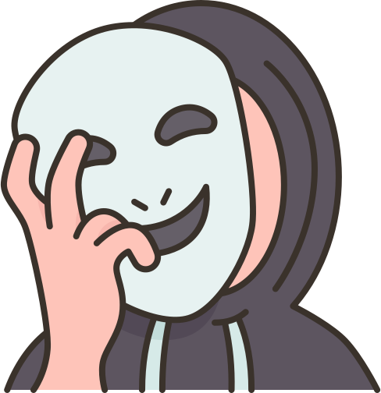
have a think
Worried your friend has met someone dodgy online? ​
How would you know?
What could you do to help?
​
Notes:
Continuing with the theme of not just looking after ourselves but looking after others too, pose the questions on the slide.
Ask young people to again work in pairs/groups. Ask them how they would know if a friend had met someone dodgy online (would there be any signs? what would make them suspect this?) and some solutions or ideas for how to help their friend.
After some discussion share the slide with some suggestions, compare and chat.

Slide 11
​
How would you know? What would be the warning signs? ​
  Have they become very secretive? And stopped sharing messages or their profile?​
  Are they distant?​
  Have they mentioned someone new? Or someone older?​
  Are they sad or withdrawn but won’t say why?​
  Are they unable to switch off from their phone or social media?​
​
How could you help?​
  Listen, don’t judge, be there for them.​
  Help them understand the risks of chatting to people online – especially someone older.​
  Show them how to get help and understand they won’t be in trouble​
  You should tell an adult you trust or contact a helpline for advice – don’t keep a secret if a friend is in danger.​
https://www.thinkuknow.co.uk/14_plus/Worried-about-a-friend/Online-friends/ ​
​
Notes:
After some discussion share the slide with some suggestions, compare and chat.

Slide 12
It’s always risky to meet up with someone you met online.
Notes:
Final discussion with the class. Stress that when meeting up with someone you met online, there is ALWAYS a risk that the person is not who they say they are, or that things could become dangerous. If someone is intent on meeting an online friend in real life, there are some safety rules they should always follow. Review these with the class on the slide.

Slide 13
safety rules
• Always meet and stay in a busy public place.
• Take a trusted responsible adult with you, not a friend. If the person you are meeting isn’t being honest, taking a friend will put you both at risk. (If you tell the person you are bringing an adult they shouldn’t have a problem with that; if they do, don’t go).
• Make sure someone knows who you are meeting, where you are going, and when you will be back.
• If your instinct tells you something is wrong, it probably is. If the person doesn’t look like the person you expected then leave as soon as possible.
• Do not accept a lift from someone you meet.
• Stay sober.
• Take your phone, keep it switched on, with credit.
• Your personal belongings can be stolen, don’t leave them unattended.
• If you are worried about your safety or think you are in danger do not hesitate! Phone 999
Notes:
Final discussion with the class. Stress that when meeting up with someone you met online, there is ALWAYS a risk that the person is not who they say they are, or that things could become dangerous. If someone is intent on meeting an online friend in real life, there are some safety rules they should always follow. Review these with the class on the slide.

Slide 14

reflection
what’s one thing you’ll take away from today’s session?
Notes:
End with thanks for all contributions. Remind young people that you are available to them if they have any questions or worries.

