Slide 1
TEACHER SLIDE
This is a sensitive and challenging topic and will need to be handled carefully. It is vital that students feel they are in a safe space to enable discussions to evolve, and issues be examined without any blame or heated arguments emerging. It is important to ensure students understand the group agreements.
It is also important that male students do not feel they are being targeted or personally blamed for wider societal issues. This lesson examines the appeal of toxic male influencers like Andrew Tate, who target young men often struggling with loneliness or a poor sense of personal identity. Feelings of shame or rejection only serve to drive young men toward these ideologies - it is important for everyone in class to remain kind and respectful when examining these issues.

Slide 2
Activity | Description | Timing
Introduction | Ask students to complete the ‘do it now’ task. Introduce learning objectives and revisit class agreements - these are particularly important today. | 5 minutes
Misogyny | Define misogyny & ask students to determine whether the scenarios listed are examples of misogyny. Allow time for discussion. | 10 minutes
Toxic masculinity | Define toxic masculinity and explain its connection to misogyny. Complete “toxic or healthy?” activity. On the board, draw two columns (one for toxic and the other for healthy). Provide students with examples of traits/actions on Handout A and ask them to stick these examples under whichever heading they believe is correct. Discuss. | 10 minutes
Harms of misogyny | Do “who does misogyny harm?” activity and discuss after each example. The point is that misogyny is harmful to all people, regardless of gender. | 5-10 minutes
Discussion | Slides 25-28 ask students to consider why people, particularly young men, might be drawn to toxic role models and misogynistic content. Ensure discussion remains respectful and empathetic - it is not about blaming boys or villainising masculinity. | 10 minutes
Ending/Reflections | Ask students to view the list of toxic/healthy beliefs and actions on the board from the earlier activity - which does Andrew Tate embody? Is he a good role model? End with asking students to reflect on their ideas of what a ‘real man’ is from the do it now task - has anything changed? | 5 minutes

Slide 3


DO IT NOW
What does it mean to be a
‘REAL MAN’
in today’s world?
Write down whatever comes to mind.

Slide 4

MISOGYNY & TOXIC MASCULINITY
YEAR 9

Slide 5
LEARNING OBJECTIVES
  Define the terms misogyny and toxic masculinity
  Explain why misogyny is harmful to both men and women
  Understand why some people are drawn to unhealthy role models

Slide 6

CLASS AGREEMENTS
  Kindness and respect
  Right to pass
  Nonjudgmental
  No such thing as silly
questions
any others?
Notes:
Explain that you would like the class to create a list of 'agreements' for how everyone will behave and treat one another in the class. Ensure a common understanding. For example:
1. We will treat one another with kindness and respect (listening to each other, speaking one at a time, etc)
2. We all have the right to 'pass' on answering a question or participating in an activity that makes us feel uncomfortable.
3. We can disagree but will not pass judgments, make fun of, or or put anybody down. 'Challenge the opinion, not the person.'
4. Asking questions is encouraged and will be valued by our teacher. We do not ask questions to purposefully embarrass or belittle another.
*Feel free to change the agreements to suit your class, and ask whether there are any others they'd add to the list in order to create a safe, comfortable learning environment.

Slide 7
Have you heard the below terms before?
What do you think they mean?
LET’S LEARN
  misogyny
  toxic masculinity

Slide 8
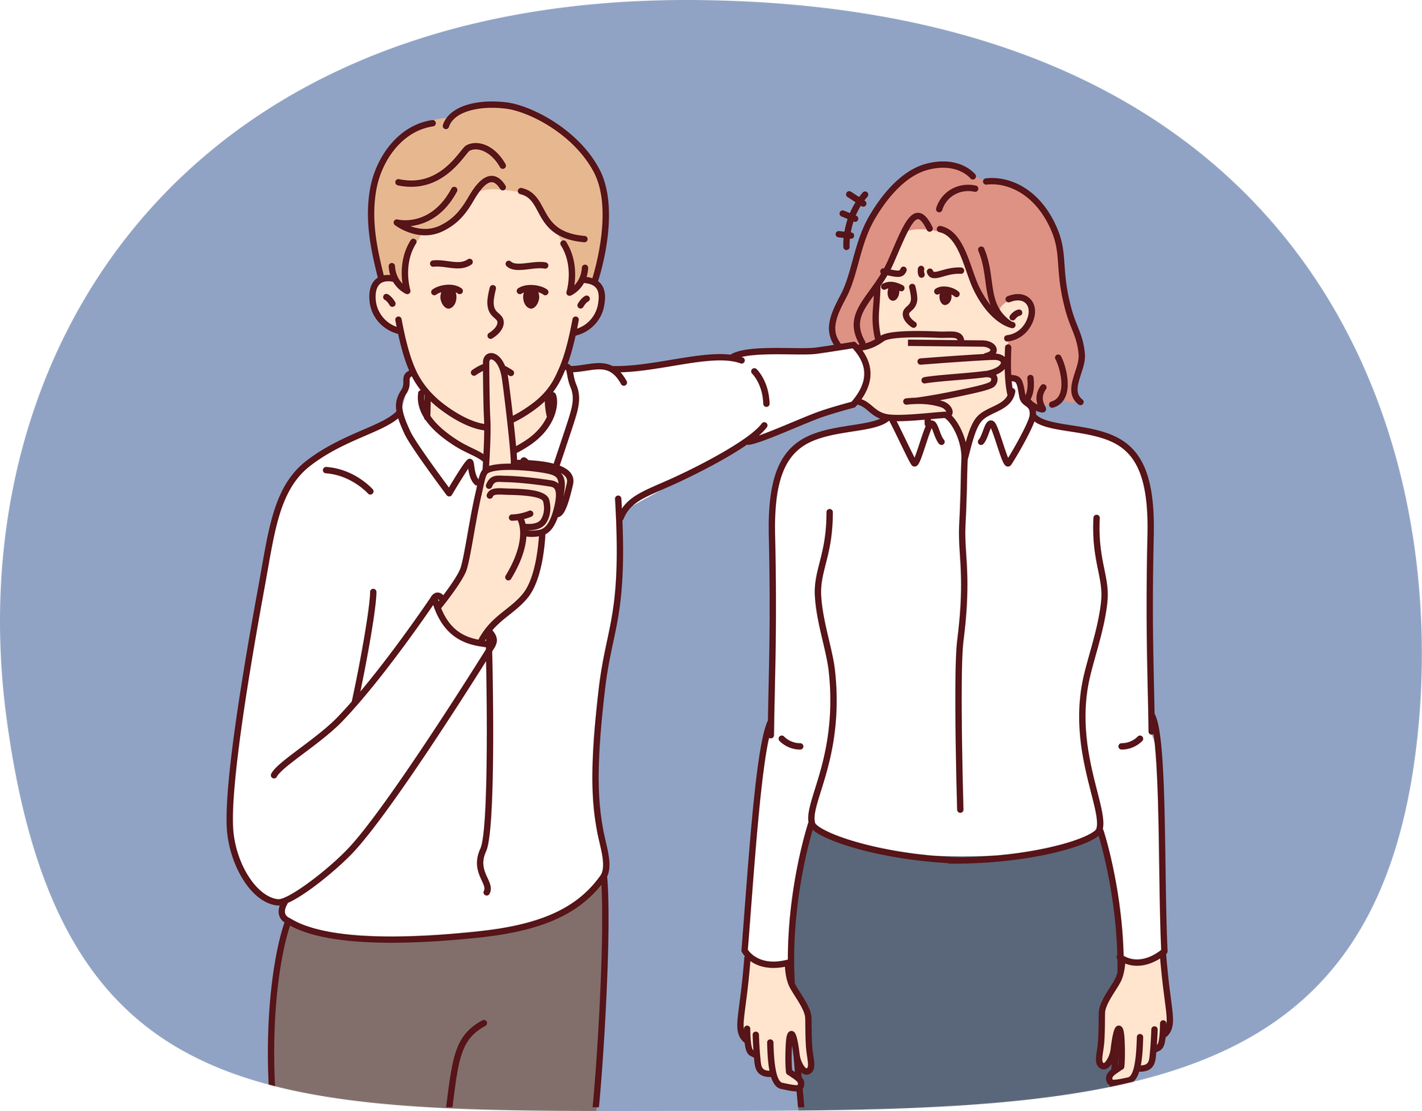
MISOGYNY
the hatred of, contempt for, or prejudice against women or girls.

Slide 9
Do you think these are examples of misogyny?
  A man holds a door open for two women, saying “ladies first!”
  After a student council meeting, the female students are asked to stay behind and clean up.
  A boy who is good at maths is asked to tutor a female student who is struggling.
  A girl says “I could never be friends with other girls - they’re so dramatic and catty.”
  A group of boys playing Fortnite mock a female gamer, telling her to log off and “go make us a sandwich.”
MISOGYNY
NOT SURE
NOT MISOGYNY

Slide 10
harassment and bullying
Misogyny can take many forms.
discrimination
violence
Misogyny is not just something that men express - women can also hold misogynistic beliefs.
social norms that devalue women
rigid gender expectations

Slide 11
TOXIC MASCULINITY
harmful social norms and expectations about masculinity (traits we normally associate with men/boys). Men and boys can feel pressured to look, act, or feel a certain way, in order to be seen as a “real man.”

Slide 12

toxic masculinity
Toxic masculinity and misogyny are connected: harmful ideas about being a man (toxic masculinity) contribute to misogyny (the hatred of or prejudice against women).
Toxic masculinity tells us that being a man is all about power, dominance and control, and that women are weak and inferior. This reinforces (makes stronger) misogyny.
misogyny

Slide 13
ACTIVITY: TOXIC OR HEALTHY?
Decide whether the card describes toxic or positive behaviour/beliefs, and stick it up on the board wherever you think it belongs.
You will be given a selection of cards, each with a different behaviour or personality trait listed.

Slide 14

WHO DOES MISOGYNY HARM?
Think about the following examples of misogyny and decide whether it is harmful to men, women, or both.

Slide 15
“Men are better suited to jobs in STEM (science, technology, engineering and maths) and women are better in caring roles like nursing or teaching.”

Slide 16
“If a girl says no, she’s just playing hard to get.”

Slide 17
“Nobody wants to watch women’s sports - it’s so boring.”

Slide 18
“Real men don’t cry - man up.”

Slide 19
“Women just want a strong man to take the lead.”

Slide 20
“Women are too emotional to be good leaders, they would start a war every time they have their period!”

Slide 21
“Men can’t be abused - just fight back.”

Slide 22
The truth is, misogyny and toxic masculinity harm both women AND men.

Slide 23

unfair treatment, due to beliefs that women are inferior, weak, or less capable
Misogyny hurts women and girls because it leads to:
limited opportunities in sports, employment, or anywhere seen as a traditionally “male” space
normalisation of harassment, violence, and abusive/controlling relationships

Slide 24
men feeling unable to express their emotions or seek support due to fear of being seen as weak or not manly enough - which can cause isolation and loneliness
Misogyny hurts men and boys because it leads to:
feeling pressure to be dominant, aggressive, or controlling, leading to unhealthy relationships or getting themselves into trouble
inability to truly be themselves and enjoy things just because they may be seen as traditionally ‘feminine’

Slide 25

Let’s talk
If toxic masculinity and misogyny are so harmful, why are some men and boys drawn to these messages?
What’s the appeal of toxic influencers?

Slide 26

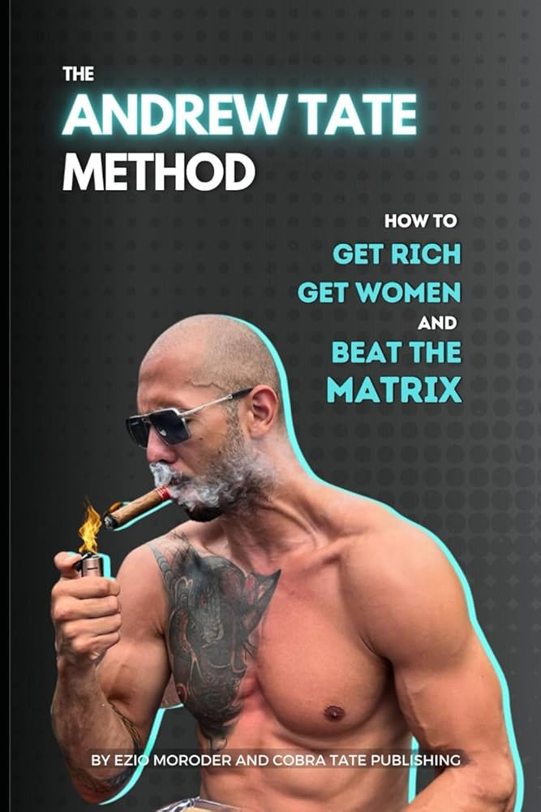
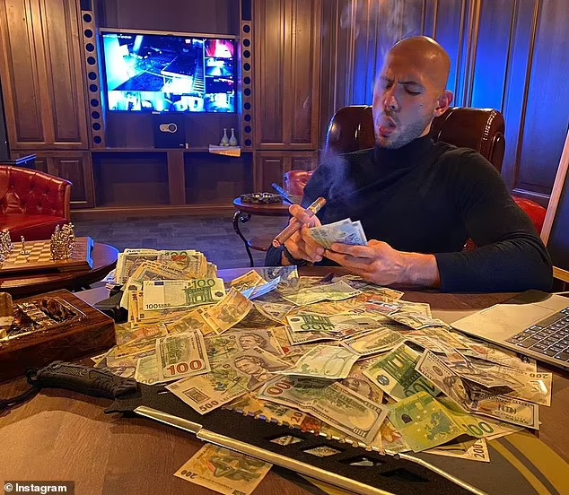

Slide 27
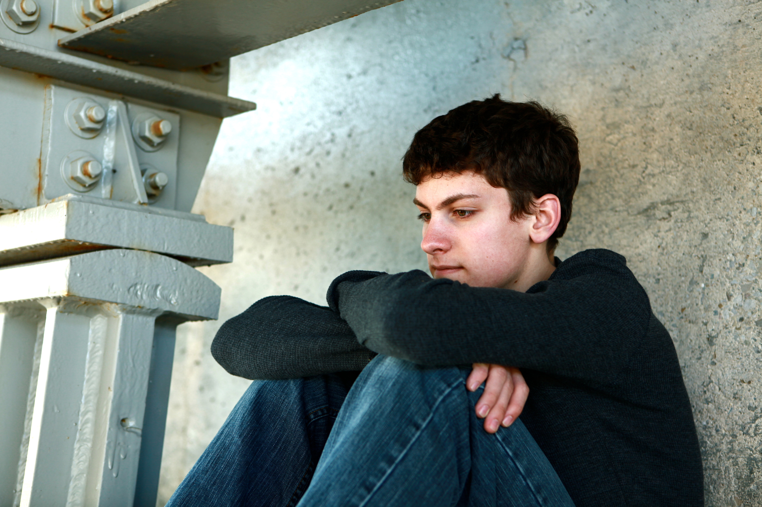
It’s a complex problem, but we think that some men and boys might be attracted to toxic role models because of:
  poor mental health and feeling unable to seek support
  feelings of loneliness and not fitting in
  lack of a strong sense of identity and poor self esteem
  feeling rejected or misunderstood
Some men and boys may also feel that, by trying to attain equality for women, that society views men as the problem - or that they’re being blamed simply for being men.

Slide 28
With many men/boys feeling lonely, isolated, blamed, rejected, and left behind - toxic influencers then come along and:
promise power and success
give them someone to blame
provide a sense of community & belonging

Slide 29
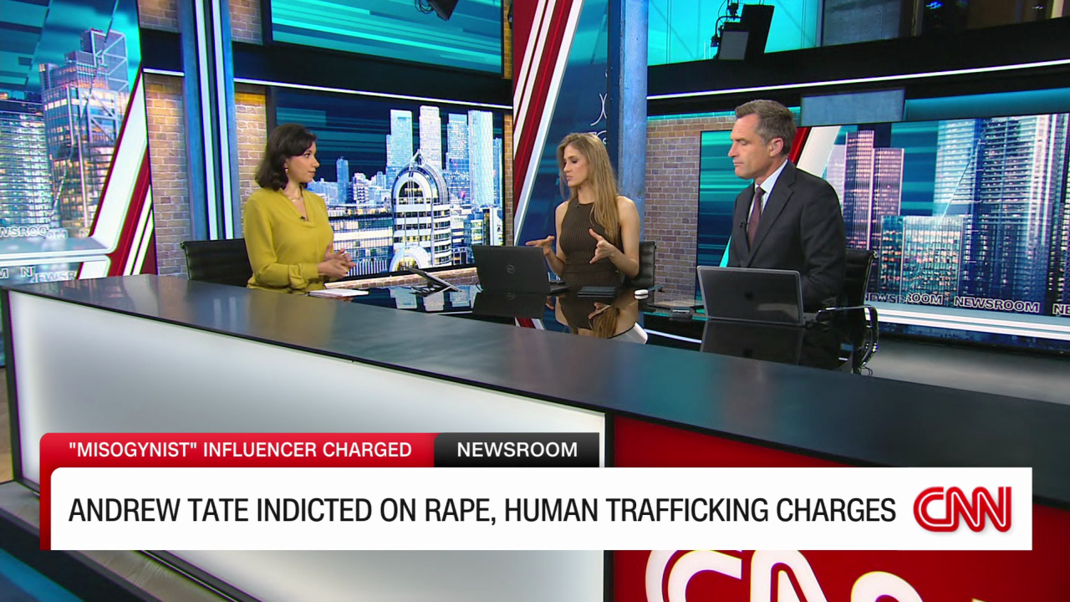
are people like this a good role model for men and boys?

Slide 30
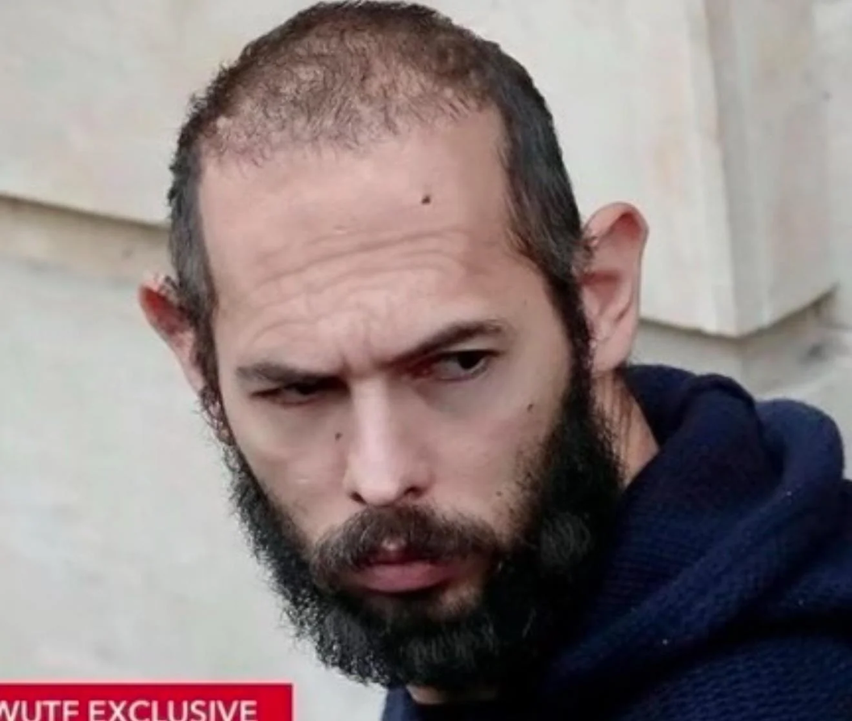
Look at the examples of positive and toxic masculinity on the board - what are these influencers an example of? Why?

Slide 31
reflection
At the beginning of the lesson, you were asked to write down everything that comes to mind when you think of what a “real man” means.
After today’s lesson, has anything changed?

