Slide 1
TEACHER SLIDE
Before the session: In the days or week before facilitating this session, let young people know they will be talking about social media – particularly how to stay safe when using it.
Ask them to think about some of the dangers young people might experience through social media and whether the Isle of Man/UK should follow other countries in banning social media for young people at the age of 16.

Slide 2

DO IT NOW
Recently, Australia announced new laws that will ban social media use for anybody under the age of 16. The Prime Minister of Australia has said that this is necessary in order to protect young people from the harm that social media can cause.
Take a few minutes to think about and answer the below questions.
  What are some of the ‘harms’ on social media you think young people may face?
  What do you think of the ban? What are the potential pros/cons?
  Do you think the Isle of Man/UK should implement similar laws? Why/why not?
  What other ways can young people be kept safe from social media harm?

Slide 3

SOCIAL MEDIA SAFETY
YEAR 9
This presentation has been adapted for the Isle of Man from Scotland’s national resource for relationships, sexual health, and parenthood (RSHP) education.

Slide 4
LEARNING OBJECTIVES
  Describe social media and why people use it.
  Work as a team to present information about social media and how it can be used safely.
  Understand why some countries are banning social media for under 16s and discuss opinions on this ban.

Slide 5

CLASS AGREEMENTS
  Kindness and respect
  Right to pass
  Nonjudgmental
  No such thing as silly
questions
any others?
Notes:
Explain that you would like the class to create a list of 'agreements' for how everyone will behave and treat one another in the class. Ensure a common understanding. For example:
1. We will treat one another with kindness and respect (listening to each other, speaking one at a time, etc)
2. We all have the right to 'pass' on answering a question or participating in an activity that makes us feel uncomfortable.
3. We can disagree but will not pass judgments, make fun of, or or put anybody down. 'Challenge the opinion, not the person.'
4. Asking questions is encouraged and will be valued by our teacher. We do not ask questions to purposefully embarrass or belittle another.
*Feel free to change the agreements to suit your class, and ask whether there are any others they'd add to the list in order to create a safe, comfortable learning environment.

Slide 6

SOCIAL MEDIA - FACTS & FIGURES
  In January 2024, 82.8% of UK population (56.2m people) were active social media users.
  WhatsApp was used by 79% of Internet users in the UK.
  The UK's most popular social media platforms are WhatsApp, Facebook, and Instagram.
  UK users spend more time on TikTok than users in any other country.
  Younger people are more active on social media. E.g. 99% of 16-24-year-olds use social media, compared to only 38% of those over 75.
(Statistica, 2024)

Slide 7
HOW MANY SOCIAL MEDIA APPS & SITES CAN YOU NAME IN 2 MINUTES?

Slide 8









HOW MANY SOCIAL MEDIA APPS & SITES CAN YOU NAME IN 2 MINUTES?

Slide 9

LET’S CHAT
In small groups, please discuss one of these questions:
1)Why do (young) people use social media?
2)What could they see or do?
3)How could it affect them?

Slide 10
WHY DO YOUNG PEOPLE USE SOCIAL MEDIA?
Some ideas:
  confidence
  belonging/connection
  self expression
  entertainment
  education

Slide 11
WHAT COULD THEY SEE/DO?
Some ideas:
  Stay in contact with friends and family
  Access job searches and useful information
  Have fun
  See or share violent, sexual & pornographic content
  Inaccurate or false information and extreme views
  Promotion of harmful behaviours, including self-harm & eating disorders
  Oversharing of personal information
  Actively or unintentionally getting involved in bullying or hurtful behaviour

Slide 12
HOW COULD IT AFFECT THEM?
  Stay in contact/connect with people, and have fun.
  Fear of missing out leads to excessive use or exaggeration.
  They get upset by things they have seen and are uncertain about what to do.
  Engaging or being pressured into engaging in more risky behaviour, either by accident or design.
  Developing unrealistic ideas of body image and gender.
  Becoming subject to peer pressure or interactions that are intense or too difficult to handle.
  Creating an online reputation that may cause problems in the future.

Slide 13
SMALL GROUP ACTIVITY
In a moment you will be split into groups and given a Safer Schools information sheet about a popular social media app/site.
In your groups, read through the information provided and answer the below questions. You will be asked to share this information in a brief (2 minutes or less) presentation back to the rest of the class.
  What is this app/site and why do young people use it?
  What are some of the risks associated with this app/site?
  How would you advise someone to stay safe while using this app/site?

Slide 14

LET’S CHAT
In your ‘do it now’ task, you were asked to think about the social media ban for under 16s that Australia will be implementing. The Prime Minister of Australia says the ban is necessary to protect young people from the ‘harms’ of social media, and many people agree. However, some critics question how the ban will work in practice, and the impact it may have on privacy and social connection.
What do you think?

Slide 15


Slide 16
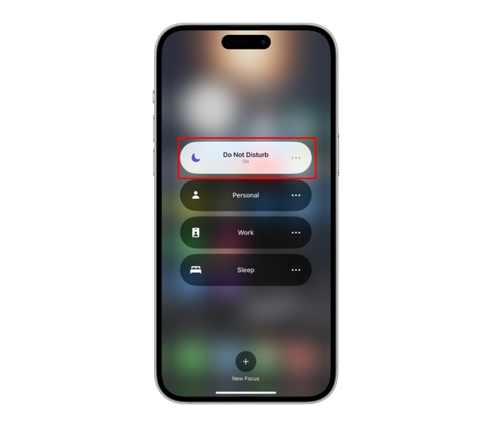
DO YOU EVER FEEL PRESSURE TO STAY CONNECTED?
HOW CAN WE HAVE A HEALTHIER RELATIONSHIP WITH OUR DEVICES/SOCIAL MEDIA?

Slide 17
6 WAYS TO IMPROVE YOUR RELATIONSHIP WITH SOCIAL MEDIA
  Try to be aware of how social media is making you feel.
  If certain friends, influencers etc. are upsetting you with their content, it’s ok to unfollow them.
  Limit social media use 30 minutes before bedtime.
  Many platforms now give insights into how long you spend on the platform each day - try to monitor your usage.
  Set time limits for your usage each day.
  At least once a week, try to refrain from using social media.

Slide 18
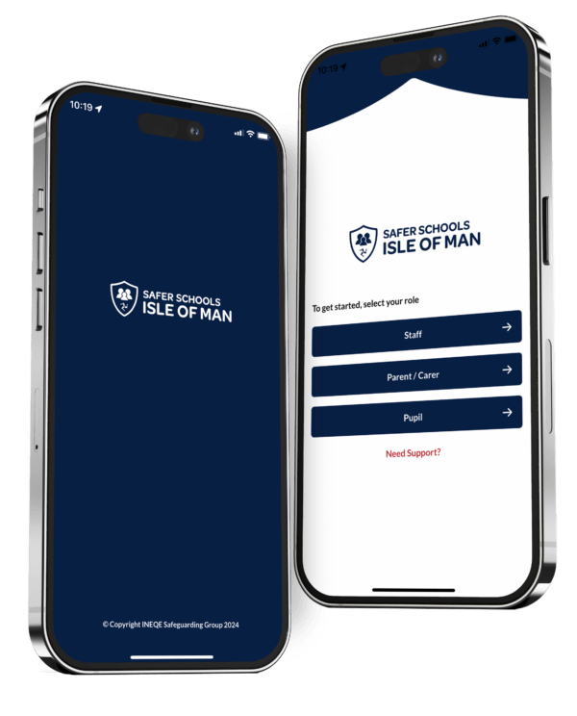
SAFER SCHOOLS ISLE OF MAN
  Practical advice on the latest trends, apps, games, and social media platforms
  How to seek further support
  How to keep safe on and offline
  How to keep your information private online

Slide 19

Information and advice:
  https://www.childnet.com/young-people/secondary
  ChildLine
    www.childline.org.uk
    If you're under 19 you can confidentially call, email or chat online about any problem big or small
    Chat 1:1 with an online advisor

Slide 20

REFLECTION
What are three things you’ll remember from today’s lesson?

