Slide 1

LIVING TOGETHER, MARRIAGE, AND CIVIL PARTNERSHIPS
YEAR 9
This presentation has been adapted for the Isle of Man from Scotland’s national resource for relationships, sexual health, and parenthood (RSHP) education.

Slide 2

CLASS AGREEMENTS
  Kindness and respect
  Right to pass
  Nonjudgmental
  No such thing as silly
questions
any others?
Notes:
Explain that you would like the class to create a list of 'agreements' for how everyone will behave and treat one another in the class. Ensure a common understanding. For example:
1. We will treat one another with kindness and respect (listening to each other, speaking one at a time, etc)
2. We all have the right to 'pass' on answering a question or participating in an activity that makes us feel uncomfortable.
3. We can disagree but will not pass judgments, make fun of, or or put anybody down. 'Challenge the opinion, not the person.'
4. Asking questions is encouraged and will be valued by our teacher. We do not ask questions to purposefully embarrass or belittle another.
*Feel free to change the agreements to suit your class, and ask whether there are any others they'd add to the list in order to create a safe, comfortable learning environment.

Slide 3
HAVE A THINK
what do you think the differences are between living together, marriage, and civil partnerships?

Slide 4

MARRIAGE
is a legal union between 2 people.
Any two people, regardless of sex, can legally get married in the Isle of Man. The marriage can happen after having either a religious or non-religious ceremony.
CIVIL PARTNERSHIP
is also legal union between 2 people.
Any two people, regardless of sex, can legally have a civil partnership in the Isle of Man. A civil partnership can happen after a non-religious ceremony.

Slide 5
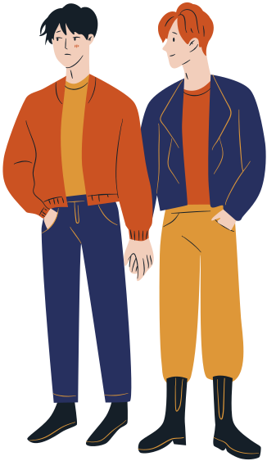
MARRIAGES
CIVIL PARTNERSHIPS
and
have the same legal status in the Isle of Man. People who are married or are in a civil partnership have the same rights and responsibilities.
Historically
CIVIL PARTNERSHIPS
were
introduced so that same-sex couples could have their relationships recognised in the eyes of the law.

Slide 6
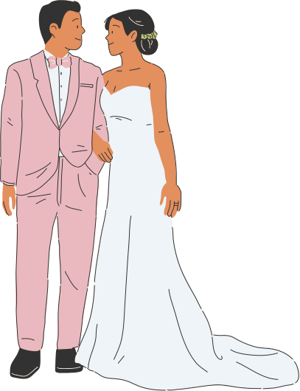

The Isle of Man legalised same-sex marriage in 2016, so same-sex couples have a choice whether they’d like to enter a marriage or civil partnership.
Opposite sex couples also have the option to enter into either a marriage or a civil partnership.
The rights and responsibilities are the same for marriages and civil partnerships. Couples may choose to have a civil partnership if they don’t align with the traditions associated with marriages, but still want their relationship legally recognised.

Slide 7
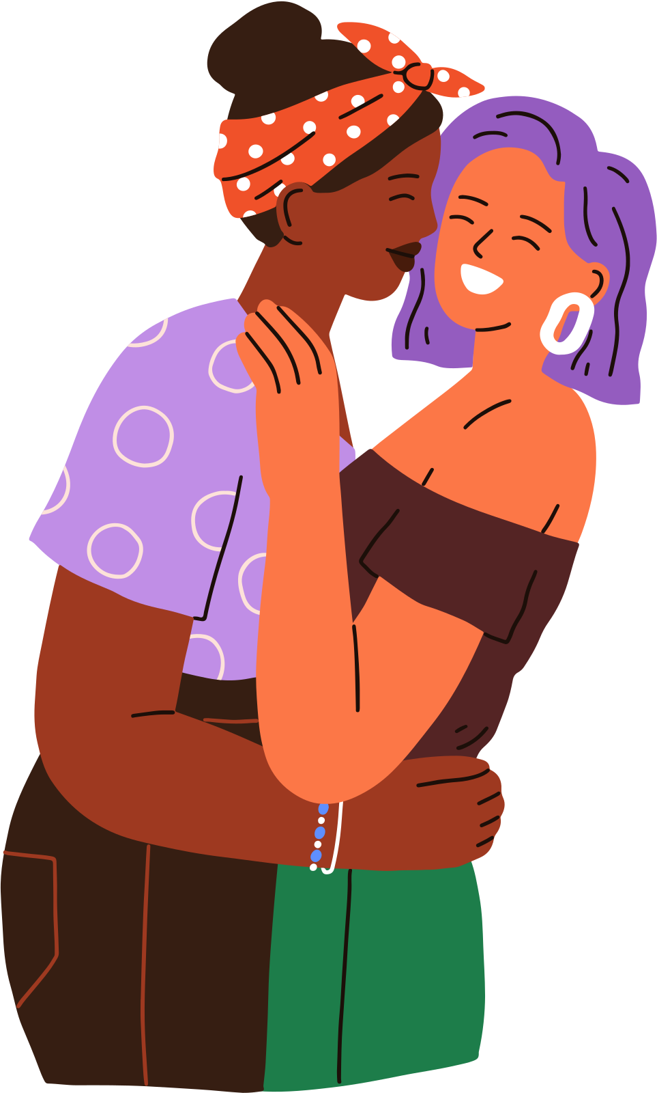
LIVING TOGETHER
Sometimes couples may choose to live together without getting married or entering into a civil partnership.
Couples living together do not have the same legal rights as people who are married or in a civil partnership. Sometimes this gets complicated. For example, if a relationship breaks up or a partner dies, and the other person has to prove that they lived like a married couple in order to keep their house or claim their pensions.​

Slide 8
LET’S TALK
In small groups, discuss the following statements. What do you think about the opinion being shared?
Notes:
Discussion. Introduce the next task: having some discussion in small groups first and then feedback and chat as a class. Remind everyone that there are no ‘right or wrong’ answers when they have discussions, everybody can have an opinion and should respect other opinions too.
Explain that these discussion points ask their opinion, but also what they think their parents/carers and other
family members would also think. Perhaps 5 minutes or so per topic

Slide 9
LET’S TALK
“Marriage is an old-fashioned idea. Most young people will probably just live together.”
what do you think?
Notes:
Discussion. Introduce the next task: having some discussion in small groups first and then feedback and chat as a class. Remind everyone that there are no ‘right or wrong’ answers when they have discussions, everybody can have an opinion and should respect other opinions too.
Explain that these discussion points ask their opinion, but also what they think their parents/carers and other
family members would also think. Perhaps 5 minutes or so per topic

Slide 10
LET’S TALK
“Getting married or having a Civil Partnership is important because it says that people are committed to their relationship.”
what do you think?
Notes:
Discussion. Introduce the next task: having some discussion in small groups first and then feedback and chat as a class. Remind everyone that there are no ‘right or wrong’ answers when they have discussions, everybody can have an opinion and should respect other opinions too.
Explain that these discussion points ask their opinion, but also what they think their parents/carers and other
family members would also think. Perhaps 5 minutes or so per topic

Slide 11
LET’S TALK
“Marriage and Civil Partnerships have become over commercialised, too expensive, and people forget what it really means to get married/civil partnered.”
what do you think?
Notes:
Discussion. Introduce the next task: having some discussion in small groups first and then feedback and chat as a class. Remind everyone that there are no ‘right or wrong’ answers when they have discussions, everybody can have an opinion and should respect other opinions too.
Explain that these discussion points ask their opinion, but also what they think their parents/carers and other
family members would also think. Perhaps 5 minutes or so per topic

Slide 12
LET’S TALK
“You should live with someone before you get married or in a civil partnership.”
what do you think?
Notes:
Discussion. Introduce the next task: having some discussion in small groups first and then feedback and chat as a class. Remind everyone that there are no ‘right or wrong’ answers when they have discussions, everybody can have an opinion and should respect other opinions too.
Explain that these discussion points ask their opinion, but also what they think their parents/carers and other
family members would also think. Perhaps 5 minutes or so per topic

Slide 13
LET’S TALK
“If a couple are having children it’s best if they are married/in a civil partnership, rather than living together.”
what do you think?
Notes:
Discussion. Introduce the next task: having some discussion in small groups first and then feedback and chat as a class. Remind everyone that there are no ‘right or wrong’ answers when they have discussions, everybody can have an opinion and should respect other opinions too.
Explain that these discussion points ask their opinion, but also what they think their parents/carers and other
family members would also think. Perhaps 5 minutes or so per topic

Slide 14


QUIZ TIME
Notes:
Introduce the next session which is a true/false quiz. You can do this with the entire class - ask students to put their hands up, or do thumbs up/down depending on whether they think a statement is true or false.
Have some discussion as you go through the answers, exploring any misinformation and opinions.
For example: What do you think about 16 as the age young people can marry/get a civil
partnership?

Slide 15
QUIZ
You have to be aged 18 or over to get married on the Isle of Man.
true/false?
Notes:
ask students to put their hands up, or do thumbs up/down depending on whether they think a statement is true or false.
Have some discussion as you go through the answers, exploring any misinformation and opinions.
For example: What do you think about 16 as the age young people can marry/get a civil
partnership?

Slide 16
QUIZ
You have to be aged 18 or over to get married on the Isle of Man.
false: you can get married from the age of 16 with parental consent
Notes:
ask students to put their hands up, or do thumbs up/down depending on whether they think a statement is true or false.
Have some discussion as you go through the answers, exploring any misinformation and opinions.
For example: What do you think about 16 as the age young people can marry/get a civil
partnership?

Slide 17
QUIZ
Once you’re engaged, you have to marry your partner.
true/false?
Notes:
ask students to put their hands up, or do thumbs up/down depending on whether they think a statement is true or false.
Have some discussion as you go through the answers, exploring any misinformation and opinions.
For example: What do you think about 16 as the age young people can marry/get a civil
partnership?

Slide 18
QUIZ
Once you’re engaged, you have to marry your partner.
false: If you or your partner decide to end an engagement, you cannot be forced to marry
Notes:
ask students to put their hands up, or do thumbs up/down depending on whether they think a statement is true or false.
Have some discussion as you go through the answers, exploring any misinformation and opinions.
For example: What do you think about 16 as the age young people can marry/get a civil
partnership?

Slide 19
QUIZ
There are 2 kinds of marriage ceremonies: a civil marriage or a religious/belief ceremony.
true/false?
Notes:
ask students to put their hands up, or do thumbs up/down depending on whether they think a statement is true or false.
Have some discussion as you go through the answers, exploring any misinformation and opinions.
For example: What do you think about 16 as the age young people can marry/get a civil
partnership?

Slide 20
QUIZ
There are 2 kinds of marriage ceremonies: a civil marriage or a religious/belief ceremony.
A religious ceremony includes religious beliefs and other belief systems such as humanism. A religious ceremony can be held anywhere. A civil marriage can take place in a registrar's office or in any other appropriate location (other than religious premises).
true:
Notes:
ask students to put their hands up, or do thumbs up/down depending on whether they think a statement is true or false.
Have some discussion as you go through the answers, exploring any misinformation and opinions.
For example: What do you think about 16 as the age young people can marry/get a civil
partnership?

Slide 21
QUIZ
Forcing someone to marry without their full and free consent is against the law and an abuse of their human rights.
true/false?
Notes:
ask students to put their hands up, or do thumbs up/down depending on whether they think a statement is true or false.
Have some discussion as you go through the answers, exploring any misinformation and opinions.
For example: What do you think about 16 as the age young people can marry/get a civil
partnership?

Slide 22
QUIZ
Forcing someone to marry without their full and free consent is against the law and an abuse of their human rights.
true: If you are afraid that you may be forced into a marriage in this country, or that someone in this country may be planning to force you into a marriage while you are abroad, you should ask for help immediately.
Notes:
ask students to put their hands up, or do thumbs up/down depending on whether they think a statement is true or false.
Have some discussion as you go through the answers, exploring any misinformation and opinions.
For example: What do you think about 16 as the age young people can marry/get a civil
partnership?

Slide 23

IMPORTANT NOTE
You may have heard the term ‘arranged marriage’ before.
This is NOT the same thing as a forced marriage.
Notes:
Ensure that the class understands the distinction between a forced marriage and an arranged marriage, which is an accepted practice in many cultures.

Slide 24
IMPORTANT NOTE
A forced marriage is when one or both people do not agree, or cannot consent, to the marriage.
They may be threatened with violence, or pressured emotionally or financially.
Forced marriage is illegal.
Notes:
Ensure that the class understands the distinction between a forced marriage and an arranged marriage, which is an accepted practice in many cultures.

Slide 25
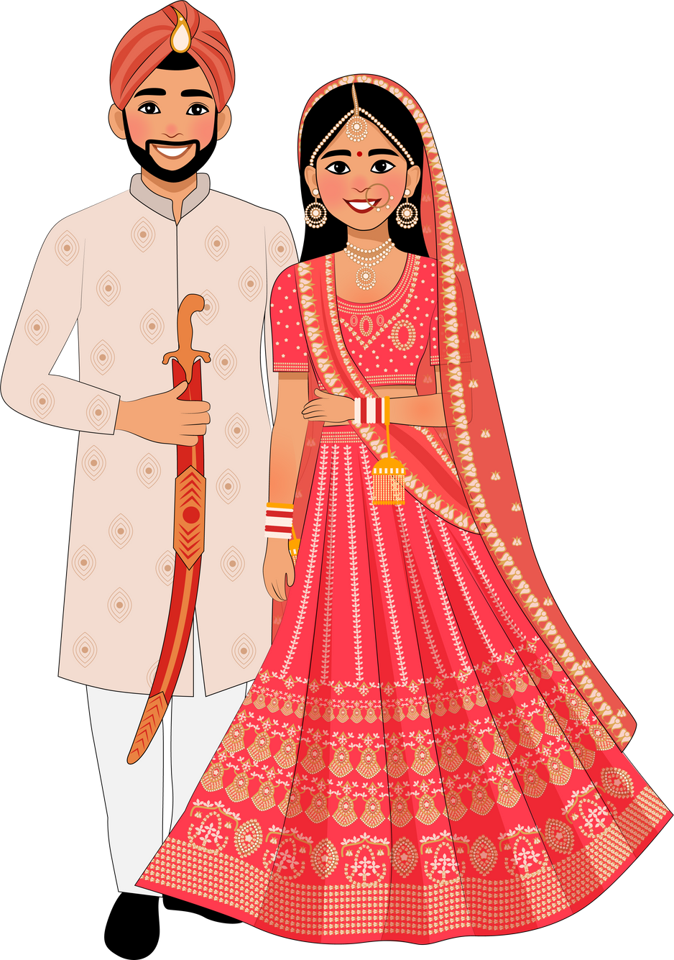
IMPORTANT NOTE
On the other hand, an arranged marriage is one where a person’s family chooses their partner, but does not force them to marry. The people involved decide if they want to get married.
Arranged marriage is legal and is practiced by many cultures.
Notes:
Ensure that the class understands the distinction between a forced marriage and an arranged marriage, which is an accepted practice in many cultures.

Slide 26

reflection
what’s one thing you’ll take away from today’s session?

