Slide 1

ENDING RELATIONSHIPS
YEAR 9
This presentation has been adapted for the Isle of Man from Scotland’s national resource for relationships, sexual health, and parenthood (RSHP) education.

Slide 2

CLASS AGREEMENTS
  Kindness and respect
  Right to pass
  Nonjudgmental
  No such thing as silly
questions
any others?
Notes:
Explain that you would like the class to create a list of 'agreements' for how everyone will behave and treat one another in the class. Ensure a common understanding. For example:
1. We will treat one another with kindness and respect (listening to each other, speaking one at a time, etc)
2. We all have the right to 'pass' on answering a question or participating in an activity that makes us feel uncomfortable.
3. We can disagree but will not pass judgments, make fun of, or or put anybody down. 'Challenge the opinion, not the person.'
4. Asking questions is encouraged and will be valued by our teacher. We do not ask questions to purposefully embarrass or belittle another.
*Feel free to change the agreements to suit your class, and ask whether there are any others they'd add to the list in order to create a safe, comfortable learning environment.

Slide 3
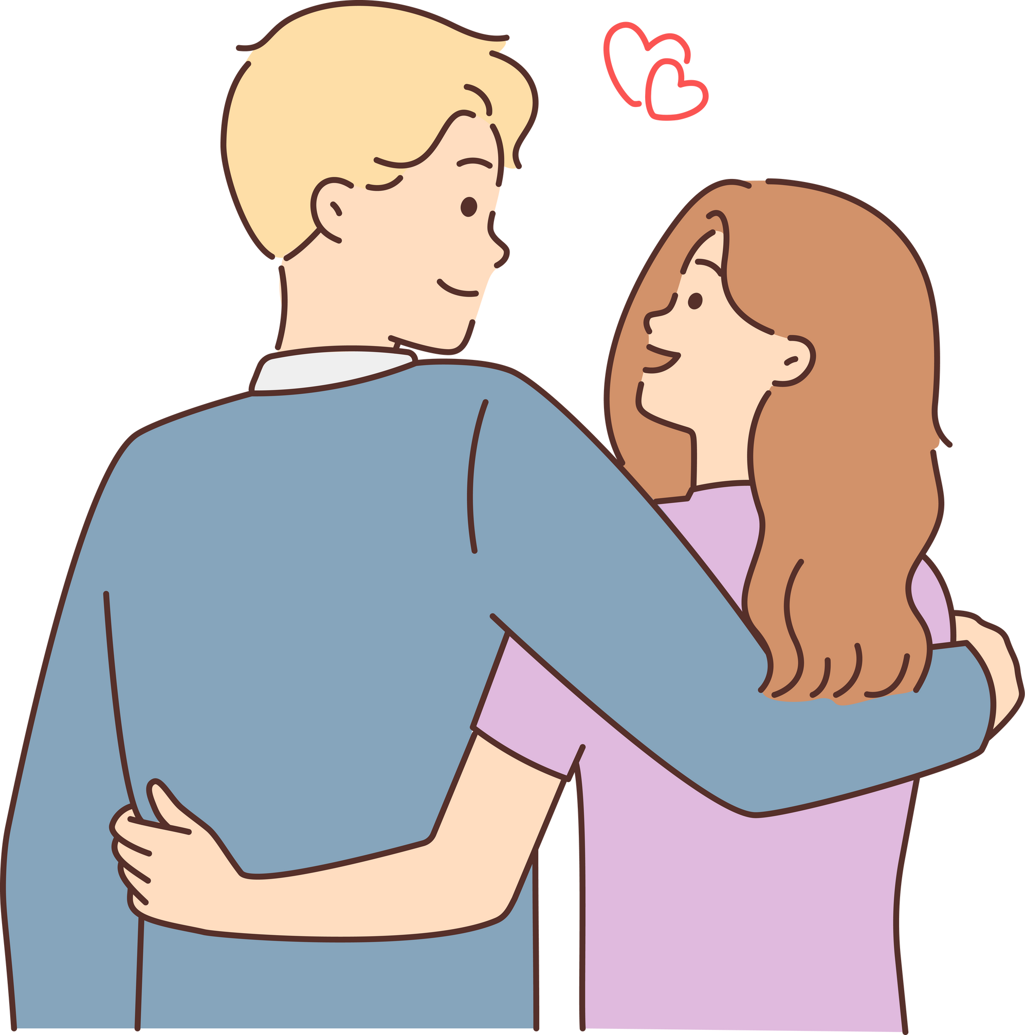
LET’S CHAT
What does a ‘good relationship’ mean to you?
Notes:
Introduce the lesson by explaining that today you will be talking about what makes relationships ‘good’ and when it might be time to end a relationship if it is not. Remind the class about the previous lessons during which they discussed the qualities of a partner, and relationship depictions in the media.
Based on this, ask them to discuss with a partner what they consider to be a “good relationship.”

Slide 4
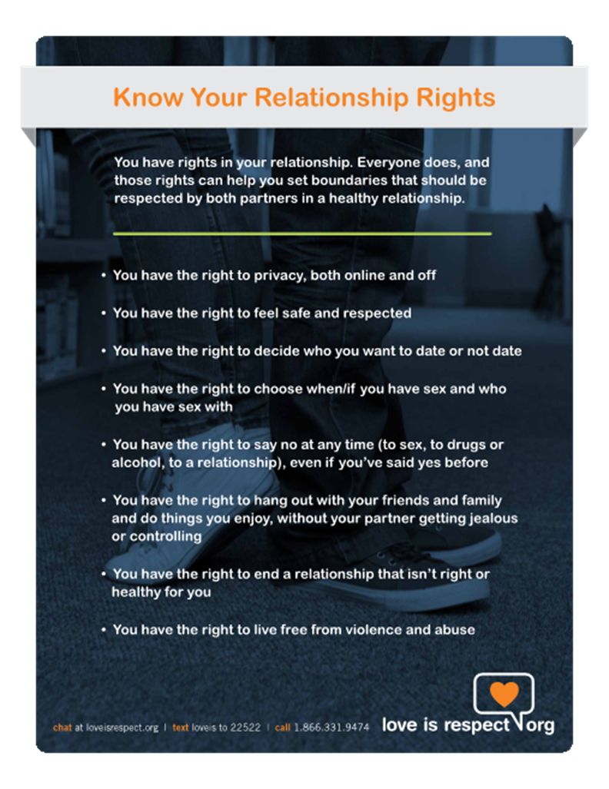
RELATIONSHIP RIGHTS
Notes:
Introduce the next slide with the ‘Relationship Rights’ graphic on it (and you may wish to have extras printed to hand out). Explain that typically, in a ‘good’ or ‘healthy’ relationship, these rights are respected.
Ask the class for their thoughts on these rights, and then prompt the class to think about relationship endings by asking "what happens when these rights are not respected in a relationship?"

Slide 5

LET’S CHAT
How do you know when it might be time to end a relationship?
Notes:
Prompt class discussion with the following questions: How do you know when it might be time to end a relationship? What kinds of feelings or situations might lead to a relationship ending?

Slide 6

ACTIVITY
TRAFFIC LIGHTS
Notes:
This activity asks young people to consider complex situations which they or their peers might find themselves in. It seeks to explore whether they are attuned to unhealthy/abusive behaviour, and to encourage them to stop, think and trust their feelings. It could be explained along these lines: On each of the cards there is a statement about a relationship a friend might be in. Using Resource b, you need to decide if the situation described in their relationship is good/ok (green light) or not good/not okay (red light) or something that makes you feel ‘you know, I’m just not sure about this’ (amber light). Work in your small group, talk things through and try to reach an agreement about each situation, but if you can’t agree put the card to the side and we’ll come back to it as a class/group. After some time, get feedback, encourage discussion and explore different views.

Slide 7
ACTIVITY
This is not OK/not good
Unsure
This is OK/good
Notes:
On the handout there are statements about a relationship a friend might be in. Using the traffic light (Handout B), you need to decide if the situation described in their relationship is good/ok (green light) or not good/not okay (red light) or something that makes you feel ‘you know, I’m just not sure about this’ (amber light). Work in your small group, talk things through and try to reach an agreement about each situation.
When finished, bring the class back for a full class discussion about the scenarios, and encourage students with different perspectives to share.

Slide 8
LET’S CHAT
If a friend wanted to end their relationship, what would you advise them to do?
If a friend were in an unhealthy or unsafe relationship, how could they end it safely?
Notes:
Whole class discussion: how can we end relationships that we're no longer happy in?Encourage discussion such as “should it be done face to face or is text OK? How can we communicate our need to end the relationship? What might make it difficult to end the relationship?”
Further discussion: How would we advise a friend to end a relationship that had become unsafe? How could they ensure their safety while doing so? Be sure to make these points:
A young person can always reach out to a trusted adult for help if they need support or feel unsafe.
Nobody should ever put themselves in an unsafe situation when ending a relationship - if they are worried they may get hurt, they should speak to a trusted adult who can support them and help them to figure out the best way to get themselves out of the situation.

Slide 9
SUPPORT
If you are worried about a relationship situation that you or a friend are in, you do not have to go through it alone.
Always talk to a trusted adult who can help.
Notes:
Be mindful of how students are responding to the material and ensure that any emotional support or safeguarding procedures should be put in place if needed. Ensure students know where to go for support if they are worried about themselves or a friend.

Slide 10

SUPPORT
www.childline.org.uk​
Chat 1:1 with an online advisor
If you're under 19 you can confidentially call, email or chat online about any problem big or small​
Freephone 24h helpline: 0800 1111​
Notes:
Be mindful of how students are responding to the material and ensure that any emotional support or safeguarding procedures should be put in place if needed. Ensure students know where to go for support if they are worried about themselves or a friend.

Slide 11

reflection
what’s one thing you’ll take away from today’s session?

