Slide 1
TEACHER SLIDE
This lesson focuses on menstruation. It is important that male students in the class understand why they are being taught this information. By including male students in learning about periods, we aim to:
  Normalise talking about periods and reduce embarrassment/shame
  Dispel myths and misconceptions
  Encourage empathy and understanding
You may also wish to invite students to write any questions they have about menstruation on a piece of paper and submit after class, if they’re not comfortable asking the question during class.

Slide 2

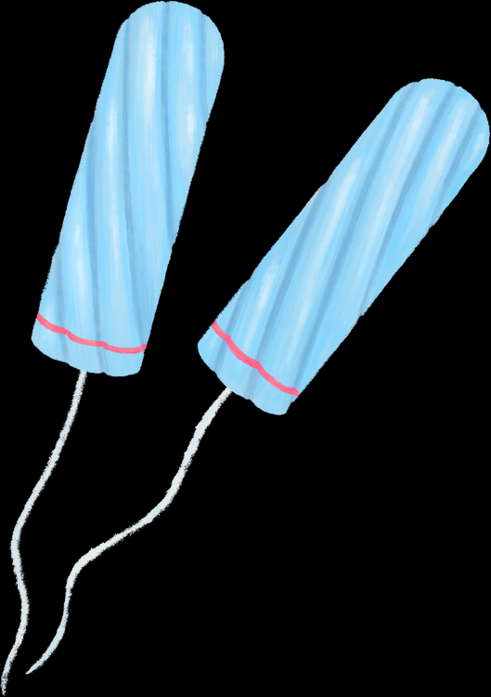

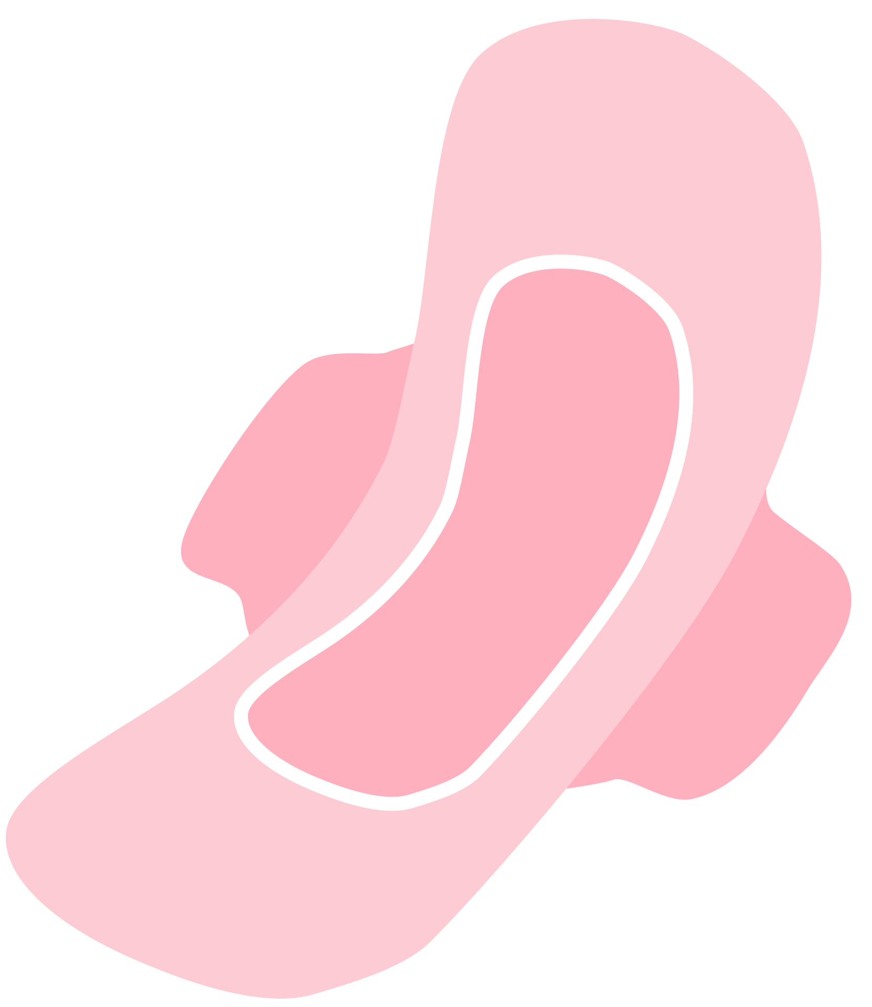

These images show different products that women/girls may use when they have their period. How many do you recognise? What are they called and how are they used?
DO IT NOW

Slide 3

MENSTRUATION
YEAR 7
This presentation has been adapted for the Isle of Man from Scotland’s national resource for relationships, sexual health, and parenthood (RSHP) education.

Slide 4
LEARNING OBJECTIVES
  Explain what menstruation is
  Describe different period products that are available
  Understand where to go for help if I have a question or worry

Slide 5

CLASS AGREEMENTS
  Kindness and respect
  Right to pass
  Nonjudgmental
  No such thing as silly
questions
any others?
Notes:
Explain that you would like the class to create a list of 'agreements' for how everyone will behave and treat one another in the class. Ensure a common understanding. For example:
1. We will treat one another with kindness and respect (listening to each other, speaking one at a time, etc)
2. We all have the right to 'pass' on answering a question or participating in an activity that makes us feel uncomfortable.
3. We can disagree but will not pass judgments, make fun of, or or put anybody down. 'Challenge the opinion, not the person.'
4. Asking questions is encouraged and will be valued by our teacher. We do not ask questions to purposefully embarrass or belittle another.
*Feel free to change the agreements to suit your class, and ask whether there are any others they'd add to the list in order to create a safe, comfortable learning environment.

Slide 6
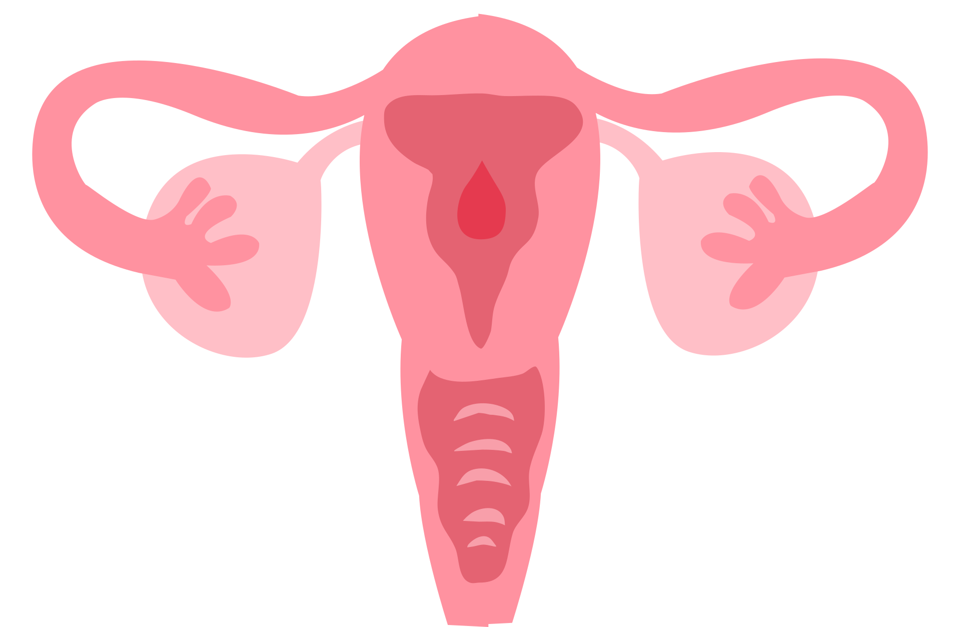
WHAT IS MENSTRUATION?
Each month, the female body prepares for the possibility of pregnancy. An egg is released from the ovaries, and the lining of the uterus thickens.
If an egg is not fertilised and no pregnancy occurs, the uterus will break down this lining (basically to get rid of what it doesn’t need!)
The lining will then come out through the vagina in the form of bleeding and other fluids. This is what’s known as menstruation, or as most people call them, periods.

Slide 7
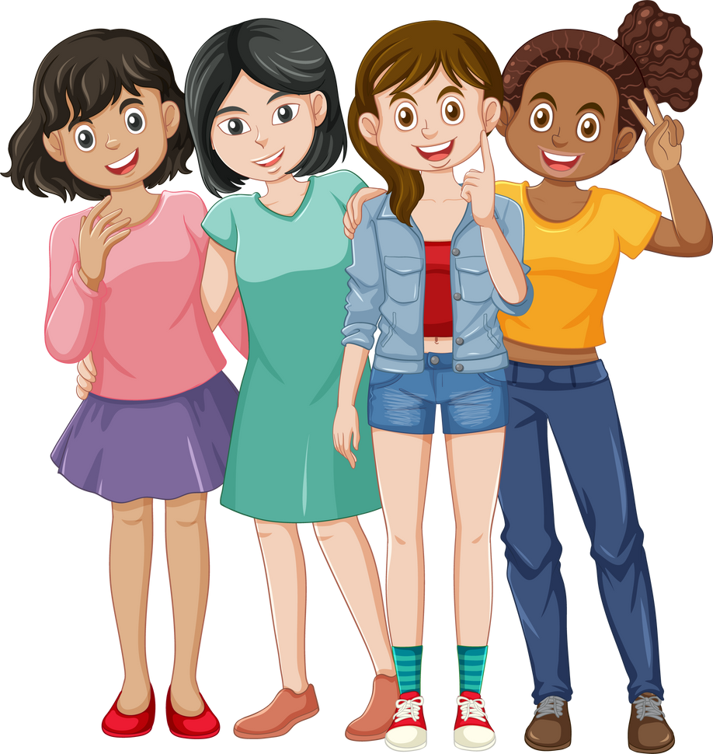
Most girls start their period between the age of 10 and 16.
Some girls start earlier, some later.
All girls are different and unique.

Slide 8
https://www.youtube.com/watch?v=ypMyH0W1trs
Notes:
Could not embed video in slide, please click on link and load video before starting
https://www.youtube.com/watch?v=ypMyH0W1trs

Slide 9
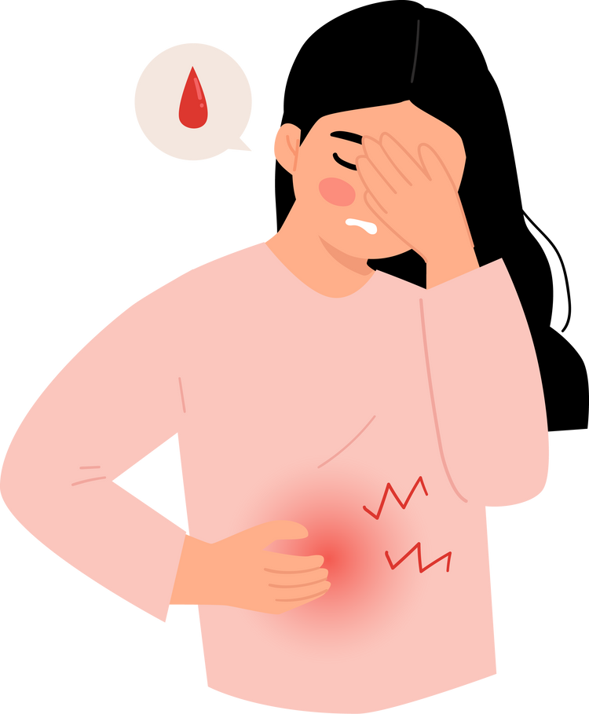
DO PERIODS HURT?
  Some girls may experience pain or discomfort during their periods.
  This may begin a few days before a period starts and can also happen during the first few days of a period.
  You may notice a sharp or dull ache in your lower abdomen.

Slide 10
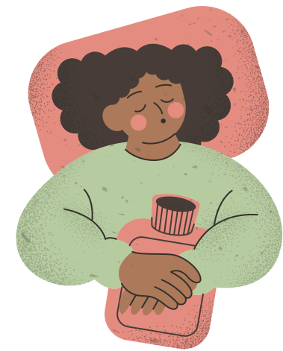
HOW CAN YOU EASE PERIOD PAIN?
  Warm baths or showers
  Hot water bottle
  Pain relief medication (paracetamol, ibuprofen)
  Gentle exercise (walking, yoga stretches, swimming)
  Massage lower abdomen/back

Slide 11
DO PERIODS HURT?
While some pain and discomfort is (unfortunately!) totally normal, period pain should not be severe. If you are concerned about pain, please tell an adult you trust, and they can help you to make a GP appointment and check for any problems that might be causing it.

Slide 12

Notes:
https://www.youtube.com/watch?v=kmWbOC8Fbb0

Slide 13
ACTIVITY
You will be split into small groups, and each group will be given an information poster about a common period product. In your group, fill in the table for your product using the information from the poster. You will then share this information with the rest of the class. By the end, everyone should have a table full of information!
Notes:
https://www.youtube.com/watch?v=kmWbOC8Fbb0

Slide 14
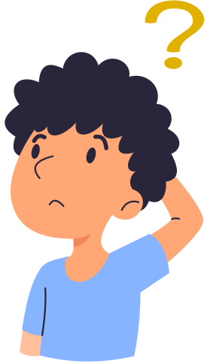
LET’S CHAT
Do you think it’s important for boys/men to learn about periods? Why or why not?

Slide 15

MYTH BUSTING
Have you heard any of these myths about periods?

Slide 16
Everyone can tell when you’ve started your period.
MYTH
No-one can tell when you’ve started your period unless you choose to tell them. Periods are private, but don’t have to be a secret. It’s perfectly normal and perfectly natural
FACT
©2024 HEY GIRLS CIC

Slide 17
You can’t go swimming if you have your period.
MYTH
There is no reason to not go swimming when you have your period (you won’t turn the whole pool red, and you won’t be eaten by sharks!). Unfortunately, you can’t really go in the water with a pad on, but using tampons or a cup, and changing them regularly, your period is secured whatever activity you take on.
FACT
©2024 HEY GIRLS CIC

Slide 18
Exercise is bad for you when you have your period.
MYTH
Exercising is almost always good for you. If you have cramps during your period, exercise is actually the most effective cure, releasing endorphins into the blood and relieving cramps.
FACT
©2024 HEY GIRLS CIC

Slide 19
Your period comes every 28 days.
MYTH
Cycles vary from person to person and can be anywhere from 25 to 35 days long. In the first few years your cycle is likely to be very irregular, but it should then settle down. After changes to your cycle can be caused by stress, travelling between time zones, strenuous exercise, illness, or drastic changes in weight and diet.
FACT
©2024 HEY GIRLS CIC

Slide 20
If you don’t get your period you’re definitely pregnant!
MYTH
There are many factors that can delay your period. So a delay in your period doesn’t necessarily mean you’re pregnant. Your period could be late due to stress, weight gain or loss or other life changes.
FACT
©2024 HEY GIRLS CIC

Slide 21
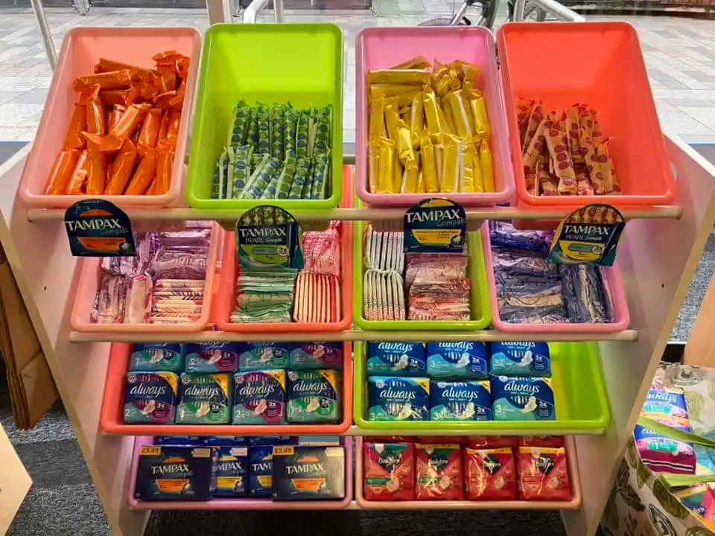
FREE PERIOD PRODUCTS
In Henry Bloom Noble Library in Douglas, you can now find a ‘Pick n Mix’ station for period products! These are free to anyone who needs them.

Slide 22

REFLECTION
What are three things you’ll remember from today’s lesson?

Slide 23
IF YOU HAVE ANY QUESTIONS OR WORRIES ABOUT PERIODS...
  Talk to a trusted adult
  Childline
    https://www.childline.org.uk/info-advice/you-your-body/puberty/
  Hey Girls...
    https://www.heygirls.co.uk/learn/you/

