Slide 1

ME ONLINE
YEAR 7
This presentation has been adapted for the Isle of Man from Scotland’s national resource for relationships, sexual health, and parenthood (RSHP) education.

Slide 2

CLASS AGREEMENTS
  Kindness and respect
  Right to pass
  Nonjudgmental
  No such thing as silly
questions
any others?
Notes:
Explain that you would like the class to create a list of 'agreements' for how everyone will behave and treat one another in the class. Ensure a common understanding. For example:
1. We will treat one another with kindness and respect (listening to each other, speaking one at a time, etc)
2. We all have the right to 'pass' on answering a question or participating in an activity that makes us feel uncomfortable.
3. We can disagree but will not pass judgments, make fun of, or or put anybody down. 'Challenge the opinion, not the person.'
4. Asking questions is encouraged and will be valued by our teacher. We do not ask questions to purposefully embarrass or belittle another.
*Feel free to change the agreements to suit your class, and ask whether there are any others they'd add to the list in order to create a safe, comfortable learning environment.

Slide 3


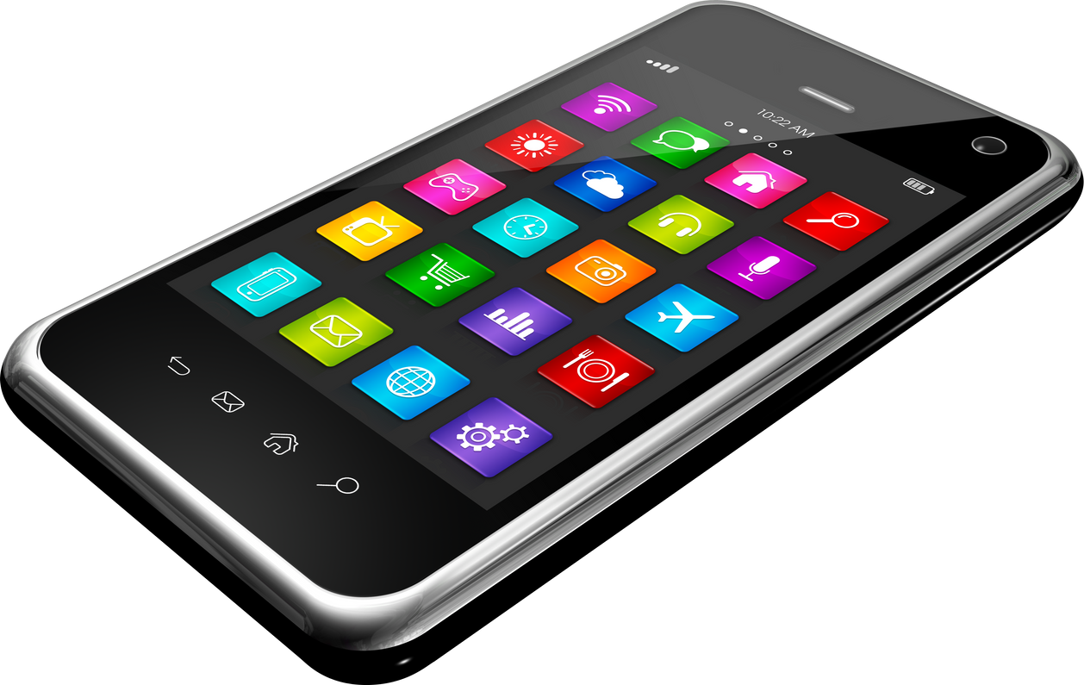
WE ALL USE THE INTERNET DIFFERENTLY.
Notes:
Start with an introduction that we all use the internet differently. Some of us will have
phones or tablets or game online, some not. Whatever access we have, whatever we use, today young people will be thinking about their online lives, and it’s likely that even with limited access now, this will probably increase for everybody as they get older.

Slide 4
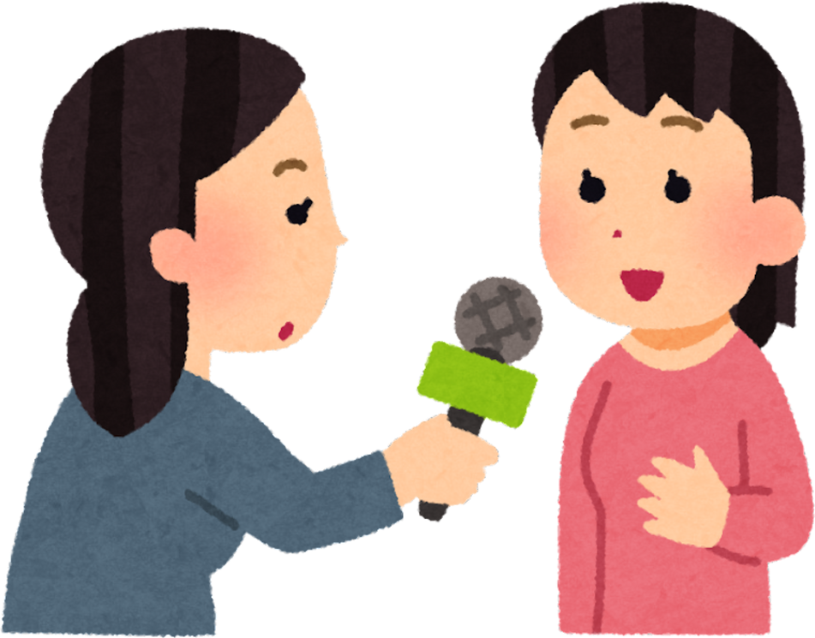
ACTIVITY
interview a partner
Notes:
Tell the class that they will be interviewing one another about their online activity. Split the young people into pairs and provide them with Handout A.
Explain that each person in the pair should have an opportunity to act as the ‘interviewer’ and ‘interviewee’ using the questions provided on the handout. Explain that once they are finished interviewing one another that they should have a conversation about any similarities or differences in their online activity.

Slide 5

LET’S TALK
share with the class
what did you & your partner have in common? what was different? what about the rest of the class?
Notes:
Encourage pairs to share their findings with the wider class.
Encourage discussion by asking questions such as ‘What did you and your partner have in common? What was different? How do you feel about your online activity after talking to your partner? How do you think your online activity compares to students in other year groups?’

Slide 6






LET’S TALK
what do young people across the UK do online?
Notes:
Share Handout B, which is an infographic from Internet Matters describing the online habits of young people across the UK.
Either print this out or read aloud some of the statistics and ask the class for their thoughts.
Do they find anything surprising? How do they feel their own online activity compares to the statistics?

Slide 7
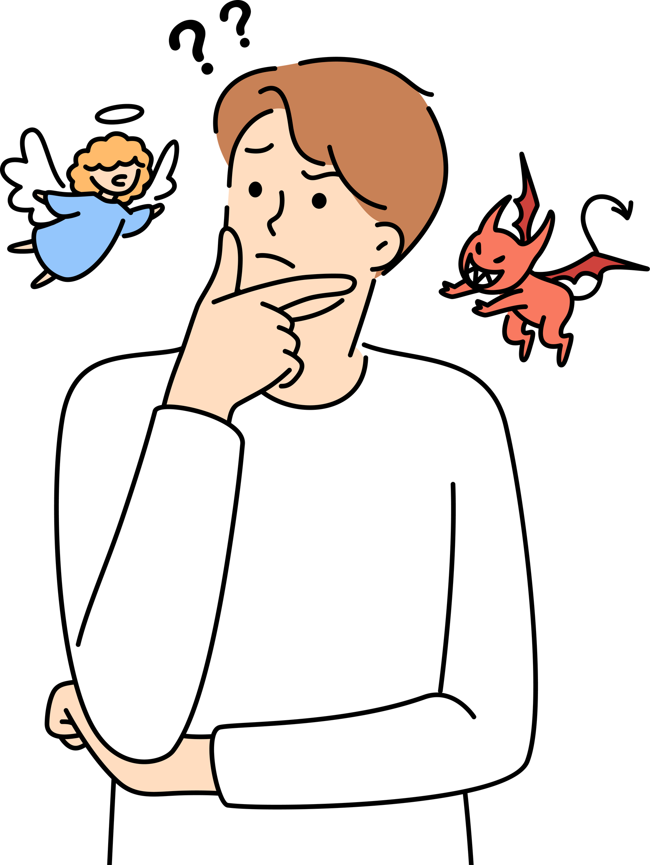
LET’S TALK
social media: good or bad?
Notes:
Activity: Ask the class the following question: “Do you think social media is a good thing, or a bad thing?”
Instruct those who believe it is a good thing to walk to one end of the classroom, and those who think it’s a bad thing to walk to the other side. Allow those who are unsure to remain in the ‘middle.’ Ask students on both sides for their reasoning: why do they think social media is good/bad? Are there any exceptions?

Slide 8

CHECK THIS OUT
Notes:
With students still on their respective sides, tell them that you are going to play a short video clip (embedded in slides).
Introduce the clip, explaining that it is an interview with Evie Roberts, a teenager on the Isle of Man and student at Ballakermeen High School. Evie is blind and hosts a popular podcast called ‘Talking in the Dark’ which aims to break barriers and challenge stigma and stereotypes.
https://www.youtube.com/watch?v=QLvf1fmd1bQ

Slide 9
LET’S TALK
social media: still good or bad?
Notes:
Revisit this question - ask students whether the video clip influenced their thinking about social media - is it sometimes a positive thing? How? When? Is it always so black and white?
Ask students for their own examples of people using social media for good (for example YouTubers or influencers who share positive messages, famous people who promote awareness of important issues, etc)

Slide 10
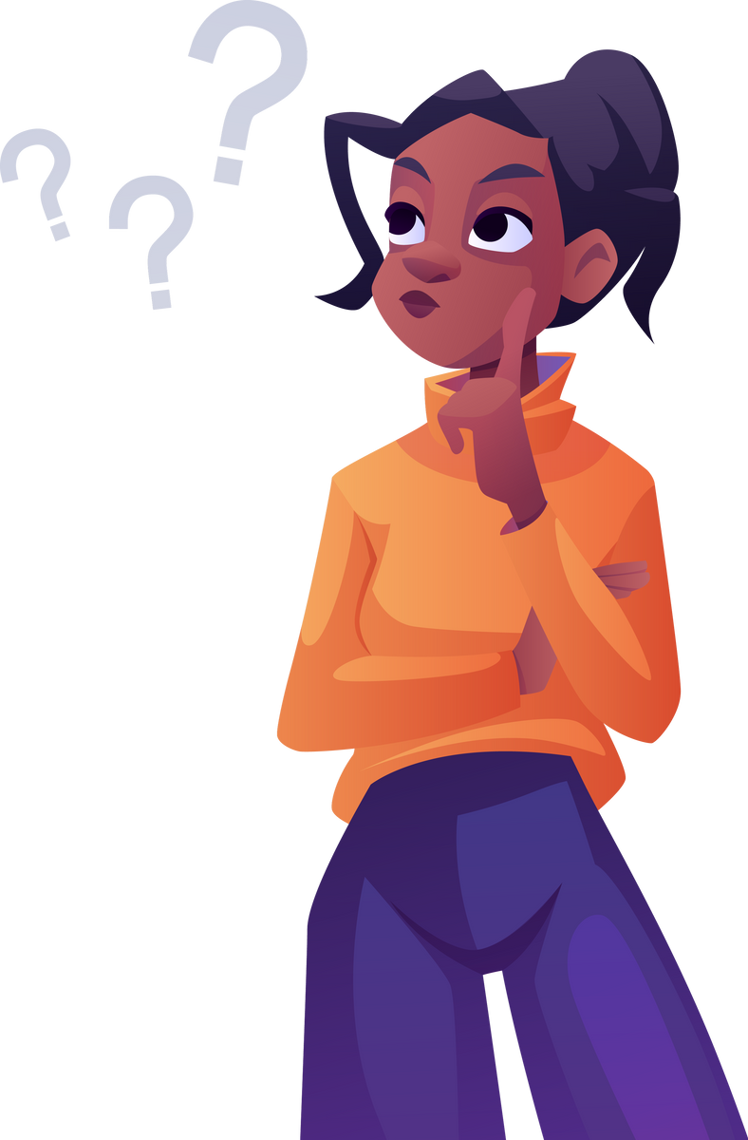
LET’S REFLECT
what’s one idea you’re taking away from today’s lesson?

