Slide 1

FEELING EMOTIONAL
YEAR 7
This presentation has been adapted for the Isle of Man from Scotland’s national resource for relationships, sexual health, and parenthood (RSHP) education.

Slide 2

CLASS AGREEMENTS
  Kindness and respect
  Right to pass
  Nonjudgmental
  No such thing as silly
questions
any others?
Notes:
Explain that you would like the class to create a list of 'agreements' for how everyone will behave and treat one another in the class. Ensure a common understanding. For example:
1. We will treat one another with kindness and respect (listening to each other, speaking one at a time, etc)
2. We all have the right to 'pass' on answering a question or participating in an activity that makes us feel uncomfortable.
3. We can disagree but will not pass judgments, make fun of, or or put anybody down. 'Challenge the opinion, not the person.'
4. Asking questions is encouraged and will be valued by our teacher. We do not ask questions to purposefully embarrass or belittle another.
*Feel free to change the agreements to suit your class, and ask whether there are any others they'd add to the list in order to create a safe, comfortable learning environment.

Slide 3

HAVE A THINK
what are emotions?
can you name any?
Notes:
Explain that you would like the class to create a list of 'agreements' for how everyone will behave and treat one another in the class. Ensure a common understanding. For example:
1. We will treat one another with kindness and respect (listening to each other, speaking one at a time, etc)
2. We all have the right to 'pass' on answering a question or participating in an activity that makes us feel uncomfortable.
3. We can disagree but will not pass judgments, make fun of, or or put anybody down. 'Challenge the opinion, not the person.'
4. Asking questions is encouraged and will be valued by our teacher. We do not ask questions to purposefully embarrass or belittle another.
*Feel free to change the agreements to suit your class, and ask whether there are any others they'd add to the list in order to create a safe, comfortable learning environment.

Slide 4
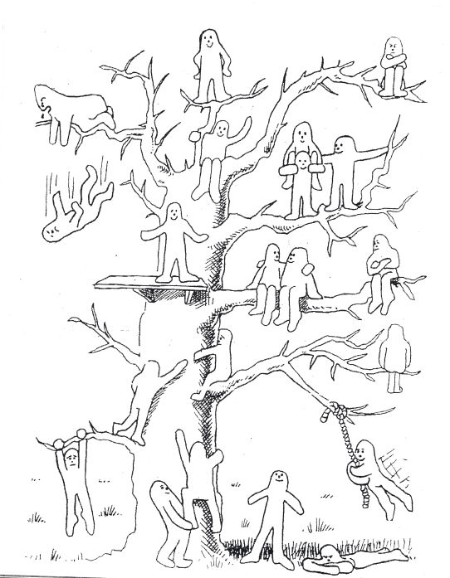
CHECK IN
which blob person are you feeling like today?

Slide 5

WATCH

Slide 6
ACTIVITY
recognising emotions
what might they look like?
what might they be thinking?
what situations might have caused this?

Slide 7

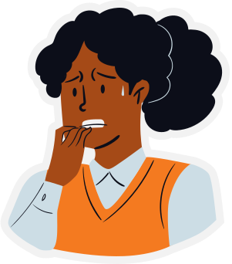
EXAMPLE
anxiety
“I’m going to fail this exam”
“Who will I sit with at lunch?”
“What if our team loses because of me?”
sweaty
shaky legs
biting fingernails
gritting teeth
situations that might make people feel anxious: important exam coming up; starting secondary school; being asked to speak in front of the class

Slide 8
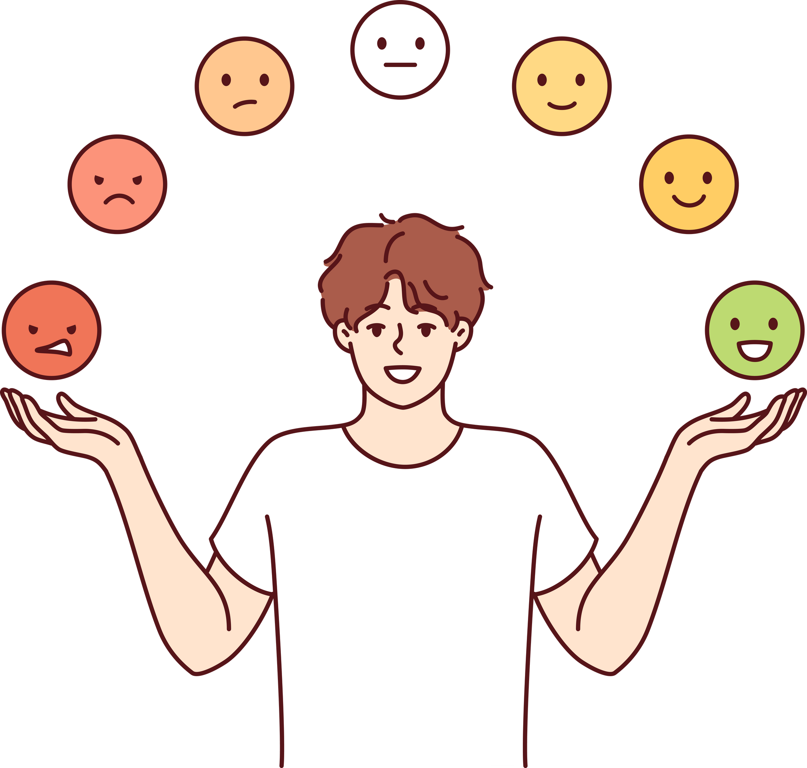
LET’S TALK
is there such a thing as a good or bad emotion?

Slide 9

SUPPORT
  Isle Listen
  Kooth
  Childline
  Young Minds
(https://www.youngminds.org.uk/)

Slide 10

LET’S REFLECT
what’s one idea you’re taking away from today’s lesson?

