Slide 1

NETIQUETTE
YEAR 7
This presentation has been adapted for the Isle of Man from Scotland’s national resource for relationships, sexual health, and parenthood (RSHP) education.

Slide 2

CLASS AGREEMENTS
  Kindness and respect
  Right to pass
  Nonjudgmental
  No such thing as silly
questions
any others?
Notes:
Explain that you would like the class to create a list of 'agreements' for how everyone will behave and treat one another in the class. Ensure a common understanding. For example:
1. We will treat one another with kindness and respect (listening to each other, speaking one at a time, etc)
2. We all have the right to 'pass' on answering a question or participating in an activity that makes us feel uncomfortable.
3. We can disagree but will not pass judgments, make fun of, or or put anybody down. 'Challenge the opinion, not the person.'
4. Asking questions is encouraged and will be valued by our teacher. We do not ask questions to purposefully embarrass or belittle another.
*Feel free to change the agreements to suit your class, and ask whether there are any others they'd add to the list in order to create a safe, comfortable learning environment.

Slide 3
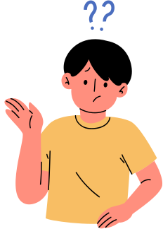
HAVE A THINK
what do you think the word ‘netiquette’ means?

Slide 4



HAVE A THINK
net (the internet)
etiquette (the rules we follow for behaviour in society)
netiquette (the rules we follow for how we behave online!)

Slide 5
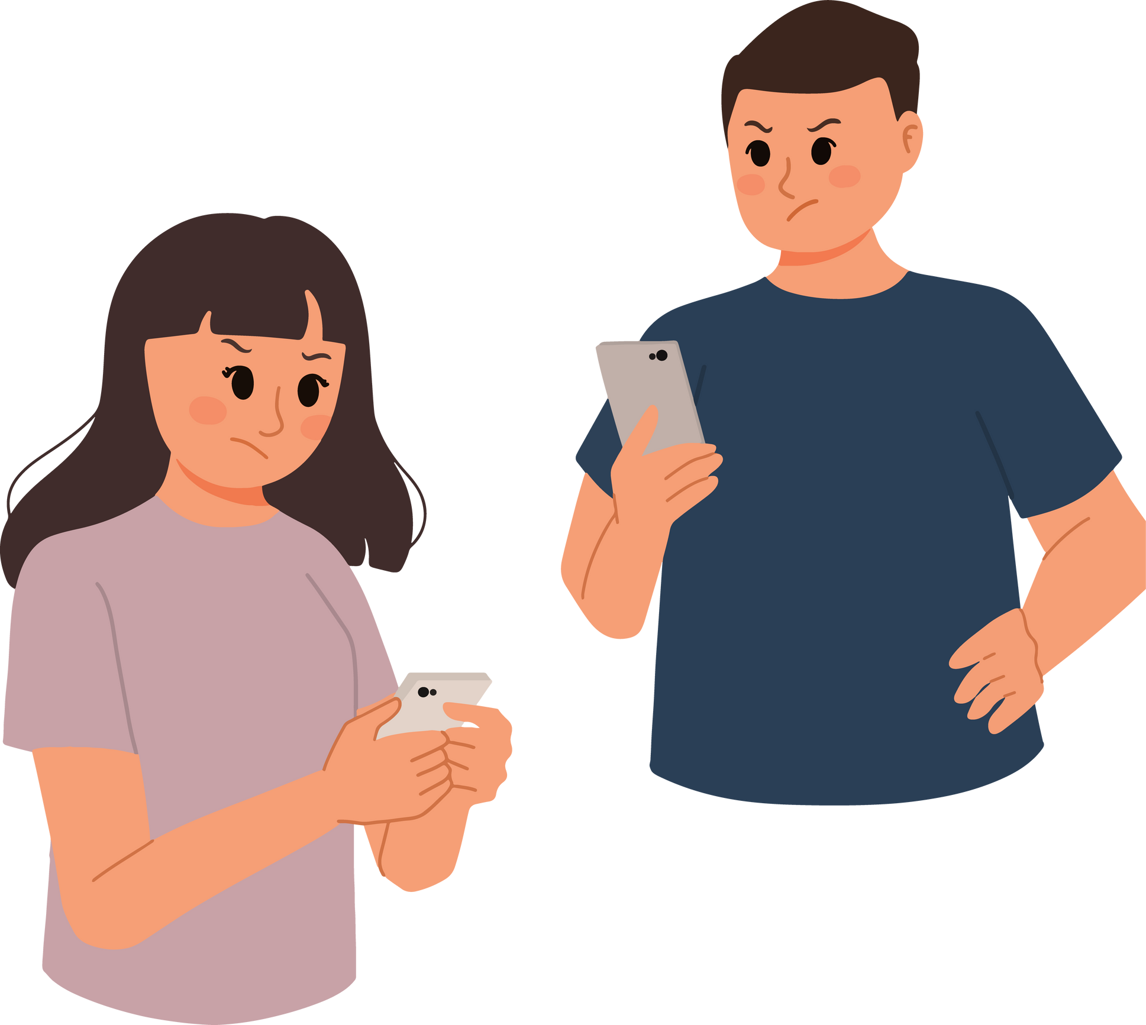
ACTIVITY
please don’t...
what do people do online that you wish they wouldn’t?

Slide 6

LET’S TALK
share with the class
what do people do online that you wish they wouldn’t?

Slide 7
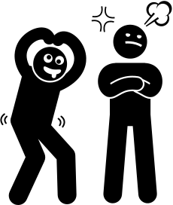
ACTIVITY
situation cards
what would you expect others to do in these situations?

Slide 8

LET’S TALK
how do we think people should behave online?

Slide 9
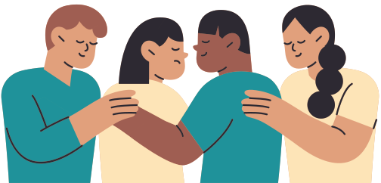
GET SUPPORT
ChildLine​
www.childline.org.uk​
If you're under 19 you can confidentially call, email or chat online about any problem big or small​
Freephone 24h helpline: 0800 1111​
Chat 1:1 with an online advisor ​

Slide 10

LET’S REFLECT
what’s one idea you’re taking away from today’s lesson?

