Slide 1

RESPECT ME
YEAR 7
This presentation has been adapted for the Isle of Man from respectme, Scotland’s anti-bullying service.

Slide 2

CLASS AGREEMENTS
  Kindness and respect
  Right to pass
  Nonjudgmental
  No such thing as silly
questions
any others?
Notes:
Explain that you would like the class to create a list of 'agreements' for how everyone will behave and treat one another in the class. Ensure a common understanding. For example:
1. We will treat one another with kindness and respect (listening to each other, speaking one at a time, etc)
2. We all have the right to 'pass' on answering a question or participating in an activity that makes us feel uncomfortable.
3. We can disagree but will not pass judgments, make fun of, or or put anybody down. 'Challenge the opinion, not the person.'
4. Asking questions is encouraged and will be valued by our teacher. We do not ask questions to purposefully embarrass or belittle another.
*Feel free to change the agreements to suit your class, and ask whether there are any others they'd add to the list in order to create a safe, comfortable learning environment.

Slide 3
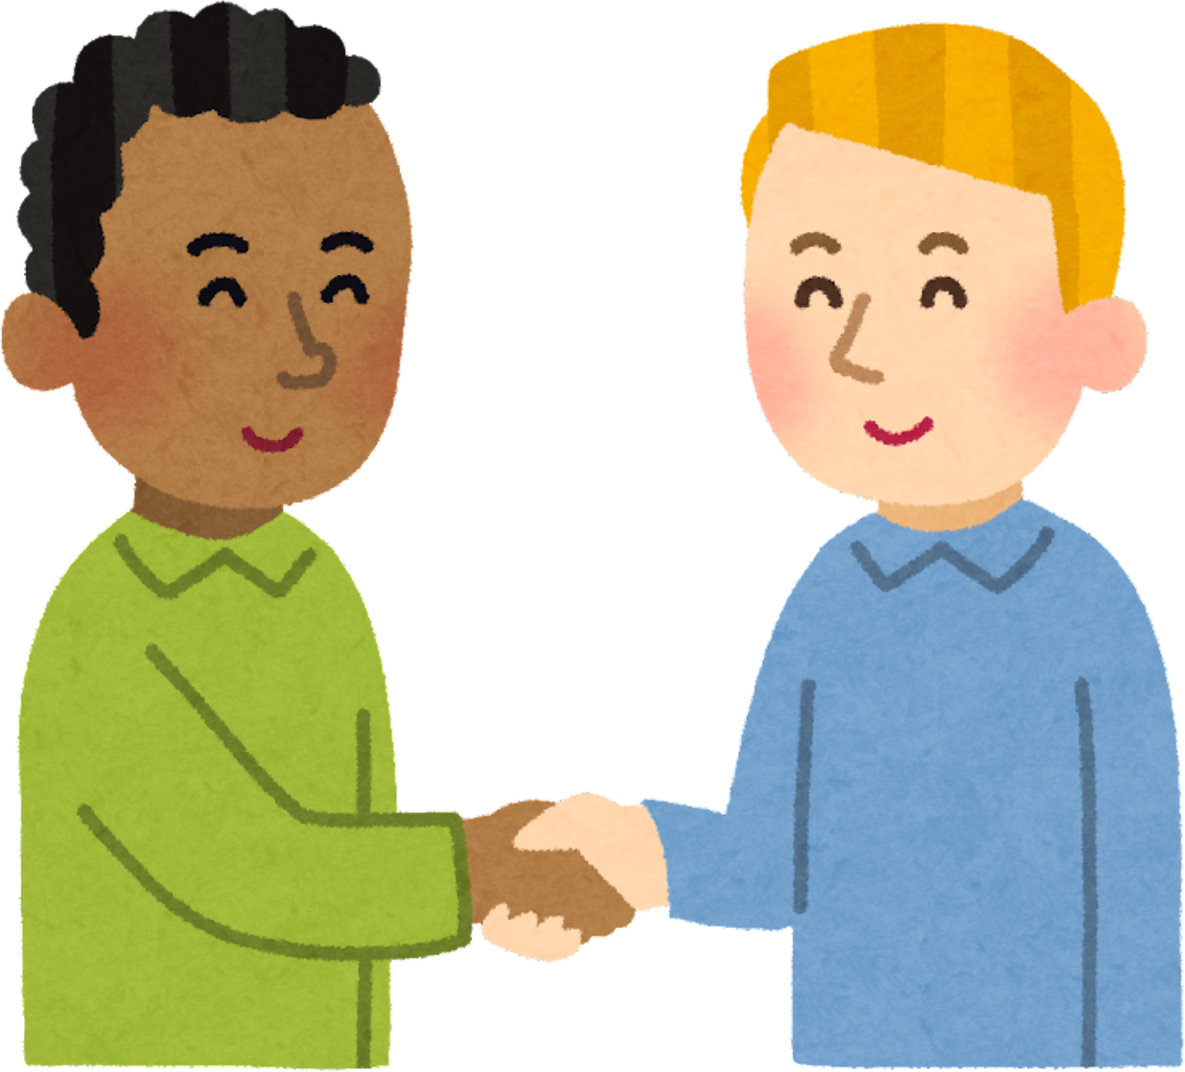
HAVE A THINK
what does the word ‘respect’ mean to you?

Slide 4
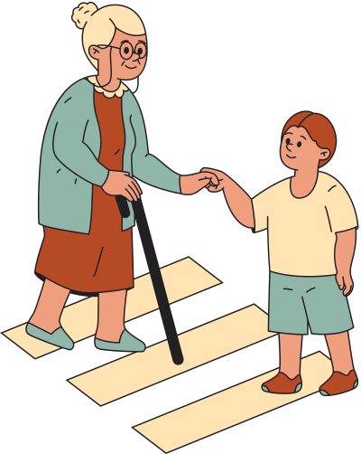
LET’S TALK
what does respect look and sound like....
...in class?
...at home?
...in town?
...with friends?
...with someone you don’t like?

Slide 5
EXAMPLES
helping carry the shopping
including someone in the conversation
shaking hands or bowing
showing interest in what others have to say
“well done!”
“how are you?”
listening to the teacher

Slide 6
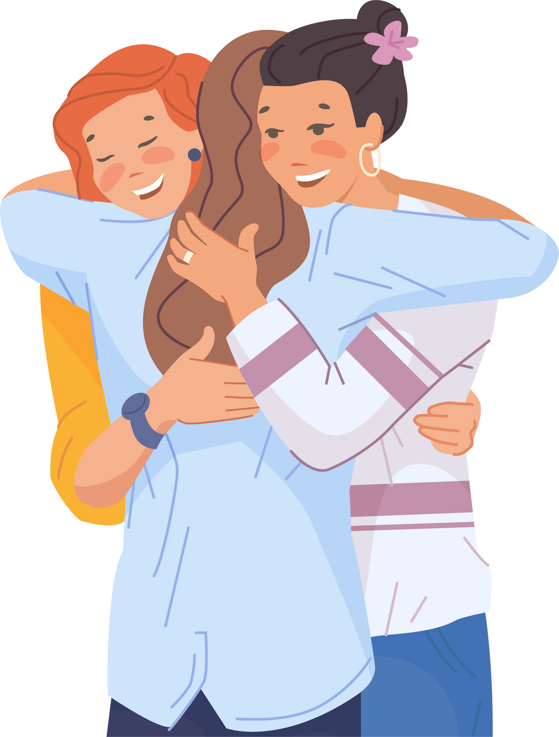
HAVE A THINK
is respect an important part of healthy relationships? why or why not?

Slide 7

ACTIVITY
the ripple effect

Slide 8

WATCH

Slide 9

LET’S REFLECT
what’s one idea you’re taking away from today’s lesson?

