Slide 1
Sexual Health

Slide 2
Ground rules
No personal comments
Listen to each other
Treat others with respect- even if we disagree
Engage with learning
Enjoy your learning ☺

Slide 3
Who are we and what do we do?
Manx Integrated Sexual Health Service
Contraception
STI testing
STI treatments
Condoms
Emergency contraception
Help and advice
Confidential
Under 16’s welcome
Notes:
What is MISH?
Small team of nurses and doctors and we provide the following services.
Information available after this session with contact information. Website www.gov.im/gum ...just google GUM IOM

Slide 4
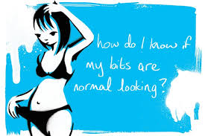
Common questions we get asked

Slide 5
Why is it important?
Notes:
We think sexual health and our job is really important as we provide education, advice, support as well as testing and treatment. Looking after your sexual health to prevent unplanned pregnancy and STI’s can prevent any long term health caused by untreated infection . Some infections are silent , so get tested even if you feel OK.

Slide 6
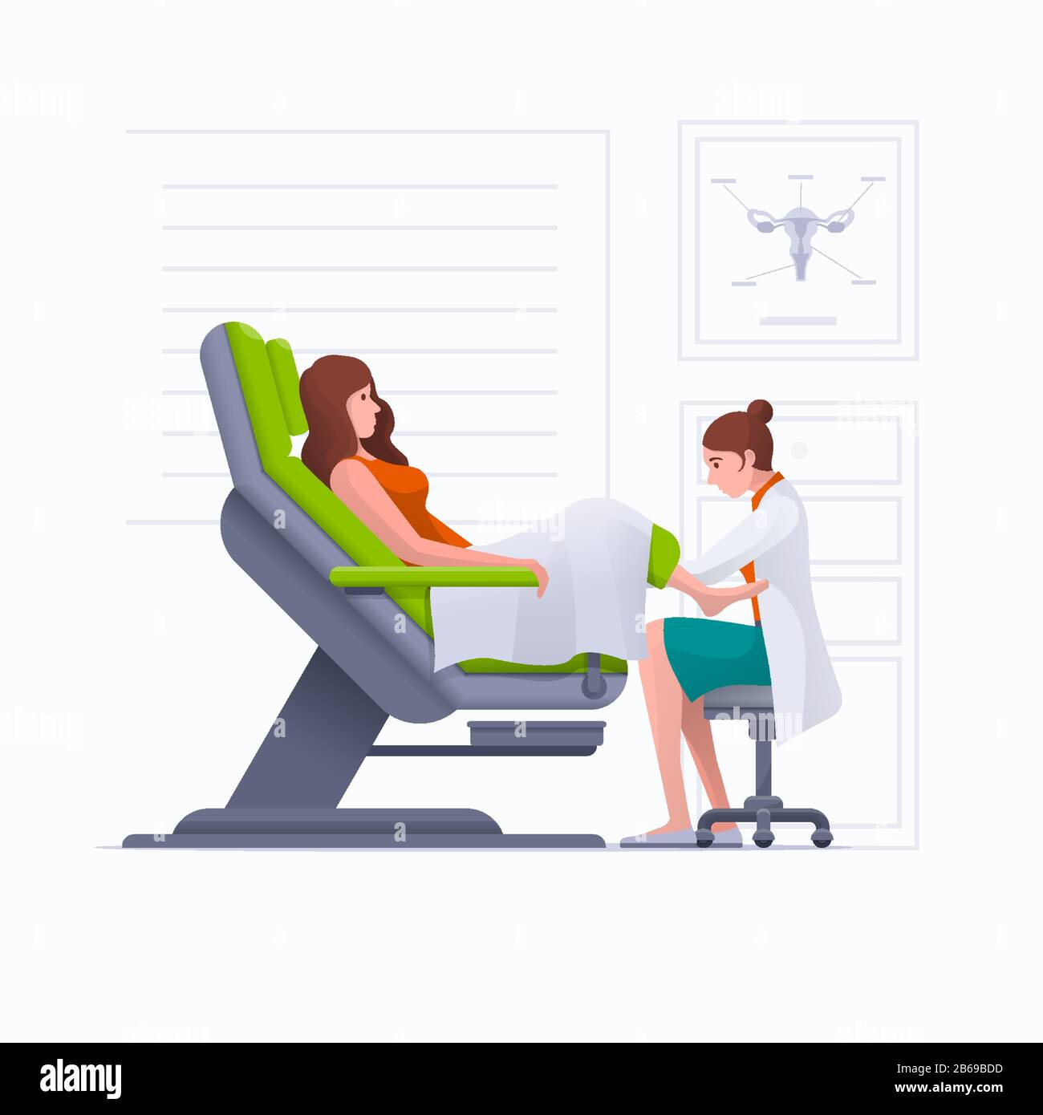
Will I be examined ?
Notes:
Most people are scared the first time they come to clinic . They may be worried about being examined and feel very embarrassed.
Examination and testing is optional.

Slide 7
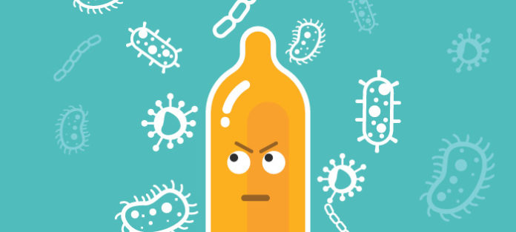
How do we stop unplanned pregnancy and the spread of STIs?
No sex ever!
Condoms
Contraception
Get tested

Slide 8
Any questions?

