Slide 1
Isle of Man Constabulary
School Education Officers
PC Butler, PC Kennaugh, PC Krejci
Notes:
Slide to be on screen when class enter room

Slide 2
Why are We here today?
To provide you with information so you can make good decisions.
Understand what is meant by misuse of your mobile device.
Explore what the law says in relation to image sharing.
Peer Pressure.
Effects and Consequences .
Notes:
Ground rules and introductions as to why we are here. Local context and no story telling/naming and shaming but if there are concerns ensure there are signposts to help/advise at the end.
Affect pupils
Learning objectives

Slide 3
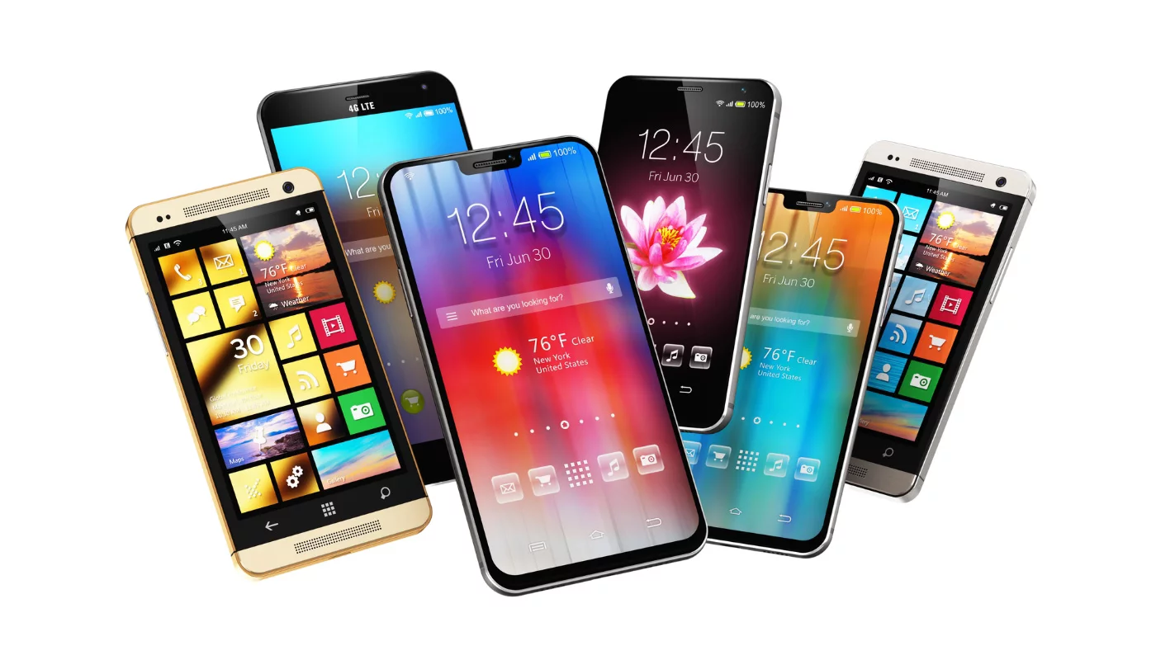
How can you MISUSE A MOBILE DEVICE
Indecent Image Sharing
Revenge Porn
Grooming
Taking Indecent ‘Selfies’
Notes:
Ask kids for suggestions and write on board
Cover what an indecent image is……

Slide 4
2

Slide 5
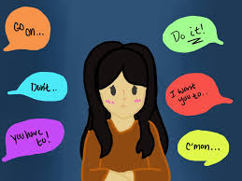
Discuss The video
Why do people send indecent images?
-Part of relationship
-Peer Pressure
-‘Everyone doing it’
-Media Influences
Don’t realise legal and emotional consequences
Notes:
Ask the questions and let kids discuss with neighbour or part of a group
Points to cover
Don’t feel real and permanent

Slide 6
Discuss the video
Did Abi consent to the photo being distributed?
If you receive an indecent image what should you do?
Notes:
‘Think about them as a person not as an image.’
Don’t feel real and permanent

Slide 7
DISCUSS THE VIDEO
What are the consequences of the photo being shared?
Legal | Emotional
- Phone Confiscated | - Anxiety
- Interaction with Police and Guardians | - Body Image Issues
- Arrest and Interview | - Reputation
- Court | - Permanency
- Sex Offenders Register | - Future prospects
 | - Spread Worldwide

Slide 8
help Abi- How would you respond to this text?
Send me something nice?
Notes:
What reply would you get this message

Slide 9
help Abi- How would you respond to this text?
OOMG Josh asked me to send him that pic?
me to send him that pic?
What do I do?
Notes:
OMG Josh asked me to send him that pic?
What do I do?
What reply would you get this message

Slide 10
What does law say?
If you are under 18 years old you can send a naked selfie of yourself to a friend.
Notes:
A 16 year old taking a photograph of his own genitals commits the offence of taking or making indecent photograph of a child.
A 17 year old sending a picture of her breasts to her boyfriend commits the offence of distribution of an indecent photograph of a child.

Slide 11
What does law say?
If you receive an indecent image of someone in your year it is OK to send it on.
Notes:
Distribution of porn
It is OK to forward on a indecent image you have been sent of a child

Slide 12
What does law say?
If you fall out with your school friend and threaten to share an indecent image of them, you won’t get in to trouble if you have deleted the image.
Notes:
Distribution of porn
Distribute intimate image
S.114 – it is an offence to distribute an intimate image without the person’s consent
Threaten to Record or Threaten to Distribute Intimate Image
•S.115 - it is an offence to threaten to record an intimate image of another person without consent
•Intending that the victim will fear that the threat will be carried out
•It is an offence to threaten to distribute an intimate image of another person without consent
•Intending that the victim will fear that the threat will be carried out.

Slide 13
What does law say?
If you receive a naked picture of someone under the age of 18 and keep it on your phone you are breaking the law.
Notes:
Distribution of porn

Slide 14
Grooming
What is grooming?
When someone builds a relationship, trust and emotional connection with a child or young person so they can manipulate, exploit and abuse them
What does someone who grooms children look like?
Often someone pretending to be a school child
Someone known to the child- sibling/ parent of friend
Notes:
Often someone pretending to be a school child
Someone known to the child- sibling/ parent of friend
Sexual Communication with a Child
A person (‘A’) commits an offence if,
For the purpose of obtaining sexual gratification,
They intentionally communicate with another person (‘B’)
The communication is sexual(or intended to encourage ‘B’ to make a sexual communication), And:
‘B’ is under 16 years of age, and:
‘A’ does not reasonably believe ‘B’ is 16 or over.

Slide 15
Methods used by groomers
Choose targets
Takes time to build relationship
Builds trust
Intimidation
Bribes
Communicating secretly
Sharing sexualised material
Notes:
Meeting Children After Grooming
Offender meets or communicates at least once with a child under 16 (anywhere & by any means)
Then subsequently meets, or travels anywhere in the world with the intention of meeting (or the child travels to meet the offender)
And
The offender intends to do anything which would constitute an offence under this Act.
Either way offence 10 years / 6 months

Slide 16
Its ok, the police can get it back!

Slide 17
How do I get help or help others?

