Slide 1
Stereotypes & Equity
I understand that how I look, how I behave, or my aspirations should not be limited by stereotypes, my sex or expectations of what boys and girls should do.
I can give examples of, and can challenge, stereotypes.

Slide 2
Activity:
Who should be doing this?
Should this task be done by a male or a female?

Slide 3
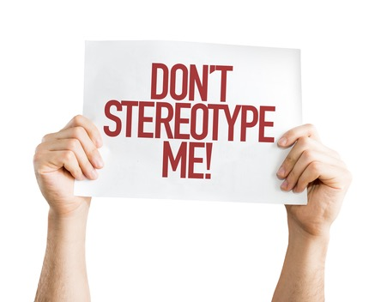
What is a stereotype?
An idea that people might have about a group of other people.
Sometimes, what you might think about a group of people might be true for some of them,
but to say they are ALL something (and especially something bad) then that’s a stereotype.

Slide 4
Activity:
Stereotypes of men
Stereotypes of women

Slide 5
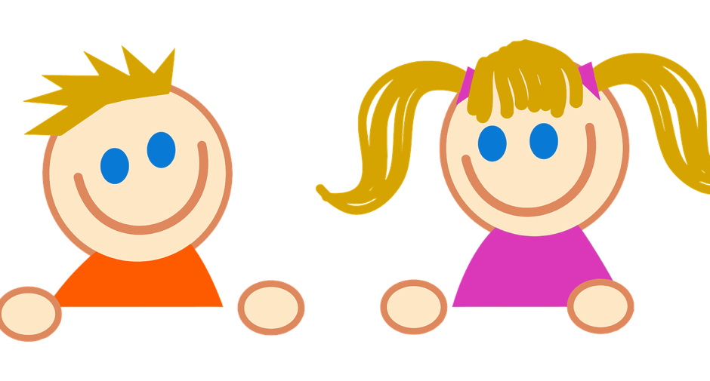
Exploring stereotypes: Nursery Rhyme
What Are Little Boys/Girls Made of?
What are little boys made of?
Frogs and snails,
And puppy-dogs' tails;
That's what little boys are made of!
What are little girls made of?
Sugar and spice,
And all that's nice;
That's what little girls are made of.

Slide 6
Exploring stereotypes: Science and technology subjects are for boys

Slide 7
Science and technology subjects are for boys
FALSE
Truth: Girls and women have been under represented, in these subjects at school, and so this becomes true in University and the workplace.
But things are changing, and girls are picking these subjects and doing better at school and so becoming students and workers in these areas of work.

Slide 8
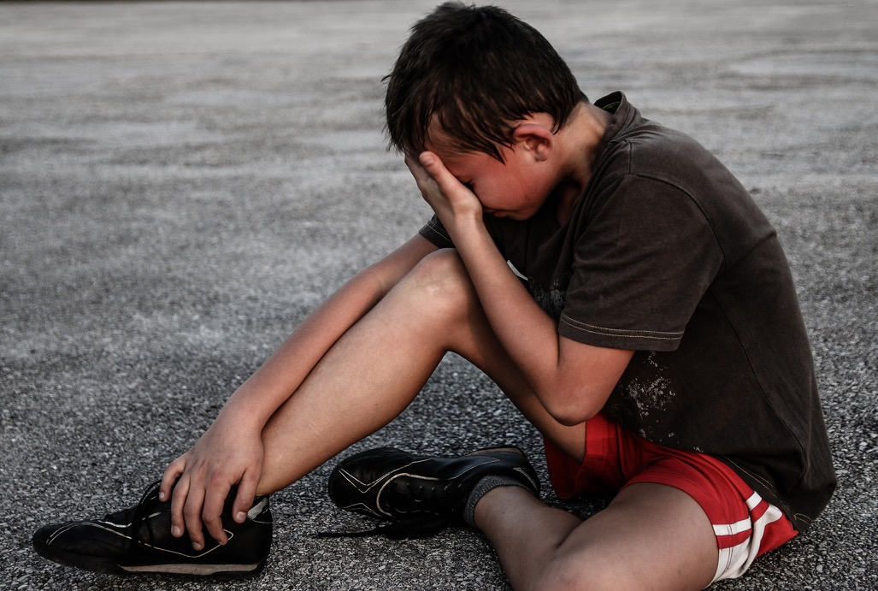
Exploring stereotypes:
Boys don’t get emotional. Boys don’t cry.

Slide 9
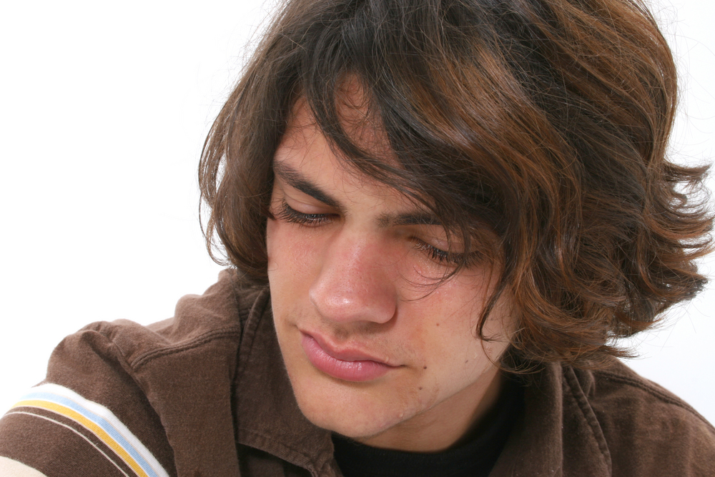
Exploring stereotypes:
Boys don’t get emotional. Boys don’t cry.
FALSE. They do, why is it important that boys and men can show their emotions.
Man up Means…
https://youtu.be/lZyHCT-hdNs
(duration 47 seconds)

Slide 10
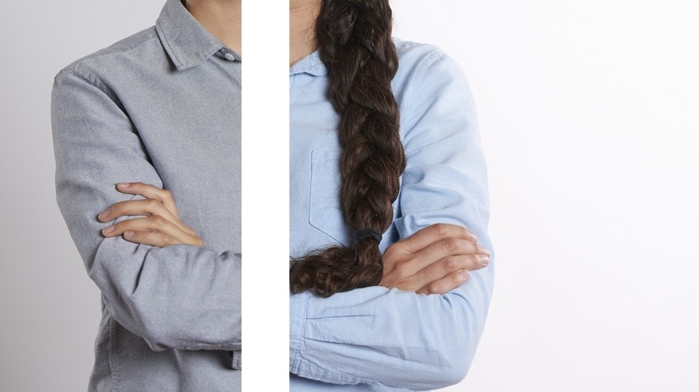
What is equity?

Slide 11
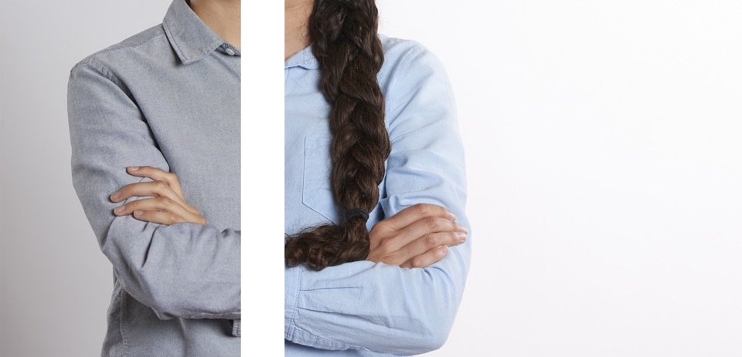
What is equity?
Equity is about making sure that every person has the same chances to make the most of their lives and talents.
It is also the belief that no one should have poorer life chances because of the way they were born, where they come from, what they believe, or whether they have a disability.
Equity recognises that certain groups of people like girls/women, LGBT people, people with disabilities or people from the global majority communities have experienced discrimination.

Slide 12
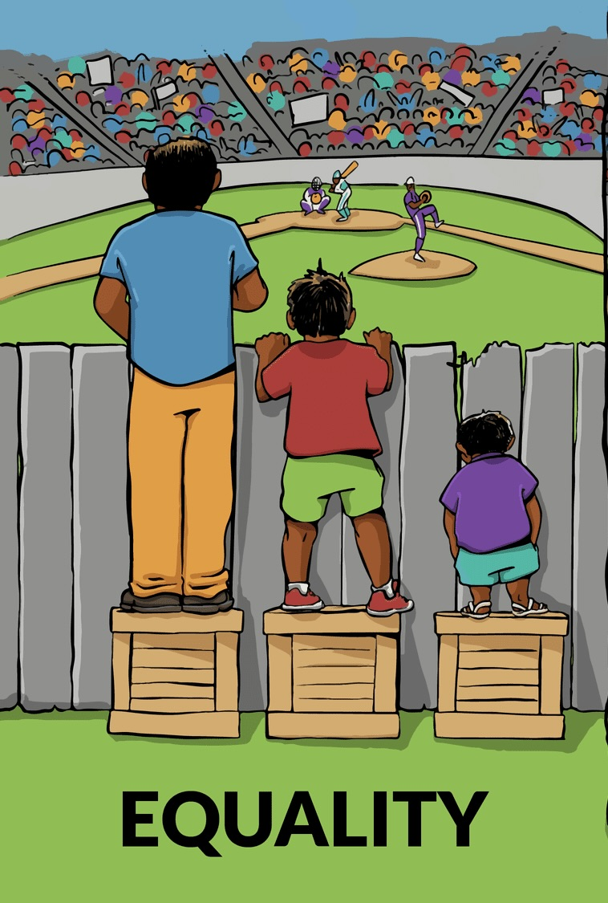
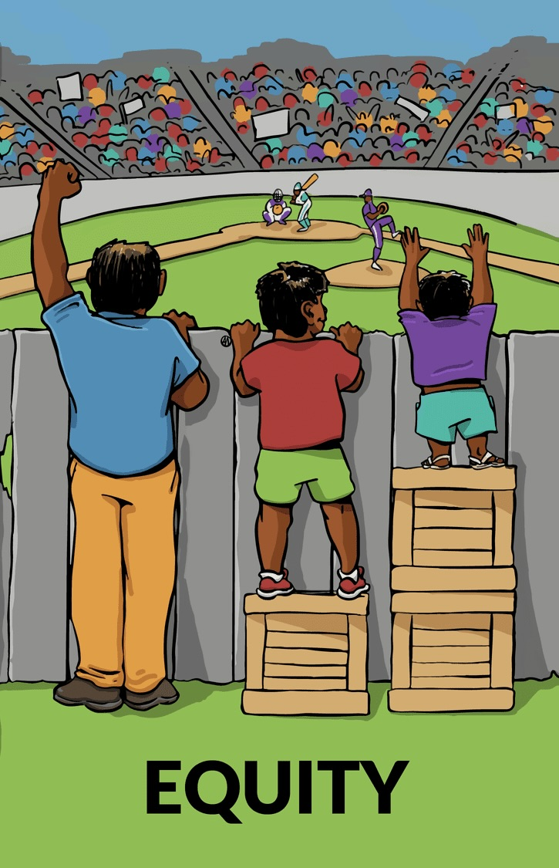
Equality or Equity?

Slide 13
Who do I look up to?
Who inspires me to be the best person I can be?

Slide 14
There are no rules about how to be a girl or a boy - be who you want to be.

